Slide 1

Introduction to Cryptosystems
Lesson 1

Slide 2
Introduction
 | a | b | c | d | e | f | g | h | i | j | k | l | m | n | o | p | q | r | s | t | u | v | w | x | y | z
code | 01 | 02 | 03 | 04 | 05 | 06 | 07 | 08 | 09 | 10 | 11 | 12 | 13 | 14 | 15 | 16 | 17 | 18 | 19 | 20 | 21 | 22 | 23 | 24 | 25 | 26
Doc: khoa cong nghe thong tin Plaintext: 11081501 03151407 14070805 2008151407 200914
VD1: k = 3 Ciphertext:
VD2: k = 4018975632 Ciphertext:
VD2: k = 0185947263 Ciphertext:

Slide 3
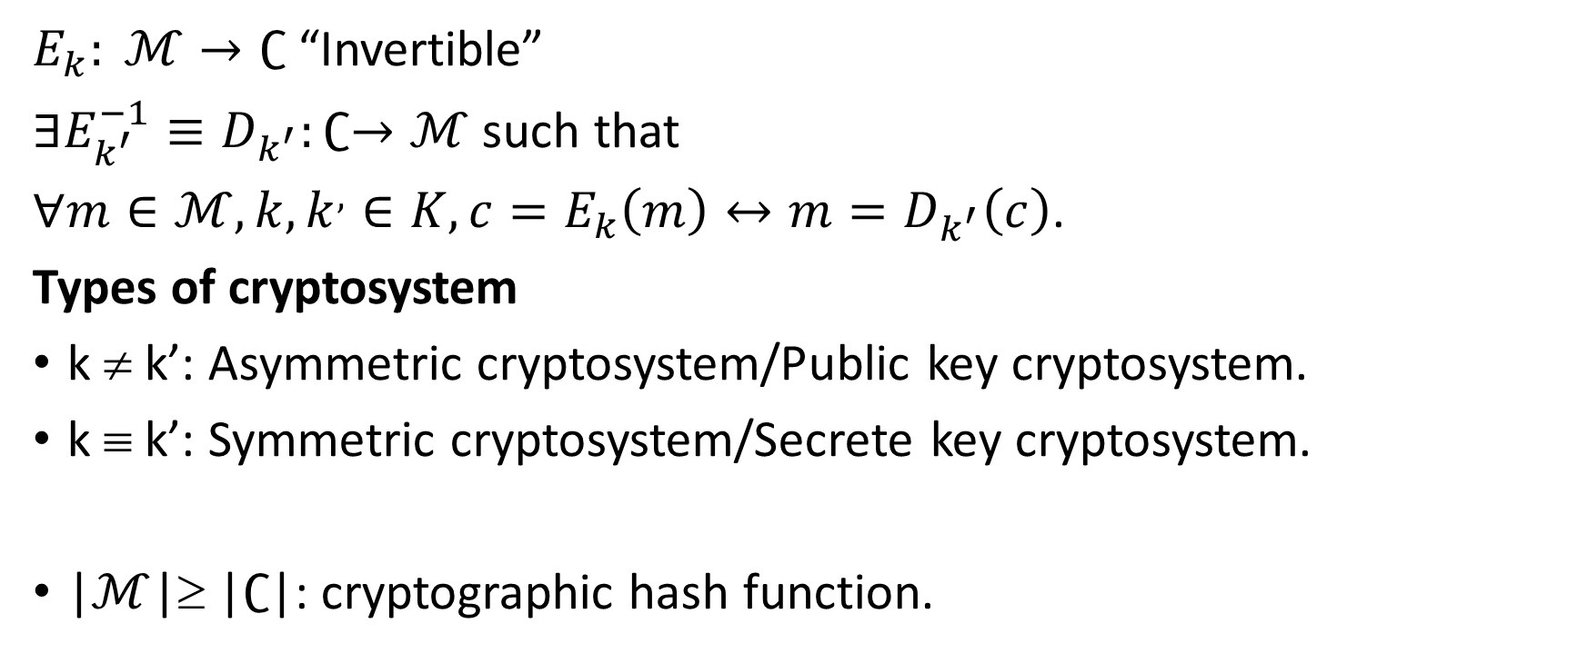
Definition
$E_{k}: ℳ→∁$ “Invertible”
$∃E_{k^{′}}^{−1}≡D_{k^{′}}:∁→ℳ$ such that
$∀m∈ℳ, k, k^{,}∈K, {c=E_{k}\left(m\right)↔m=D}_{k^{′}}\left(c\right)$.
Types of cryptosystem
k ≠ k’: Asymmetric cryptosystem/Public key cryptosystem.
k ≡ k’: Symmetric cryptosystem/Secrete key cryptosystem.
|$ℳ$|≥ |$∁$|: cryptographic hash function.

Slide 4
Example
 | a | b | c | d | e | f | g | h | i | j | k | l | m | n | o | p | q | r | s | t | u | v | w | x | y | z
code | 01 | 02 | 03 | 04 | 05 | 06 | 07 | 08 | 09 | 10 | 11 | 12 | 13 | 14 | 15 | 16 | 17 | 18 | 19 | 20 | 21 | 22 | 23 | 24 | 25 | 26
Doc: khoa cong nghe thong tin Plaintext: 11081501 03151407 14070805 2008151407 200914
VD1: k = 3 Ciphertext:
VD2: k = 4018975632 Ciphertext:
VD2: k = 0185947263 Ciphertext:

Slide 5
Kerckhoff’s Principle for Cryptosystem
The cryptosystem should be unbreakable practically, if not mathematically.
Falling of the cryptosystem in the hands of an intruder should not lead to any compromise of the system, preventing any inconvenience to the user.
The key should be easily communicable, memorable, and changeable.
The ciphertext should be transmissible by telegraph, an unsecure channel.
The encryption apparatus and documents should be portable and operable by a single person.
Finally, it is necessary that the system be easy to use, requiring neither mental strain nor the knowledge of a long series of rules to observe.

Slide 6
Attacks
Attacks are typically categorized based on the action performed by the attacker. An attack, thus, can be passive or active
Passive Attacks. The main goal of a passive attack is to obtain unauthorized access to the information.
Active Attacks. An active attack involves changing the information in some way by conducting some process on the information.

Slide 7
Assumptions of Attacker
Environment around Cryptosystem
Details of the Encryption Scheme
Availability of Ciphertext
Availability of Plaintext and Ciphertext

Slide 8
Cryptographic Attacks
Ciphertext Only Attacks (COA)
Known Plaintext Attack (KPA)
Chosen Plaintext Attack (CPA)
Dictionary Attack
Brute Force Attack (BFA)
Birthday Attack
Man in Middle Attack (MIM)
Side Channel Attack (SCA)
Timing Attacks
Power Analysis Attacks
Fault analysis Attacks

Slide 9
Practicality of Attacks

Slide 10
References
https://www.tutorialspoint.com/cryptography/block_cipher.htm

