Slide 1

RSA cryptosystem
Lesson 2

Slide 2
RSA theorem
Let p, q be two different primes and n = pq and ϕ = ϕ(n) = (p-1)(q-1);
Let e, d be to integers such that ed mod ϕ = 1.
∀m ∈ {0, 1, …, n-1}, if c = m^{e} mod n then m = c^{d} mod n, and vice versa.

Slide 3
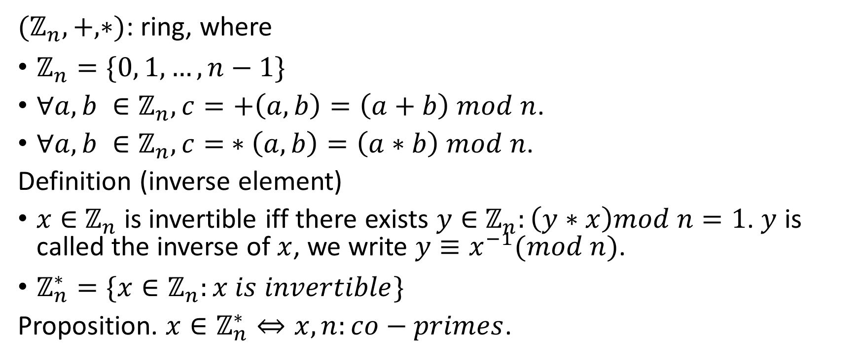

Ring $ℤ_{n}$
${(ℤ}_{n}, +, ∗)$: ring, where
$ℤ_{n}=\{0, 1, …, n−1\}$
$∀a, b ∈ℤ_{n}, c=+\left(a, b\right)=\left(a+b\right) mod n$.
$∀a, b ∈ℤ_{n}, c= ∗\left(a, b\right)=\left(a∗b\right) mod n$.
Definition (inverse element)
$x∈$ $ℤ_{n}$ is invertible iff there exists $y∈$ $ℤ_{n}:\left(y∗x\right)mod n=1$. $y$ is called the inverse of $x$, we write $y≡x^{−1}(mod n)$.
$ℤ_{n}^{∗}=\{x∈ℤ_{n}:x is invertible\}$
Proposition. $x∈ℤ_{n}^{∗}⇔x, n:co−primes$.

Slide 4

RSA implementation:- (1) Big Integer
$x∈ℤ_{N} ≡ x_{0}x_{0}…x_{n−1}:x_{i}∈\left\{0, 1\right\}, ∀0≤i≤n, n=\left\lceil \log_{2}\left(N\right)\right\rceil −1$
Add_Mod(x, y, N) = (x + y) mod N.
Mul_Mod(x, y, N) = (x * y) mod N.
Power_Mod(x, p, N) = x^{p} mod N = (x*x mod N)…(x*x mod N).

Slide 5
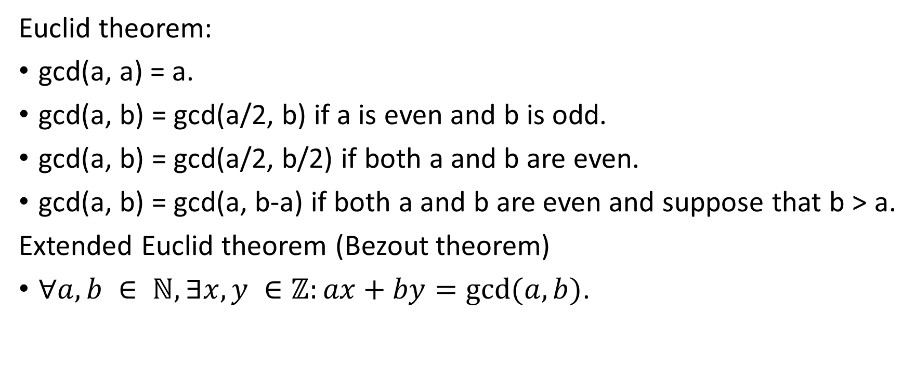
RSA implementation:- (2) Euclid theorem
Euclid theorem:
gcd(a, a) = a.
gcd(a, b) = gcd(a/2, b) if a is even and b is odd.
gcd(a, b) = gcd(a/2, b/2) if both a and b are even.
gcd(a, b) = gcd(a, b-a) if both a and b are even and suppose that b > a.
Extended Euclid theorem (Bezout theorem)
$∀a, b ∈ ℕ, ∃x, y ∈ℤ:ax+by=gcd⁡(a,b)$.

Slide 6
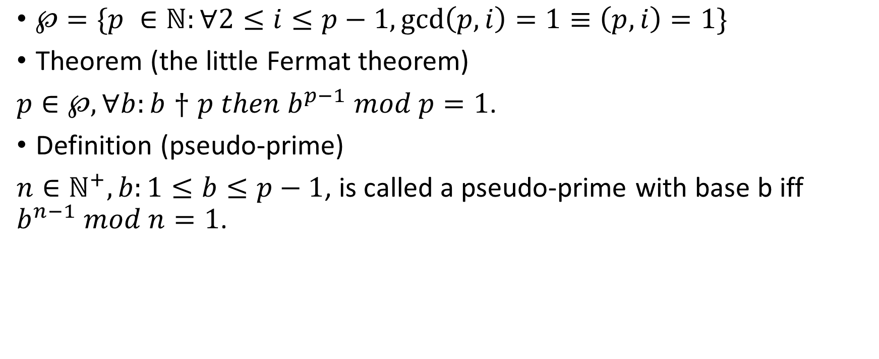
RSA implementation:- (3) primes
$℘=\{p ∈ℕ:∀2≤i≤p−1,\gcd\left(p, i\right)=1≡\left(p,i\right)=1\}$
Theorem (the little Fermat theorem)
$p∈℘, ∀b:b†p then b^{p−1} mod p=1$.
Definition (pseudo-prime)
$n∈ℕ^{+}, b:1≤b≤p−1$, is called a pseudo-prime with base b iff $b^{n−1} mod n=1$.

Slide 7
RSA protocol
Alice |  | Bob
(1) p, q ← PrimeGen(λ) n ← p*q ϕ ← (p-1)*(q-1) e, q ← KeyGen()
(2) Publish (e, n)
 |  | (3) c ← PowerMod(m,e,n)
 | ←
(4) m ← PowerMod(c,e,n)

Slide 8
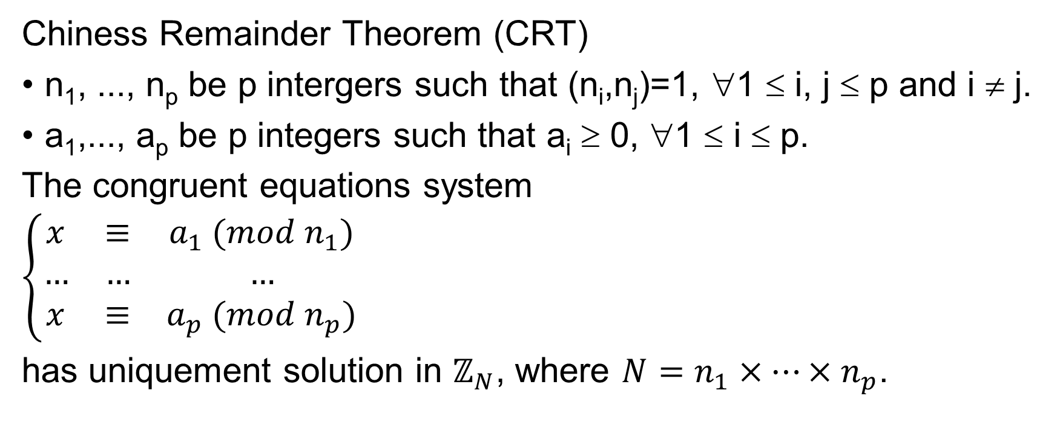
Prove RSA:- (1) Chiness Remainder Theorem
Chiness Remainder Theorem (CRT)
n₁, ..., n_{p} be p intergers such that (n_{i},n_{j})=1, ∀1 ≤ i, j ≤ p and i ≠ j.
a₁,..., a_{p} be p integers such that a_{i} ≥ 0, ∀1 ≤ i ≤ p.
The congruent equations system
$\left\{\begin{matrix}x & ≡ & a_{1} (mod n_{1}) \\ … & … & … \\ x & ≡ & a_{p} (mod n_{p})\end{matrix} \right.$
has uniquement solution in $ℤ_{N}$, where $N=n_{1}×…×n_{p}$.

Slide 9
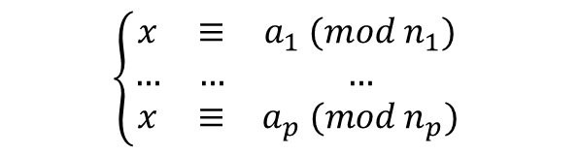
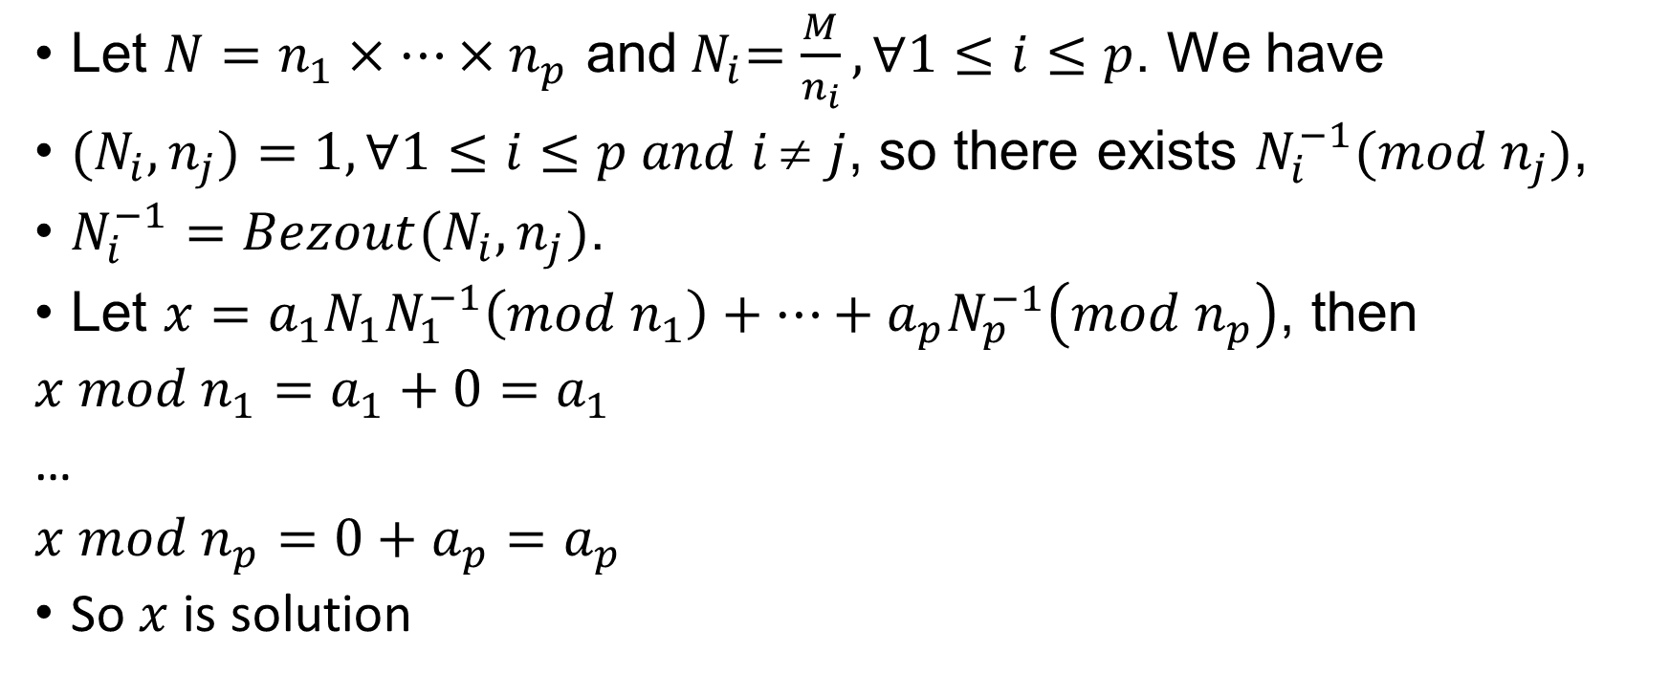
RSA proving:- (2) Prove CRT
$$\left\{\begin{matrix}x & ≡ & a_{1} (mod n_{1}) \\ … & … & … \\ x & ≡ & a_{p} (mod n_{p})\end{matrix} \right.$$
Let $N=n_{1}×…×n_{p}$ and${ N}_{i}=\frac{M}{n_{i}}, ∀1≤i≤p$. We have
${(N}_{i},n_{j})=1,∀1≤i≤p and i \text{≠} j$, so there exists $N_{i}^{−1}(mod n_{j})$,
$N_{i}^{−1}=Bezout(N_{i},n_{j})$.
Let $x={a_{1}N_{1}N}_{1}^{−1}\left(mod n_{1}\right)+…+{a_{p}N}_{p}^{−1}\left(mod n_{p}\right)$, then
$x mod n_{1}=a_{1}+0=a_{1}$
…
$x mod n_{p}={0+a}_{p}=a_{p}$
So $x$ is solution

Slide 10
Prove RSA theorem
c^{d} mod n = (m^{e})^{d} mod n

Slide 11
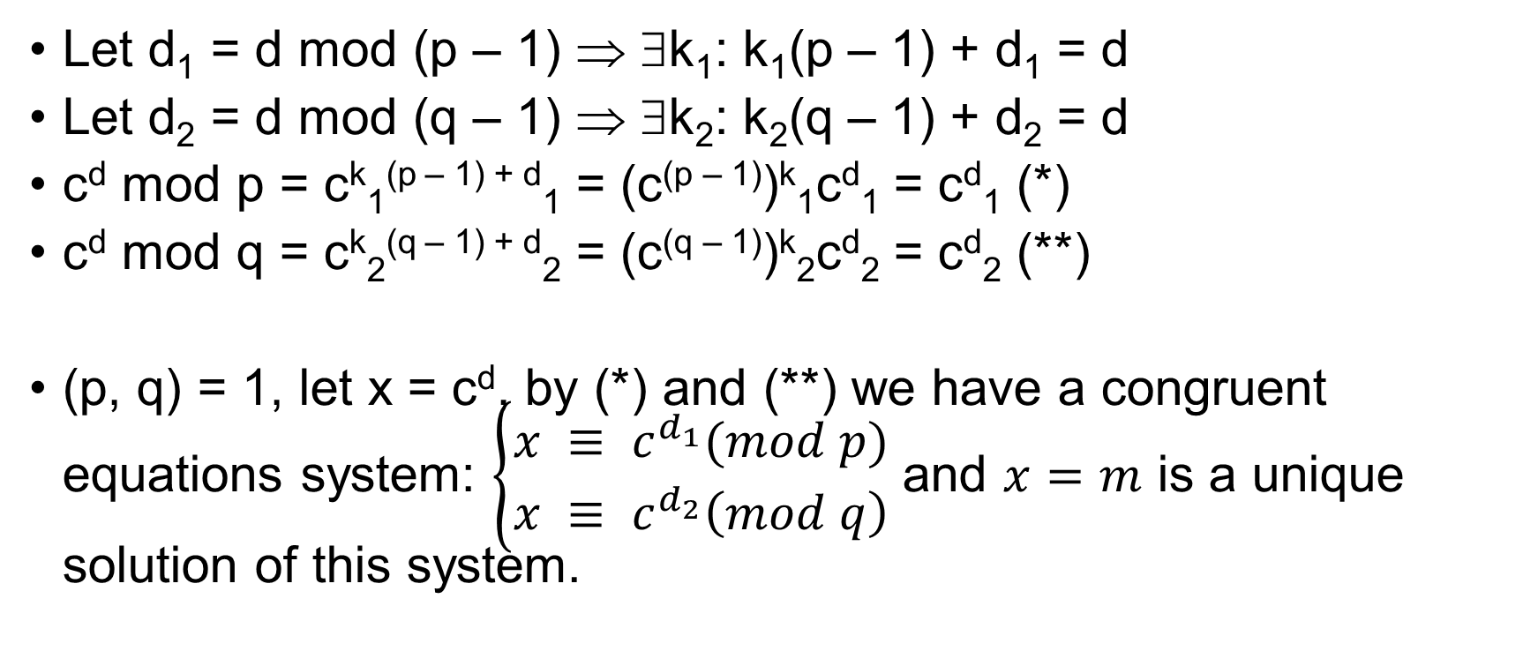
Fast decrypting
Let d₁ = d mod (p – 1) ⇒ ∃k₁: k₁(p – 1) + d₁ = d
Let d₂ = d mod (q – 1) ⇒ ∃k₂: k₂(q – 1) + d₂ = d
c^{d} mod p = c^{k}₁^{(p – 1) + d}₁ = (c^{(p – 1)})^{k}₁c^{d}₁ = c^{d}₁ (*)
c^{d} mod q = c^{k}₂^{(q – 1) + d}₂ = (c^{(q – 1)})^{k}₂c^{d}₂ = c^{d}₂ (**)
(p, q) = 1, let x = c^{d}, by (*) and (**) we have a congruent equations system: $\left\{\begin{matrix}x ≡ c^{d_{1}}(mod p) \\ x ≡ c^{d_{2}}\left(mod q\right)\end{matrix}\right.$ and $x=m$ is a unique solution of this system.

