Slide 1

Elliptic Curve and Cryptography – ECC
Lesson 4

Slide 2
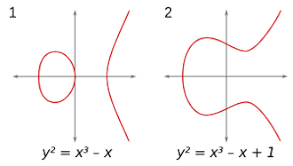
Elliptic curves
An elliptic curve is the set of solution (x, y)
to an equation of the form (E): Y² = X³ + AX + B
Let P and Q be two points on E, R = P ⊕ Q is defined as the following:
Let R’ is intersection of E and the line L through P and Q.
Then R is the reflection of R’ by x-axis.
P ⊕ P = ?. Take L to be the tangent line to E at P.
P ⊕ Q, where P = (a, b) and Q = (a, -b)? L is the vertical line x = a. There is no third point of intersection. The solution is to create an extra point O that lives “at infinity”: P ⊕ Q = (a, b) ⊕ (a, -b) = O.

Slide 3
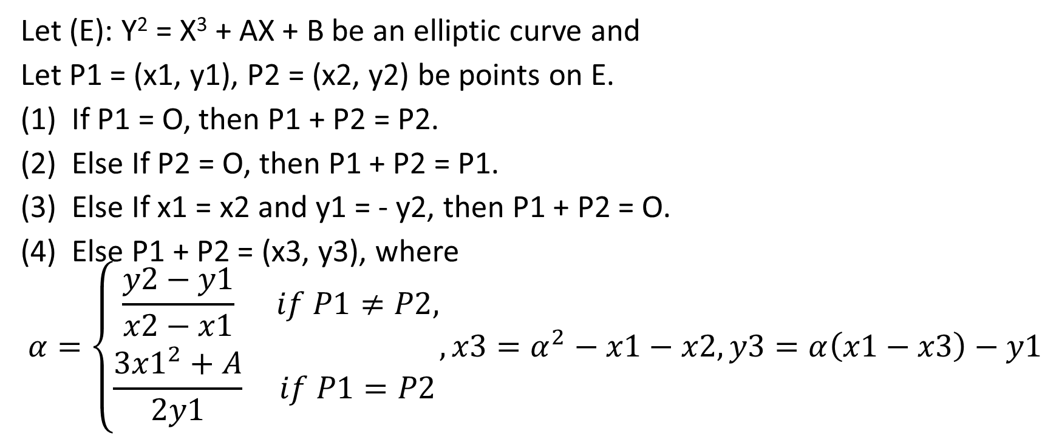
Elliptic Curve Addition Algorithm
Let (E): Y² = X³ + AX + B be an elliptic curve and
Let P1 = (x1, y1), P2 = (x2, y2) be points on E.
If P1 = O, then P1 + P2 = P2.
Else If P2 = O, then P1 + P2 = P1.
Else If x1 = x2 and y1 = - y2, then P1 + P2 = O.
Else P1 + P2 = (x3, y3), where
$$α=\left\{\begin{matrix}\frac{y2−y1}{x2−x1} & if P1≠P2, \\ \frac{3{x1}^{2}+A}{2y1} & if P1=P2\end{matrix}, x3=α^{2}−x1−x2, y3=α\left(x1−x3\right)−y1\right.$$

Slide 4
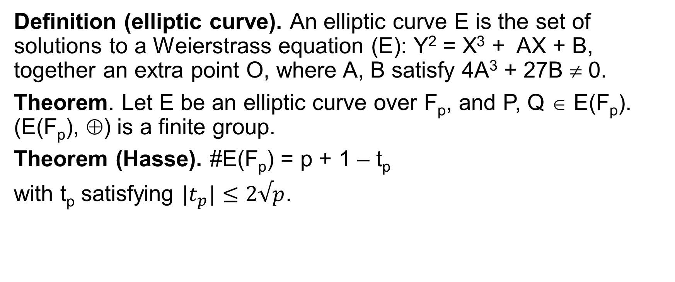
Elliptic curves over finite fields
Definition (elliptic curve). An elliptic curve E is the set of solutions to a Weierstrass equation (E): Y² = X³ + AX + B, together an extra point O, where A, B satisfy 4A³ + 27B ≠ 0.
Theorem. Let E be an elliptic curve over F_{p}, and P, Q ∈ E(F_{p}). (E(F_{p}), ⊕) is a finite group.
Theorem (Hasse). #E(F_{p}) = p + 1 – t_{p}
with t_{p} satisfying $|t_{p}|≤2√p$.

Slide 5
The elliptic curve DLP - ECDLP
Definition (ECDLP). P, Q ∈ E(F_{p}). The ECDLP is finding an integer n: Q = nP. We denote n = log_{P}(Q).
The Double-and-Add algorithm
Input: P ∈ E(F_{p}), n ≥ 1
Output: R = nP
Set Q = P, R = O.
While n > 0 {
If n ≡ 1 (mod 2), set R = R + Q
Set Q = 2Q; n = ⎣n/2⎦
}
(3) Return R

Slide 6
Elliptic Diffie-Hellman key exchange
Public Parameter Creation
A trusted party chooses and publishes a (large) prime, an elliptic curve E(F_{p}), and a point P in E(F_{p})
Private Computations
Alice | Bob
Chooses a secret integer n_{A}. Computes the point Q_{A} = n_{A}P. | Chooses a secret integer n_{B}. Computes the point Q_{B} = n_{B}P.
Public Exchange of Values
Alice sends Q_{A} to Bob Q_{B} ←⎯⎯ | ⎯⎯→ Q_{A}. Bob sends Q_{B} to Alice
Furthure Private Computations
Computes the point n_{A}Q_{B}. | Computes the point n_{B}Q_{A}.
The shared secret value is n_{A}Q_{B} = n_{A}(n_{B}P) = n_{B}(n_{A}P) = n_{B}Q_{A}.

Slide 7
The Elliptic Curve Diffie-Hellman Problem
Definition (ECDP). Le E(F_{p}) be an elliptic curve over a finite F_{p} and let P ∈ E(F_{p}). The Elliptic Curve Diffie-Hellman Problem is the problem of computing the value n₁n₂P from the known values n₁P and n₂P.

Slide 8
Elliptic ElGamal public key cryptography
Public Parameter Creation
A trusted party chooses and publishes a (large) prime p, an elliptic curve E(F_{p}), and a point P ∈ E(F_{p})
Alice | Bob
Key Creation
Chooses a private key n_{A}. Computes Q_{A} = n_{A}P. Publishes the public key Q_{A}.
Encryption
 | Chooses plaintext M ∈ E(F_{p}). Chooses an ephemeral key k. Uses Alice’s public key Q_{A} to Compute C₁ = M + kP and Compute C₂ = M + kQ_{A}. Sends ciphertext (C₁, C₂) to Alice
Decryption
Computes C₂ – n_{A}C₁.

