Slide 1

Advanced Cryptography
Lesson 5

Slide 2
Digital signature
Private key K_priv
Digital document to be signed
D
Signing Algorithm
D_sig
Digital signature
Public key
Digital signature
D_sig
Verification Algorithm
TRUE if D signed by K_priv is D_sig
FALSE otherwise
D
Digital document to be signed

Slide 3
RSA digital signature
Samantha | Victor
Key Creation
Choose secrete primes p, q Choose verification exponent v with gcd(v, (p-1)(q-1)) = 1 Publish N = pq and v
Signing
Compute s satisfying s ≡ 1 (mod (p-1)(q-1)) Sign document D by computing S ≡ D^{s} (mod N)
Verification
 | Compute S_{v} mod N and Verify that it is equal to D

Slide 4
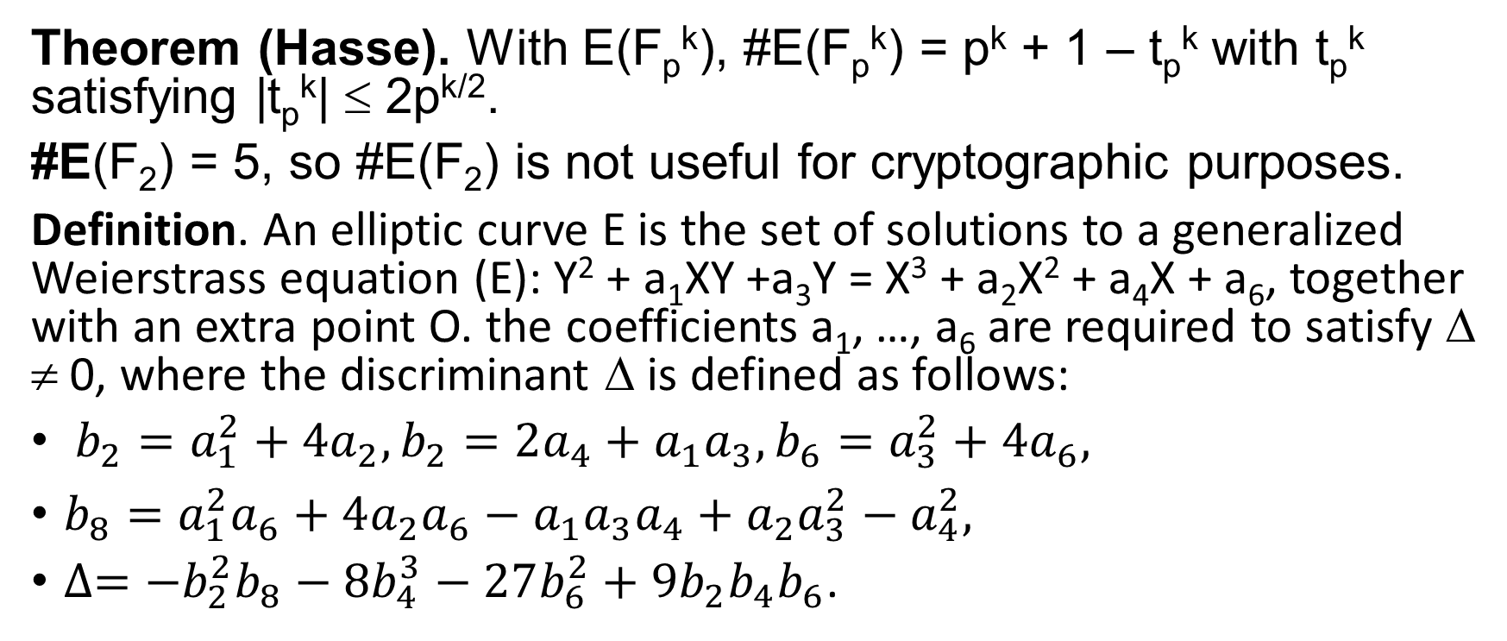
Elliptic curves over F₂ and over F₂^{k}
Theorem (Hasse). With E(F_{p}^{k}), #E(F_{p}^{k}) = p^{k} + 1 – t_{p}^{k} with t_{p}^{k} satisfying |t_{p}^{k}| ≤ 2p^{k/2}.
#E(F₂) = 5, so #E(F₂) is not useful for cryptographic purposes.
Definition. An elliptic curve E is the set of solutions to a generalized Weierstrass equation (E): Y² + a₁XY +a₃Y = X³ + a₂X² + a₄X + a₆, together with an extra point O. the coefficients a₁, …, a₆ are required to satisfy Δ ≠ 0, where the discriminant Δ is defined as follows:
$b_{2}=a_{1}^{2}+4a_{2}, b_{2}=2a_{4}+a_{1}a_{3}, b_{6}=a_{3}^{2}+4a_{6},$
$b_{8}=a_{1}^{2}a_{6}+4a_{2}a_{6}−a_{1}a_{3}a_{4}+a_{2}a_{3}^{2}−a_{4}^{2},$
$∆=−b_{2}^{2}b_{8}−8b_{4}^{3}−27b_{6}^{2}+9b_{2}b_{4}b_{6}$.

Slide 5
ElGamal digital signatures
Public Parameter Creation
A trusted party chooses and publishes a large prime p and primitive root g modulo p
Samatha | Victor
Key creation
Choose secret signing key 1 ≤ s ≤ p – 1. Compute v ≡ g^{s} (mod p). Publish the verification key v.
Signing
Choose document D mod p. Choose ephemeral key e mod p. Compute signature . S₁ ≡ g^{e} (mod p). . S₂ ≡ (D – sS₁)e⁻¹ (mod p-1)
Verification
 | Compute v^{S}₁S₁^{S}₂ mod p. Verify that it is equal to g^{D} mod p.

Slide 6
DSA – digital signature algorithm
Public Parameter Creation
A trusted party chooses and publishes a large primes p and q satisfying p ≡ 1 (mod q) and an element g of order q modulo p
Samatha | Victor
Key creation
Choose secret signing key 1 ≤ s ≤ q – 1. Compute v ≡ g^{s} (mod p). Publish the verification key v.
Signing
Choose document D mod p. Choose ephemeral key e mod p. Compute signature . S₁ ≡ g^{e} (mod p). . S₂ ≡ (D + sS₁)e⁻¹ (mod p-1)
Verification
 | Compute DS₁^{S}₂ mod p and V₂ ≡ S₁S₂⁻¹ (mod q). Verify that (g^{V}₁v^{V}₂ mod p) mod q = S₁.

