Slide 1

DLP-base cryptosystems
Lesson 3

Slide 2
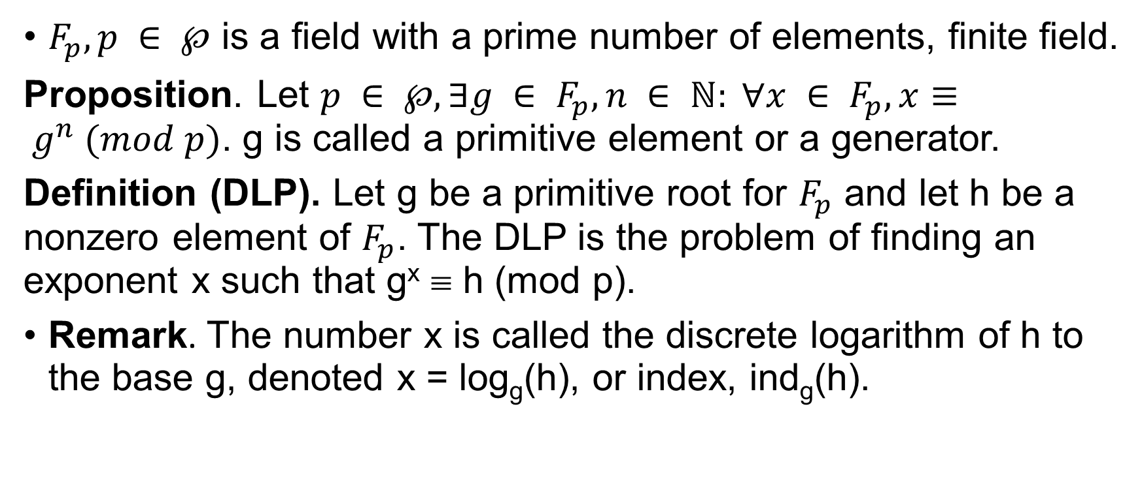
Discrete Logarithm Problem – DLP
$F_{p}, p ∈ ℘$ is a field with a prime number of elements, finite field.
Proposition. Let $p ∈ ℘, ∃g ∈ F_{p}, n ∈ ℕ: ∀x ∈ F_{p}, x≡ g^{n} (mod p)$. g is called a primitive element or a generator.
Definition (DLP). Let g be a primitive root for $F_{p}$ and let h be a nonzero element of $F_{p}$. The DLP is the problem of finding an exponent x such that g^{x} ≡ h (mod p).
Remark. The number x is called the discrete logarithm of h to the base g, denoted x = log_{g}(h), or index, ind_{g}(h).

Slide 3
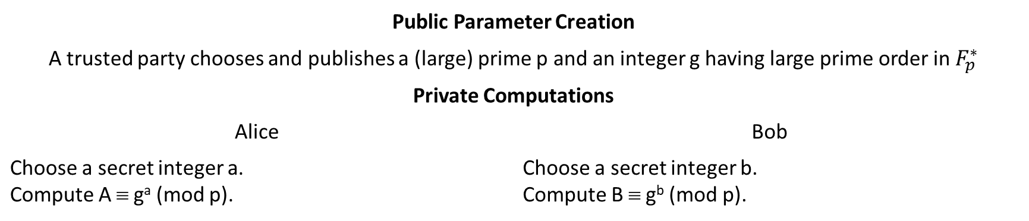
Diffie-Hellman key exchange
Public Parameter Creation
A trusted party chooses and publishes a (large) prime p and an integer g having large prime order in $F_{p}^{∗}$
Private Computations
Alice | Bob
Choose a secret integer a. Compute A ≡ gª (mod p). | Choose a secret integer b. Compute B ≡ g^{b} (mod p).
Public Exchange of Values
Alice sends A to Bob ⎯⎯→ B | A ←⎯⎯ Bob sends to Alice
Further Private Computations
Compute the number K ≡ Bª (mod p) | Compute the number K ≡ A^{b} (mod p)

Slide 4
The Diffie-Hellman Problem – DHP
Definition (DHP). Let p be a prime and g an integer. The DHP is the problem of computing the value g^{ab} (mod p) from the known values gª and g^{b} (mod p)
Remark. DHP is no harder DLP.
If Eve can solve DLP, she can get a or b from A ≡ gª (mod p) and B ≡ g^{b} (mod p). So, se can compute K ≡ g^{ab} (mod p).
Suppose that Ever has an algorithm that efficiently solves the DHP. Can she use it to also efficiently solve the DLP? The answer is not known.

Slide 5
ElGamal public key cryptosystem
It is just a variation of Diffie-Hellman key-exchange protocol for encryption data

Slide 6
ElGamal public key cryptanalysis
Proposition. Fix a prime p and base g to use for ElGamal encryption. Suppose that Eve has access to an oracle that decrypts arbitrary ElGamal ciphertexts encrypted using arbitrary ElGamal public keys. Then she can use the oracle to solve the DHP.

