Slide 1
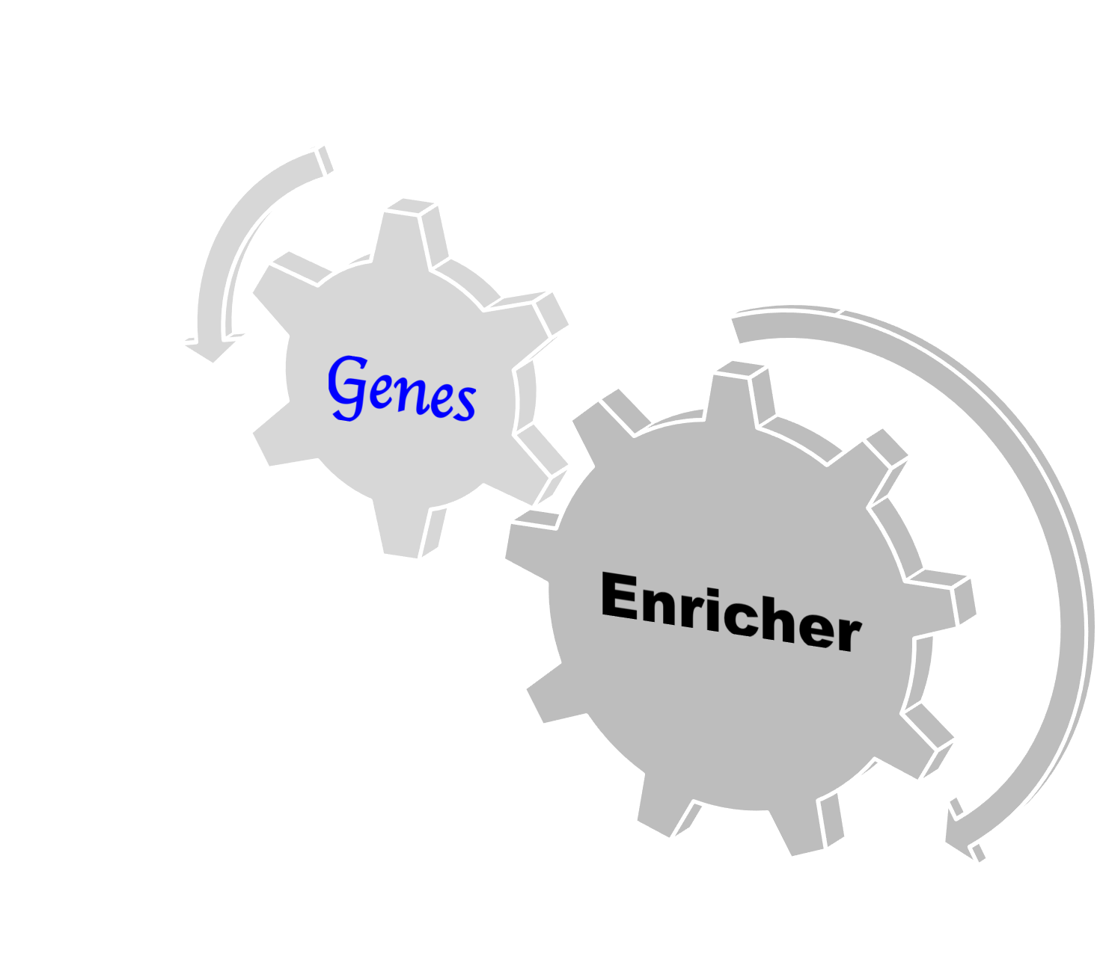
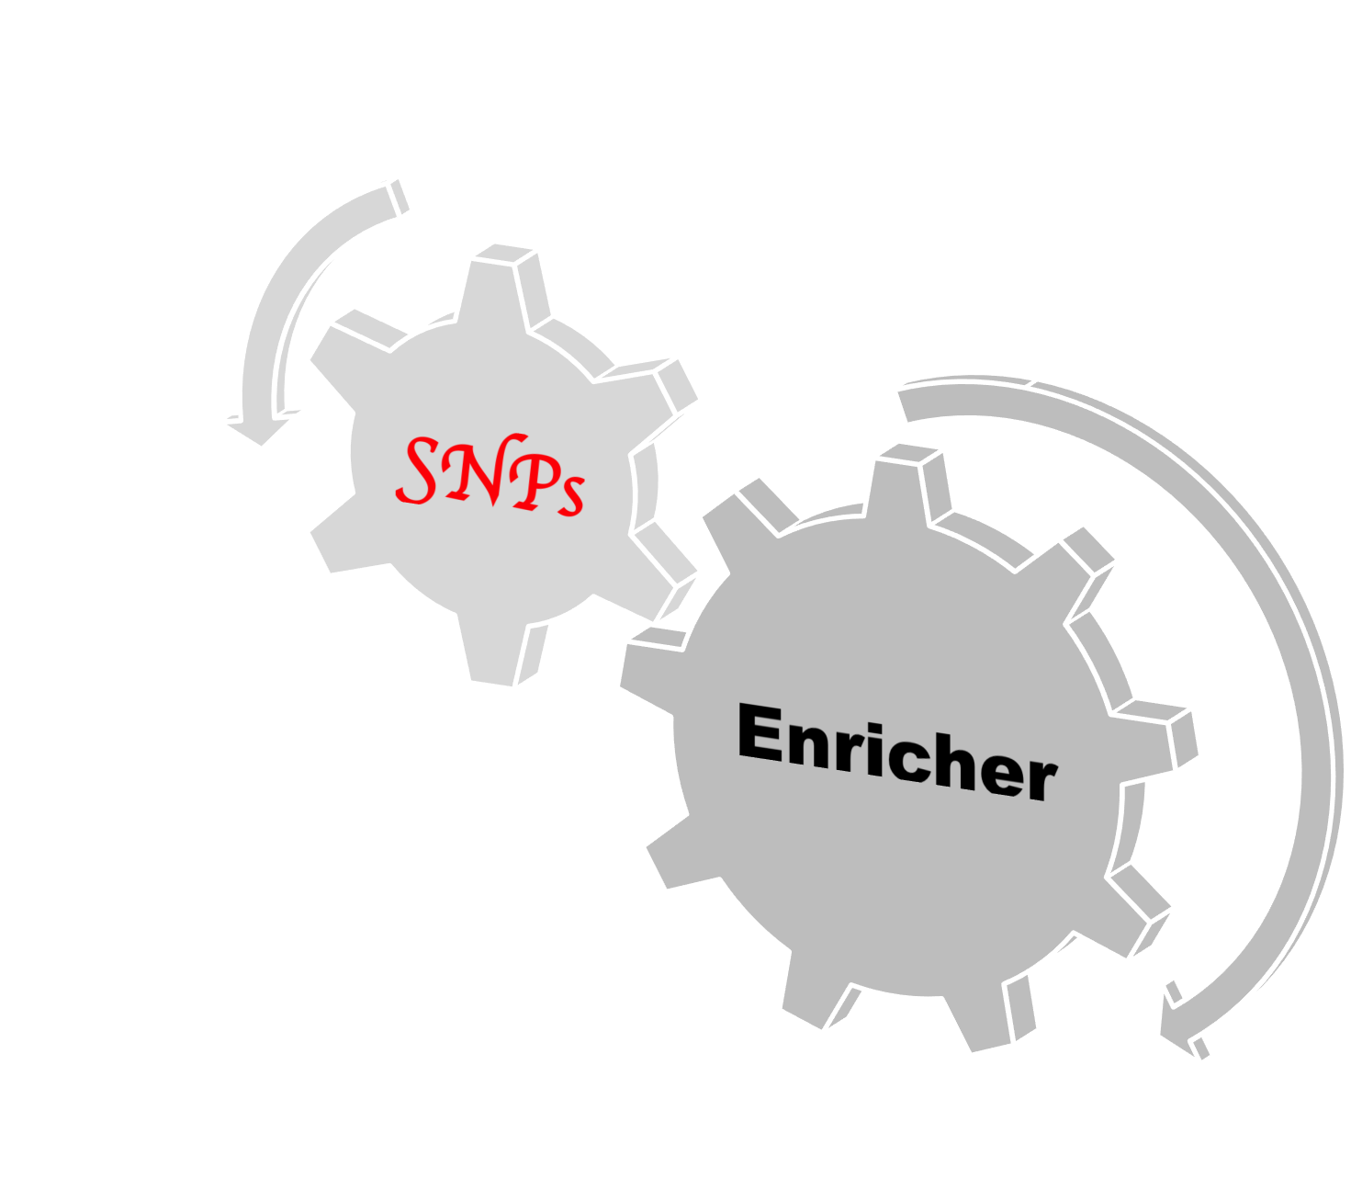
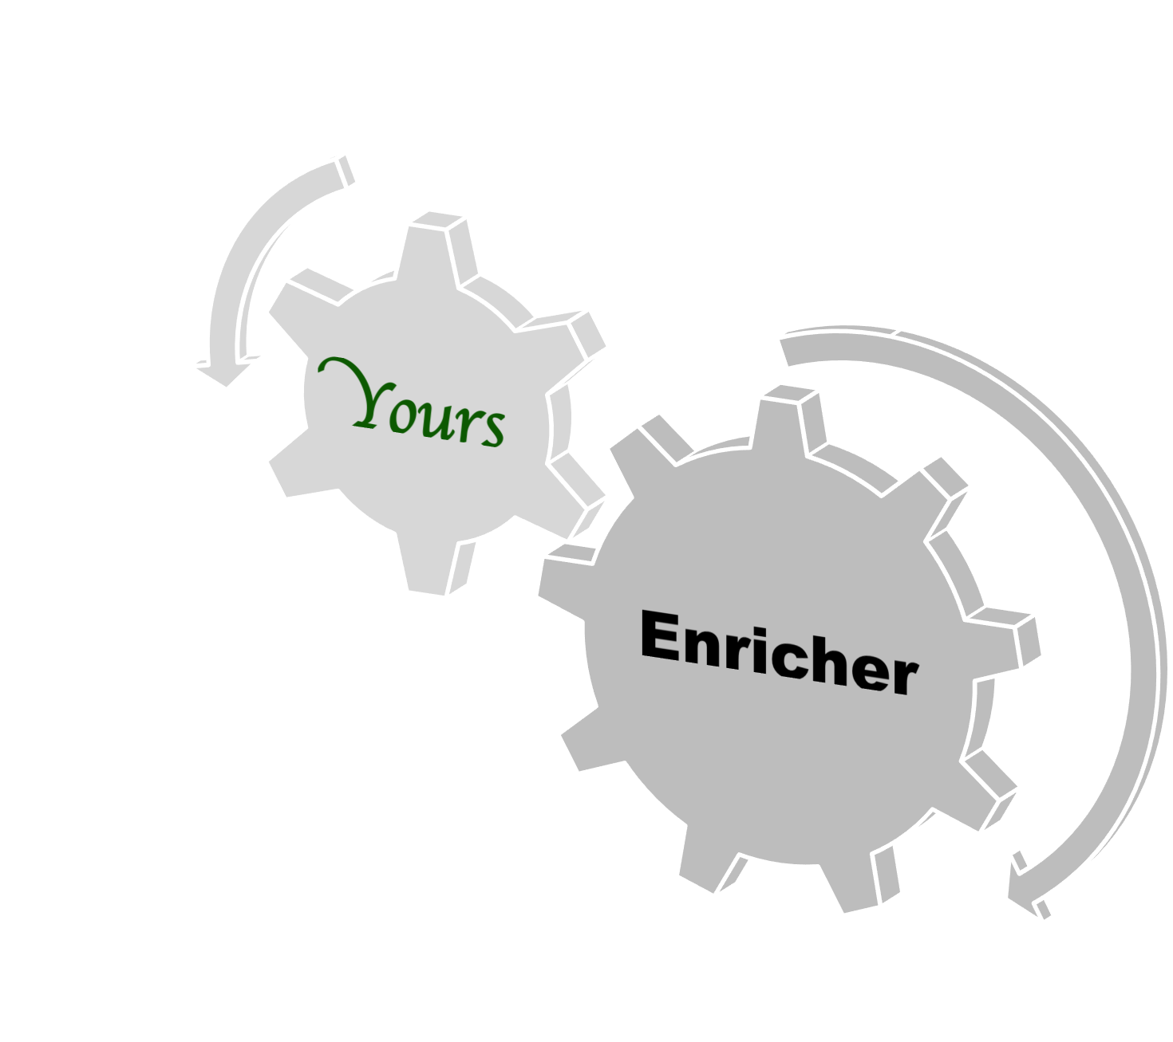
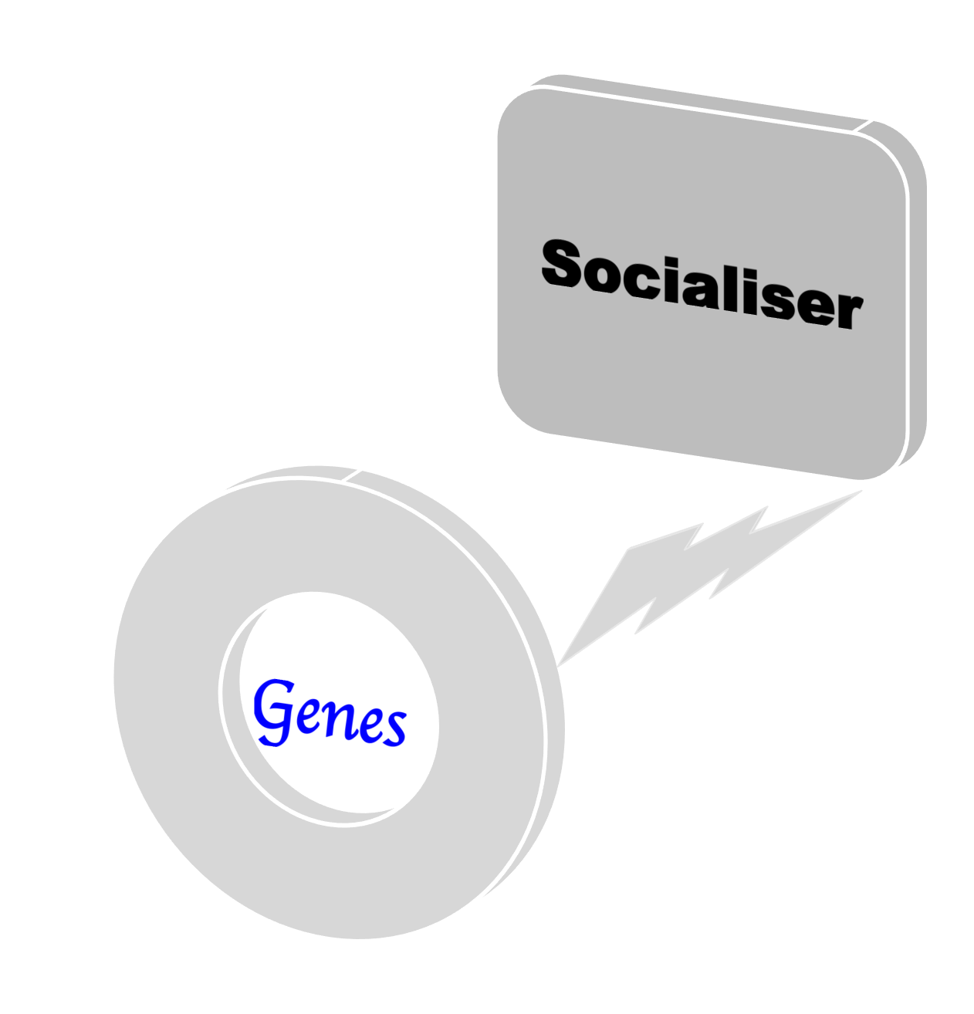
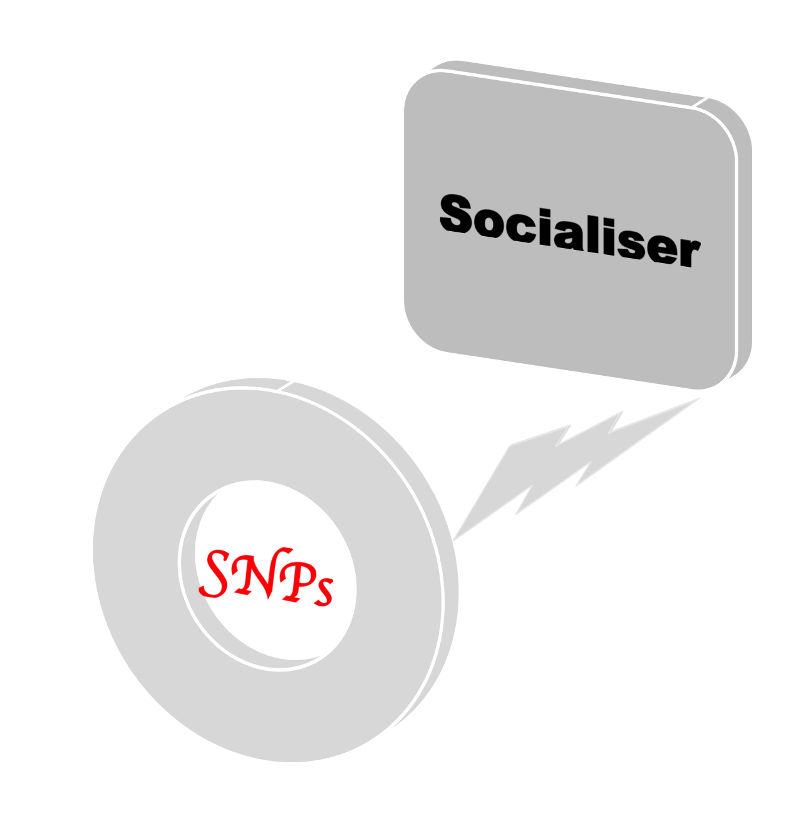
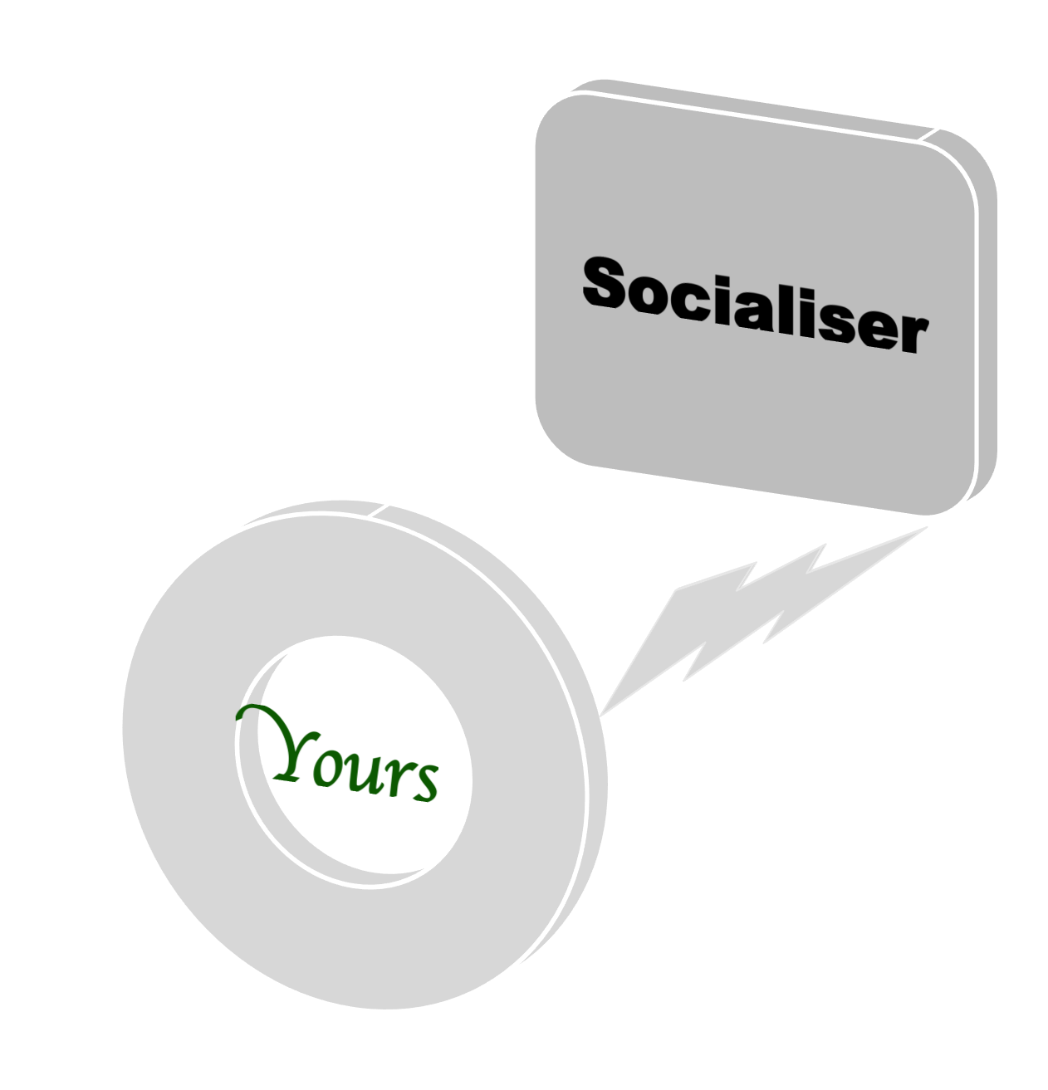

Slide 2


Slide 3
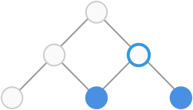
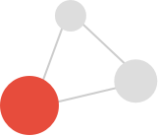

Slide 4




GR
GR

Slide 6
G

Slide 7
GR
G
GR
G

Slide 8




R
GR
GR
G
R

Slide 9




Logo

Slide 10
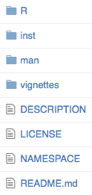
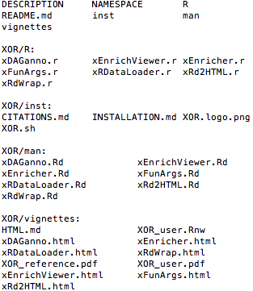
Skeleton

Slide 11
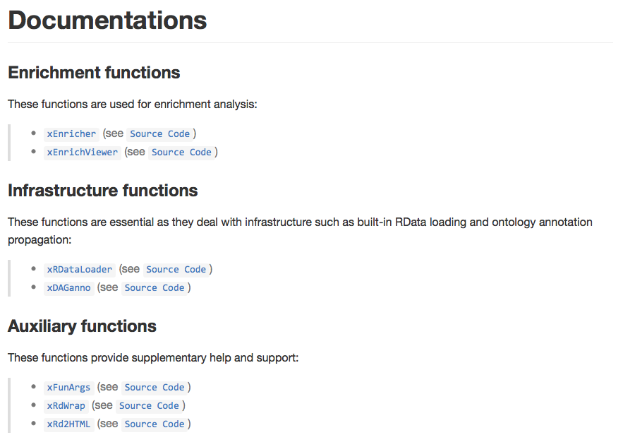
Functionalities

Slide 12
Dependency
Minimise package dependency
  dnet
  igraph
  GenomicRanges

Slide 13

A list of genes
or
A list of SNPs
Ontology term enrichments
Network-like relationshps
Files and Visuals
User inputs
User outputs
Choose ontology
Analysis modules
Choose/specify which ontology to use
Ontology manipulations & visualisations
Enrichment analysis
  use a variety of ontologies
  support for several statistical tests
  account for ontology hierarchy
  visualise enriched terms in hierarchy
Similarity analysis
  use a variety of ontologies
  support for several metrics
  visualise semantic similarity network
Built-in RData
Info on Entrez Genes
Info on GWAS SNPs and LD SNPs
Ontologies (GO, DO, HPO & MPO, EFO)
Annotations by ontologies

Slide 14
A list of genes
or
A list of SNPs
Enriched ontology terms
Network-like relationshps
Files and Visuals
User inputs
User outputs
Frontend: choose ontology
Backend:
‘software’
‘hardware’
Ontology manipulations
Enrichment analysis
  a handful of ontologies
  several statistical tests
  ontology hierarchy
Similarity analysis
  a handful of ontologies
  several metrics
  similarity network
Built-in RData
  Info on Entrez Genes
  Info on GWAS SNPs and LD SNPs
  Ontologies (GO, DO, HPO & MPO, EFO)
  Annotations by ontologies

Slide 15
A list of genes
or
A list of SNPs
Enriched ontology terms
Network-like relationships
Files and Visuals
User inputs
User outputs
Frontend: choose ontology
Backend:
‘software’
‘hardware’
Enrichment analysis
  a handful of ontologies
  several statistical tests
Similarity analysis
  a handful of ontologies
  several metrics
Built-in RData
  Info on EntrezGenes
  Info on GWAS SNPs and LD SNPs
  Ontologies
  Annotations

Slide 16
Frontend: Web app
Ontologies
User inputs
User outputs
A list of genes
or
A list of SNPs
Enriched terms
Network-like relations
Files and Visuals
Backend: R package
‘soft’ part
‘hard’ part
Enrichment analysis
  a dozen ontologies
  several tests
Similarity analysis
  a dozen ontologies
  several metrics
Built-in RData
  Info on Genes
  Info on GWAS SNPs and LD SNPs
  Ontologies
  Annotations

