Slide 1
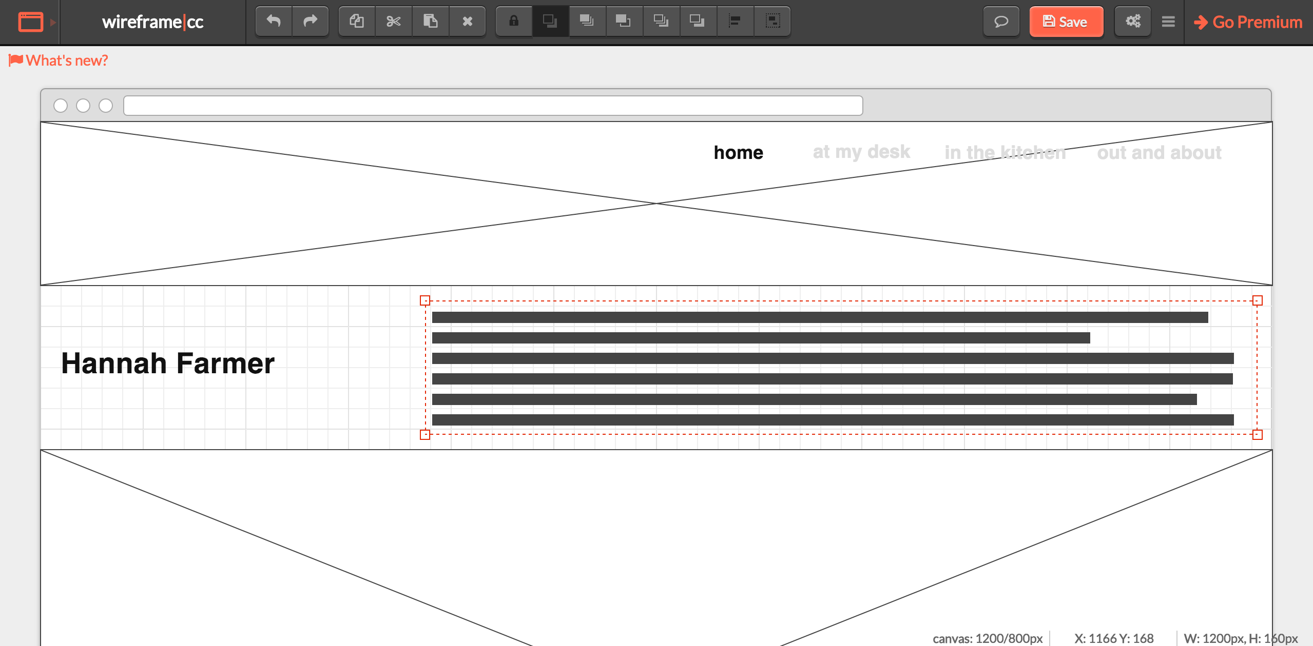
Nav
Header
Footer

Slide 2
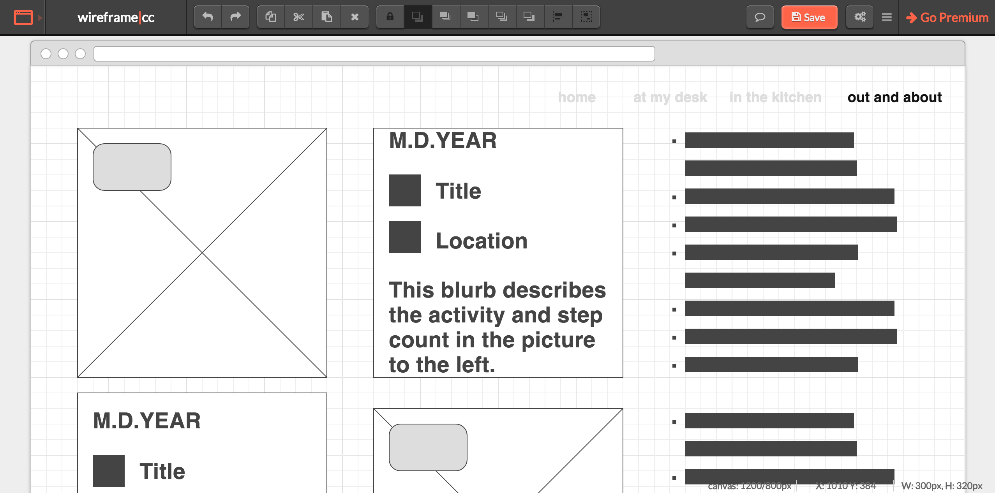
Nav
Div
Div
Div

