Slide 1
education++
Husain Fazal
Preshoth Paramalingam
Robert Stanica

Slide 2
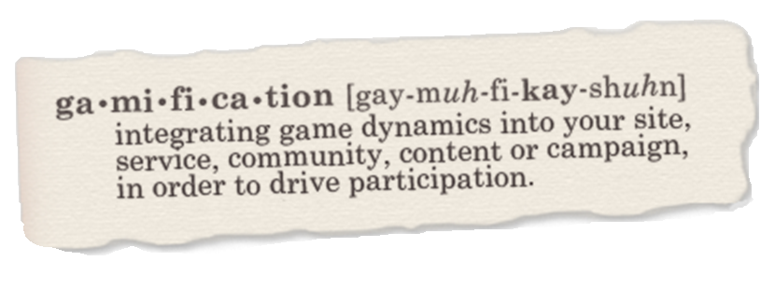


Slide 3
Our Idea
Our idea was to create an environment in which students can compete with one another, earn points for their academic achievements, and have the opportunity to buy rewards that they can actually use.

Slide 4
What is our System?
Moodle Plugin that brings gaming elements to the Education world.
Engages users to a whole new level

Slide 5
Point Earning Scenarios
Allows Professors to define situations in which students can earn points
Getting 90% or higher across all tests in a course could get the student 1000 points

Slide 6
Incentives
Allows Professors to define rewards or badges that students can purchase with their earned points.
Reward: Real Application- drop your lowest quiz for 1000 points
Badge: Also known as a trophy/achievement for all to see

Slide 7
Leaderboard System
Allows Students to have a friendly competition by comparing statistics.
Class Leaderboard: Class Point Based
School Leaderboard: Badge Based

Slide 8
Supporting Tools
Student Spending Reports
Notification tools to contact students
Automated Gradebook Parser

Slide 9
education++
Husain Fazal
Preshoth Paramalingam
Robert Stanica

