Slide 1

UDP-Based Chatting System
CHEN Yunkun 13103214D
LIU Xin 15007974X
ZHENG Hongyi 13104036D

Slide 2

Design
General Design
点击添加文本
点击添加文本
Design of Client
点击添加文本
Design of Server
点击添加文本

Slide 3


General Design
Deployed on Microsoft Azure.
Connected by client.
Maintain client list.
Forwards all messages received to all client connected.
SERVER
点击添加文本
点击添加文本
点击添加文本
Connect to server.
Initialize P2P chatting, provided the ip address and port number of other side.
Send/receive messages to/from server/other client.
Client
点击添加文本

Slide 4
Design of Client
点击添加文本
Module
Ui
点击添加文本
Handles internal mechanism
Build a graphic user interface.
点击添加文本
点击添加文本

Slide 5
Module——3 Parts
Interface
Captures user input and deploys ClientSend to send message
Collect the message received by ClientRece and shows them on ui.
ClientControl
点击添加文本
点击添加文本
Receives Messages
ClientRece
ClientSend
点击添加文本
Sends messages
点击添加文本

Slide 6
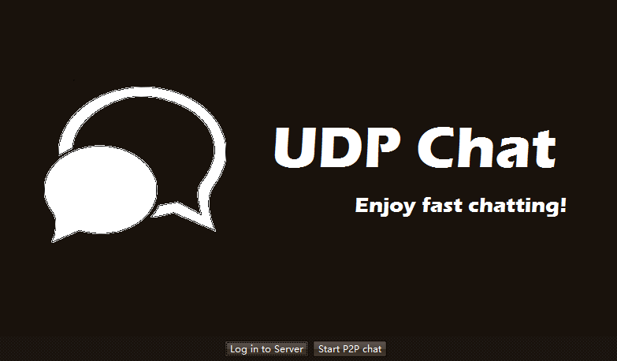
Ui —— 3 Pages
Login Page
点击添加文本
Chat through server
P2P Chat
点击添加文本
点击添加文本
点击添加文本

Slide 7
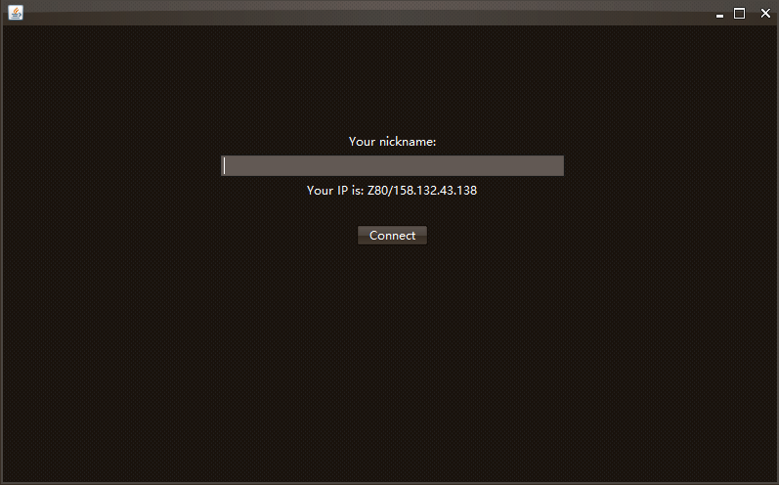
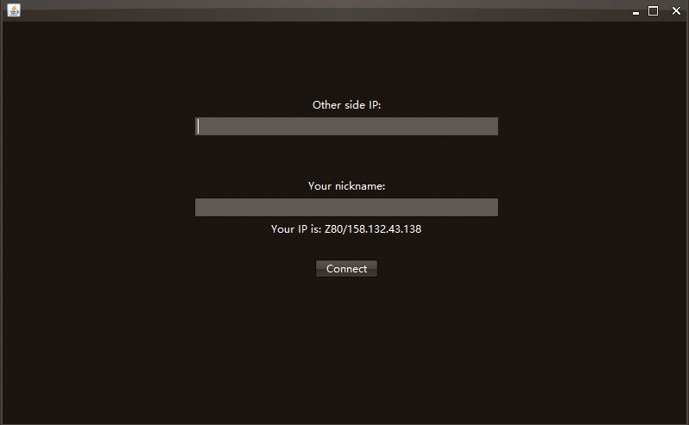
Ui —— 3 Pages
Initialization Page
点击添加文本
Nickname
Other side IP
Other side port number
点击添加文本
点击添加文本
点击添加文本

Slide 8
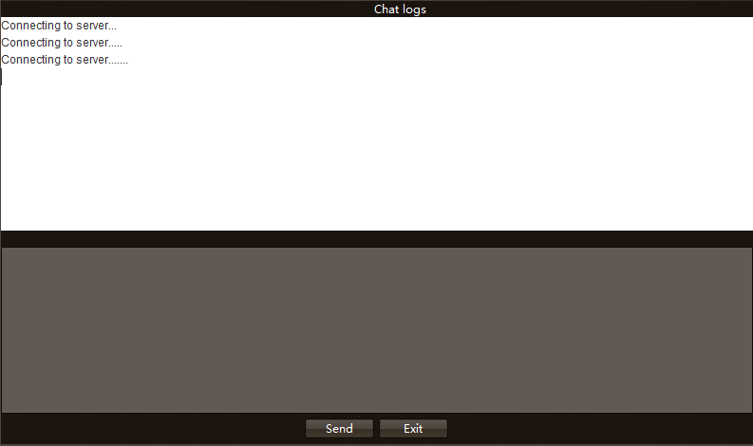
Ui —— 3 Pages
Chatting Page
点击添加文本
Chat logs
Input board
Send/Exit button
点击添加文本
点击添加文本
点击添加文本

Slide 9
Design of Server——3 Parts
点击添加文本
ServerControl
Coordinate ServerSend and ServerRece
Maintains the message pool/client list.
ServerRece
Receives message
Stores messages into message pool.
点击添加文本
ServerContro
ServerSend
Fetches message from message pool
Forwards messages
ServerRece
点击添加文本
ServerSend
点击添加文本

Slide 10
Implementation Keys
Language
点击添加文本
点击添加文本
Message forwarding mechanism
点击添加文本
Multithreading
点击添加文本
Client registration mechanism

Slide 11
Language
点击添加文本
点击添加文本
JAVA
点击添加文本
点击添加文本

Slide 12
Message Forwarding Mechanism
ServerControl
Maintain message pool
Queue
ServerSend
Dequeue-oldest message
Send
ServerRece
Enqueue-new message
点击添加文本
点击添加文本
点击添加文本
点击添加文本

Slide 13
Multithreading
Run on separated thread
Keep tracking port to receive messages
ServerRece
ClientRece
点击添加文本
Synchronized: MessageQueue
点击添加文本
Run on separated thread
Keep sending as long as message pool is not empty
点击添加文本
ServerSend
点击添加文本

Slide 14
Client Registration Mechanism
DIS_BEY
Search client
Delete client
INIT_HELO
Add client
Record IP
Record Nickname
点击添加文本
点击添加文本
点击添加文本
点击添加文本

Slide 15
Demo Time

