Slide 1
Thermal Management Considerations for PCBs
Measurement techniques
and heat conduction
Dr Graham Berry

Slide 2



Apple Apps for Thermal Engineers
Gear1-Convection is comprised of three natural convection and three forced convection calculators. It is a visual application designed for touch-based interaction. This provides an instant sensitivity analysis to determine which parameters are the most important.
Gear2-Materials is an encyclopedia in your pocket for Thermo-Physical properties of over 1,300 materials. These properties include: Density, Specific Heat, and Thermal Conductivity.
Gear3-Finishes is an encyclopedia in your pocket for Thermo-Physical surface properties of hundreds of materials. If you need properties for Asphalt Shingles, Second Surface Silvered Teflon. or even a Deciduous Forest, you can find it here!

Slide 3
Thermal Resistance
TSP Method (temperature sensitive parameter)
Meets military specifications
Use forward voltage drop of calibrated diode to measure change in T_{j} due to known power dissipation

Slide 4
Thermal resistance calculation
Recall formula for junction temperature:
T_{J} = (P_{D} x θ_{JA}) + T_{A}
Rearranging equation, thermal resistance calculated by:
θ_{JA}=ΔT_{J}/P_{D}=T_{J}-T_{A}/P_{D}
where T_{J} is junction temp, T_{A} is ambient temp and P_{D} is power dissipation

Slide 5
TSP Calibration
TSP diode calibrated in constant temperature oil bath, measured to ±0.1°C
Calibration current low to minimise self-heating
Normally performed at 25°C and 75°C

Slide 6
Temperature coefficient
Temperature coefficient known as K-factor
Calculated using K=T₂-T₁/V_{F2}-V_{F1}
at constant I_{F} where:
K=Temperature coefficient (°C/mV)
T_{1,2} = lower and higher test temperatures (°C)
V_{F1,F2}=Forward voltage at I_{F} and T_{1,2}
I_{F}=Constant forward voltage measurement current

Slide 7
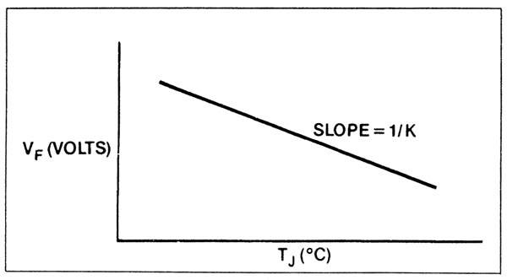
Calibration graph
K-factor measured from inverse of slope

Slide 8
Thermal resistance measurement
Constant voltage and constant current pulses applied to test device
Constant current pulse is same value as used to calibrate TSP diode
This is used to measure forward voltage
Constant voltage pulse used to heat test device

Slide 9
Thermal resistance measurements
Constant voltage (heating) pulse much longer than constant current (measurement) pulse to minimise cooling during measurement
Typically >99:1ratio

Slide 10
Thermal resistance measurements
Measurement cycle starts at ambient temperature
Continues until steady state reached, i.e. thermal equilibrium

Slide 11
Thermal resistance measurements
Thermal resistance calculated by:
θ_{JA}=ΔT_{J}/P_{D}=K(V_{FA}-V_{FS})/V_{H} × I_{H} where:
V_{FA}=forward voltage of TSP at ambient temp (mV)
V_{FS}=Forward voltage of TSP at equilibrium (mV)
V_{H}=Heating voltage (V)
I_{H}=Heating current (A)

Slide 12
Test ambient
Measurement of θ_{JA}
Devices soldered to special thermal resistance test boards
8-9 mil (200-225µm) standoff from board
Placed in box of known volume (1cu ft if you’re American!)
Temperature rise measured

Slide 13
Air flow tests
Ambient test can also use moving air
Air flow passed over device at known constant rate
Required for calculations involving active cooling (Lecture 2)
Similar setup to static ambient test

Slide 14
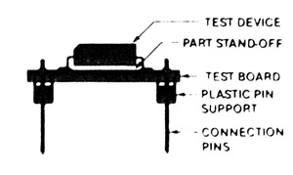
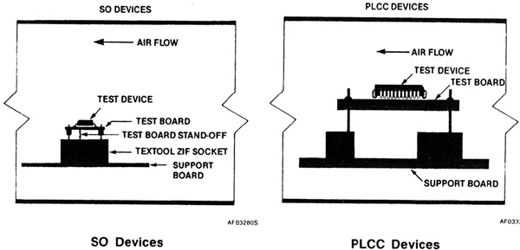
Test setups
Test device on board
Air flow test setups

Slide 15
θ_{JC} Tests
Test device held against an infinite heatsink
This comprises a massive, water-cooled copper block, kept at 20°C
In this way, θ_{CA} (case-ambient) is very close to zero, so any measurement is purely θ_{JC} (junction-case)

Slide 16
θ_{JC} Tests
SO devices mounted with bottom of package against heatsink, using thermal grease for good conductivity
PLCC devices mounted upside down, with top of package against heatsink
Spacer used on bottom side to prevent heat loss from here

Slide 17
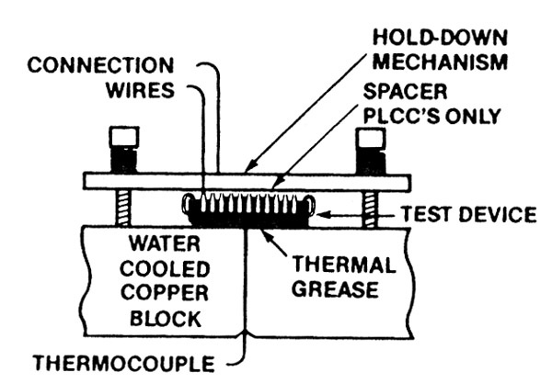
PLCC θ_{JC} test setup

Slide 18
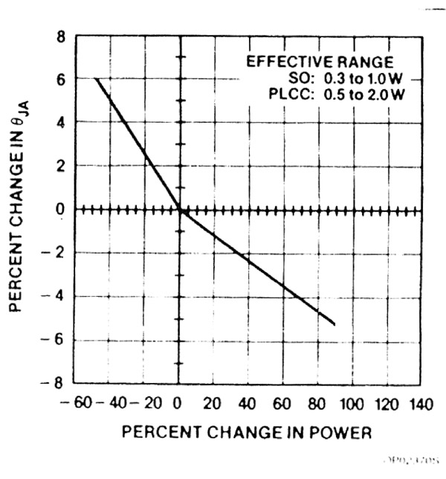
θ_{JC} data
Power dissipation has an effect on thermal resistance
Must be considered
when calculating
cooling requirements

Slide 19
Other factors affecting θ_{JC}
Recall from Lecture 1:
Leadframe design, pad size
Larger pads reduce thermal resistance for given die size
Leadframe material - Alloy 42 or copper

Slide 20
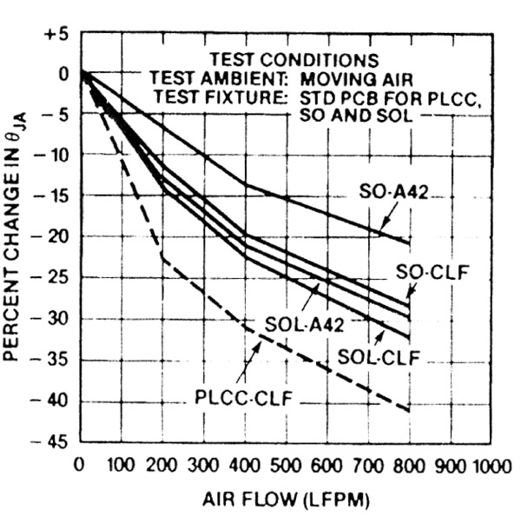
θ_{JA} data
Air flow also affects θ_{JA}
Important
consideration
for forced-air
cooling

Slide 21
Heatsinks
Purpose of a heatsink is to conduct heat away from a device
Made of high thermal conductivity material (usually Al, Cu)
Increased surface area (fins etc) helps to remove heat to ambient
Interface between heatsink and device important for good thermal transfer

Slide 22
Interface roughness
Surface roughness at interface between two materials makes a huge difference to thermal conductivity
Various different contact configurations on microscopic scale

Slide 23
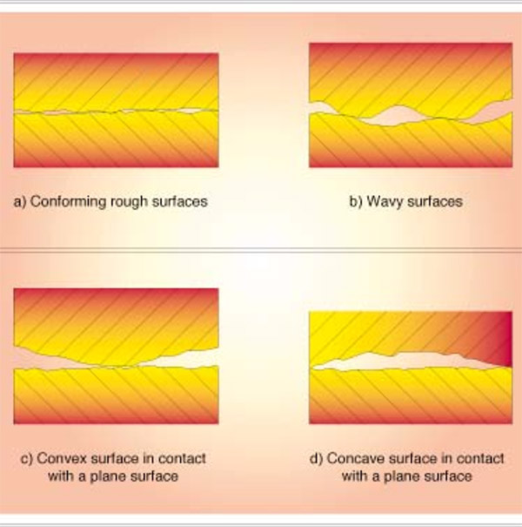
Surface roughness

Slide 24
Surface roughness
Air gaps act as effective insulators
Need some interstitial filler
Many types available, including greases, elastomers, adhesive tapes
Seen by consumers e.g. in PC processor heatsink/fan kits

Slide 25
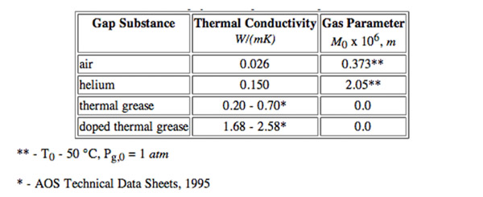
Interstitial filler materials

Slide 26
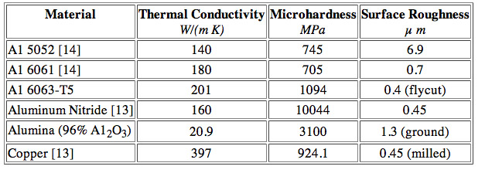
Solid interfaces
Conforming rough surfaces can have high conductivity:

Slide 27
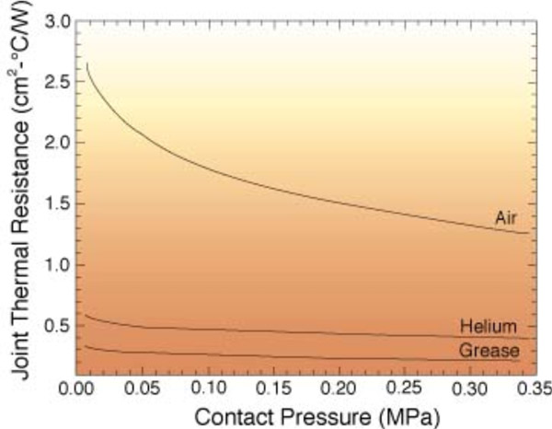
Effect of contact pressure

Slide 28

Heat Conduction in a PCB
PCB is layered composite of copper foil and glass-reinforced polymer (FR4)

Slide 29
Heat conduction in PCB
Can treat this layered structure as homogeneous material with two different thermal conductivities
Heat flow within plane is κ_{In-plane}
Heat flow through thickness of plane is κ_{Through}

Slide 30
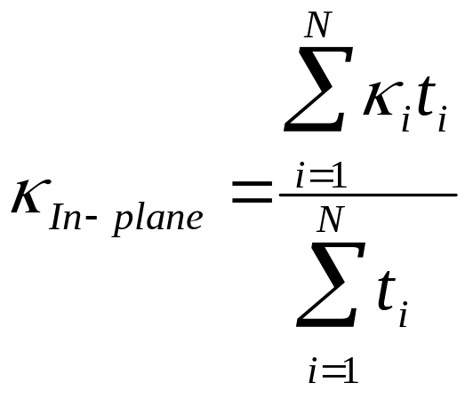
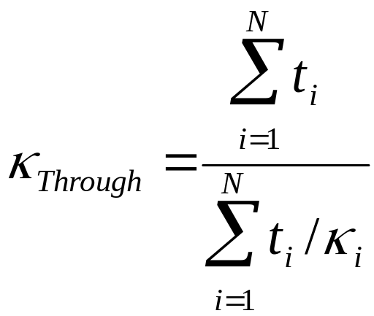
Conductivity Equations
where t is thickness of given layer
and κ is thermal conductivity of that layer

Slide 31
Sample results
Total PCB thickness is 1.59mm
PCB comprises only copper and FR4 layers
κ of copper is 390 W/mK
κ of FR4 is 0.25 W/mK

Slide 32
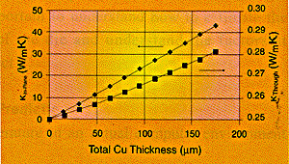
Sample results

Slide 33
Conclusions from results
Even for thin copper layers, κ_{In-plane} is much greater than κ_{Through}
As FR4 has very low thermal conductivity, a continuous copper layer will dominate heat flow
Because of this, thermal conduction is not efficient where no continuous copper path exists

Slide 34
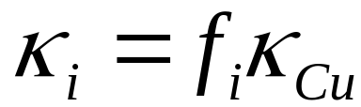
Refining calculations
Trace (signal-carrying) copper layers have much less effect on heat transfer than planes
Trace layers can normally be excluded from calculations
If required, conductivity of trace layer can be calculated from
where f_{i} is fractional copper coverage

Slide 35
Summary
TSP Method for measuring junction temperatures
Thermal resistance test methods - junction-air and junction-case
Effects of power dissipation and airflow on thermal resistance
Interface resistance
Use of interstitial materials to decrease this

Slide 36
Summary
Heat conduction in copper-clad PCB dominated by in-plane transfer
Trace layers have only a small contribution to total conduction
FR4 is a good insulator!

Slide 37

Thermal Analysis Software
PCAnalyze ™ is an engineering application used to mathematically model and predict the thermal behavior of printed circuit assembly (PCA) designs. Component placement, cooling strategies, or "worst case" conditions can be quickly evaluated using this software.
PCAnalyze will calculate the temperature of the board and its individual components, using its integrated steady state and transient solver. This is the same solver used in the TAK2000 Pro™ thermal analyzer.
PCAnalyze ™ is a stand-alone application with its own built-in solver. No third-party compiler, linker, or graphics package is required.
http://www.pcanalyze.com/product.htm

