Slide 1
Multi-Label Classification of Reuters-21578 Dataset
Fei He
4/11/2022

Slide 2
Overview
Reuters-21578 Dataset Process and Cleanup
Multi-label Classification using Machine Learning Classifier
Multi-label Classification using Transfer Learning Fine-Tuning
Summary and Further Improvement

Slide 3
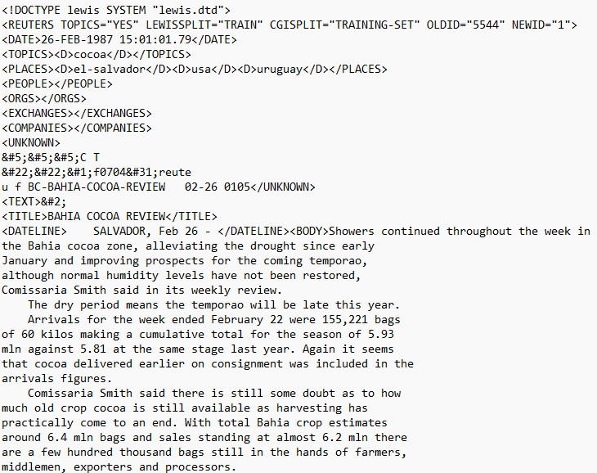
Reuters-21578 Dataset
Dataset Overview
A collection of 21578 news articles, stored in 22 *.sgm files as xml format having date, place, topic, title, and news contents, etc.
All above information can be missing and contents need to be cleaned before building models on it
Goal here is to label the news (generate topic(s) information) based on contents

Slide 4
Reuters-21578 Dataset
Data Process and Cleanup
BeautifulSoup is a Python package for conveniently parsing HTML and XML documents. It creates a parse tree for parsed pages that can be used to extract data
Extract each news topic(s) and news contents
Remove news that had no topic(s) or contents, or contents only had “blah blah blah”
Contents need to remove below:
Line breaks (\n)
None-alphabetical characters and numbers
Single backslash (\)
Multiple spaces
Convert all words to lower cases, consider lower case and upper case delivered the same information

Slide 5
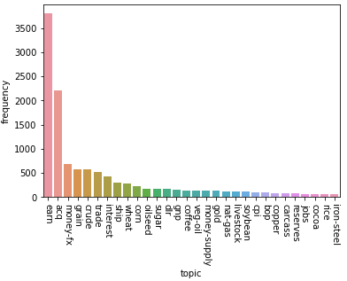
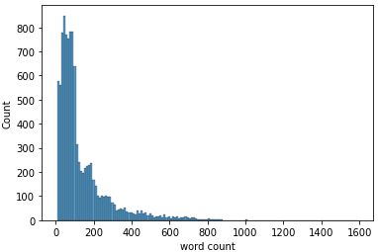
Reuters-21578 Dataset
Cleanup Data Summary
Total of 10439 news, Lewis splits them to 7115 TRAIN sets, 2759 TEST sets and 565 NOT-USED sets
There are 120 unique news topics, frequency ranges from 1 (corn-oil, castorseed etc.) to 3799 (earn)
Word counts in the news contents ranges from 7 to 1593, but 97% are less than 512 words

Slide 6
Classification Using Machine Learning Classifier
Multi-label Classification
Multiple labels can be assigned to each instance, want to find a model that maps inputs x to binary vectors y (assigning a value of 0 or 1 for each element (label) in y)
OneVsRestClassifier is implemented in sklearn Python package that can perform multilabel classification, which involves training one binary classifier independently for each label
We will use OneVsRestClassifier with few classic binary machine learning classifier to label the Reuters data
Naïve Bayes
Support Vector Machine (SVM)
Logistic Regression
Random Forest
Multi-Label k-Nearest Neighbor (ML-kNN)

Slide 7
Classification Using Machine Learning Classifier
Feature Extraction w/ TF-IDF
Term Frequency–Inverse Document Frequency (TF-IDF) is a useful text-mining tool which generates a term-weighting statistic that is intended to reflect how important a word is to a document in a corpus
TF-IDF(t,d,D)=TF(t,d)∗IDF(t, D)
TF(t, d): relative frequency of word t within document d
IDF(d, D): log⁡of (total number of documents in the corpus/ number of documents where word t appears)
Use TF-IDF to preprocess the news contents before running classification

Slide 8
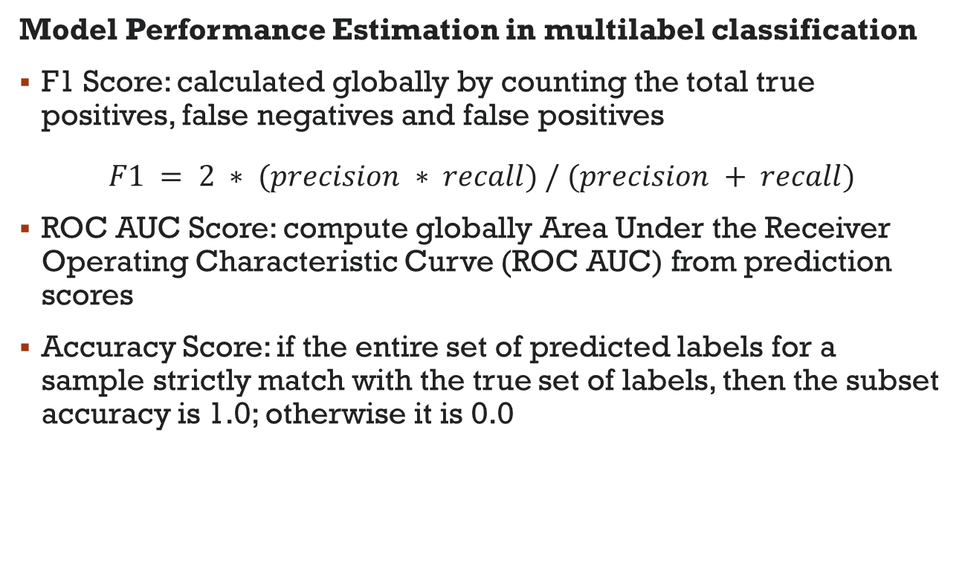
Classification Using Machine Learning Classifier
Model Performance Estimation in multilabel classification
F1 Score: calculated globally by counting the total true positives, false negatives and false positives
$$F1 = 2 ∗ (precision ∗ recall) / (precision + recall)$$
ROC AUC Score: compute globally Area Under the Receiver Operating Characteristic Curve (ROC AUC) from prediction scores
Accuracy Score: if the entire set of predicted labels for a sample strictly match with the true set of labels, then the subset accuracy is 1.0; otherwise it is 0.0

Slide 9
Classification Using Machine Learning Classifier
Results
SVM outperformed under all 3 metrics
Naïve Bayes underperformed under all 3 metrics
 | F1 Score | ROC AUC Score | Accuracy Score
Naïve Bayes | 0.48 | 0.66 | 0.39
SVM | 0.85 | 0.89 | 0.79
Logistic Regression | 0.74 | 0.80 | 0.66
Random Forest | 0.68 | 0.76 | 0.60
ML-kNN | 0.79 | 0.87 | 0.74

Slide 10
Classification Using Transfer Learning Fine-Tuning
Transfer Learning and Fine-Tuning
Transfer learning is a technique where a deep learning model pretrained on a large dataset is used to perform similar tasks on another dataset. It is better to use a pre-trained model as a starting point to solve a problem rather than building a model from scratch
Given a pre-trained model, we can then further train the model on our relatively smaller dataset and this process is known as model fine-tuning
BERT (Bidirectional Encoder Representations from Transformers) is a big neural network architecture with hundreds of millions of parameters, we can freeze all the layers of BERT during fine-tuning and attach a few neural network layers of our own and train this new model

Slide 11
Classification Using Transfer Learning Fine-Tuning
BERT Fine-Tuning w/ Hugging Face Transformers Module
BERT is designed to pre-train deep bidirectional representations from unlabeled text by jointly conditioning on both left and right context
Hugging Face Transformers module provides pre-trained modern deep learning models (Transformer, BERT, etc.) and framework to integrate with PyTorch and TensorFlow for research and development
Due to the limited time I have and limited capability of my own GPU, I only did simple models by adding a dropout and linear layer on top of pre-trained BERT model (code framework had been built)
The overheating of the hard drive caused multiple crash of my computer when training more BERT layers, XLNET and Longformer models…

Slide 12
Classification Using Transfer Learning Fine-Tuning
BERT Fine-Tuning Results
I add a linear layer on top of pre-trained BERT model with following parameters:
News contents limited to 512 words when tokenizing
2e-5 learning rate (recommended by the author)
1 epoch
Take sigmoid of prediction and use 0.5 as threshold to determine label
Result is not very satisfactory:
 | F1 Score | ROC AUC Score | Accuracy Score
one dropout and linear layer | 0.67 | 0.75 | 0.59

Slide 13
Summary and Further Improvement
Further Improvement
Dealing with Raw Data:
Remove single characters or short words, they might not very informative
Remove numbers
Lemmatisation the words
Model Performance:
Add Hamming loss to assess the results
Tuning the hyperparameters in the models
Add more layers on pre-trained models, use more epochs for the training
Train the fine-tuning model on powerful GPU clusters (I tried google colab but didn’t quite work it out…)

Slide 14
Summary and Further Improvement
Summary
Finely-preprocess the raw data could help the accuracy of the classifications
Classic machine learning classifiers can do reasonably good job on multi-lab classification
Fine-tuning on pre-trained sophisticated models is a powerful tool but serious design is needed to promote the accuracy

Slide 15
Reference
https://scikit-learn.org/stable/modules/multiclass.html
https://huggingface.co/docs/transformers/index
https://d2l.ai/
Thank you!

