Slide 1
Mobile Handset Memory Management

Slide 2
Outline
Introduction
Memory Management Basics
Android Memory Management
iOS Memory Management

Slide 3
Goal of Memory Management
Memory management is part of an operating system which allocates memory among competing processes, maximizing memory utilization and system throughput
Provide isolation between processes
Provide a convenient high level abstraction of low level hardware for programmers and compilers

Slide 4
Tasks of Memory Management
It keeps track of each memory location either it is allocated to some process or it is free
It checks how much memory should be allocated to processes
It decides which process will get memory at what time
It tracks whenever some memory gets unallocated and correspondingly it updates the status

Slide 5
Memory Management in OS
User Programs
User Interface
Operating
System
System Calls
File Management
Memory
Management
Process
Management
Network
Management
Power
Management
Hardware

Slide 6
Mobile Handset Memory Management
The memory management in mobile handset is based on the general computer memory management techniques
We first review general memory management techniques and then choose Android and iOS as typical mobile platforms to show the differences

Slide 7
Outline
Introduction
Memory Management Basics
Android Memory Management
iOS Memory Management

Slide 8
Hardware Facts
The CPU can only access its registers and memory. It cannot make direct access to the hard drive. Data stored there must first be transferred into the memory before CPU processes it
Accesses to registers are very fast, generally 1 nanosecond. Accesses to memory are relatively slow, generally 100 nanoseconds (use cache to speedup). Accesses to hard drive are slowest, generally 10 millisecond

Slide 9
Some Terms
Register: A high-speed storage area inside the CPU
When a typical program gets loaded into memory, it consists of four memory areas:
Stack: stores temporary variables created by each function of that program
Heap: the area particularly for dynamic memory allocation
Data: stores global and static variables of that program
Code: stores instructions of that program

Slide 10
Major Memory Management Techniques
Base and limit registers
Virtual memory
Swapping
Segmentation
Paging

Slide 11
Base and Limit Registers(1)
Processes must be restricted so that they can only access memory locations that belong to that particular process
Each process has a base register and limit register
The base register holds the smallest valid memory address
The limit register specifies the size of the range

Slide 12
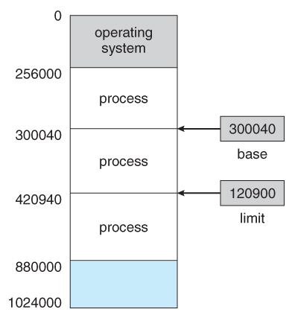
Base and Limit Registers(2)
For example, the valid memory address for process 2 is from 300040 to 420940
1
2
3

Slide 13
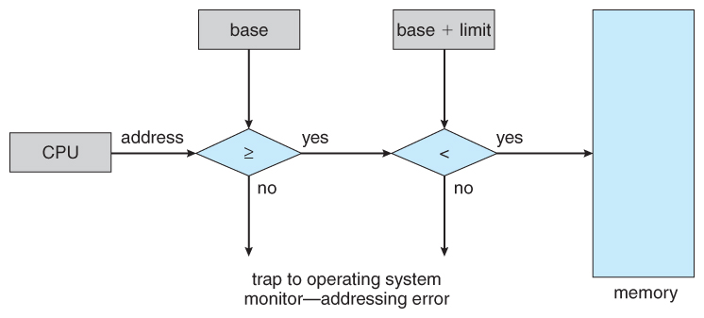
Base and Limit Registers(3)
Every memory access from a user process is checked against these two registers
The OS kernel has access to all memory locations as it needs to manage the whole memory

Slide 14
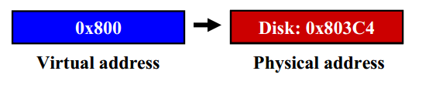
Virtual Memory (1)
Virtual memory (VM) is the basic abstraction that OS provides for memory management. “Virtual” means “using a level of indirection”
All programs use virtual memory addresses
Virtual address is converted to a physical address
Physical address indicates the real physical location of data
Physical location can be memory or disk

Slide 15
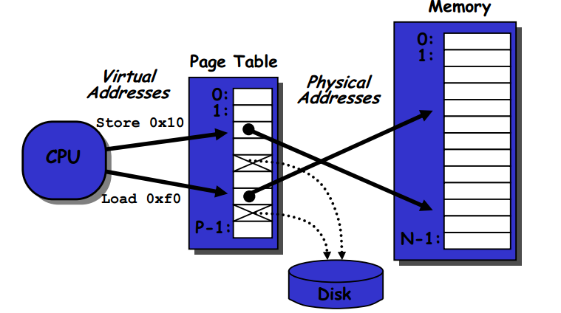
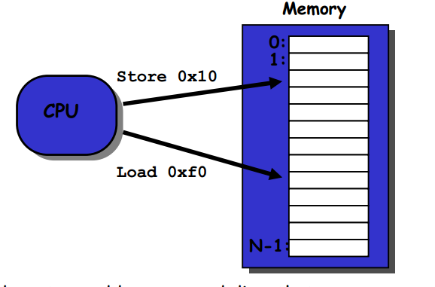
Virtual Memory (2)
Without virtual memory
With virtual memory
Address Translation

Slide 16
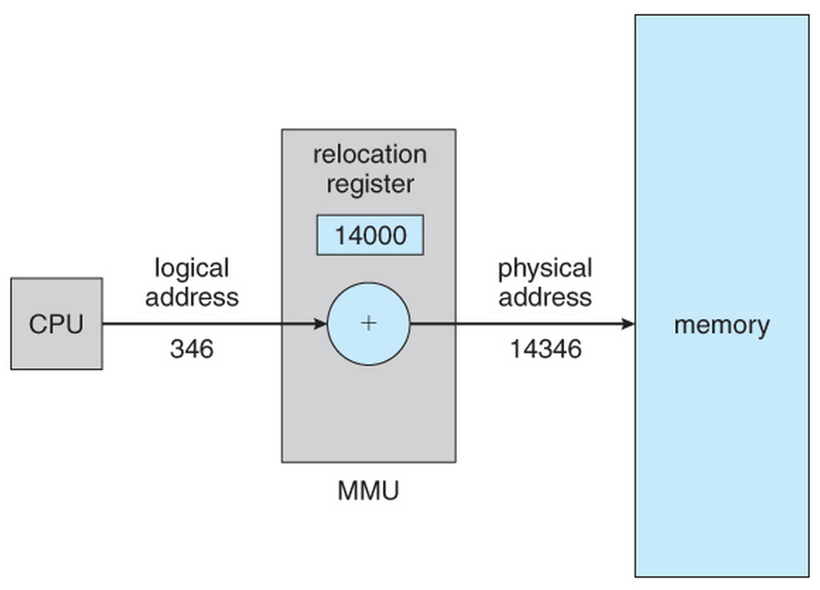
Virtual Memory (3)
The translation of virtual to physical addresses is handled by the memory-management unit (MMU).
MMU uses a relocation register whose value is added to every memory request at the hardware level

Slide 17
Swapping (1)
Swapping is a technique in which a process can be swapped temporarily out of memory to a backing store, and then brought back into memory for continued execution
Backing store is usually a hard drive which is fast in access and large enough to store copies of memory images
If there is not enough memory available to keep all running processes in memory at the same time, some processes who are not currently using the CPU may have their memory swapped out to the backing store

Slide 18
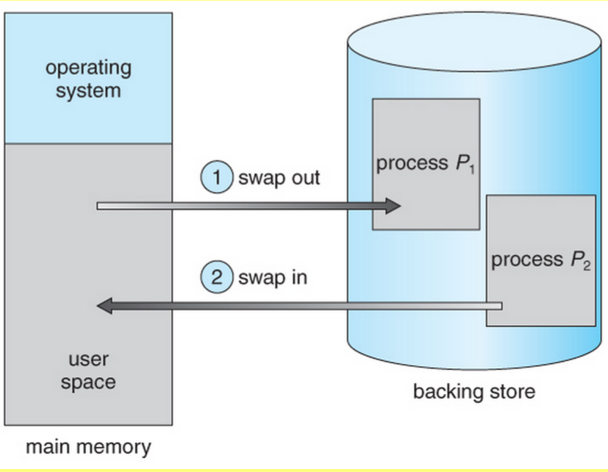
Swapping (2)

Slide 19
Swapping (3)
Swapping is a very slow process. The major time consuming part is the data transfer time
E.g., if a process occupies 10MB memory and the transfer rate for the backing store is 40MB per second, it will take 0.25 second just to do the data transfer. Adding in the time for swapping in new data, the overall transfer time can be half a second, which is a huge delay
Some OSes no longer use swapping because it is too slow

Slide 20
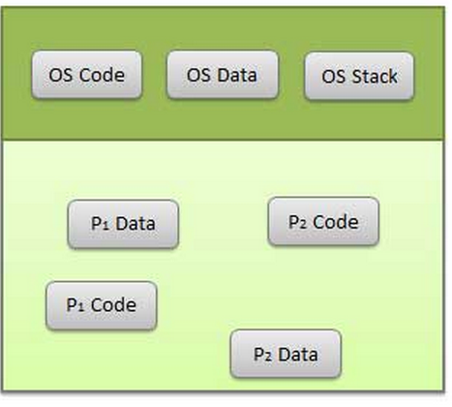
Segmentation (1)
Segmentation is a technique to break memory into logical pieces where each piece represents a group of related information. For example, stack, heap, data or code segments for each process, data segments for OS kernel, etc.
Breaking up the memory into smaller chucks increases chances of finding free memory
Logical Address Space

Slide 21
Segmentation (2)
Each segment has a pair of registers
Base register: contains the starting physical address where the segment reside in memory
Limit register: specifies the length of the segment
Segment table stores the base and limit register information for each segment
Segment 1
Segment 2
limit
base
Segment 3
Segment Table

Slide 22
Segmentation (3)
When using segmentation, the virtual memory address is a pair: <segment number, offset>
Segment number is used as index into the segment table to find a specific entry
Offset is first compared against the limit and then combined with base address to calculate the physical memory address

Slide 23
Segmentation (4)
Index to segment table
Segment Table
physical memory
limit
base
segment 0
segment #
offset
segment 1
virtual memory address
segment 2
<?
yes
+
segment 3
no
Physical
Address
raise
eorr
segment 4

Slide 24
Paging (1)
Sometimes the available memory is broken up into lots of little pieces, none of which is big enough to satisfy the next memory requirement, although the sum total could
This problem is called fragmentation and many memory allocation strategies suffer from it

Slide 25
Paging (2)
Paging is a memory management technique that allows the process’s physical memory to be discontinuous
It eliminates the fragmentation problem by allocating memory in equal sized blocks known as pages
It is the predominant memory management technique now

Slide 26
Paging (3)
Paging divides physical memory into a number of equal sized blocks called frames and divides a process’s logical memory space into equal sized blocks called pages
Any page from any process can be placed into any available frame
A page table is used to look up what frame a particular page is stored in at the moment

Slide 27
Paging (4)
virtual address space
physical address space
page 0
Page Table
frame 0
page 1
0
frame 1
page 2
1
Y
frame 2
2
page 3
…
3
2
…
frame Y
…
page X
X
1

Slide 28
Paging (5)
When using paging, a virtual memory address if a pair: <page number, offset >
Page number is used as an index into the page table to find the entry for this page
Offset is combined with base address to define the physical memory address

Slide 29
Paging (6)
virtual address
page number
offset
physical memory
frame 0
page table
frame 1
physical address
frame 2
Frame number
frame number
offset
frame 3
…
frame Y

Slide 30
Paging (7)
An example of address translation for paging
Virtual memory address is 0x13325328
Page table entry 0x13325 contains value 0x03004
What is the physical address
Physical address is 0x03004328
Page number is 0x13325 and offset is 0x328
The corresponding frame number is 0x03004

Slide 31
Outline
Introduction
Memory Management Basics
Android Memory Management
iOS Memory Management

Slide 32
Android Memory Management (1)
Android uses virtual memory and paging
Android does not support swapping
It uses flash memory for persistent storage like the hard drives in a desktop, so there is not as much space available
Flash memory can only be written to a limited number of times before it becomes unreliable
The bandwidth to flash memory is lower

Slide 33
Android Memory Management (2)
Processes can share memory
Each process is forked from the Zygote process (as we talked in last class).
The Zygote process starts when the system boots and loads common framework code and resources into memory
Memory pages of framework code and resources can be shared across all application processes

Slide 34
Android Memory Management (3)
Dalvik garbage collection:
Each Android app runs in a Dalvik virtual machine and has its own Dalvik garbage collector
The garbage collector maintains a free list which contains all the free memory blocks
If a process requests a free block and the free list is empty, the garbage collector will be triggered to work:
Each block has a bit to indicate if it is in use
Mark the bits for blocks that are in use and cannot be collected. These mark bits are stored in a separate memory area
Sweep and collect all unmarked blocks and put them back to the free list

Slide 35
Android Memory Management (4)
Restricting application memory:
Android sets a hard limit on the heap size for each application
If an app has reached the heap capacity and tries to allocated more memory, it will receive an OutOfMemoryError

Slide 36
Android Memory Management (5)
Switching apps:
When the user switches between apps, Android keeps apps which are not currently visible to the user in a least-recently used (LRU) cache
When the user later returns to the cached app, the app is reused for faster switching
When the system runs low on memory, it will kill apps in the LRU cache beginning with the one least recently used

Slide 37
Outline
Introduction
Memory Management Basics
Android Memory Management
iOS Memory Management

Slide 38
iOS Memory Management (1)
iOS include a fully-integrated virtual memory system that is always on
Like Android, iOS does not support swapping for the same reason (in fact, most mobile platform does not support swapping)

Slide 39
iOS Memory Management (2)
The principles to free up memory
Read-only data which has a copy on the flash is simply removed from memory and reloaded from flash as needed
Modified data is never removed from memory by the OS
The system asks the running apps to free up memory voluntarily to make room for new data
Apps that fail to free up sufficient memory will be terminated by the OS

Slide 40
iOS Memory Management (3)
iOS also uses the concept of paging
Besides, it divides the virtual address space of a process into a number of regions. Each region contains a known number of pages
The kernel associates a virtual memory (VM) object with each region and uses VM objects to track and manage the memory

Slide 41
Summary
Compared with general techniques
 | Android | iOS
Similarity | Use virtual memory and paging Do not use swapping | Use virtual memory and paging Do not use swapping
Difference | Memory share Garbage collection Heap restriction Application cache | Voluntarily memory free up principle Memory region concept VM objects

Slide 42
References (1)
https://www.cs.rutgers.edu/~pxk/416/notes/09-memory.html
http://www.cs.uic.edu/~jbell/CourseNotes/OperatingSystems/8_MainMemory.html
http://www.tutorialspoint.com/operating_system/os_memory_management.htm
http://developer.android.com/training/articles/memory.html
https://mobworld.wordpress.com/2010/07/05/memory-management-in-android/
http://courses.cs.washington.edu/courses/cse451/13au/lectures.html

