Slide 1

Azure Synapse for Actuaries Solvency II Use Case
October 28, 2021
Presenters:
Brent Carpenetti; Senior Actuary
Hiram Fleitas; Senior Customer Engineer

Slide 2
SOA Antitrust Compliance Guidelines
2

Slide 3
Presentation Disclaimer
3

Slide 4
What is Solvency II?
Solvency II is a risk-based capital regime, similar in concept to Basel II, implemented for European insurers on 1 January 2016. The risk-based capital requirement, the Solvency Capital Requirement (SCR), is calculated using either the standard formula; an approved internal model; or a mixture of both. The calculation is calibrated to a 99.5 per cent confidence level over a 1-year period.
4

Slide 5
What is Synapse Analytics?
Synapse is a limitless analytics service that brings together data integration, enterprise data warehousing, and big data analytics. It gives you the freedom to query data on your terms, using either serverless or dedicated resources—at scale. Azure Synapse brings these worlds together with a unified experience to ingest, explore, prepare, and serve data for immediate BI and machine learning needs.
5

Slide 6
Why?
10M+ Simulations * 100s Perspectives
Spreadsheets cannot mange the data size.
Database servers lack adv. statistical functions.
R-language and library versions hinder collaboration between actuaries.
Business processes often experience delays
Excel VBA(s) fall short of real automation.
Actuarial code is not programmatically DRY (Don't Repeat Yourself).
Actuaries lack collaboration with IT.
Ref: https://support.microsoft.com/office/excel-specifications-and-limits-1672b34d-7043-467e-8e27-269d656771c3
6

Slide 7
Why?
Legacy workflows do not drive performance
Process owners are consumed with operations.
Little availability to evaluate outcomes.
Teams are unable to achieve new opportunities.
7

Slide 8
How?
Modernize intelligent R & SQL
R is best used for model or statistics heavy workloads
SQL is best used for data management workloads
Collaborate with Azure DevOps or GitHub
Code management to decrease knowledge silos
Improve activity visibility and documentation
Automate with Azure Data Factory or Synapse Pipelines
Expose flows to teams
Enable real-time monitoring and completion tracking
Unify the experience with Azure Synapse
8

Slide 9
AGENDA
Demo intelligent R & SQL
Demo Azure DevOps
Demo Azure Data Factory
Demo Azure Synapse
What’s Next & Resources

Slide 10
DEMO 1
Intelligent R & SQL
R Desktop: “Bad-Case Scenario”
R on the Server: An interim solution
R in the database & Azure Data Studio

Slide 11
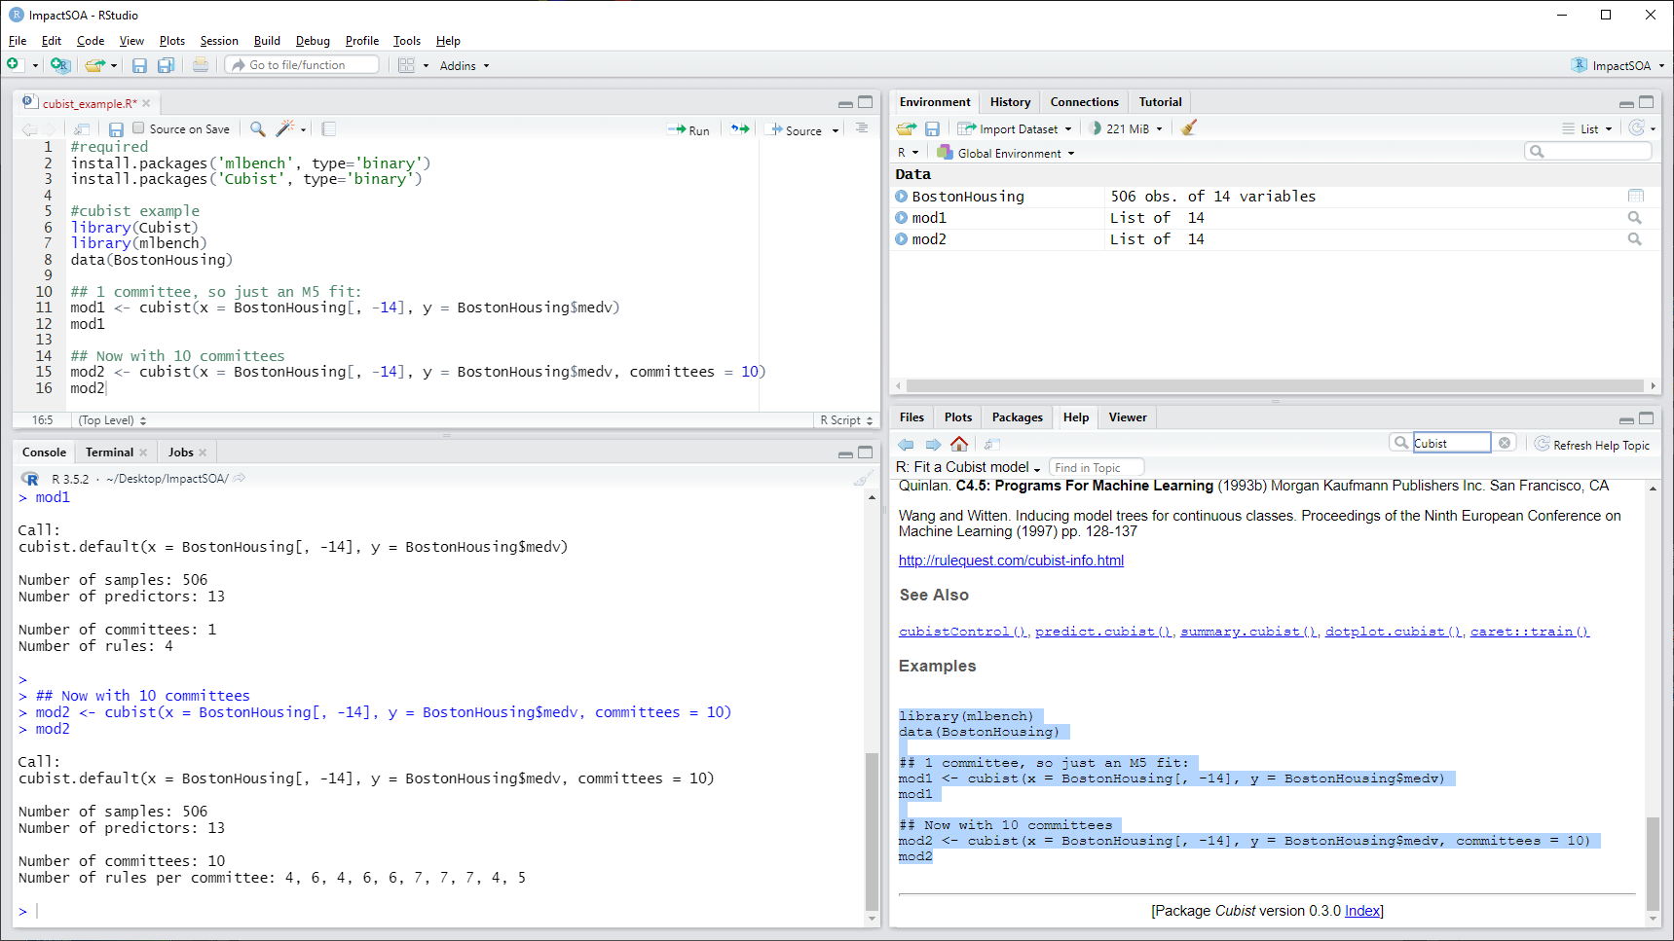



Slide 12

Diagram A
Diagram B
Desktop
Server
Memory
ODBC
C:\Users\username\Documents\R\R-3.5.2\library\mlbench\data\BostonHousing.rda
E:\Data_UserDB\ImpactSOA.mdf
Memory
Memory
Cubist
Cubist
Results
Results

Slide 13
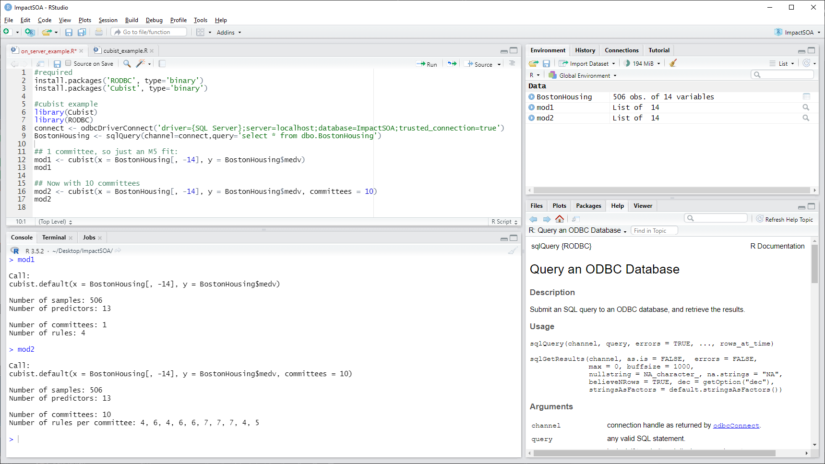

Slide 14

Diagram B
Diagram C
Server
Desktop
Memory
ODBC
SQL Server
Satellite
E:\Data_UserDB\ImpactSOA.mdf
Direct Communication
Memory
Cubist
Cubist
Launchpad
Results
Results

Slide 15
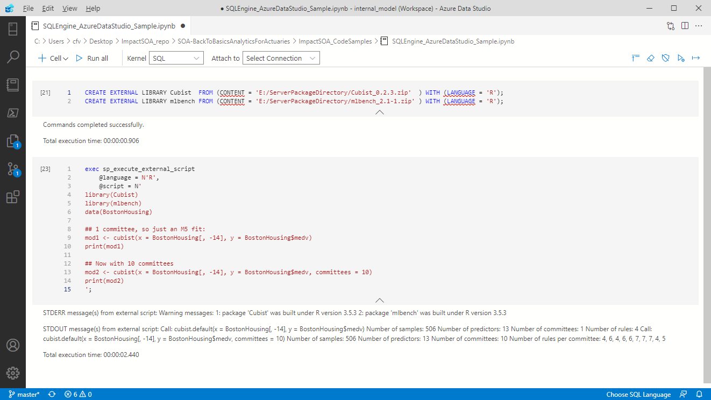

Slide 16
Resources Demo 1
https://bit.ly/3zvALdN (Code repository)
https://www.rstudio.com/products/rstudio/download/
Reading data from Microsoft SQL Server into R - Stack Overflow
Install on Windows - SQL Server Machine Learning Services | Microsoft Docs
R language extension - SQL Server Machine Learning Services | Microsoft Docs
CREATE EXTERNAL LIBRARY (Transact-SQL) - SQL Server - SQL Server | Microsoft Docs

Slide 17
DEMO 2
Azure DevOps
Boards
Repos: enable more rapid actuarial development
Pipelines: maturing to CI/CD

Slide 18
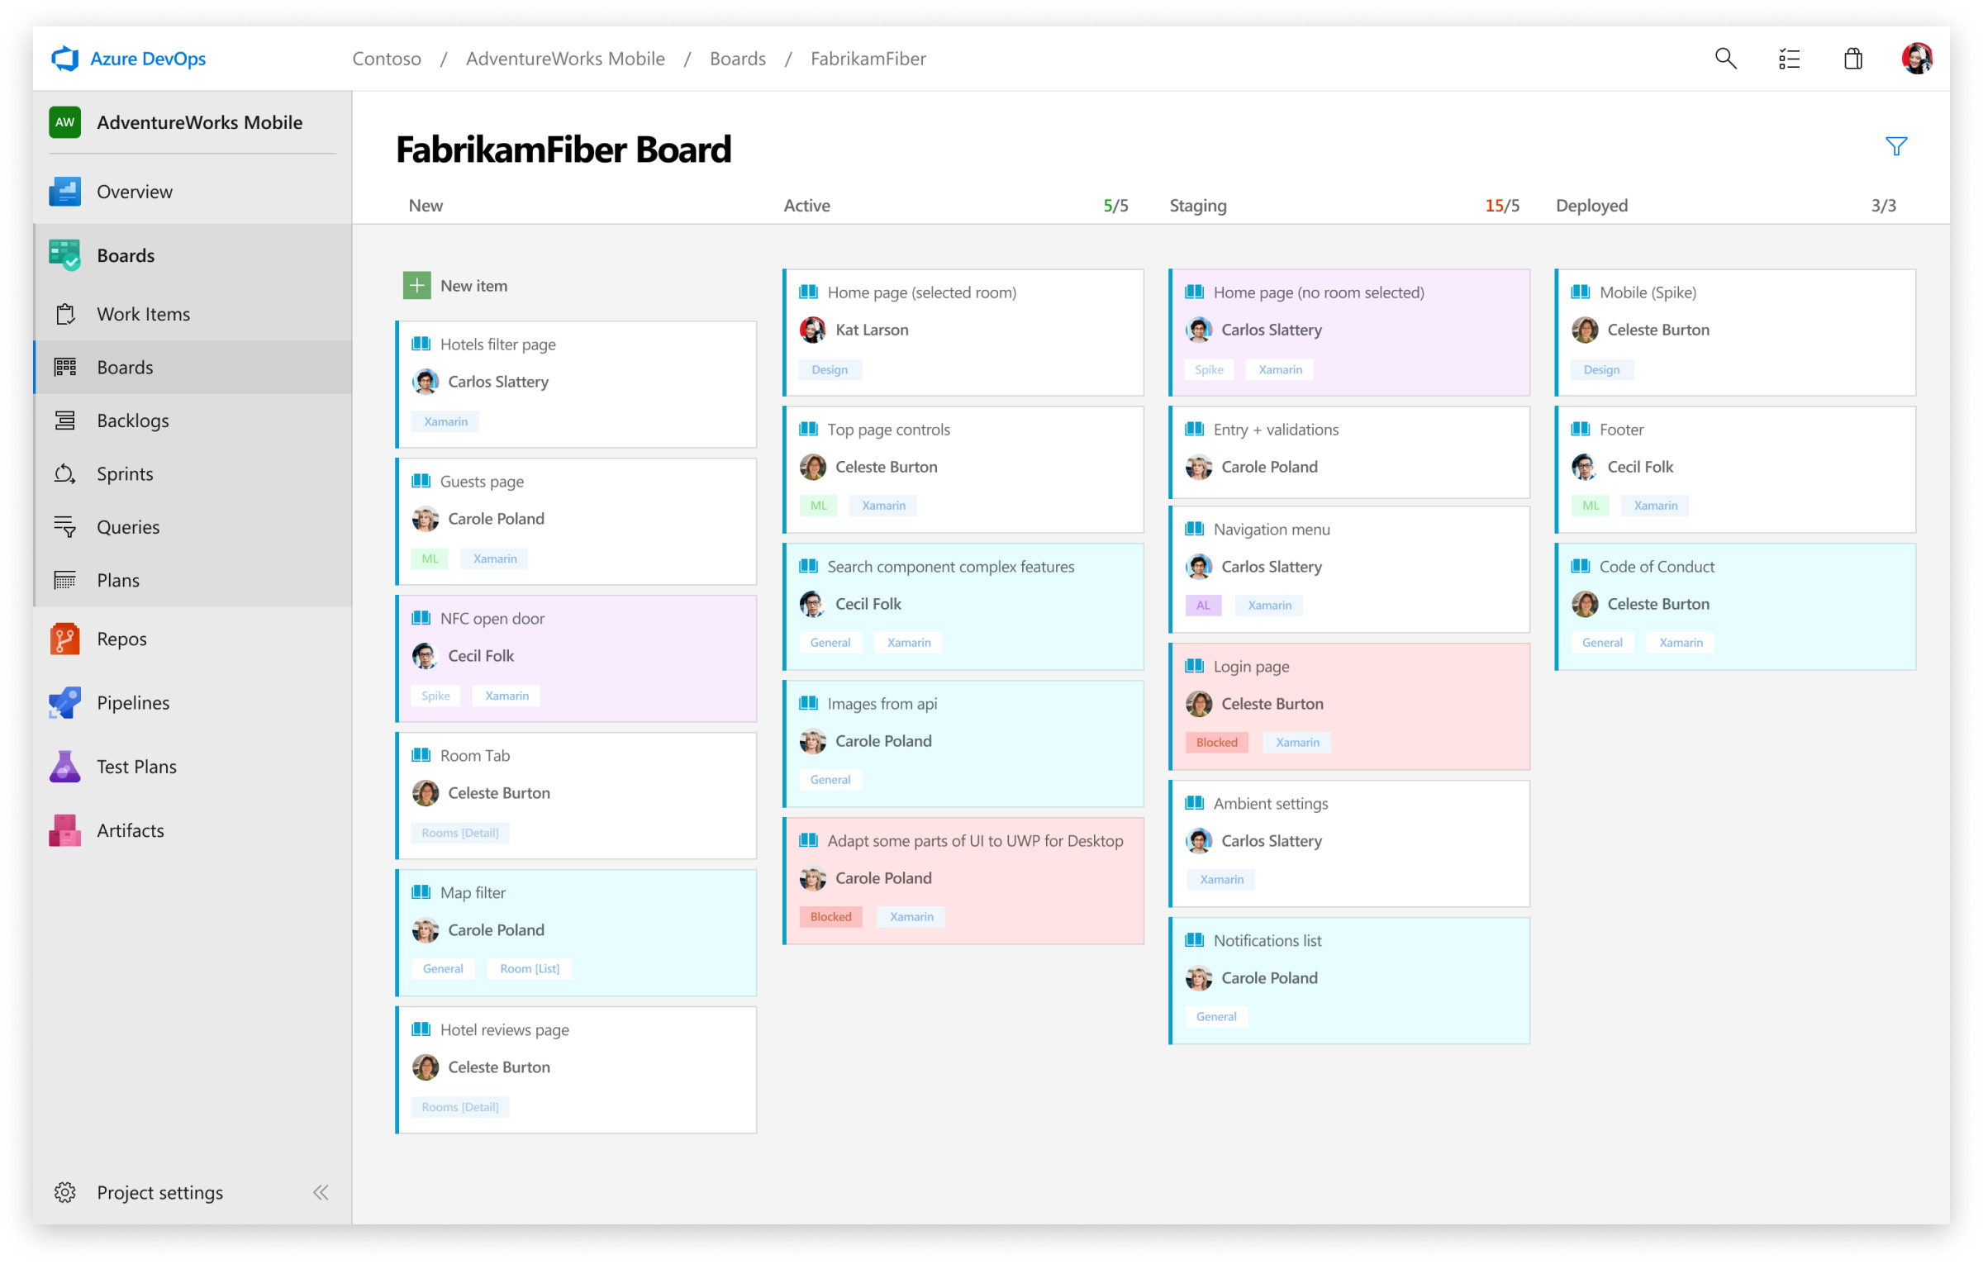

Slide 19
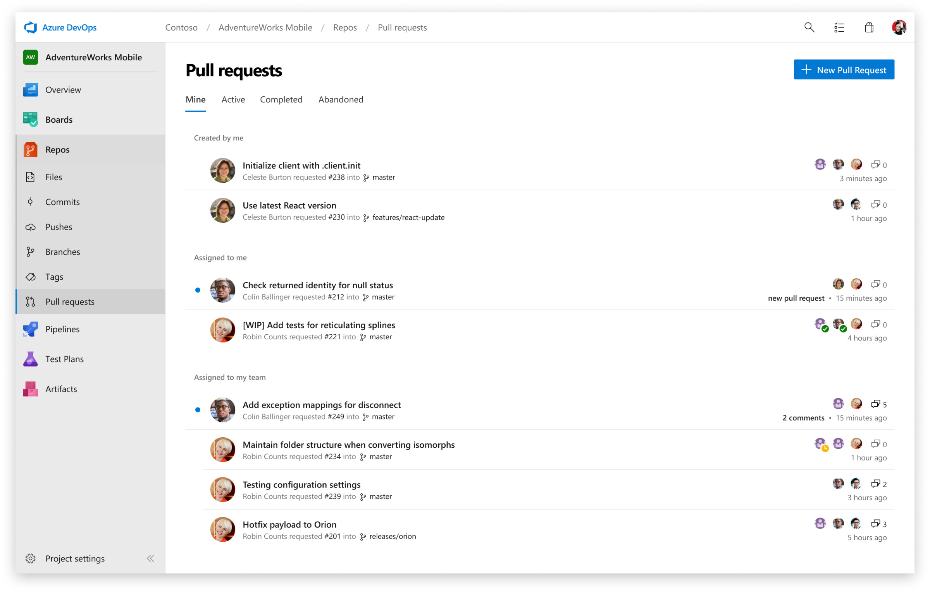

Slide 20
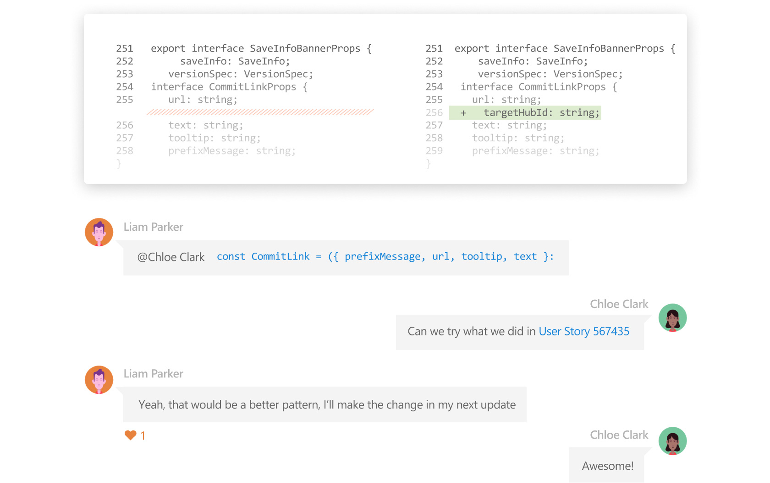

Slide 21
Resources Demo 2
Understand what you get with Azure Boards - Azure Boards | Microsoft Docs
Azure Repos – Git Repositories | Microsoft Azure

Slide 22
DEMO 3
Azure Data Factory
Pipelines for Orchestrating Automation
Transformations: Wrangling & Mapping Data Flows
Data movement: Including on-premises sources

Slide 23
DEMO 4
Azure Synapse
Data exploration
Notebook development
Server-less pools
Purview: Data Dictionary & Process Flows

Slide 24
Resources
A
B
C
D
E
24

Slide 25
What is Solvency II?
Edit Master text styles
Second level
Third level
Fourth level
Fifth level
25

Slide 26
Azure Synapse for Actuaries Solvency II Use Case
October 28, 2021
Presenters:
Brent Carpenetti; Senior Actuary
Hiram Fleitas; Senior Customer Engineer

Slide 27


Slide 28

Fill Out the Evaluation and Claim Your CPD Credits

