Slide 1


Azure Synapse
How to work with Delta?
Hiram Fleitas
Senior Customer Engineer, Data & AI
aka.ms/hiram

Slide 2
Run log & telemetry analytics seamlessly with Azure Synapse Analytics
Observational Analytics
Interactive
Data warehousing
Kusto
SQL
Raw
Data
Well Curated
Pre-processed
Spark
Referential
Integrity
Transactions
Batch, long running, heavy duty model training
Machine learning
ETL

Slide 3
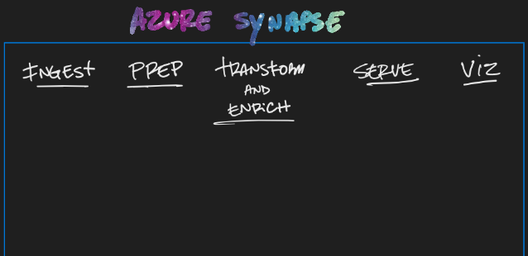

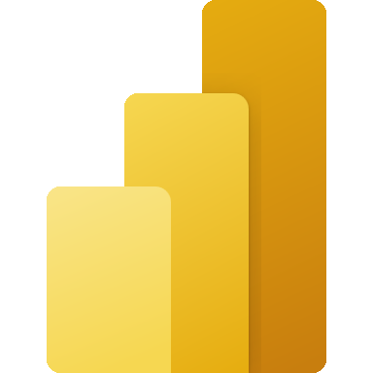
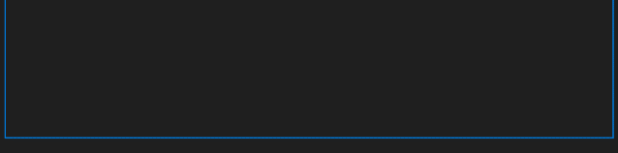


Notes:
Ref: https://techcommunity.microsoft.com/t5/azure-synapse-analytics/query-delta-lake-files-using-t-sql-language-in-azure-synapse/ba-p/2388398

Slide 4
Demo
# | pipeline | notebook | sqlscript
1 | Delta-AutoDemo | 2 & 3
2 | Delta-FromScratch | Delta-FromScratch | ctas
3 | Delta-Changes | Delta-Changes | MergeLatest
4 | Delta-ReadLog | Delta-ReadLog | MergeLatest
5 |  | Delta-Guide(s)
https://aka.ms/hiram > synapsedelta (repo)

Slide 5
Resources
Azure Synapse Analytics Blog
MERGE (Transact-SQL)
What is Delta Lake
Query Delta Lake format using serverless
Hitchikers Guide to Delta Lake at microsoft/Synapse

Slide 6
Thank you
Hiram Fleitas
aka.ms/hiram

