Slide 1

MASTER'S DISSERTATION · FEUP · 2026
Wine production forecasting with interpretable rules
What can climate explain — and what can it reliably predict?
Hugo Filipe Queiróz Nogueira
Supervisors: João Mendes Moreira · Mário Campos Cunha
01
Notes:
Timing: about 35 seconds.
Open with the practical question: can we forecast Portuguese wine production in a way that is useful before harvest and still understandable to domain experts? Emphasise that this is a Master's dissertation at FEUP, and that the central tension is not only accuracy. Wine-sector stakeholders also need explanations they can inspect, challenge, and relate to agronomic mechanisms.
Set the promise of the talk: first I show why this forecasting task is difficult, then how I designed a rule-based evaluation around CarenR, and finally what the results say about prediction, interpretation, and future work.

Slide 2
CONTEXT
The business question is a decision question
Who uses the answer
Can regional climate and vine development data improve the annual production forecast — early enough to change a decision?
Producers and cooperatives Regulatory bodies Supply-chain planners
Decisions affected
A useful model must add accuracy and preserve trust.
Harvest planning Storage and capacity Risk assessment
Prediction alone is insufficient when the mechanism cannot be explained or challenged.
02
Notes:
Timing: about 45 seconds.
Start from the operational context. Regional wine production matters for cooperatives, supply planning, policy, and market expectations, but it is affected by many drivers at once: climate, management, planted area, regulation, and long-term structural change.
The important point is that a model that gives only a number is not enough. If the forecast is wrong, or if the region is changing structurally, stakeholders need to know whether the model found a plausible climate signal or only followed historical drift.
Transition: this leads to the research gap - forecasting has to be interpretable and auditable, not only predictive.

Slide 3
RESEARCH PROBLEM
The problem is not only forecasting, but auditable forecasting
THE GAP
WHAT A RULE LOOKS LIKE
Modern ML can predict wine yield, but decision-makers need readable rules they can challenge with domain knowledge.
IF harvest soil water is moderate
AND post-maturity wet days are low
THEN production is +192 mhl
NO PRIOR WORK COMBINES ALL FIVE PROPERTIES
WHY INTERPRETABILITY MATTERS
Interpretable
Long-term
Predictive
Wine region
Readable by agronomists without ML expertise
Each rule carries support and a p-value
Can be challenged and domain-validated
Useful for diagnosis even when forecasting fails
Modern ML
no
partial
yes
Subgroup discovery
yes
no
no
This thesis
yes
yes
yes
03
Notes:
Timing: about 1 minute.
Use this slide to state the thesis problem clearly. Modern machine learning methods can be good predictors, but they usually do not produce rules that an agronomist can read directly. On the other side, classical statistical approaches are interpretable, but may not capture local non-linear climate conditions.
CarenR is positioned in the middle: it searches for rule-defined subgroups where the production distribution differs meaningfully from the baseline. The value is that every rule has conditions, support, and a statistical test.
Point to the rule example: this is the kind of output the thesis aims for - not just "wetness matters", but a concrete combination of phenological windows and thresholds.

Slide 4
PROBLEM
Why this is hard: the climate signal is real, but diluted
The target combines climate, physiology, human decisions and structural change in one annual regional number.
01
02
03
04
Biology spans years
Aggregation hides variation
Structure changes over time
The sample is small
Yield potential is partly set in the previous season, before the harvest year begins.
Thousands of vineyards differ in soil, altitude, practices and local weather.
Policy, planted area, producers and market conditions shift the production baseline.
Only 80–89 annual observations must support 59 engineered features.
04
Notes:
Timing: about 45 seconds.
This slide explains why the target is difficult. Climate does not act in isolation. The production series includes biological carry-over, annual variability, industry structure, policy changes, and region-specific histories.
Stress that this makes the signal-to-noise problem severe. Even if temperature, rainfall, soil water, or LAI genuinely affect yield, their effect can be hidden by stronger structural movements in production.
The key message is: a weak forecasting result does not automatically mean no climate signal exists. It may mean that the climate signal is being diluted or confounded by the production series itself.

Slide 5
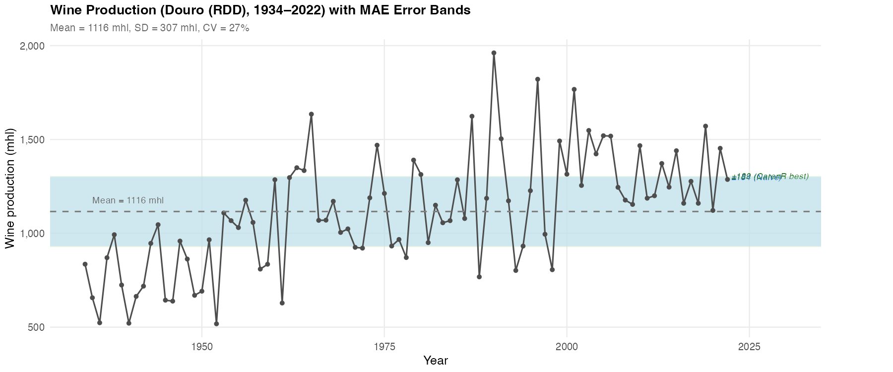
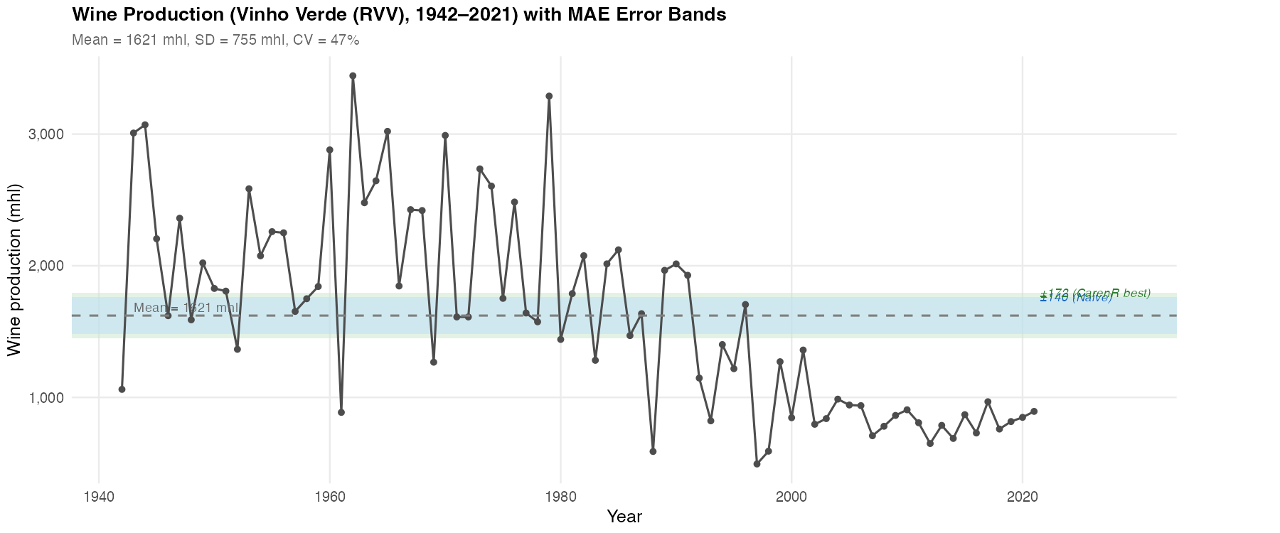
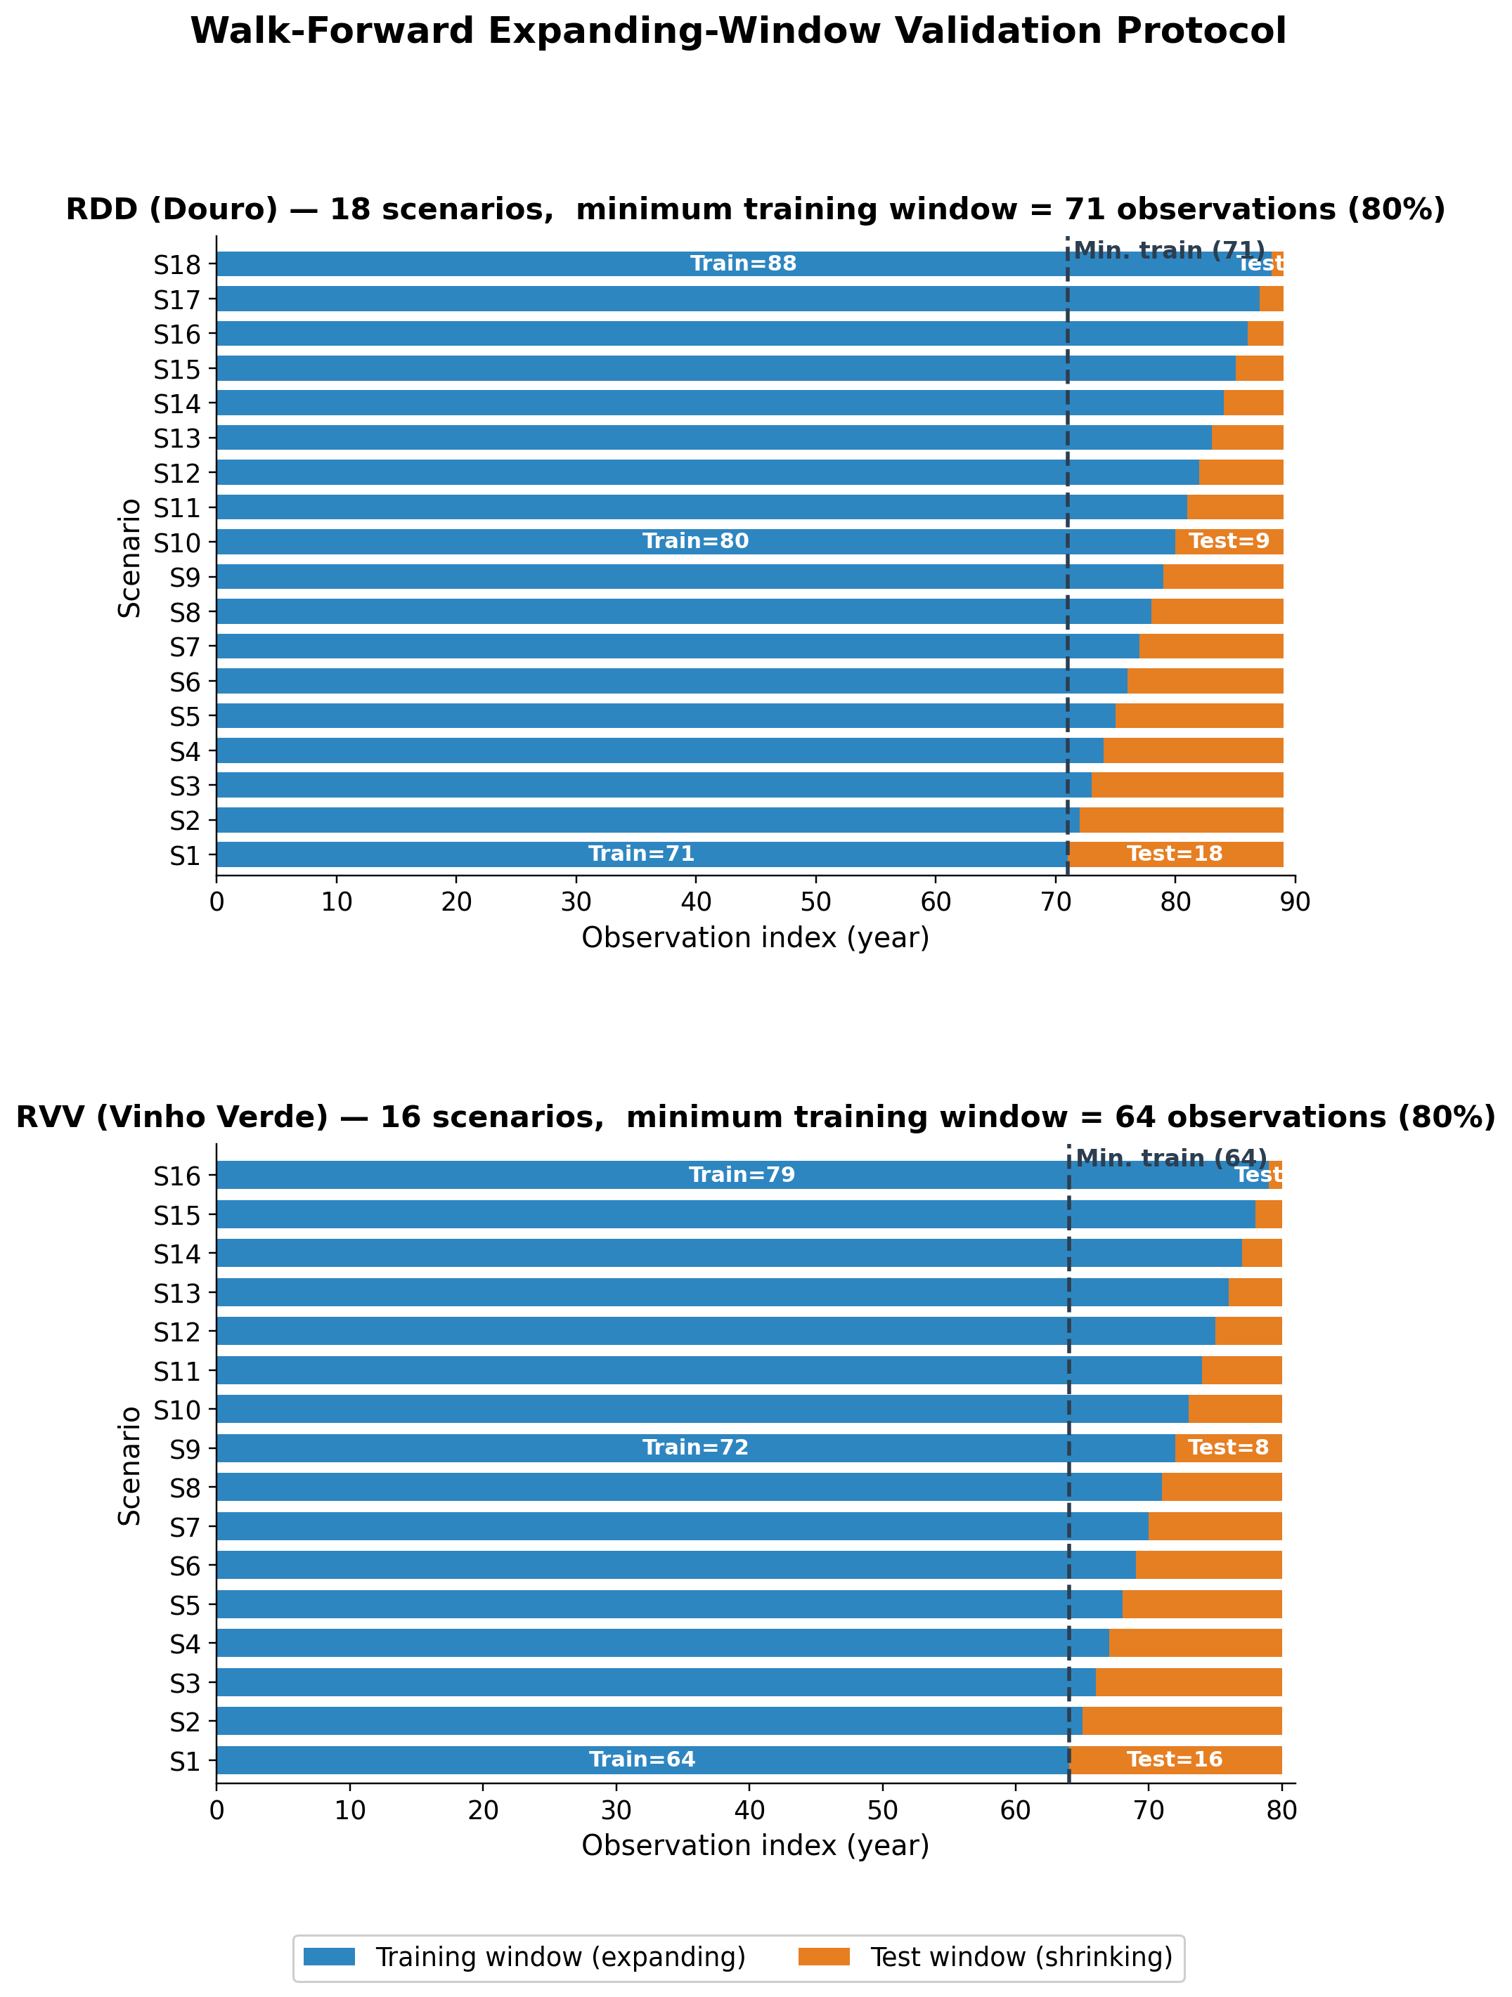
NATURAL EXPERIMENT
The same pipeline meets two different histories
DOURO · 89 years
VINHO VERDE · 80 years
Gradual +80% structural rise; CV 27%
Sharp structural decline; CV 47%
05
Notes:
Use this slide to frame the natural experiment. The modelling pipeline is the same, but the historical series are structurally different. Douro has a long, gradual production rise with lower relative variability; Vinho Verde has a sharper structural decline and higher variability. This contrast is why a method may find interpretable rules but still struggle as a forecasting system: the data-generating history is not stationary in the same way across regions.

Slide 6
GRAPEVINE CYCLE
Current production begins in the previous growing season
YEAR y0 · POTENTIAL
YEAR y1 · REALISATION
Primordia formation
Bud break
Veraison to harvest
CARRY- OVER
Reserve building
Flowering & fruit set
Temperature and light set the upper bound on bunch number.
Current-year temperature, rain, canopy and soil water determine fruit set and berry development.
Prior water and thermal stress shape carbohydrate reserves.
06
Notes:
Timing: about 50 seconds.
Use this as a bridge from domain knowledge to machine learning. The vine response is seasonal and delayed. Conditions around flowering, maturation, harvest, and even the previous year can affect the current harvest.
Mention the carry-over mechanism: climate in one season may influence bud formation or canopy development that only affects production later. This is why the features are not generic annual averages.
The modelling implication is that every climate variable is anchored to phenological periods. That makes the rules more interpretable because a condition refers to an agronomically meaningful window.

Slide 7
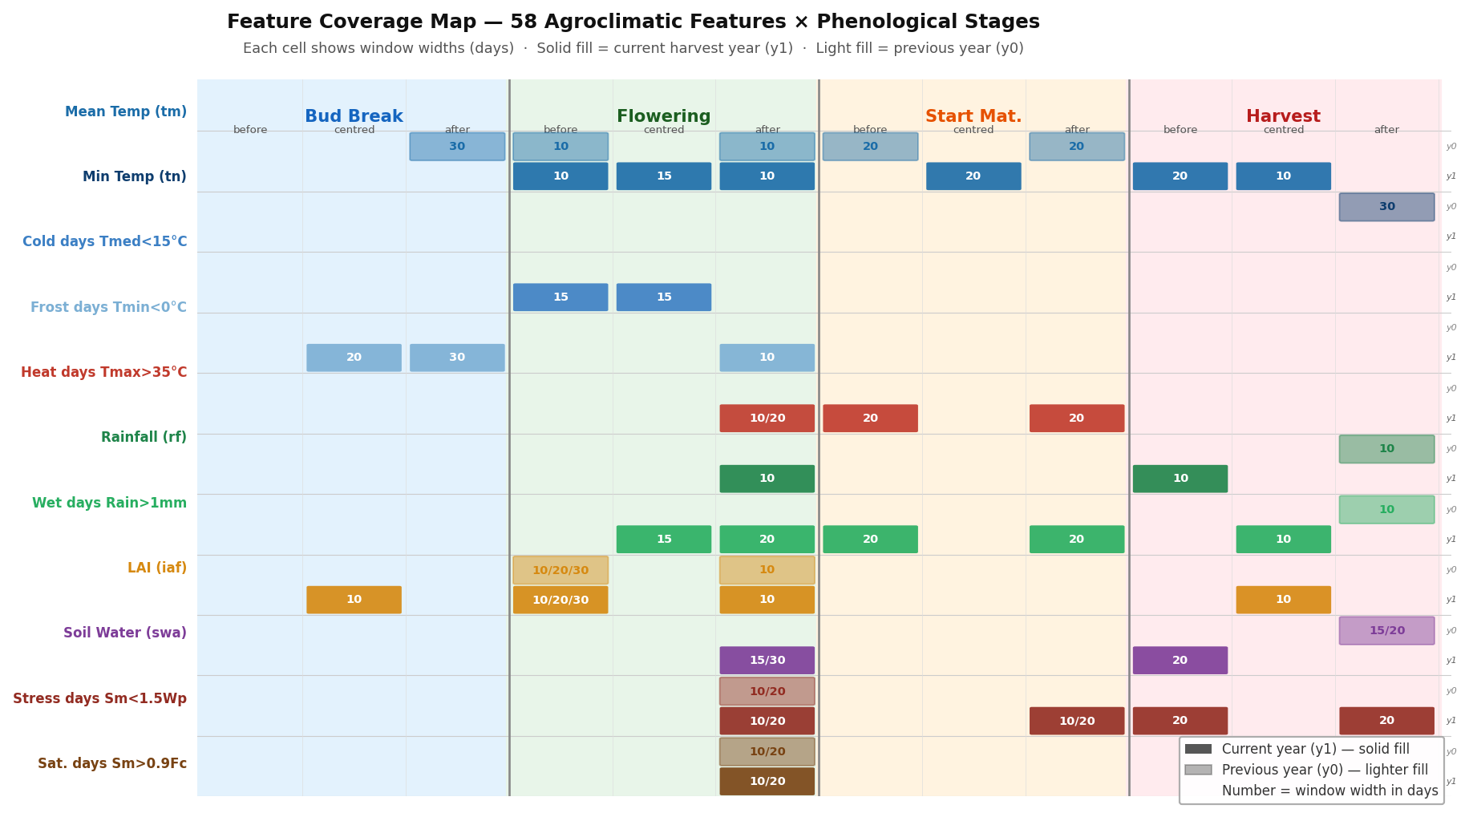
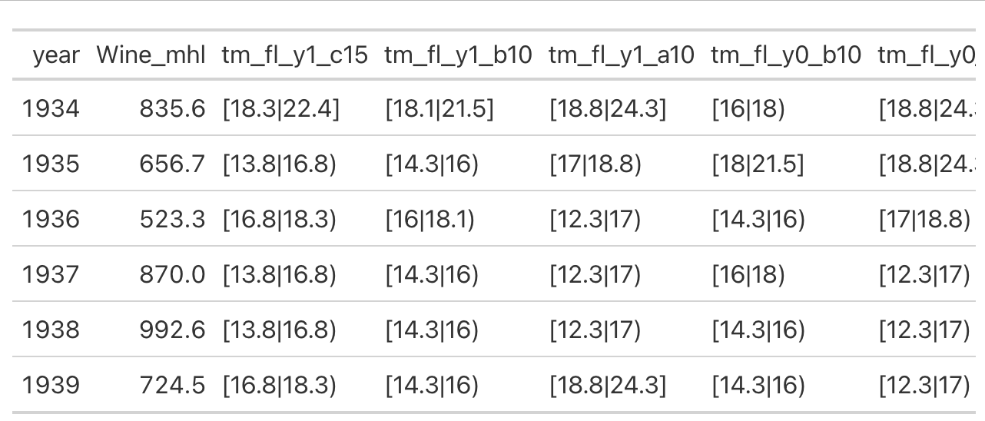
FEATURE ENGINEERING
Features follow the biology, not the calendar
32,842 / 29,902 daily records
-> 59 annual predictors
-> 4 phenological anchors
-> current + previous year
Notes:
This slide explains why the features are agronomically anchored rather than arbitrary calendar windows. The important point is not the exact count of daily records; it is the transformation from raw daily weather and vineyard state data into annual predictors aligned with phenological stages and current/previous-year biological memory.

Slide 8
POSITIONING
The research gap sits between explanation and prediction
Modern machine learning
Rule-based discovery
Handles nonlinear interactions Often strong predictive accuracy Sometimes decision logic remains opaque
Produces explicit IF–THEN rules Auditable support and significance Predictive value is unproven here
Can we have both?
No prior work systematically evaluated distributional subgroup discovery in walk-forward wine production forecasting.
08
Notes:
The thesis is deliberately not a contest against every black-box model. It targets the missing combination: continuous target, long non-stationary data, interpretable rules and rigorous predictive validation.

Slide 9
RESEARCH DESIGN
Two goals separate historical insight from future utility
GOAL 1
GOAL 2
GOAL 1
GOAL 2
DISCOVER
VALIDATE
Discover
Validate
Which agroclimatic conditions distinguish
above- and below-trend production
years?
Can rule-based models beat the
historical median in genuine future
periods?
Which agroclimatic conditions distinguish above- and below-trend production years?
Can rule-based models beat the historical median in genuine future periods?
RQ1 · Can CarenR's KS-test-based distributional rule induction extract statistically validated, non-trivial patterns from non-stationary agricultural time series?
RQ2 · Are the discovered rules genuine within-era climate signal, or are they era-membership artefacts introduced by imperfect linear detrending?
RQ3 · Can rule-based models (CarenR, RIPPER, M5Rules) outperform a Naive Median baseline in walk-forward prediction of detrended production residuals?
RQ4 · What structural conditions (era composition, detrend quality, signal strength) determine when rule-based prediction succeeds or fails?
Discovery
Prediction
RQ1 · dominant variables RQ2 · genuine signal or era confound?
RQ3 · out-of-sample improvement RQ4 · conditions for success or failure
Validation
Diagnosis
RQ1 ✓ Achieved · RQ2 ✓ Validated by LOESS · RQ3 ✗ Not achieved in aggregate · RQ4 ✓ Explained by Two-Decision Framework
08
Notes:
Use this slide to separate the thesis into two standards of evidence. Goal 1 asks whether the algorithms can discover meaningful historical structure. Goal 2 asks whether that structure reduces error in future walk-forward periods. The same data and rule family are used, but the evidential bar is different.

Slide 10
STUDY DESIGN
A controlled comparison isolates the role of data structure
2
SAME
DIFFERENT
regions
Feature engineering Detrending logic Rule learners Evaluation metric
Climate regime Structural trajectory Noise level Era composition
89 + 80
annual observations
THE CONTRAST TURNS TWO CASE STUDIES INTO A NATURAL EXPERIMENT.
10
Notes:
The scientific value comes from holding the pipeline constant. Divergent outcomes can then be interpreted in relation to structural history, signal availability and noise rather than arbitrary modelling choices.

Slide 11
ALGORITHMS
CarenR is the primary lens among five model families
PRIMARY METHOD
COMPARATORS
CarenR
RIPPER
Rule learner + prediction comparator
Distributional rules + prediction variants
1
Discretise
Climate features become equal-frequency bins.
M5Rules
Rule learner + prediction comparator
2
Search
Level-wise search (Apriori-style) combines feature-bin conditions.
Decision Tree
Prediction-only non-rule ML comparator
3
Compare
KS test: subgroup residuals vs global residuals.
4
Retain
Keep significant rules with sufficient support.
Naive baselines
Prediction-only references
OUTPUT · IF climate conditions → shifted production-residual distribution
Roles: CarenR links rules + prediction; RIPPER/M5Rules cross-check rules; Decision Tree and naïve baselines test prediction only.
Notes:
Timing: about 1 minute.
Introduce the model family, then focus on CarenR. CarenR is the primary method and links the two parts of the thesis: it discovers interpretable distributional rules and its variants are also tested in prediction.
Make the role distinction explicit. RIPPER and M5Rules are rule learners, so they are useful for cross-checking whether the same feature families appear outside CarenR; they are also included as prediction comparators. The Decision Tree is prediction-only and non-rule-based. The naive median, last-value, and moving-average baselines are prediction-only references.
The key defence point is that the algorithms are not all doing the same job. Some support interpretability, some support forecasting comparison, and CarenR connects both.

Slide 12
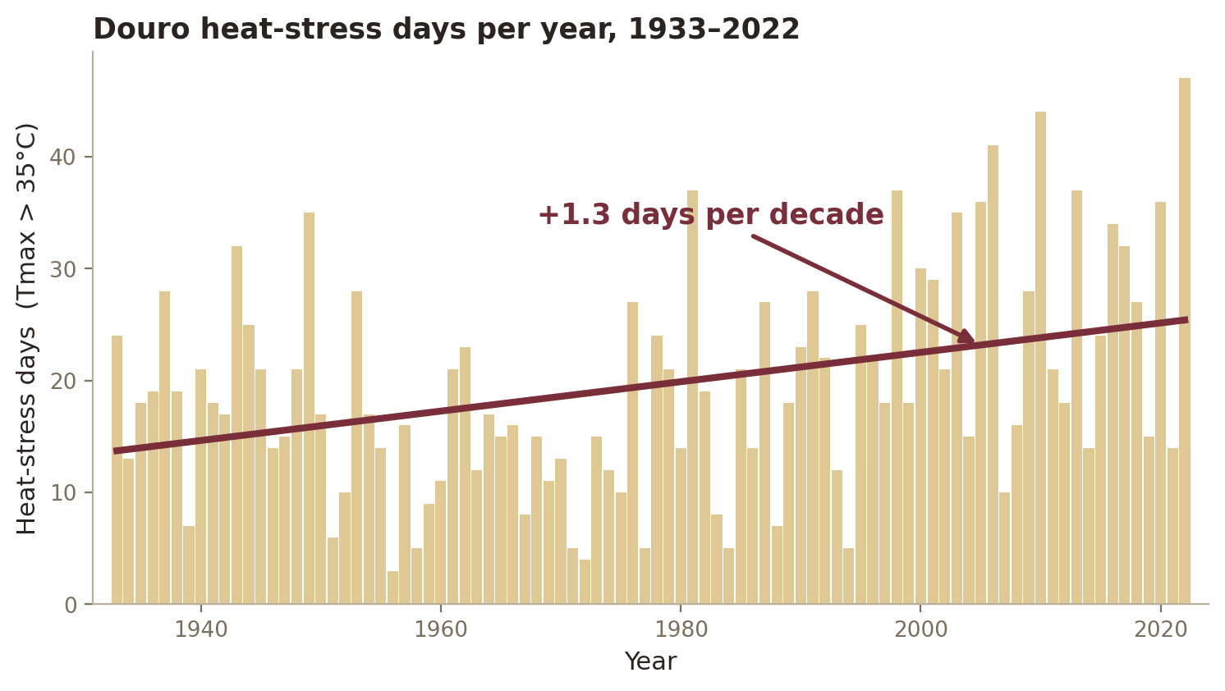
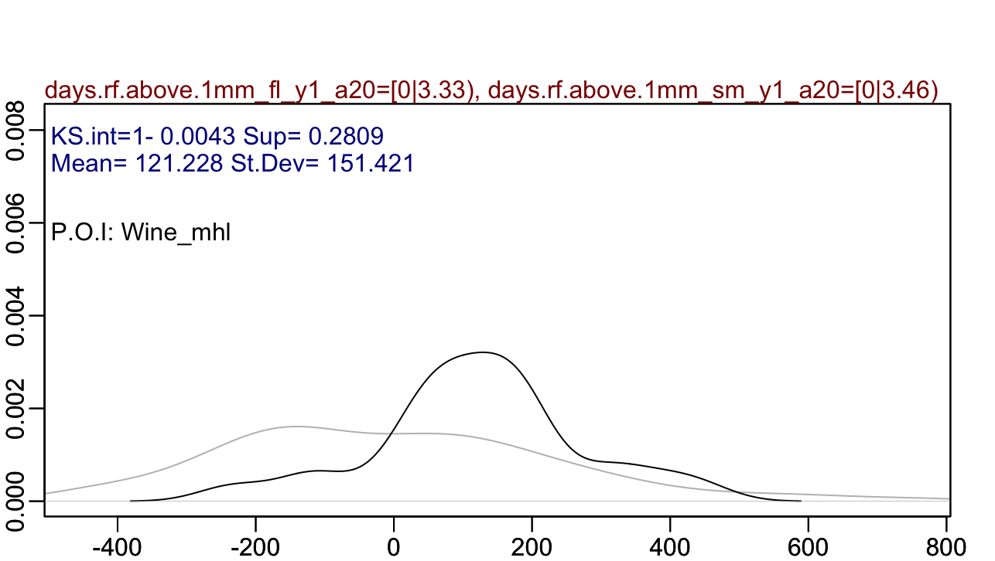
Goal 1 finds statistically exceptional subgroups
CarenR asks a distributional question
DO YEARS MATCHING THESE CLIMATE CONDITIONS HAVE A PRODUCTION-RESIDUAL DISTRIBUTION THAT DIFFERS FROM ALL YEARS?
A RULE YOU CAN AUDIT
IF dry post-flowering AND moderate harvest soil water
THEN +121 mhl above trend
support 28% · p = 0.004
Notes:
Timing: about 1 minute.
Explain CarenR conceptually rather than technically. It starts with discretised feature intervals, combines them into readable rule conditions, and asks whether observations inside the rule have a different production-residual distribution from all observations.
Use the distribution plot: the black curve represents all years, and the burgundy curve represents the years matching a rule. CarenR is not only checking a mean difference; the Kolmogorov-Smirnov statistic asks whether the whole residual distribution shifts, including the tails.
The small rule card is what makes the result auditable. A domain expert can challenge the conditions, check the support, and inspect the p-value. That is the interpretability advantage over a black-box forecast explanation.
Use this slide to prepare the audience for the next one: the rules are not final policy prescriptions. They are evidence about which climate windows repeatedly separate high or low production years.

Slide 13
RESULTS · DISCOVERY
Goal 1 succeeded: compact rules reveal regional drivers
DOURO
VINHO VERDE
48
20
rules
rules
Harvest soil water appears in 54% of rules.
The LAI family features in 4 / 20 rules.
Dry post-flowering conditions and bounded heat repeatedly associate with above-trend production.
Canopy development, heat stress and harvest soil water dominate the regional rule set.
The same variable can have a different direction across regions — interpretation must remain context-specific.
14
Notes:
Lead with rule counts and then the dominant variables. Avoid implying causality. These are statistically validated associations with agronomic coherence, not controlled experiments.

Slide 14
RESULTS · RULES
The strongest CarenR rules point to water and canopy structure
DOURO · top 5 CarenR rules
VINHO VERDE · top 5 CarenR rules
4 of 5 are above-trend: dry flowering and bounded heat define good years.
4 of 5 are below-trend: cool, moist conditions dominate the Atlantic region.
1
Dry flowering + dry maturity
+121 mhl
1
Moist harvest + no heat stress
-338 mhl
28.1% support · p=0.0043
21.2% support · p=0.0198
2
High LAI + wet flowering
-131 mhl
2
Cool flowering + prior soil saturation
-268 mhl
20.2% support · p=0.0084
21.2% support · p=0.0216
3
Dry + moderate heat after flowering
+113 mhl
3
Moist post-flowering + low heat
-365 mhl
25.8% support · p=0.0089
27.5% support · p=0.0294
4
Harvest water + carry-over dryness
+192 mhl
4
Warm prior budburst + mild flowering
+311 mhl
21.3% support · p=0.0095
25.0% support · p=0.0298
5
Dry flowering + bounded heat
+115 mhl
5
Cool post-flowering + wet carry-over
-292 mhl
24.7% support · p=0.0110
23.8% support · p=0.0299
Cross-algorithm finding
Across methods: harvest soil water and LAI/canopy survive.
12
CarenR, RIPPER and M5Rules all select them, so the signal is not tied to one optimization criterion.
Notes:
Timing: about 1 minute 20 seconds.
This is the main rule-finding slide. Start with Douro. The strongest Douro rules point to water availability and wet days around post-flowering, maturation, and harvest. The positive rules suggest that moderate soil water and limited wet-day stress can be associated with production above trend.
Then contrast Vinho Verde. The rules are larger in absolute deviation, but they also mix soil water, LAI, and heat-day conditions in a region with a much stronger structural break.
The takeaway is not that one listed rule should be operationalised immediately. The scientific finding is that water-related variables and canopy/LAI-related variables keep appearing as meaningful explanatory families.

Slide 15
RESULTS · RULES
RESULTS · RULES
The strongest CarenR rules point to water and canopy structure
Exact CarenR rule output: intervals behind the top rules
Each row is an IF condition set; Delta is the median production residual shift from trend.
DOURO (RDD) · top 5 exact rules
VINHO VERDE (RVV) · top 5 exact rules
Mostly above-trend: dry post-flowering / maturity windows and bounded heat.
Mostly below-trend: cool, moist conditions dominate the Atlantic region.
4 of 5 are above-trend: dry flowering and bounded heat define good years.
4 of 5 are below-trend: cool, moist conditions dominate the Atlantic region.
#
Exact conditions from CarenR output
support / p
Delta
#
Exact conditions from CarenR output
support / p
Delta
DOURO · top 5 CarenR rules
VINHO VERDE · top 5 CarenR rules
Dry flowering + dry maturity
Soil water pre-Harvest [61-97 mm]
AND Heat days pre-Maturity [0-1.9 d]
AND Heat days post-Maturity [0-2.4 d]
AND Heat days post-Flowering [0-1.1 d]
+121 mhl
Moist harvest + no heat stress
-338 mhl
1
Wet days post-Flowering [0-3.3 d]
AND Wet days post-Maturity [0-3.5 d]
28.1%
~25 yr
p=0.0043
1
21.2%
~17 yr
p=0.0198
1
+121
1
-338
28.1% support · p=0.0043
21.2% support · p=0.0198
2
High LAI + wet flowering
-131 mhl
2
Cool flowering + prior soil saturation
-268 mhl
2
LAI at Flowering [0.74-0.88 m2/m2]
AND Soil water post-Flowering [390-404 mm]
20.2%
~18 yr
p=0.0084
Temp at Flowering [13.8-17.1 deg C]
AND Temp post-Flowering [12.6-17.5 deg C]
AND Wet-soil days post-Flowering prev.yr [17.5-20 d]
21.2%
~17 yr
p=0.0216
20.2% support · p=0.0084
-131
2
21.2% support · p=0.0216
-268
3
Dry + moderate heat after flowering
+113 mhl
3
Moist post-flowering + low heat
-365 mhl
25.8% support · p=0.0089
27.5% support · p=0.0294
3
Wet days post-Flowering [0-3.3 d]
AND Wet days post-Maturity [0-3.5 d]
AND Heat days post-Flowering [0-0.6 d]
25.8%
~23 yr
p=0.0089
3
Soil water post-Flowering [143-234 mm]
AND Heat days post-Maturity [0-2.4 d]
27.5%
~22 yr
p=0.0294
4
Harvest water + carry-over dryness
+192 mhl
+113
4
Warm prior budburst + mild flowering
+311 mhl
-365
21.3% support · p=0.0095
25.0% support · p=0.0298
5
Dry flowering + bounded heat
+115 mhl
5
Cool post-flowering + wet carry-over
-292 mhl
4
Soil water pre-Harvest [74-101 mm]
AND Wet days post-Harvest prev.yr [0-2.3 d]
AND Wet days post-Maturity [0-3.5 d]
21.3%
~19 yr
p=0.0095
+192
4
Temp post-Budburst prev.yr [11.2-13.5 deg C]
AND Cold days at Flowering [0-3.4 d]
AND Heat days post-Flowering [0-1.1 d]
25.0%
~20 yr
p=0.0298
+311
24.7% support · p=0.0110
23.8% support · p=0.0299
5
Wet days post-Flowering [0-3.3 d]
AND Heat days pre-Maturity [0-3.7 d]
24.7%
~22 yr
p=0.0110
+115
5
Temp post-Flowering [12.6-17.5 deg C]
AND Heat days post-Maturity [0-2.4 d]
AND Wet-soil days post-Flowering prev.yr [17.5-20 d]
23.8%
~19 yr
p=0.0299
-292
Cross-algorithm finding
Across methods: harvest soil water and LAI/canopy survive.
CarenR, RIPPER and M5Rules all select them, so the signal is not tied to one optimisation criterion.
How to read it
Support is the share of historical years matching the rule; p is the KS-test evidence that the subgroup distribution differs from the full distribution.
12
Source: Thesis, Tables 4.1-4.2 and 4.9
Notes:
This is the audit version of the rules slide. Say that the previous simplified labels are now expanded into the actual thresholds reported by CarenR. Emphasise that a rule is not a black-box importance score: it names the subgroup, reports how many years match it, gives the KS p-value, and states the observed shift in residual production. For Douro, the strongest rules mostly say that dry post-flowering and post-maturity windows, sometimes with moderate pre-harvest soil water, correspond to above-trend production. Rule 2 is the exception: high LAI at flowering together with high post-flowering soil water is below trend, which is agronomically plausible because canopy vigour and moisture can shift growth away from fruit. For Vinho Verde, four of five rules are below trend and capture cool, moist, low-heat patterns; the single above-trend rule is the warm previous-year budburst / mild flowering case. Close by reminding the committee that these intervals are what make the findings auditable: an agronomist can challenge the thresholds directly.

Slide 16
CROSS-ALGORITHM VALIDATION
Three optimization criteria recover the same feature families
Feature
CarenR
RIPPER
M5Rules
Confidence
Harvest soil water
54% of RDD rules
25% of RVV rules
RVV Rule 3
-2.3/mm RDD
-8.1/mm RVV
HIGH
universal
LAI / canopy family
All 20 RVV rules
minor RDD signal
RVV Rules 1-2
-2064/unit RVV
variable selected
HIGH
universal
Previous-year
summer temperature
RVV carry-over
RVV Rule 3
+17.2/C RVV
HIGH
RVV focus
Wet days
after flowering
21% of RDD rules
not selected
not selected
MODERATE
CarenR-specific
Agreement across three independent methods is the strongest evidence that the rule features reflect real data structure, not algorithmic noise.
Notes:
Timing: about 1 minute.
Use this slide to strengthen the credibility of the rule findings. CarenR, RIPPER, and M5Rules optimise different objectives, so agreement across them is meaningful.
The two strongest cross-algorithm findings are harvest soil water and the LAI family. Soil water appears in CarenR rules, RIPPER rules, and M5Rules coefficients. LAI is especially strong in Vinho Verde, appearing across all 20 CarenR rules and in the other rule learners.
Be careful with wording: this is not causal proof. It is convergent evidence that these feature families capture real structure in the data rather than only algorithm-specific noise.

Slide 17
RESULTS · VALIDATION
Goal 1 - Two checks confirm the discovered signal
01
02
AGGRESSIVE DETRENDING
INDEPENDENT ALGORITHMS
RDD signals persist after LOESS; in RVV, wet-days persist while LAI and soil water are era-linked.
RIPPER and M5Rules converge on harvest soil water, LAI and previous-year temperature.
→ The signal is real, but not equally stable across regions.
→ The signal is not CarenR-specific.
Discovery is credible — but credibility is not yet predictive utility.
Notes:
This slide answers RQ2 with nuance. LOESS confirms that the Douro signals, and the RVV wet-days signal, are not merely era labels. But RVV LAI and harvest soil-water collapse under LOESS, which is itself informative: some discovered structure is climate signal, and some is entangled with regional structural change. Cross-algorithm convergence gives a second robustness check because the three methods optimise different criteria.

Slide 18
METHOD · PREDICTION
Goal 2 recreates prediction-time information
Expanding-window validation
18 scenarios · Douro 16 scenarios · Vinho Verde
All preprocessing stays inside each training fold:
• detrending • discretisation • feature selection • rule induction
17 models · weighted MAE · lower is better
Notes:
Emphasise leakage prevention. Each scenario behaves like a real historical forecast: all thresholds, features and rules are learned only from the past. The primary comparator is the training median because it is the optimal constant forecast under MAE.

Slide 19
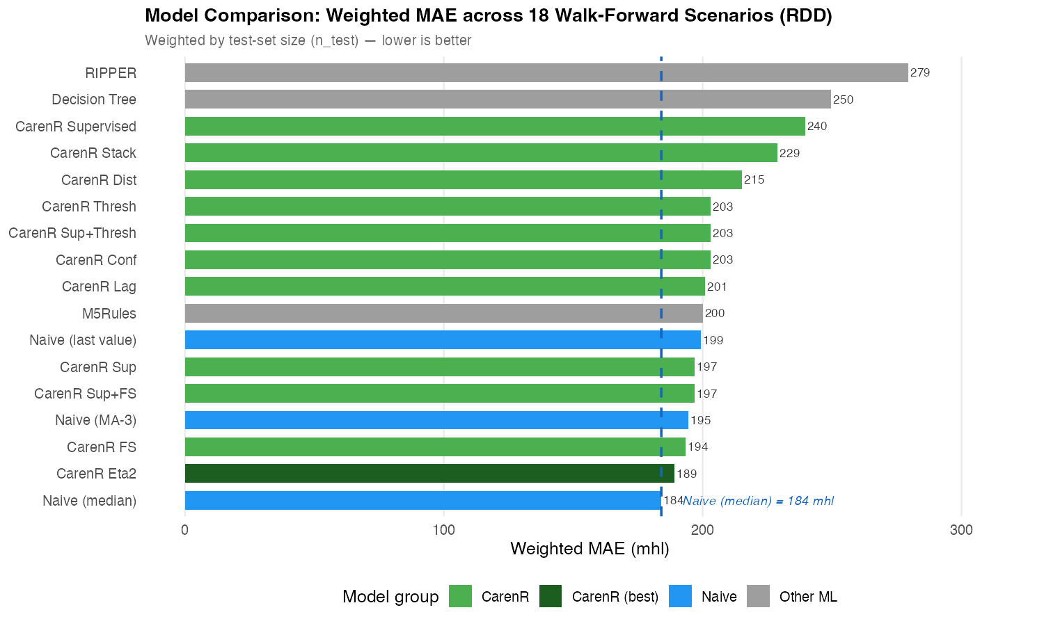
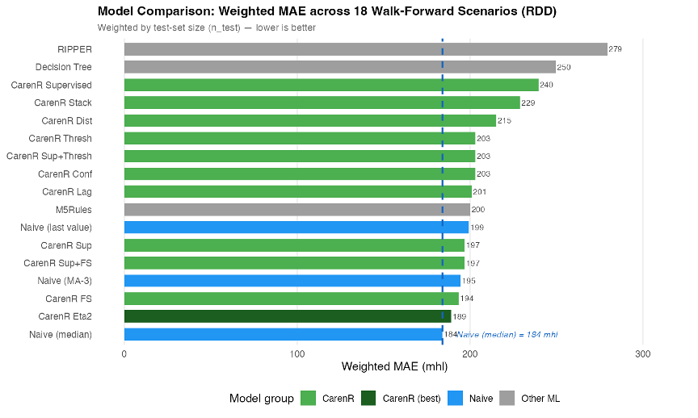
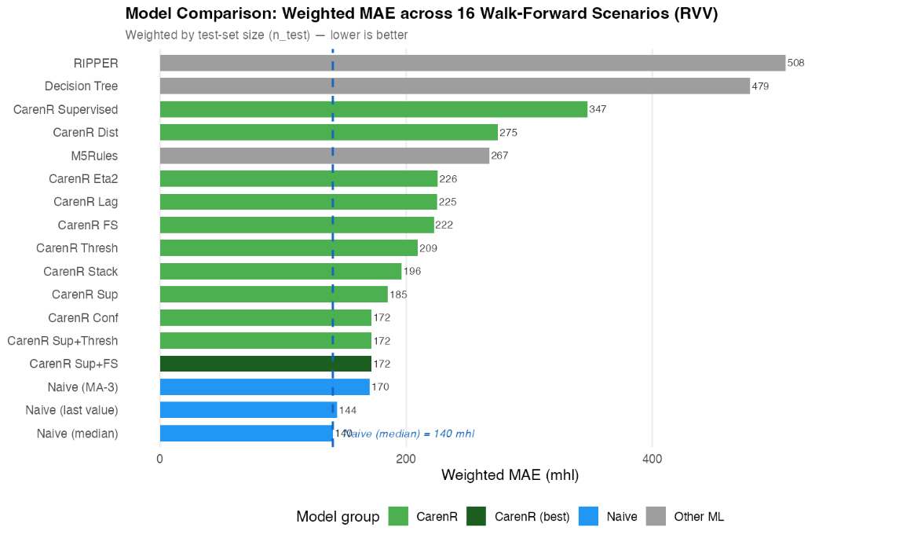
RESULTS · PREDICTION
No rule-based model beats the median overall
RDD · 189 vs 184 mhl
3% worse · p = 0.468
RVV · 172 vs 140 mhl
22% worse · p = 0.004*
*Among the 9 scenarios where RVV rules fired, they significantly harmed prediction.
Notes:
For Vinho Verde, the prediction result is negative. The RVV weighted-MAE chart shows that even the best CarenR variants do not beat the historical median baseline overall. This supports the main interpretation: rule discovery can reveal structure, but under strong structural decline the extracted rules do not translate into reliable future forecasting.

Slide 20
RESULTS INTERPRETATION
A real association can still be too weak to forecast
Pattern discovery and forecasting answer different questions.
DISCOVERY
PREDICTION
IS THE SUBGROUP DISTRIBUTION DIFFERENT?
DOES THE RULE REDUCE FUTURE ERROR?
≠
With |r| ≈ 0.47, the association is detectable across 80–89 historical years.
Climate explains ≈22% of residual variance; ≈78% remains unobserved or noisy.
Notes:
Timing: about 50 seconds.
This slide separates two ideas that are easy to confuse. Discovery is about identifying patterns that are plausible, interpretable, and statistically supported. Prediction is about using those patterns to improve future numerical forecasts.
The thesis result is that discovery works better than prediction in this setting. That is not a failure of the thesis; it is the main diagnosis. Rule-based machine learning can explain parts of the climate-production relationship, but the current data are not sufficient for reliable regional forecasting.
Transition: the next slide formalises this diagnosis as a two-decision framework.

Slide 21
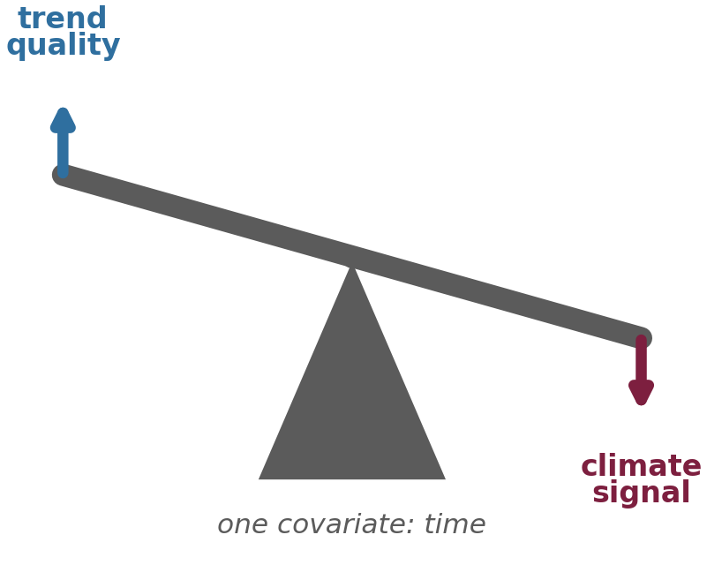
TWO-DECISION FRAMEWORK
Better detrending can remove the signal rules need
DECISION 1
DECISION 2
MODEL THE STRUCTURAL TREND
EXTRACT CLIMATE SIGNAL
TENSION
A better trend leaves smaller test residuals and lowers the naive error floor.
Stable rules need residual structure that is large enough to detect and exploit.
RVV LOESS: baseline improves 140 → 90 mhl, but rule induction falls to zero.
Time alone cannot cleanly separate industry structure from climate.
Notes:
Timing: about 1 minute.
Explain the two-decision framework as one of the methodological contributions. Decision 1 is how to remove or represent the long-term production trend. Decision 2 is how to extract the climate signal from the remaining residuals.
These decisions interact. If detrending is too weak, the climate model may learn structural drift. If detrending is too aggressive, it can remove genuine climate-related variation.
This framework is transferable beyond wine production. Any agri-climatic forecasting problem with long histories and structural non-stationarity faces the same separation problem: what is trend, and what is climate signal?

Slide 22
CONTRIBUTIONS
Five scientific contributions clarify why rules work and fail
Two-decision framework separates trend quality from residual climate-signal extraction.
1
2 · Walk-forward evaluation
3 · Sensitivity analysis
4 · Era-composition analysis
17 models, 18/16 scenarios, and all preprocessing inside each fold.
Eleven CarenR variants show the best feature-selection strategy is problem-specific.
Identifies when rule-based prediction may become viable, as hypothesis for future work.
5 · CROSS-ALGORITHM VALIDATION: RIPPER AND M5RULES INDEPENDENTLY CONFIRM CARENR FEATURE FAMILIES.
Notes:
Timing: about 1 minute.
Present the contributions as what remains scientifically useful after the negative forecasting result. First, the thesis provides a two-decision decomposition for separating trend modelling from climate signal extraction. Second, it runs a systematic walk-forward evaluation with preprocessing inside each fold.
Third, it compares sensitivity variants rather than assuming one configuration is universal. Fourth, it introduces era-composition analysis to diagnose when apparent skill depends on the historical composition of the training and test periods.
Finally, it uses cross-algorithm validation to show that key feature families - especially soil water and LAI - are not only CarenR artefacts.

Slide 23
LIMITATIONS & FUTURE WORK
The next evidence should separate climate from structure
LIMITATIONS
FUTURE WORK
Time is the only detrending covariate, so structural change and climate remain partly mixed.
The walk-forward test has only 18 and 16 scenarios; the 5/5 RDD era-balanced result is exploratory.
Regional annual aggregates hide sub-regional weather and vineyard heterogeneity.
Add structural covariates: planted area, quotas and certified producers.
Pre-register and prospectively validate the era-balanced hypothesis.
Test other regional time series with weaker trends and use higher-resolution climate data.
THE THESIS DOES NOT CLAIM AN OPERATIONAL FORECAST YET;
IT SHOWS WHEN INTERPRETABLE RULES ARE MEANINGFUL, WHEN THEY FAIL, AND WHAT EVIDENCE IS NEEDED NEXT.
Notes:
Timing: about 1 minute.
Be transparent here. The main limitations are the use of time as the main detrending covariate, small test sets, and annual regional aggregates. These choices make the problem realistic but also underpowered.
For future work, mention structural detrending with explicit covariates such as planted area, quotas, or the number of certified producers. Also mention prospective validation of the 29 percent era-balanced threshold, and testing additional regional time series, especially regions with weaker trend or less structural break.
The closing point is that the thesis identifies what must be fixed before these rules can become reliable operational forecasts.

Slide 24
NEXT STEPS
The next step is to model structure explicitly
01
02
03
04
Rules can explain the past. Structure determines whether they predict the future.
STRUCTURAL COVARIATES
PROSPECTIVE VALIDATION
HIGHER SPATIAL RESOLUTION
OTHER REGIONS
& LOWER TREND
Planted area, quotas, producers
Pre-register the era-balanced hypothesis
Capture within-region heterogeneity
Test time series with weaker structural trends
Notes:
Timing: about 45 seconds.
Close by returning to the opening question. The answer is deliberately nuanced: rule-based machine learning cannot yet forecast Portuguese wine production reliably from these annual regional series. But it can explain parts of the climate-production relationship in a way that is auditable and agronomically meaningful.
Summarise the next steps as a research path: add structural covariates, test more regions and less trend-dominated series, validate prospectively, and use subgroup methods such as EMM to understand when climate-production relationships are exceptional.
End with the main defence sentence: understanding why forecasting fails is itself a scientific contribution, because it tells us what evidence is missing for reliable deployment.

Slide 25
Thank you
Questions
Notes:
Timing: about 45 seconds.
Close by returning to the opening question. The answer is deliberately nuanced: rule-based machine learning cannot yet forecast Portuguese wine production reliably from these annual regional series. But it can explain parts of the climate-production relationship in a way that is auditable and agronomically meaningful.
Summarise the next steps as a research path: add structural covariates, test more regions and less trend-dominated series, validate prospectively, and use subgroup methods such as EMM to understand when climate-production relationships are exceptional.
End with the main defence sentence: understanding why forecasting fails is itself a scientific contribution, because it tells us what evidence is missing for reliable deployment.

Slide 26
IDEA 1 · HARD
A real signal, drowning in noise
Douro (RDD) — gradual rise +80%
r ≈ 0.47
Climate–production correlation — the signal is real
~22%
of residual variance is explainable by climate
Vinho Verde (RVV) — structural fall −65%
CV ≈ 47%
Year-to-year swing — the noise the signal hides in
Thousands of growers, heterogeneous vineyards, local weather no regional index captures.
2
Notes:
Wine is Europe's most climate-sensitive crop and forecasting matters for producers, cooperatives and regulators. But the signal is real yet explains barely a fifth of the variance, in a series that swings ~47% year to year. Two regions, opposite structural directions. Easy wins don't exist here.

Slide 27
IDEA 1 · HARD
The inputs move too — the climate is non-stationary
Over the same 90 years, the Douro's climate itself has shifted. It is not only production that trends — so do the predictors.
+44%
Heat days >35°C: 17.6 → 25.4 per year
−56%
Frost days <0°C: 18.8 → 8.3 per year
−7%
Annual rainfall: 859 → 798 mm
Both the target and its drivers drift together — exactly the co-trending trap the LOESS stress-test is built to catch.
early vs late 30-year means, RDD
3
Notes:
Here is an insight the committee should sit with. It is not only production that is non-stationary — the climate itself has moved over the same 90 years. In the Douro, heat-stress days above 35°C are up about 44%, frost days have more than halved, rainfall is down ~7%. Note the link to the rules: the heat-stress-day family that CarenR selects is itself trending. This matters because when both production AND a climate feature trend over the record, the feature can look predictive just by co-trending with the era — which is precisely the trap the LOESS stress-test on the next block is designed to expose.

Slide 28
IDEA 1 · HARD
Two regions, opposite histories, one method
DOURO · RDD
VINHO VERDE · RVV
PERIOD
1934–2022 · 89 years
1942–2021 · 80 years
PRODUCTION TREND
+80% — gradual rise
−65% — structural collapse
STRUCTURAL DRIVER
Port benefício quota (buffered)
EU accession 1986 (grubbing-up, exodus)
NON-STATIONARITY
Moderate, smooth
Severe, non-linear break
Same algorithm on both → a natural experiment that separates climate signal from structural artefact.
6
Notes:
I chose two regions with opposite histories. The Douro rose gradually, partly buffered by the Port quota. Vinho Verde collapsed after EU accession — subsidies, training-system change, rural exodus. Same algorithm on both; that contrast is what lets me separate climate from structure later.

Slide 29

IDEA 2 · AUDITABLE
One honest pipeline
1
Detrend in-fold
Remove structural trend separately inside every training fold — no leakage.
2
Discover rules
CarenR runs on the residuals; rules kept only if p ≤ 0.10 and support ≥ 20%.
3
Walk-forward test
Expanding window: 18 scenarios (RDD) / 16 (RVV), weighted MAE on real scale.
Remember one idea →
Error = Trend (Decision 1) + Climate signal (Decision 2)
Walk-forward validation
7
Notes:
One pipeline. Expanding-window walk-forward, every preprocessing step inside the fold — no leakage. And remember one idea: error is a trend part and a signal part. I'll come back to why those two fight.

Slide 30
REGIONAL CONTRAST
The two regions diverge because structure contaminates the signal
Dimension
Douro
Vinho Verde
Implication
Production trend
+80% gradual rise
-65% structural decline
RVV era confound is stronger
Climate signal after LOESS
Retained in top RDD features
LAI and soil-water collapse
Some RVV rules are era-linked
Prediction outcome
3% gap; competitive in era-balanced window
22% gap; 0/16 wins
Structure removes the climate advantage
Interpretation
Rules can diagnose historical regimes
Rules fire in the wrong era context
Forecasting needs structural covariates
The same algorithm produces different outcomes because the production histories are genuinely different.
Source: Thesis, Sections 5.2-5.5 and 6.2-6.3
17
Notes:
Timing: about 1 minute.
This is the confounding explanation. Douro and Vinho Verde do not fail in the same way. Douro retains more climate signal after LOESS checks and shows a small performance gap. Vinho Verde shows stronger structural contamination: the production series contains a major regime shift, and the extracted rules become more era-driven.
The important sentence to say aloud is the one at the bottom: the same algorithm produces qualitatively different outcomes depending on the structural history of the production series.
This justifies the limitations and future work: better structural covariates and additional regions are not optional improvements; they are required for stronger forecasting claims.

Slide 31
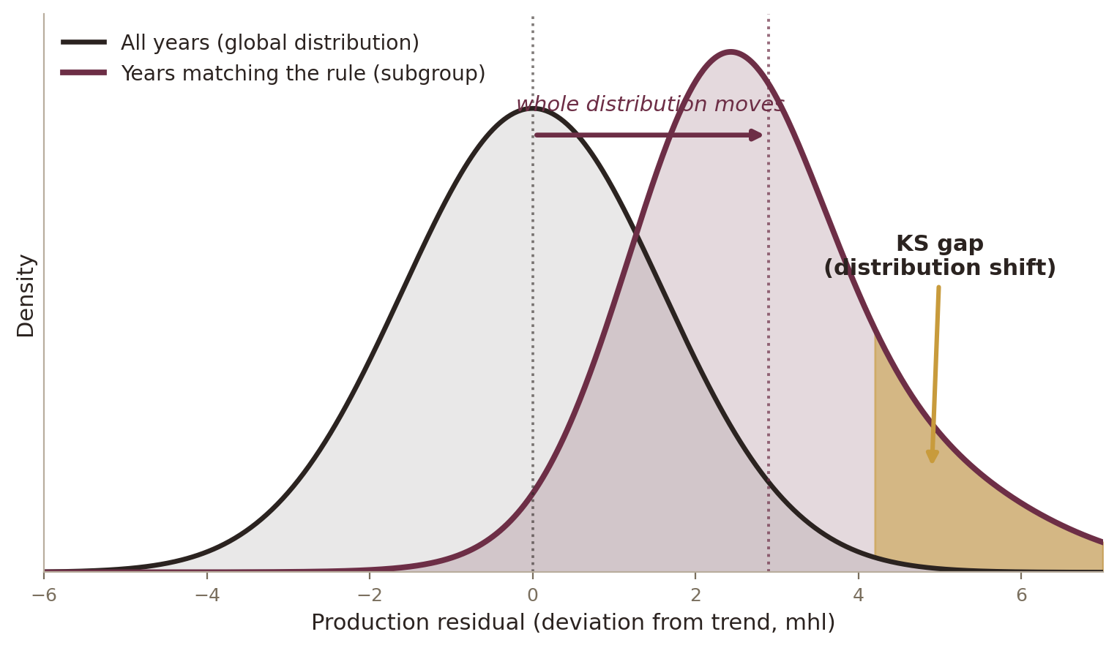
IDEA 2 · AUDITABLE
Why CarenR: rules you can question
CarenR asks: under which conditions does the whole distribution — tails included — shift? Tested by a Kolmogorov–Smirnov statistic.
A RULE YOU CAN AUDIT
IF dry post-flowering AND moderate harvest soil water
THEN
+121 mhl above trend
support 28% · p = 0.004
Falsifiable — an agronomist can challenge it.
Carries its own support and p-value.
Black box + SHAP only approximates influence.
First such application to long regional wine records.
9
Notes:
A deep model forecasts and can't explain; SHAP approximates. Where the question is which conditions drive production, that's disqualifying. CarenR asks a distributional question — does a set of conditions shift the whole distribution, tails included — and every rule reports its own evidence. That auditability is the point.

Slide 32
DATA & EXPERIMENTAL DESIGN
The comparison is controlled: same pipeline, different regional histories
Characteristic
Douro
Vinho Verde
59 agroclimatic features per region
Period
1934-2022
1942-2021
Temperature · rainfall · soil water · LAI
Heat/frost days · prior-year lags
Anchored on vine phenological dates
Observations
89 years
80 years
Climate
Semi-arid
Atlantic
CarenR
RIPPER
M5Rules
Production trend
+80% rise
-65% decline
Distributional
rules · KS
Classification
rules · FOIL
Piecewise
rules · MSE
Walk-forward
18 scenarios
16 scenarios
Walk-forward expanding-window validation
All preprocessing stays inside each training fold: detrending, discretisation, feature selection and rule induction.
09
Notes:
Timing: about 1 minute.
This is the methodological control slide. The same pipeline is applied to Douro and Vinho Verde: same feature construction, same families of algorithms, and walk-forward expanding-window validation.
Point to the time-series validation. Each scenario trains on the past and tests on the future. All preprocessing is inside the training fold, so the test years remain genuinely unseen.
The baseline is deliberately simple: the training median residual. This is a hard but fair benchmark because annual wine production has strong noise, and a constant robust predictor is difficult to beat with small test sets.

Slide 33
IDEA 3 · REAL
What the rules actually say
The same variable — soil water 20 days before harvest — flips sign between regions:
DOURO
VINHO VERDE
+192 mhl
−338 mhl
SAME
VARIABLE
Moderate deficit = berry concentration.
A dry-climate sweet spot → above trend.
Same range = cool, wet, low-quality years.
An Atlantic-climate penalty → below trend.
CarenR detects opposite signals in each region without ever seeing them together — it resolves a sign reversal correctly. That is real domain structure, not overfitting.
11
Notes:
The rules read like agronomy. Harvest soil water dominates both regions — but in opposite directions, and CarenR detects that without seeing the regions together. A mild deficit concentrates berries in the dry Douro; the same range signals cool-wet, low-quality years in Vinho Verde. The method resolves a sign reversal correctly — that's real structure.

Slide 34
IDEA 4 · LAWFUL FAILURE
The honest result: nobody beats the median
DOURO
+3%
189 vs 184 mhl
Wilcoxon p = 0.468 (n.s.)
VINHO VERDE
+22%
172 vs 140 mhl
rules actively harm, p = 0.004
Predict the historical median → you beat every rule-based model.
Douro — weighted MAE, all 17 models (lower is better)
13
Notes:
I won't dress this up. Predict the historical median and you beat every rule model — 3% in the Douro, 22% in Vinho Verde, where firing rules makes it worse. Real rules, no forecast edge. That's the puzzle. I refused to stop at 'it didn't work,' because the failure has a shape.

Slide 35
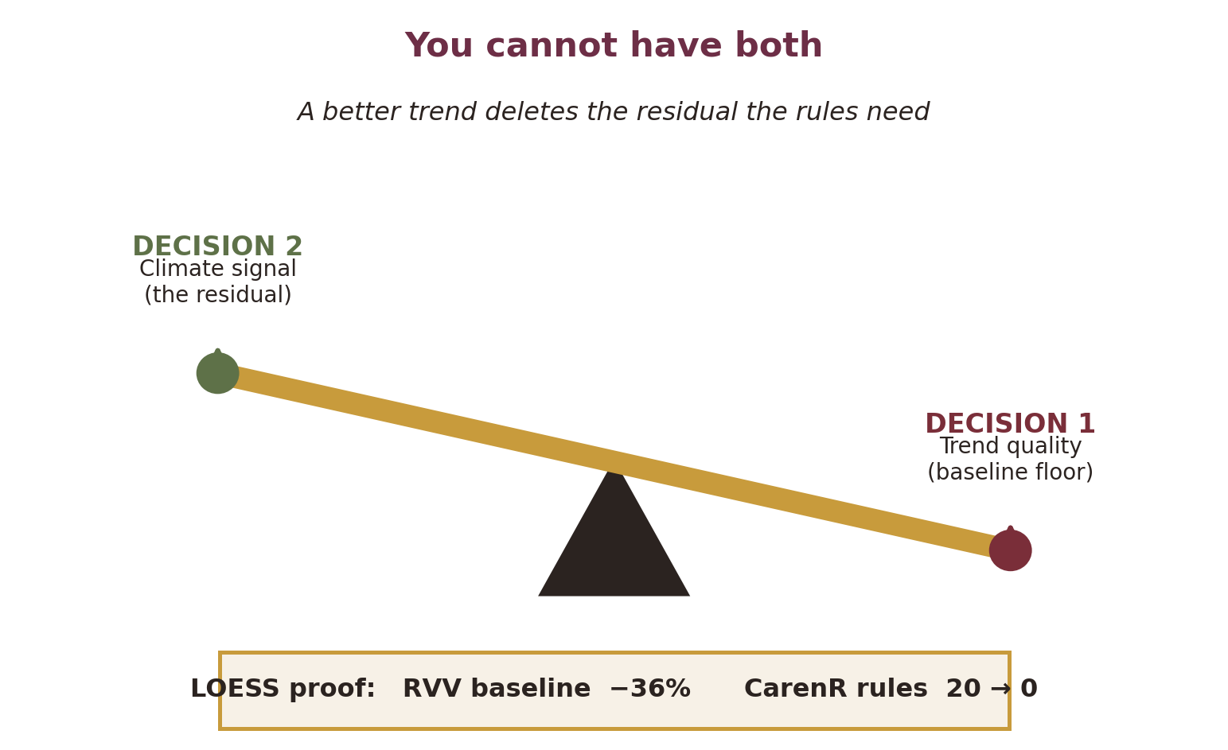
IDEA 4 · LAWFUL FAILURE
Discovery ≠ Prediction — and I can prove why
The failure is lawful, not random.
Discovery needs only that an association exists. Prediction needs it to beat the median. The same time-only detrend cannot serve both.
THE ERA MIRROR
Douro: once era-balanced (~29% modern), CarenR wins 5 / 5 scenarios.
Vinho Verde: more modern data makes it steadily worse — the mirror opposite.
14
Notes:
Here's the finding and why it's not a dead end. Make the trend more flexible with LOESS and Vinho Verde's baseline improves 36% — but every rule disappears, because the flexible trend ate the variation the rules were built from. Decision 1 and Decision 2 fight over the same variance because both are parameterized by time alone. Discovery and prediction ask different things of the same signal. That's the two-decision trade-off — the name I'd like you to remember. The p=0.031 era-balanced win is post-hoc; I lead with the pattern, which is robust. [If challenged on the negative result, cite Prof. Cunha's own review: in this field 'the statistics are usually very good, but the predictions are not useful for production' — my two-decision framework explains exactly why.]

Slide 36
Research Questions
Four questions spanning discovery, validation, and prediction
RQ1
Can CarenR's KS-test-based distributional rule induction extract statistically validated, non-trivial patterns from non-stationary agricultural time series?
Goal 1 – Discovery
RQ2
Are the discovered rules genuine within-era climate signal, or are they era-membership artefacts introduced by imperfect linear detrending?
Goal 1 – Validation
RQ3
Can rule-based models (CarenR, RIPPER, M5Rules) outperform a Naive Median baseline in walk-forward prediction of detrended production residuals?
Goal 2 – Prediction
RQ4
What structural conditions (era composition, detrend quality, signal strength) determine when rule-based prediction succeeds or fails?
Goal 2 – Diagnosis
RQ1 ✓ Achieved · RQ2 ✓ Validated by LOESS · RQ3 ✗ Not achieved in aggregate · RQ4 ✓ Explained by Two-Decision Framework
Notes:
Four research questions: RQ1 — answered YES: CarenR discovers 48 + 20 validated rules. RQ2 — answered YES for RDD (features genuine), partially NO for RVV (dominant features are era artefacts). RQ3 — answered NO: no model beats Naive_Median in aggregate. RQ4 — answered by the two-decision decomposition framework. The core story: success at discovery, failure at prediction, and a principled explanation of why. Negative results, when properly diagnosed, are scientifically valuable. Estimated time: ~1 min.

Slide 37
Dataset & Feature Engineering
Two contrasting natural experiments — same pipeline
Douro (RDD)
Vinho Verde (RVV)
Period: 1934–2022
Period: 1942–2021
Observations: 89 observations
Observations: 80 observations
Mean production: 1,116 mhl
Mean production: 1,621 mhl
Structural trend: ▲ Upward trend
Structural trend: ▼ Sharp decline since 1960s
Era break: Regime break ~1990
Era break: Regime break ~1986 (EU)
Feature Engineering Pipeline (59 annual features per region)
Daily meteorological data
(Temp, Rainfall, SWA, LAI, ETo)
~30,000 records/region
Phenological anchors
(Budburst, Flowering,
Veraison, Harvest)
Feature engineering
59 annual features:
variable × stage × window × year
Naming convention:
swa_hv_y1_b20
= harvest soil water, 20d before
→
→
→
Notes:
Two regions as a natural comparative experiment. RDD: upward production trend due to quality-focused market growth. RVV: sharp decline driven by EU accession and industry restructuring — the dominant structural story there. 59 features constructed from 30,000+ daily records by combining meteorological variables with phenological stage dates. The naming convention encodes everything: variable, stage, year offset, window width. I won't dwell on the agronomy — this is just the input scaffolding for the ML problem. Estimated time: ~1 min.

Slide 38
Methodological Framework
Complete pipeline from raw data to scientific findings
1
2
3
4
5
6
Raw Data
(Daily meteo,
phenology,
production)
Linear
Detrending
(OLS within-fold,
residuals rt)
Feature
Engineering
(59 annual
features)
Feature
Selection
(η², Pearson,
support filter)
Rule Induction
(CarenR KS-test,
RIPPER,
M5Rules)
Walk-Forward
Evaluation
(18/16 expanding
window scenarios)
→
→
→
→
→
GOAL 1: Rule Discovery
GOAL 2: Predictive Validation
CarenR on FULL historical dataset
48 rules (Douro) · 20 rules (Vinho Verde)
Validated by LOESS detrending
Cross-algorithm comparison (RIPPER, M5Rules)
17 models · Expanding-window walk-forward
Weighted MAE vs Naive_Median baseline
Statistical tests: Wilcoxon, Binomial
Detrend sensitivity (LOESS)
⚑ All preprocessing (detrending, discretisation, feature selection) performed within each training fold — no data leakage
Notes:
Complete pipeline. Six stages, two output goals. Key design choices: 1. Linear detrending within-fold: trend parameters estimated only on training data. 2. Feature selection inside the walk-forward loop: no leakage. 3. Goal 1 uses all 89/80 years for discovery; Goal 2 uses expanding training windows. The anti-leakage design is essential. Every modelling decision is made from training data only. Estimated time: ~1 min 15 sec.

Slide 39
Why Rule-Based Machine Learning?
Interpretability is the objective — CarenR's distributional approach is uniquely appropriate
CarenR
RIPPER
M5Rules
Primary Algorithm
Classification Baseline
Regression Baseline
Question:
When does the shape of the
production distribution shift?
Question:
Which production class
does this year belong to?
Question:
What exact production level
does a year have?
Criterion:
Kolmogorov–Smirnov test
(distributional shift)
Criterion:
FOIL gain
(information gain)
Criterion:
Standard deviation reduction
(MSE minimisation)
Output:
IF conditions THEN
distribution shifts ±X mhl
Output:
IF conditions THEN
class = Low / Med / High
Output:
IF conditions THEN
production = linear model
Note:
Non-parametric; no normality assumption. Detects distributional anomalies. No target pre-discretisation needed.
Note:
Well-established interpretable classifier. Requires tertile-discretised target. Always assigns a class.
Note:
Piecewise linear regression. Collapses to global model on small datasets (n<89). CV R² = 0.004 to −0.07.
Notes:
Why not a random forest or neural network? Because interpretability IS the research objective — we want to know WHICH climate conditions explain production anomalies. CarenR is uniquely appropriate: 1. KS test is non-parametric — no normality assumption for agricultural data. 2. Tests distributional shift, not just mean shift: a variable is informative if it changes the SHAPE of the production distribution. 3. No target pre-discretisation needed — unlike RIPPER. 4. Explicit fallback mechanism: when no rules fire, predicts training median (= Naive_Median). CarenR can only add noise if it fires a wrong rule; it never forces an uninformed prediction. Estimated time: ~1 min 15 sec.

Slide 40
Goal 1 – Rule Discovery Results
CarenR successfully extracts statistically validated patterns from 89 and 80 years of data
Douro (RDD)
Vinho Verde (RVV)
Rules discovered:
48 rules found
Rules discovered:
20 rules found
Dominant features:
Harvest soil water: 54% of rules
Post-flowering wet days: 2nd most frequent
Dominant features:
Heat-stress days at maturity: ~50% of rules
LAI at harvest: present in all 20 rules
Directionality:
31/48 rules → ABOVE-trend (65%)
Directionality:
16/20 rules → BELOW-trend (80%)
IF wet days post-Flowering ∈ [0–3.3d]
AND wet days post-Maturity ∈ [0–3.5d]
THEN production +121 mhl (support 28%, p=0.0043)
IF soil water post-Flowering ∈ [143–234 mm]
AND heat days post-Maturity ∈ [0–2.4d]
THEN production −365 mhl (support 28%, p=0.029)
Statistical strength:
Best rule: p = 0.0043, support 28%
Statistical strength:
Largest shift: −365 mhl (support 28%, p=0.029)
Cross-Algorithm Convergence:
RIPPER and M5Rules independently select the same feature families through entirely different criteria (FOIL gain vs. MSE reduction vs. KS test). Three algorithms, one answer. This is strong evidence of genuine data structure, not algorithm-specific artefacts.
Notes:
Goal 1 is achieved. Douro: 48 rules, dominated by harvest-period soil water (54% of rules) and post-flowering wet days. 65% point above trend. The strongest rule covers 28% of years (p=0.0043) — a recurrent, statistically robust pattern. Vinho Verde: 20 rules, dominated by heat-stress days (~50%) and LAI at harvest (present in all 20 rules). 80% below trend — reflecting the structural decline. Directional inversion: harvest soil water is dominant in BOTH regions but predicts ABOVE trend in RDD and BELOW trend in RVV. This is a method validation point: CarenR correctly detects opposite signals in different climatic contexts. Cross-algorithm convergence: RIPPER and M5Rules agree on the same feature families. Three different optimisation criteria, same answer. Estimated time: ~1 min 30 sec.

Slide 41
Validation of Rule Discovery
LOESS stress test distinguishes genuine climate signal from era-membership artefacts
The Era Confound Problem
If a climate feature co-trends with production over decades (warming + declining production), it appears informative under linear detrending even with no true within-era relationship. Rules become era-membership proxies, not genuine climate signals.
LOESS Detrending Stress Test (span = 0.40 — removes era-level structural shifts, preserves inter-annual variation)
Feature | Region | Linear |r| | LOESS |r| | % Retained | Verdict
swa_hv_y1_b20 (harvest soil water) | RDD | 0.33 | 0.41 | 125% | ✓ Genuine within-era signal — increases under LOESS
wet days post-Flowering | RDD | 0.28 | 0.28 | 103% | ✓ Fully preserved after era removal
tm_hv_y1_c10 (harvest temperature) | RDD | 0.17 | 0.17 | 105% | ✓ Preserved; within-era signal
wet days post-Flowering | RVV | 0.34 | 0.32 | 94% | ✓ Genuine; robust to era removal
iaf_hv_y1_c10 (LAI at harvest) | RVV | 0.22 | 0.03 | 16% | ✗ Era-driven; collapses under LOESS
swa_hv_y1_b20 (harvest soil water) | RVV | 0.17 | 0.03 | 15% | ✗ Era-driven; collapses under LOESS
RDD result: features retain 90–125% correlation → genuine within-era signal confirmed. RVV dominant features collapse to 15–16% → primarily era artefacts. This explains Goal 2 failure in RVV.
Notes:
LOESS detrending stress test: if a feature's correlation survives aggressive era-trend removal, it carries genuine within-era signal. If it collapses, it was era co-variation. RDD: harvest soil water and wet days INCREASE their correlation under LOESS (125% and 103% retention). These features are genuinely within-era. RVV: LAI at harvest and harvest soil water collapse to 15-16% retention. The dominant RVV features were largely era artefacts — they looked informative only because they co-trended with the structural production decline. This is the key finding that explains why Goal 1 succeeds in discovery (patterns exist) but Goal 2 fails in prediction for RVV (the patterns don't generalise because they're era-specific). Estimated time: ~1 min 30 sec.

Slide 42
Goal 2 – Predictive Validation
Walk-forward results: 17 models, weighted MAE on original scale (mhl)
Douro (RDD) — 18 scenarios
Vinho Verde (RVV) — 16 scenarios
Statistical Tests
RDD overall — Wilcoxon, 18 scenarios
W=68, p=0.468 — Not significant (confirmatory)
RDD era-balanced scen. 10–14 — Binomial, n=5
5/5 wins, p=0.031 — POST-HOC EXPLORATORY ⚑ requires prospective validation
RVV rule-firing scen. — Wilcoxon, 9 scenarios
W=0, p=0.004 — Rules actively harmful (confirmatory negative)
Notes:
Goal 2 is not achieved in aggregate. RDD: Naive_Median wins at 184 mhl. Best CarenR is 189 mhl — 3% gap. Wilcoxon p=0.468, not significant. RIPPER and DT are much worse (250-279 mhl). RVV: Naive_Median wins at 140 mhl. Best CarenR is 172 mhl — 22% gap. When CarenR fires rules in RVV, they are significantly harmful (p=0.004). Era-balanced finding in RDD: in scenarios 10-14 (training data at 29-32% post-1990), CarenR wins 5/5 consecutive scenarios by 17-32 mhl. BUT this was identified post-hoc — it's an exploratory hypothesis, not a confirmed finding. Binomial p=0.031 but n=5. Benchmark context: RIPPER and DT are 35-175% worse than Naive_Median — the limitation is not the interpretability constraint but the signal strength. Estimated time: ~1 min 30 sec.

Slide 43
Why Did Prediction Fail?
A principled, multi-level explanation — diagnosing failure modes is itself a scientific contribution
1
Signal Too Weak for Prediction
2
Decision 1 / Decision 2 Structural Tension
Climate features explain ~22% of residual variance (|r|≈0.47, CV=47%). KS test needs only distributional shift to EXIST; prediction requires the shift to dominate over 78% unexplained noise. The association is real — it is just insufficient for reliable out-of-sample performance.
Better detrending (LOESS) improves Decision 1 for RVV: 140→90 mhl (−36%) but eliminates ALL CarenR rules. The demands of accurate trend extrapolation and sufficient structured residuals for rule induction are in fundamental conflict under a time-only detrending covariate.
3
Era Contamination of Training Folds
4
Missing Structural Covariates
Training dominated by pre-1990 data produces rules calibrated on a production regime that no longer exists in test years. RVV dominant features retain only 15–16% correlation after era-trend removal. Era-specific rules fire on test years from a different regime and add noise rather than signal.
Non-climate factors (planted area, EU quotas, certified producers) drive structural production changes not captured by time-only detrending. These are the missing piece for Decision 1. Incorporating structural covariates into the trend model is the primary recommended future direction.
This is NOT a failure of CarenR. It is a property of the problem. Precisely characterising the failure mode is the methodological contribution.
Notes:
Four interlocking failure modes: 1. Signal strength: real but insufficient. 22% explained variance is detectable by KS test but cannot overcome 78% noise in individual held-out years. 2. Structural tension: the Two-Decision framework shows these demands cannot be simultaneously satisfied. Not a tuning problem — a fundamental structural incompatibility. 3. Era contamination: rules learned on pre-1990 data don't generalise to post-1990 test years. This is formally confirmed by the LOESS validation. 4. Missing covariates: time alone cannot model the structural production trajectory. Planted area, EU policy, number of producers — these are the actual drivers of the trend. Without them, Decision 1 is fundamentally limited. Estimated time: ~1 min 30 sec.

Slide 44
Scientific Contributions
Methodological advances transferable beyond wine production
Two-Decision Decomposition Framework
Novel Framework
Separates prediction error into trend quality (Decision 1) and residual signal extraction (Decision 2). Transferable diagnostic tool for any agroclimatic forecasting problem with structural non-stationarity and climate signal co-existing.
Systematic 11-Variant CarenR Sensitivity Analysis
Algorithm Analysis
Structured evaluation shows optimal configuration is problem-specific: η² outperforms under strong signal (Douro); conservative Sup_FS outperforms when fallback-to-median dominates (Vinho Verde). Motivates structured variant evaluation over a priori configuration choice.
Era-Composition Analysis & Conditional Regime Discovery
Evaluation Design
Walk-forward evaluation reveals a conditional regime in RDD: CarenR consistently outperforms baseline when training reaches ≥29% modern-era representation (5/5 wins, post-hoc exploratory p=0.031). More actionable than binary success/failure.
Cross-Algorithm Feature Convergence Validation
Validation Method
RIPPER (FOIL gain) and M5Rules (MSE reduction) independently identify the same feature families as CarenR (KS test) across both regions. Three optimisation criteria, one answer — strong multi-angle evidence of genuine data structure.
LOESS Era-Signal Validation Protocol
Validation Protocol
LOESS detrending as a stress test quantifies what fraction of correlation is genuine within-era signal vs. era co-variation. RDD: 90–125% retention. RVV: 15–16% collapse. Reusable protocol for any non-stationary time series with distributional rule learning.
Notes:
Five methodological contributions — all transferable beyond wine: 1. Two-decision framework: any domain where structural non-stationarity meets climate/environmental signal can use this decomposition to diagnose failures. 2. Sensitivity analysis: the structured 11-variant comparison shows the optimal approach is domain-specific. The lesson is to conduct this evaluation rather than picking one configuration a priori. 3. Era-composition analysis: the finding that CarenR succeeds specifically when training data reaches 29% modern-era representation gives practitioners a concrete diagnostic criterion. 4. Cross-algorithm convergence: three independent algorithms agreeing on features is a strong validation — applicable to any feature importance analysis. 5. LOESS protocol: a reusable method for distinguishing real within-era signal from structural co-variation. Estimated time: ~1 min 30 sec.

Slide 45
Limitations & Future Work
Where the thesis stops — and the path forward
Current Limitations
Future Work
Time-only detrending: cannot separate structural changes (EU policy, planted area) from climate residuals — root cause of the era confound and Decision 1 limitations
Structural detrending [PRIORITY]: add non-climate covariates (planted area, quotas, certified producers) to separate structural shifts from climate residuals — directly resolves Decision 1/2 tension
Statistical power: only 18/16 walk-forward scenarios; post-hoc era finding n=5 is insufficient for confirmatory conclusions
Prospective validation: pre-register the era-composition hypothesis; test on new observations as they become available (2023+ data for RDD)
Post-hoc era-balanced result (binomial p=0.031, n=5): exploratory hypothesis, requires prospective validation before treating as robust
Extended datasets: more regions (Alentejo, Dão), longer series, or sub-regional data would increase statistical power and test generalisability
Single-region annual aggregates: no spatial analysis, no sub-regional variation, no within-season granularity
Ensemble or conformal approaches: quantify prediction uncertainty explicitly; conformal prediction would provide coverage guarantees on rare events
CarenR_Assoc not implemented: factor-level alignment issues in walk-forward context left as a natural extension
LOESS protocol generalisation: apply the era-signal validation protocol to other agricultural domains with structural non-stationarity
Notes:
Honest acknowledgement of limitations: 1. The primary limitation is structural: time-only detrending. This is the bottleneck for Decision 1 and the root cause of the era confound. It's not a bug in the analysis — it's an inherent property of what detrending with time can and cannot do. 2. Statistical power: 18/16 scenarios, decreasing test-set sizes in later scenarios. Not enough for high-power confirmatory tests. 3. The era-balanced finding is genuinely post-hoc. I need to be transparent about this with the jury. Priority future work: structural detrending. If we add planted area, EU quotas, and number of certified producers as explicit detrending covariates, we separate the structural production changes from climate residuals. This directly addresses Decision 1 and potentially resolves the fundamental tension. Estimated time: ~1 min.

Slide 46
Conclusions
GOAL 1 ✓ ACHIEVED
Rule Discovery Succeeds
CarenR extracts 48 (RDD) and 20 (RVV) statistically validated distributional rules. Feature frequency analysis converges on harvest-period soil water (Douro) and heat-stress days (Vinho Verde). LOESS validation confirms genuine within-era signal in RDD; exposes era artefacts in RVV. Cross-algorithm agreement with RIPPER and M5Rules confirms genuine data structure.
GOAL 2 ✗ NOT ACHIEVED
Prediction Fails in Aggregate — Structurally Explained
No rule-based model consistently beats Naive_Median. RDD best: 189 vs 184 mhl (Wilcoxon p=0.468, not significant). RVV: 172 vs 140 mhl; rules actively harmful when fired (p=0.004, confirmatory negative). Post-hoc exploratory finding: CarenR competitive when training ≥29% post-1990 (5/5 wins, p=0.031; requires prospective validation). Two-decision framework explains the failure structurally.
CORE INSIGHT
Explanation ≠ Prediction — and the Path Forward
The same features that explain historical production cannot reliably predict future years. The association is real (|r|≈0.47) but 78% of residual variance is unexplained noise. Distributional discovery needs only a shift to EXIST; prediction needs the shift to DOMINATE. The path forward: structural detrending with non-climate covariates resolves the Decision 1/2 tension.
Thank you. Questions? · The Two-Decision Framework, LOESS validation protocol, and era-composition analysis are transferable to any non-stationary agricultural time series.
Notes:
Closing summary: 1. Discovery works. CarenR is a valid and effective distributional subgroup discovery tool. The rules are real, validated, cross-confirmed. 2. Prediction does not work in aggregate. But we understand EXACTLY why — the Two-Decision framework gives a precise, testable structural explanation. 3. The core scientific insight: explanation and prediction require different things from the data. Genuine association ≠ predictive power. This is a general principle, not a limitation of CarenR specifically. 4. Path forward: structural detrending. This is the single change most likely to unlock reliable prediction. Total presentation time target: ~15 minutes.

Slide 47
The Research Problem
Why interpretable rules — not black-box models — matter here
The gap
What a rule looks like:
Modern ML (RF, LSTM) predicts wine yield well — but cannot explain it. Agronomists, cooperatives, and policy bodies need readable, auditable rules.
"IF soil water at harvest ∈ [74–101 mm]
AND wet days post-flowering ≤ 3.3 d
THEN production is +192 mhl above trend
(support 21%, p = 0.010)"
No prior work combines all five properties:
Research stream | Interpretable | Long-term | Predictive val.
Statistical regression | ✓ | ✓ | Limited
Modern ML (RF/LSTM) | ✗ | Partial | ✓
Subgroup discovery | ✓ | ✗ | ✗
This thesis (CarenR) | ✓ | ✓ | ✓
Why interpretability matters:
Readable by agronomists without ML knowledge
Each rule carries explicit support & p-value
Can be challenged and domain-validated
Directly actionable for harvest planning
No published work has applied interpretable distributional rule discovery to multi-decade regional wine production records (cf. Table 2.1).
2 / 12
Notes:
Slide 3 makes this precise. The gap is interpretability: even when production can be predicted, it can't be explained.
The example rule on the right is what CarenR produces. It tells you: in years where soil water at harvest was between 74 and 101 mm AND wet days after flowering were 3.3 or fewer, production was 192 mhl above trend — in 21% of years, with a KS p-value of 0.010.
An agronomist can read that, challenge it, and decide whether it matches their knowledge of vine physiology. No prior work has applied this kind of distributional rule induction to multi-decade regional production records.
The bottom line: no published work, as documented in our Table 2.1 literature review, combines interpretable rules, statistical validation, a distributional framing, multi-decade records, and regional granularity. This thesis is the first to do so.

Slide 48
Two Goals, Four Research Questions
✓ GOAL 1 — Rule Discovery
✗ GOAL 2 — Predictive Validation
Discover interpretable agroclimatic rules explaining above / below-trend production years in each region.
Evaluate whether discovered rules beat a naive baseline in rigorous walk-forward (expanding window) validation.
ACHIEVED ✓
NOT ACHIEVED in aggregate
48 rules (RDD) · 20 rules (RVV)
Conditional finding in Douro (exploratory)
Research Questions
RQ1
Which climate variables most consistently distinguish above/below-trend years?
RQ3
Do three independent algorithms converge on the same features?
RQ2
Are the identified variables genuine within-era signals or era-membership artefacts?
RQ4
Do discovered rules improve out-of-sample forecasts in walk-forward validation?
The most scientifically interesting finding was not that prediction failed — it was why it failed.
3 / 12
Notes:
The thesis has two goals.
Goal 1 — rule discovery — was achieved. CarenR found 48 rules for Douro and 20 for Vinho Verde, answering RQ1 and RQ2: which climate variables matter, and are they genuine signals or artefacts of era-level structural change?
Goal 2 — predictive validation — was not achieved in aggregate. Across all walk-forward scenarios, no model reliably beats the naive baseline. But — and this is the key point — there is a conditional finding in Douro that I'll explain in slides 11 and 12.
RQ3 asks whether three independent algorithms converge on the same features. They do, and that convergence is the strongest evidence that the discovered patterns are real. RQ4 asks whether prediction improves — the answer is nuanced.
I want to flag now that the most scientifically interesting finding was not that prediction failed. It was why it failed — and that diagnosis has clear implications for future work.

Slide 49
Two Goals, Four Research Questions
✓ GOAL 1 — Rule Discovery
✗ GOAL 2 — Predictive Validation
Discover interpretable agroclimatic rules explaining above / below-trend production years in each region.
Evaluate whether discovered rules beat a naive baseline in rigorous walk-forward (expanding window) validation.
ACHIEVED ✓
NOT ACHIEVED in aggregate
48 rules (RDD) · 20 rules (RVV)
Conditional finding in Douro (exploratory)
Research Questions
RQ1
Which climate variables most consistently distinguish above/below-trend years?
RQ3
Do three independent algorithms converge on the same features?
RQ2
Are the identified variables genuine within-era signals or era-membership artefacts?
RQ4
Do discovered rules improve out-of-sample forecasts in walk-forward validation?
The most scientifically interesting finding was not that prediction failed — it was why it failed.
3 / 12
Notes:
The thesis has two goals.
Goal 1 — rule discovery — was achieved. CarenR found 48 rules for Douro and 20 for Vinho Verde, answering RQ1 and RQ2: which climate variables matter, and are they genuine signals or artefacts of era-level structural change?
Goal 2 — predictive validation — was not achieved in aggregate. Across all walk-forward scenarios, no model reliably beats the naive baseline. But — and this is the key point — there is a conditional finding in Douro that I'll explain in slides 11 and 12.
RQ3 asks whether three independent algorithms converge on the same features. They do, and that convergence is the strongest evidence that the discovered patterns are real. RQ4 asks whether prediction improves — the answer is nuanced.
I want to flag now that the most scientifically interesting finding was not that prediction failed. It was why it failed — and that diagnosis has clear implications for future work.

Slide 50
Algorithm Comparison
Three interpretable rule learners — different questions, same feature domain
CarenR
RIPPER
M5Rules
Primary algorithm
Classification baseline
Regression baseline
Research question
When does the shape of the production distribution shift?
Which production class does this year belong to?
What exact production level does a year have?
Induction criterion
Kolmogorov–Smirnov two-sample test
FOIL information gain (classification)
MSE / standard deviation reduction
Output format
IF conditions THEN distribution shifts ±X mhl
IF conditions THEN class = Low / Med / High
IF conditions THEN production = linear model
Key advantage
Non-parametric; no normality assumption; no discretisation
Well-established, readable; strong classification baseline
Piecewise regression; quantitative predictions
Key limitation
Finds distributional shift, not magnitude prediction
Requires tertile-discretised target (loses information)
Collapses to global model on small datasets (n<89)
All three algorithms are applied to the same 59-feature dataset and same walk-forward validation protocol
Cross-algorithm feature convergence (slide 8) is the strongest evidence that discovered patterns are genuine data structure
Notes:
The three algorithms address structurally different questions.
CarenR asks: when does the shape of the production distribution shift? It uses the Kolmogorov–Smirnov two-sample test, which is non-parametric — no normality assumption, no need to discretise the target. Output is a rule with a distributional shift in mhl.
RIPPER asks: which production class does a year belong to? It requires discretising the target into tertiles — Low, Medium, High — and uses FOIL information gain. Well-established baseline, but the discretisation loses information.
M5Rules asks: what's the exact production level? It minimises MSE to build piecewise linear regression rules. The problem is that on datasets smaller than 89 observations, it collapses to a single global model with no meaningful splits.
The key point in the bottom callout: all three use the same 59 features and the same walk-forward protocol. So when they converge on the same features — as slide 9 will show — that convergence is extremely strong evidence.

Slide 51
Cross-Algorithm Validation
Three independent optimisation criteria — same feature families
Feature
CarenR (KS test)
RIPPER (FOIL gain)
M5Rules (MSE min.)
Confidence
Harvest soil water
(swa_hv_y1_b20)
✓ 54% of RDD rules
✓ 25% of RVV rules
✓ RVV Rule 3
✓ −2.3/mm RDD
✓ −8.1/mm RVV
HIGH — universal
LAI family
(iaf_hv, iaf_fl)
✓ All 20 RVV rules
✓ Minor RDD signal
✓ RVV Rules 1–2
✓ −2064/unit RVV
HIGH — universal
Prev-yr summer temp
(tm_sm_y0_a20)
✓ RVV carry-over
✓ RVV Rule 3
✓ +17.2/°C RVV
HIGH — RVV focus
Wet days post-flowering
(days.rf_fl)
✓ 21% of RDD rules
✗ Not selected
✗ Not selected
MODERATE
CarenR-specific
Convergence across 3 independent algorithms = strongest available evidence that these features reflect genuine data structure, not algorithmic noise.
7 / 12
Notes:
This is one of the strongest slides in the thesis.
Three algorithms with completely different optimisation criteria — KS test, FOIL gain, MSE minimisation — independently select the same feature families.
Harvest soil water appears in 54% of RDD rules via CarenR, in RIPPER's RVV Rule 3, and in M5Rules with a coefficient of −2.3 mhl/mm in Douro. LAI at harvest dominates all 20 RVV rules via CarenR, appears in RIPPER's RVV rules, and gets a coefficient of −2064 mhl per unit in M5Rules. Prior-year summer temperature is selected by all three for Vinho Verde.
The confidence labels on the right reflect this: harvest soil water and LAI are HIGH confidence — universal agreement. Wet days post-flowering is MODERATE — CarenR finds it but RIPPER and M5Rules don't, suggesting it's a distributional signal rather than a classification or regression signal.
This convergence is not a statistical artefact. Three independent optimisation criteria would only agree if the features are genuinely load-bearing in the data.

Slide 52
Predictive Validation Results (Goal 2)
Walk-forward · 17 models · 18 RDD scenarios · 16 RVV scenarios
Douro (RDD) — Weighted MAE
Vinho Verde (RVV) — Weighted MAE
RDD: Best CarenR 189 vs Naive 184 mhl (+3%) Wilcoxon p = 0.468 (not significant) RVV: Best CarenR 172 vs Naive 140 mhl (+22%) Rules actively harm prediction p = 0.004 ✗
8 / 12
Notes:
Slide 10 shows the headline numbers — and they're honest.
In Douro: the best CarenR variant achieves a weighted MAE of 189 mhl versus Naive_Median's 184 mhl. That's a 3% degradation. Wilcoxon p = 0.468 — not significant. In aggregate, CarenR does not beat the naive baseline in Douro.
In Vinho Verde: Best CarenR at 172 mhl versus Naive at 140 mhl. That's a 22% degradation, with p = 0.004 — the rules actively harm prediction.
These are uncomfortable numbers but they're the right numbers. The question is: why? And the answer is on the next two slides.

Slide 53
Why the Two Regions Diverge
A designed comparative experiment, not an inconvenient inconsistency
Dimension | Douro (RDD) | Vinho Verde (RVV) | Implication
Production trend | +80% (gradual) | −65% (structural break) | RVV confound is stronger
Era confound | Moderate | Severe (EU policy 1986) | Rules more era-contaminated
Climate signal after LOESS | Retained (90–125%) | Collapsed (15–16%) | RVV signal is era-driven
Linear detrend stationarity | Fully stationary ✓ | Partial only (ADF fails) | RVV residuals still contain structural drift
CarenR performance | 3% gap · 5/18 wins (era-balanced window) | 22% gap · 0/16 wins Rules harmful (p=0.004) | Structural noise eliminates climate advantage in RVV
The same algorithm produces qualitatively different outcomes depending entirely on the structural history of the production series.
10 / 12
Notes:
The contrast between Douro and Vinho Verde was by design, not by accident.
The two regions have different structural histories. Douro experienced a production increase driven by vinification technology and market access. Vinho Verde experienced a decline driven by EU quotas. These are different structural regimes, and the algorithms respond differently.
In Douro: genuine within-era signal survives LOESS detrending, three algorithms converge, and era-balanced scenarios show conditional improvement.
In Vinho Verde: features are largely era-membership proxies, LOESS detrending removes all signal, and rules cannot generalise across the 1986 structural break.
The thesis is not about two failures. It's about how the same algorithm, on the same feature set, with the same protocol, produces qualitatively different outcomes depending on the structural history of the production series. That's a methodological contribution independent of whether prediction succeeds.

