Slide 1
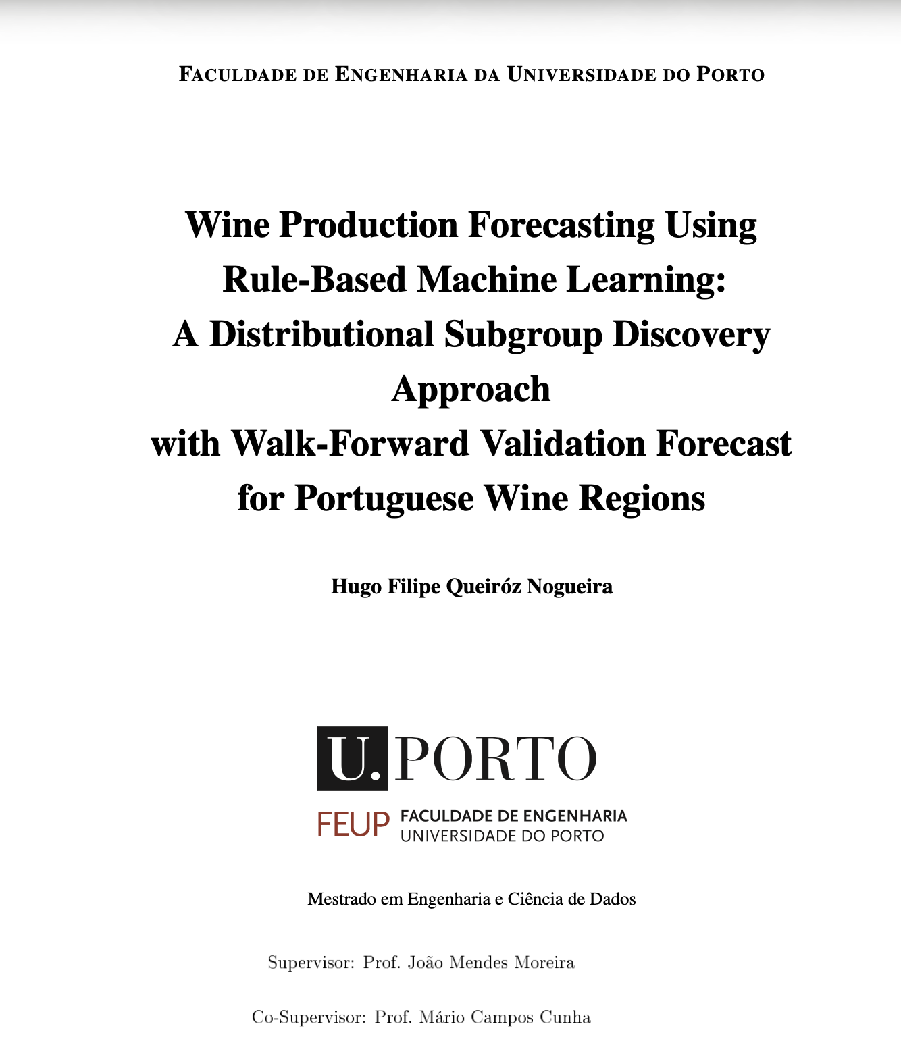
MASTER'S DISSERTATION · FEUP · 2026
Wine production forecasting with interpretable rules
What can climate explain — and what can it reliably predict?
Hugo Filipe Queiróz Nogueira
Supervisors: João Mendes Moreira · Mário Campos Cunha
01
Notes:
Timing: about 35 seconds.
Open with the practical question: can we forecast Portuguese wine production in a way that is useful before harvest and still understandable to domain experts? Emphasise that this is a Master's dissertation at FEUP, and that the central tension is not only accuracy. Wine-sector stakeholders also need explanations they can inspect, challenge, and relate to agronomic mechanisms.
Set the promise of the talk: first I show why this forecasting task is difficult, then how I designed a rule-based evaluation around CarenR, and finally what the results say about prediction, interpretation, and future work.

Slide 2
CONTEXT
The business question is a decision question
Who uses the answer
Can regional climate and vine development data improve the annual production forecast — early enough to change a decision?
Producers and cooperatives Regulatory bodies Supply-chain planners
Decisions affected
A useful model must add accuracy and preserve trust.
Harvest planning Storage and capacity Risk assessment
Prediction alone is insufficient when the mechanism cannot be explained or challenged.
02
Notes:
Timing: about 45 seconds.
Start from the operational context. Regional wine production matters for cooperatives, supply planning, policy, and market expectations, but it is affected by many drivers at once: climate, management, planted area, regulation, and long-term structural change.
The important point is that a model that gives only a number is not enough. If the forecast is wrong, or if the region is changing structurally, stakeholders need to know whether the model found a plausible climate signal or only followed historical drift.
Transition: this leads to the research gap - forecasting has to be interpretable and auditable, not only predictive.

Slide 3
RESEARCH PROBLEM
The problem is not only forecasting, but auditable forecasting
THE GAP
WHAT A RULE LOOKS LIKE
Modern ML can predict wine yield, but decision-makers need readable rules they can challenge with domain knowledge.
IF harvest soil water is moderate
AND post-maturity wet days are low
THEN production is +192 mhl
NO PRIOR WORK COMBINES ALL FIVE PROPERTIES
WHY INTERPRETABILITY MATTERS
Interpretable
Long-term
Predictive
Wine region
Readable by agronomists without ML expertise
Each rule carries support and a p-value
Can be challenged and domain-validated
Useful for diagnosis even when forecasting fails
Modern ML
no
partial
yes
Subgroup discovery
yes
no
no
This thesis
yes
yes
yes
03
Notes:
Timing: about 1 minute.
Use this slide to state the thesis problem clearly. Modern machine learning methods can be good predictors, but they usually do not produce rules that an agronomist can read directly. On the other side, classical statistical approaches are interpretable, but may not capture local non-linear climate conditions.
CarenR is positioned in the middle: it searches for rule-defined subgroups where the production distribution differs meaningfully from the baseline. The value is that every rule has conditions, support, and a statistical test.
Point to the rule example: this is the kind of output the thesis aims for - not just "wetness matters", but a concrete combination of phenological windows and thresholds.

Slide 4
PROBLEM
Why this is hard: the climate signal is real, but diluted
The target combines climate, physiology, human decisions and structural change in one annual regional number.
01
02
03
04
Biology spans years
Aggregation hides variation
Structure changes over time
The sample is small
Yield potential is partly set in the previous season, before the harvest year begins.
Thousands of vineyards differ in soil, altitude, practices and local weather.
Policy, planted area, producers and market conditions shift the production baseline.
Only 80–89 annual observations must support 59 engineered features.
04
Notes:
Timing: about 45 seconds.
This slide explains why the target is difficult. Climate does not act in isolation. The production series includes biological carry-over, annual variability, industry structure, policy changes, and region-specific histories.
Stress that this makes the signal-to-noise problem severe. Even if temperature, rainfall, soil water, or LAI genuinely affect yield, their effect can be hidden by stronger structural movements in production.
The key message is: a weak forecasting result does not automatically mean no climate signal exists. It may mean that the climate signal is being diluted or confounded by the production series itself.

Slide 5
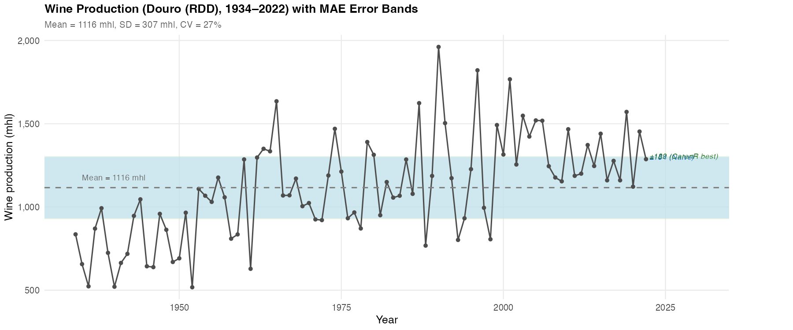
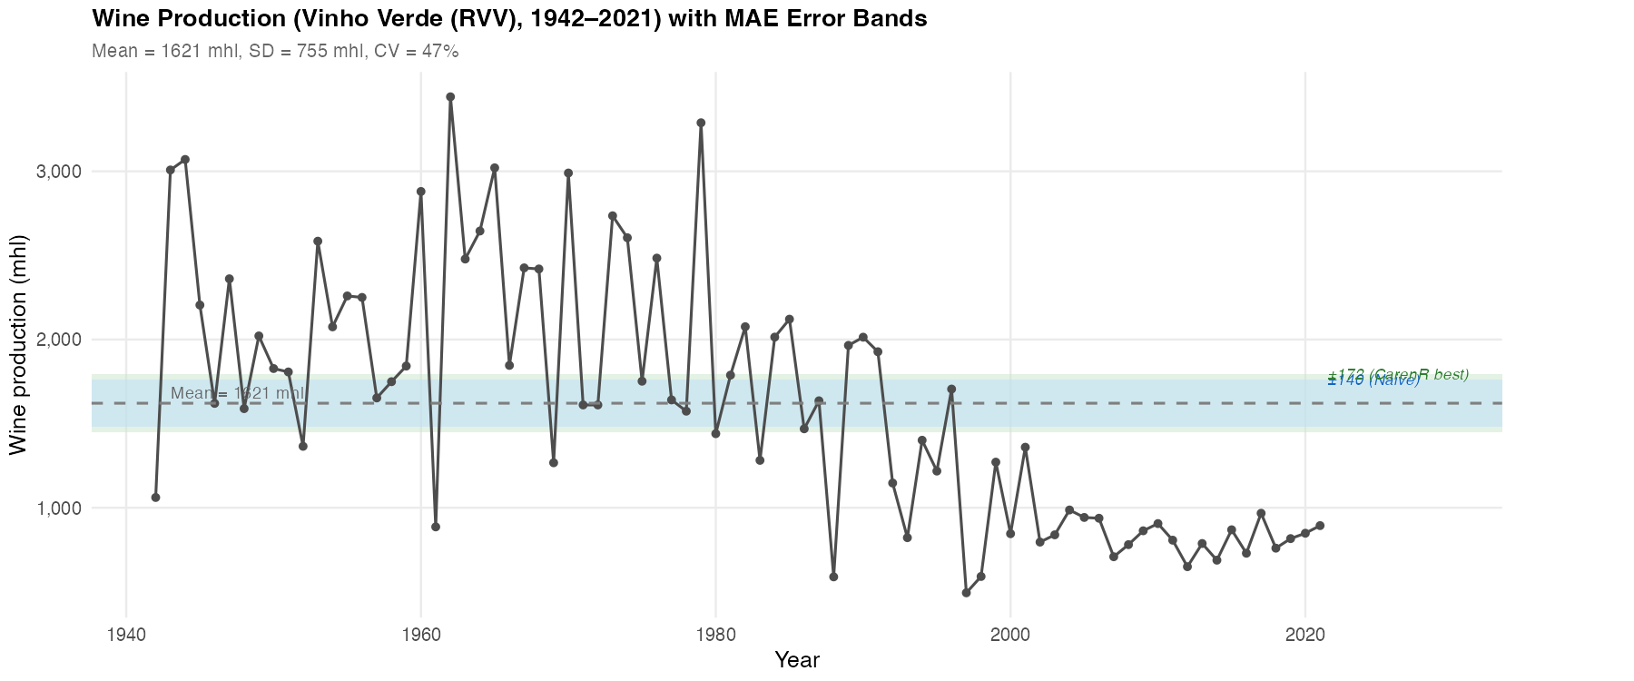
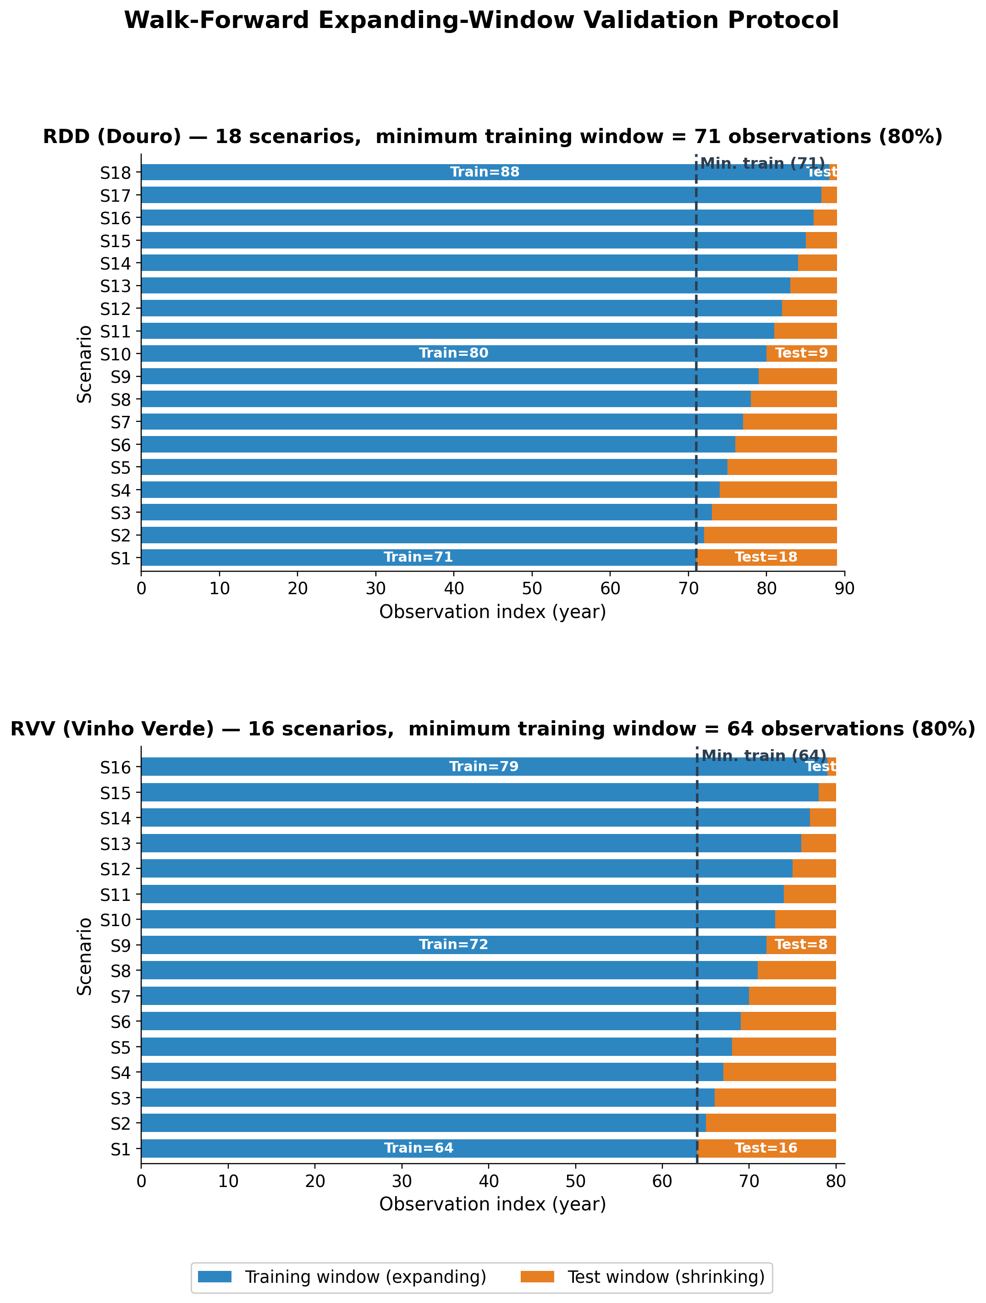
NATURAL EXPERIMENT
The same pipeline meets two different histories
DOURO · 89 years
VINHO VERDE · 80 years
Gradual +80% structural rise; CV 27%
Sharp structural decline; CV 47%
05
Notes:
Use this slide to frame the natural experiment. The modelling pipeline is the same, but the historical series are structurally different. Douro has a long, gradual production rise with lower relative variability; Vinho Verde has a sharper structural decline and higher variability. This contrast is why a method may find interpretable rules but still struggle as a forecasting system: the data-generating history is not stationary in the same way across regions.

Slide 6
GRAPEVINE CYCLE
Current production begins in the previous growing season
YEAR y0 · POTENTIAL
YEAR y1 · REALISATION
Primordia formation
Bud break
Veraison to harvest
CARRY- OVER
Reserve building
Flowering & fruit set
Temperature and light set the upper bound on bunch number.
Current-year temperature, rain, canopy and soil water determine fruit set and berry development.
Prior water and thermal stress shape carbohydrate reserves.
06
Notes:
Timing: about 50 seconds.
Use this as a bridge from domain knowledge to machine learning. The vine response is seasonal and delayed. Conditions around flowering, maturation, harvest, and even the previous year can affect the current harvest.
Mention the carry-over mechanism: climate in one season may influence bud formation or canopy development that only affects production later. This is why the features are not generic annual averages.
The modelling implication is that every climate variable is anchored to phenological periods. That makes the rules more interpretable because a condition refers to an agronomically meaningful window.

Slide 7
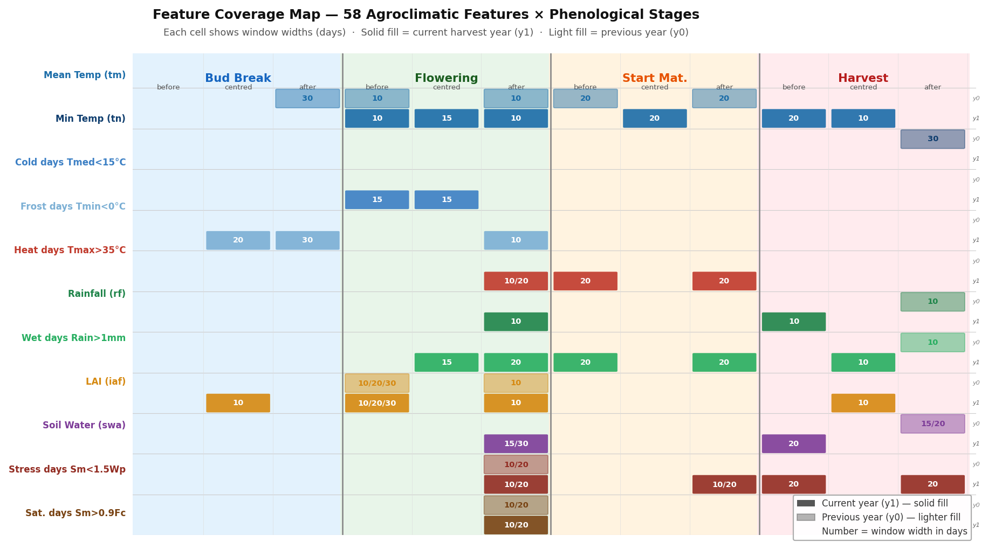
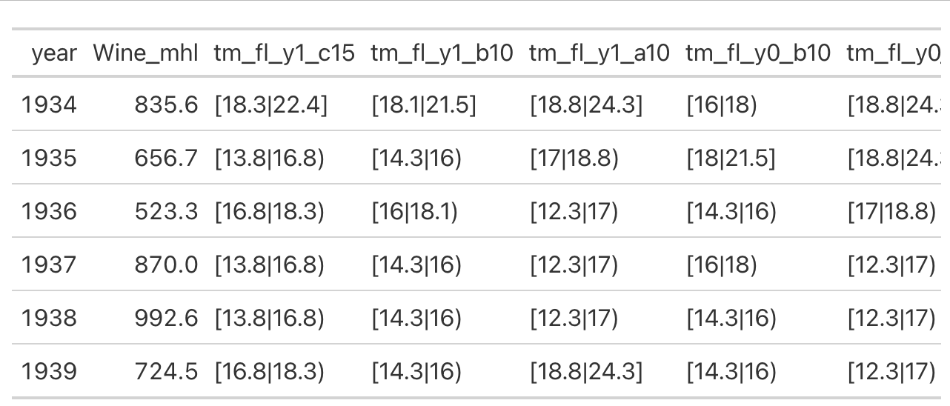
FEATURE ENGINEERING
Features follow the biology, not the calendar
32,842 / 29,902 daily records
-> 59 annual predictors
-> 4 phenological anchors
-> current + previous year
Notes:
This slide explains why the features are agronomically anchored rather than arbitrary calendar windows. The important point is not the exact count of daily records; it is the transformation from raw daily weather and vineyard state data into annual predictors aligned with phenological stages and current/previous-year biological memory.

Slide 8
POSITIONING
The research gap sits between explanation and prediction
Modern machine learning
Rule-based discovery
Handles nonlinear interactions Often strong predictive accuracy Sometimes decision logic remains opaque
Produces explicit IF–THEN rules Auditable support and significance Predictive value is unproven here
Can we have both?
No prior work systematically evaluated distributional subgroup discovery in walk-forward wine production forecasting.
08
Notes:
The thesis is deliberately not a contest against every black-box model. It targets the missing combination: continuous target, long non-stationary data, interpretable rules and rigorous predictive validation.

Slide 9
RESEARCH DESIGN
Two goals separate historical insight from future utility
GOAL 1
GOAL 2
GOAL 1
GOAL 2
DISCOVER
VALIDATE
Discover
Validate
Which agroclimatic conditions distinguish
above- and below-trend production
years?
Can rule-based models beat the
historical median in genuine future
periods?
Which agroclimatic conditions distinguish above- and below-trend production years?
Can rule-based models beat the historical median in genuine future periods?
RQ1 · Can CarenR's KS-test-based distributional rule induction extract statistically validated, non-trivial patterns from non-stationary agricultural time series?
RQ2 · Are the discovered rules genuine within-era climate signal, or are they era-membership artefacts introduced by imperfect linear detrending?
RQ3 · Can rule-based models (CarenR, RIPPER, M5Rules) outperform a Naive Median baseline in walk-forward prediction of detrended production residuals?
RQ4 · What structural conditions (era composition, detrend quality, signal strength) determine when rule-based prediction succeeds or fails?
Discovery
Prediction
RQ1 · dominant variables RQ2 · genuine signal or era confound?
RQ3 · out-of-sample improvement RQ4 · conditions for success or failure
Validation
Diagnosis
RQ1 ✓ Achieved · RQ2 ✓ Validated by LOESS · RQ3 ✗ Not achieved in aggregate · RQ4 ✓ Explained by Two-Decision Framework
08
Notes:
Use this slide to separate the thesis into two standards of evidence. Goal 1 asks whether the algorithms can discover meaningful historical structure. Goal 2 asks whether that structure reduces error in future walk-forward periods. The same data and rule family are used, but the evidential bar is different.

Slide 10
STUDY DESIGN
A controlled comparison isolates the role of data structure
2
SAME
DIFFERENT
regions
Feature engineering Detrending logic Rule learners Evaluation metric
Climate regime Structural trajectory Noise level Era composition
89 + 80
annual observations
THE CONTRAST TURNS TWO CASE STUDIES INTO A NATURAL EXPERIMENT.
10
Notes:
The scientific value comes from holding the pipeline constant. Divergent outcomes can then be interpreted in relation to structural history, signal availability and noise rather than arbitrary modelling choices.

Slide 11
ALGORITHMS
CarenR is the primary lens among five model families
PRIMARY METHOD
COMPARATORS
CarenR
RIPPER
Rule learner + prediction comparator
Distributional rules + prediction variants
1
Discretise
Climate features become equal-frequency bins.
M5Rules
Rule learner + prediction comparator
2
Search
Level-wise search (Apriori-style) combines feature-bin conditions.
Decision Tree
Prediction-only non-rule ML comparator
3
Compare
KS test: subgroup residuals vs global residuals.
4
Retain
Keep significant rules with sufficient support.
Naive baselines
Prediction-only references
OUTPUT · IF climate conditions → shifted production-residual distribution
Roles: CarenR links rules + prediction; RIPPER/M5Rules cross-check rules; Decision Tree and naïve baselines test prediction only.
Notes:
Timing: about 1 minute.
Introduce the model family, then focus on CarenR. CarenR is the primary method and links the two parts of the thesis: it discovers interpretable distributional rules and its variants are also tested in prediction.
Make the role distinction explicit. RIPPER and M5Rules are rule learners, so they are useful for cross-checking whether the same feature families appear outside CarenR; they are also included as prediction comparators. The Decision Tree is prediction-only and non-rule-based. The naive median, last-value, and moving-average baselines are prediction-only references.
The key defence point is that the algorithms are not all doing the same job. Some support interpretability, some support forecasting comparison, and CarenR connects both.

Slide 12
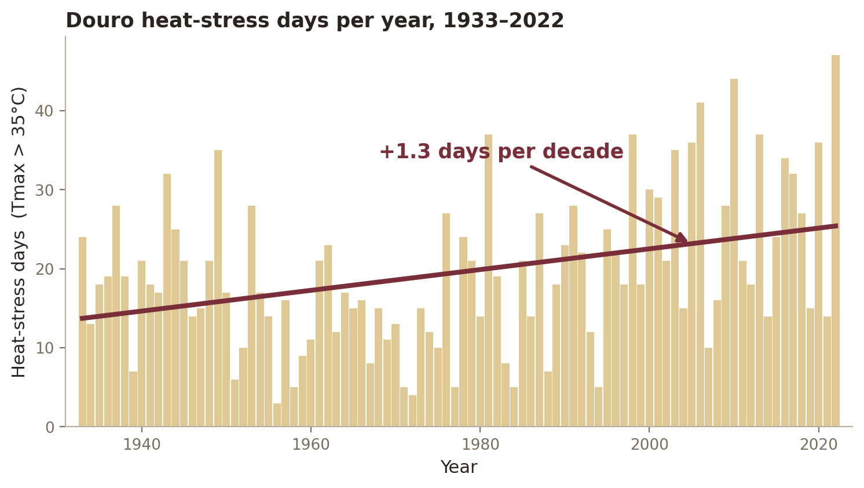
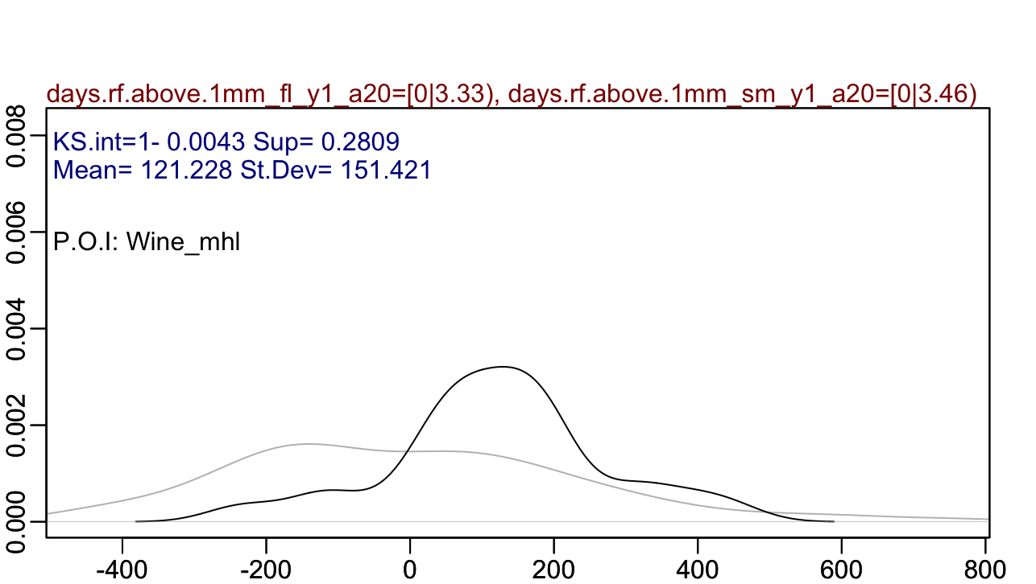
Goal 1 finds statistically exceptional subgroups
CarenR asks a distributional question
DO YEARS MATCHING THESE CLIMATE CONDITIONS HAVE A PRODUCTION-RESIDUAL DISTRIBUTION THAT DIFFERS FROM ALL YEARS?
A RULE YOU CAN AUDIT
IF dry post-flowering AND moderate harvest soil water
THEN +121 mhl above trend
support 28% · p = 0.004
Notes:
Timing: about 1 minute.
Explain CarenR conceptually rather than technically. It starts with discretised feature intervals, combines them into readable rule conditions, and asks whether observations inside the rule have a different production-residual distribution from all observations.
Use the distribution plot: the black curve represents all years, and the burgundy curve represents the years matching a rule. CarenR is not only checking a mean difference; the Kolmogorov-Smirnov statistic asks whether the whole residual distribution shifts, including the tails.
The small rule card is what makes the result auditable. A domain expert can challenge the conditions, check the support, and inspect the p-value. That is the interpretability advantage over a black-box forecast explanation.
Use this slide to prepare the audience for the next one: the rules are not final policy prescriptions. They are evidence about which climate windows repeatedly separate high or low production years.

Slide 13
RESULTS · DISCOVERY
Goal 1 succeeded: compact rules reveal regional drivers
DOURO
VINHO VERDE
48
20
rules
rules
Harvest soil water appears in 54% of rules.
The LAI family features in 4 / 20 rules.
Dry post-flowering conditions and bounded heat repeatedly associate with above-trend production.
Canopy development, heat stress and harvest soil water dominate the regional rule set.
The same variable can have a different direction across regions — interpretation must remain context-specific.
14
Notes:
Lead with rule counts and then the dominant variables. Avoid implying causality. These are statistically validated associations with agronomic coherence, not controlled experiments.

Slide 14
RESULTS · RULES
The strongest CarenR rules point to water and canopy structure
DOURO · top 5 CarenR rules
VINHO VERDE · top 5 CarenR rules
4 of 5 are above-trend: dry flowering and bounded heat define good years.
4 of 5 are below-trend: cool, moist conditions dominate the Atlantic region.
1
Dry flowering + dry maturity
+121 mhl
1
Moist harvest + no heat stress
-338 mhl
28.1% support · p=0.0043
21.2% support · p=0.0198
2
High LAI + wet flowering
-131 mhl
2
Cool flowering + prior soil saturation
-268 mhl
20.2% support · p=0.0084
21.2% support · p=0.0216
3
Dry + moderate heat after flowering
+113 mhl
3
Moist post-flowering + low heat
-365 mhl
25.8% support · p=0.0089
27.5% support · p=0.0294
4
Harvest water + carry-over dryness
+192 mhl
4
Warm prior budburst + mild flowering
+311 mhl
21.3% support · p=0.0095
25.0% support · p=0.0298
5
Dry flowering + bounded heat
+115 mhl
5
Cool post-flowering + wet carry-over
-292 mhl
24.7% support · p=0.0110
23.8% support · p=0.0299
Cross-algorithm finding
Across methods: harvest soil water and LAI/canopy survive.
12
CarenR, RIPPER and M5Rules all select them, so the signal is not tied to one optimization criterion.
Notes:
Timing: about 1 minute 20 seconds.
This is the main rule-finding slide. Start with Douro. The strongest Douro rules point to water availability and wet days around post-flowering, maturation, and harvest. The positive rules suggest that moderate soil water and limited wet-day stress can be associated with production above trend.
Then contrast Vinho Verde. The rules are larger in absolute deviation, but they also mix soil water, LAI, and heat-day conditions in a region with a much stronger structural break.
The takeaway is not that one listed rule should be operationalised immediately. The scientific finding is that water-related variables and canopy/LAI-related variables keep appearing as meaningful explanatory families.

Slide 15
RESULTS · RULES
RESULTS · RULES
The strongest CarenR rules point to water and canopy structure
Exact CarenR rule output: intervals behind the top rules
Each row is an IF condition set; Delta is the median production residual shift from trend.
DOURO (RDD) · top 5 exact rules
VINHO VERDE (RVV) · top 5 exact rules
Mostly above-trend: dry post-flowering / maturity windows and bounded heat.
Mostly below-trend: cool, moist conditions dominate the Atlantic region.
4 of 5 are above-trend: dry flowering and bounded heat define good years.
4 of 5 are below-trend: cool, moist conditions dominate the Atlantic region.
#
Exact conditions from CarenR output
support / p
Delta
#
Exact conditions from CarenR output
support / p
Delta
DOURO · top 5 CarenR rules
VINHO VERDE · top 5 CarenR rules
Dry flowering + dry maturity
Soil water pre-Harvest [61-97 mm]
AND Heat days pre-Maturity [0-1.9 d]
AND Heat days post-Maturity [0-2.4 d]
AND Heat days post-Flowering [0-1.1 d]
+121 mhl
Moist harvest + no heat stress
-338 mhl
1
Wet days post-Flowering [0-3.3 d]
AND Wet days post-Maturity [0-3.5 d]
28.1%
~25 yr
p=0.0043
1
21.2%
~17 yr
p=0.0198
1
+121
1
-338
28.1% support · p=0.0043
21.2% support · p=0.0198
2
High LAI + wet flowering
-131 mhl
2
Cool flowering + prior soil saturation
-268 mhl
2
LAI at Flowering [0.74-0.88 m2/m2]
AND Soil water post-Flowering [390-404 mm]
20.2%
~18 yr
p=0.0084
Temp at Flowering [13.8-17.1 deg C]
AND Temp post-Flowering [12.6-17.5 deg C]
AND Wet-soil days post-Flowering prev.yr [17.5-20 d]
21.2%
~17 yr
p=0.0216
20.2% support · p=0.0084
-131
2
21.2% support · p=0.0216
-268
3
Dry + moderate heat after flowering
+113 mhl
3
Moist post-flowering + low heat
-365 mhl
25.8% support · p=0.0089
27.5% support · p=0.0294
3
Wet days post-Flowering [0-3.3 d]
AND Wet days post-Maturity [0-3.5 d]
AND Heat days post-Flowering [0-0.6 d]
25.8%
~23 yr
p=0.0089
3
Soil water post-Flowering [143-234 mm]
AND Heat days post-Maturity [0-2.4 d]
27.5%
~22 yr
p=0.0294
4
Harvest water + carry-over dryness
+192 mhl
+113
4
Warm prior budburst + mild flowering
+311 mhl
-365
21.3% support · p=0.0095
25.0% support · p=0.0298
5
Dry flowering + bounded heat
+115 mhl
5
Cool post-flowering + wet carry-over
-292 mhl
4
Soil water pre-Harvest [74-101 mm]
AND Wet days post-Harvest prev.yr [0-2.3 d]
AND Wet days post-Maturity [0-3.5 d]
21.3%
~19 yr
p=0.0095
+192
4
Temp post-Budburst prev.yr [11.2-13.5 deg C]
AND Cold days at Flowering [0-3.4 d]
AND Heat days post-Flowering [0-1.1 d]
25.0%
~20 yr
p=0.0298
+311
24.7% support · p=0.0110
23.8% support · p=0.0299
5
Wet days post-Flowering [0-3.3 d]
AND Heat days pre-Maturity [0-3.7 d]
24.7%
~22 yr
p=0.0110
+115
5
Temp post-Flowering [12.6-17.5 deg C]
AND Heat days post-Maturity [0-2.4 d]
AND Wet-soil days post-Flowering prev.yr [17.5-20 d]
23.8%
~19 yr
p=0.0299
-292
Cross-algorithm finding
Across methods: harvest soil water and LAI/canopy survive.
CarenR, RIPPER and M5Rules all select them, so the signal is not tied to one optimisation criterion.
How to read it
Support is the share of historical years matching the rule; p is the KS-test evidence that the subgroup distribution differs from the full distribution.
12
Source: Thesis, Tables 4.1-4.2 and 4.9
Notes:
This is the audit version of the rules slide. Say that the previous simplified labels are now expanded into the actual thresholds reported by CarenR. Emphasise that a rule is not a black-box importance score: it names the subgroup, reports how many years match it, gives the KS p-value, and states the observed shift in residual production. For Douro, the strongest rules mostly say that dry post-flowering and post-maturity windows, sometimes with moderate pre-harvest soil water, correspond to above-trend production. Rule 2 is the exception: high LAI at flowering together with high post-flowering soil water is below trend, which is agronomically plausible because canopy vigour and moisture can shift growth away from fruit. For Vinho Verde, four of five rules are below trend and capture cool, moist, low-heat patterns; the single above-trend rule is the warm previous-year budburst / mild flowering case. Close by reminding the committee that these intervals are what make the findings auditable: an agronomist can challenge the thresholds directly.

Slide 16
CROSS-ALGORITHM VALIDATION
Three optimization criteria recover the same feature families
Feature
CarenR
RIPPER
M5Rules
Confidence
Harvest soil water
54% of RDD rules
25% of RVV rules
RVV Rule 3
-2.3/mm RDD
-8.1/mm RVV
HIGH
universal
LAI / canopy family
All 20 RVV rules
minor RDD signal
RVV Rules 1-2
-2064/unit RVV
variable selected
HIGH
universal
Previous-year
summer temperature
RVV carry-over
RVV Rule 3
+17.2/C RVV
HIGH
RVV focus
Wet days
after flowering
21% of RDD rules
not selected
not selected
MODERATE
CarenR-specific
Agreement across three independent methods is the strongest evidence that the rule features reflect real data structure, not algorithmic noise.
Notes:
Timing: about 1 minute.
Use this slide to strengthen the credibility of the rule findings. CarenR, RIPPER, and M5Rules optimise different objectives, so agreement across them is meaningful.
The two strongest cross-algorithm findings are harvest soil water and the LAI family. Soil water appears in CarenR rules, RIPPER rules, and M5Rules coefficients. LAI is especially strong in Vinho Verde, appearing across all 20 CarenR rules and in the other rule learners.
Be careful with wording: this is not causal proof. It is convergent evidence that these feature families capture real structure in the data rather than only algorithm-specific noise.

Slide 17
RESULTS · VALIDATION
Goal 1 - Two checks confirm the discovered signal
01
02
AGGRESSIVE DETRENDING
INDEPENDENT ALGORITHMS
RDD signals persist after LOESS; in RVV, wet-days persist while LAI and soil water are era-linked.
RIPPER and M5Rules converge on harvest soil water, LAI and previous-year temperature.
→ The signal is real, but not equally stable across regions.
→ The signal is not CarenR-specific.
Discovery is credible — but credibility is not yet predictive utility.
Notes:
This slide answers RQ2 with nuance. LOESS confirms that the Douro signals, and the RVV wet-days signal, are not merely era labels. But RVV LAI and harvest soil-water collapse under LOESS, which is itself informative: some discovered structure is climate signal, and some is entangled with regional structural change. Cross-algorithm convergence gives a second robustness check because the three methods optimise different criteria.

Slide 18
METHOD · PREDICTION
Goal 2 recreates prediction-time information
Expanding-window validation
18 scenarios · Douro 16 scenarios · Vinho Verde
All preprocessing stays inside each training fold:
• detrending • discretisation • feature selection • rule induction
17 models · weighted MAE · lower is better
Notes:
Emphasise leakage prevention. Each scenario behaves like a real historical forecast: all thresholds, features and rules are learned only from the past. The primary comparator is the training median because it is the optimal constant forecast under MAE.

Slide 19
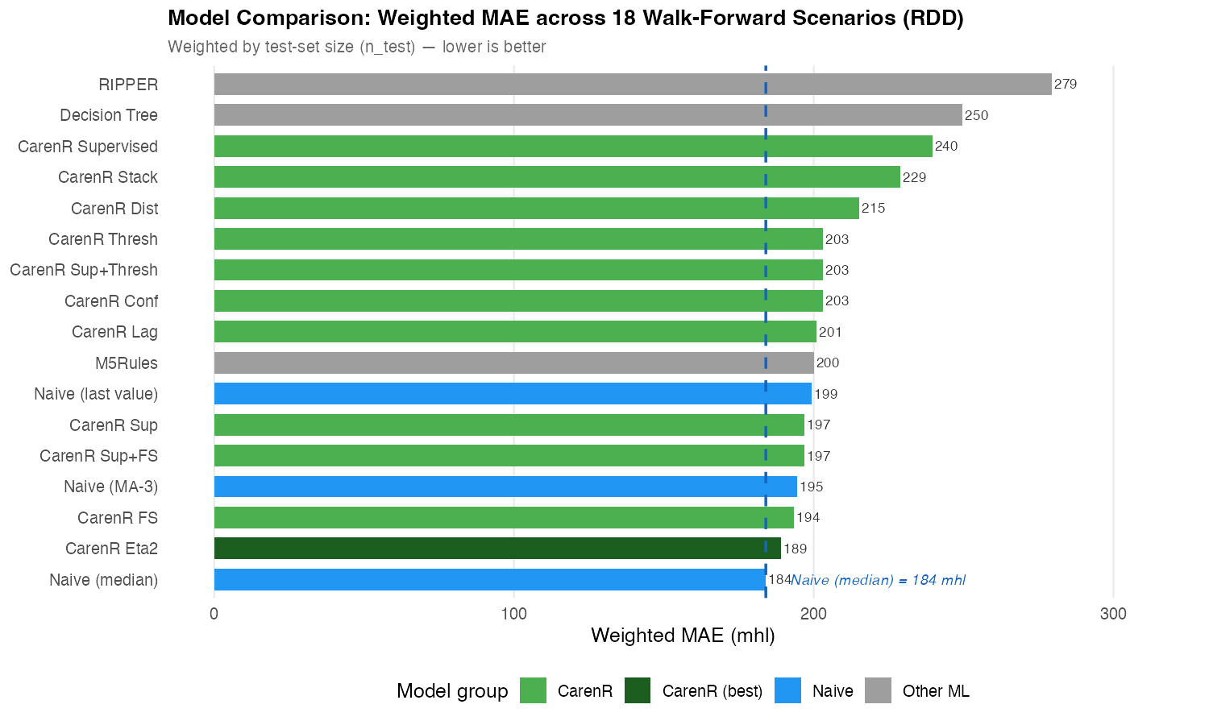
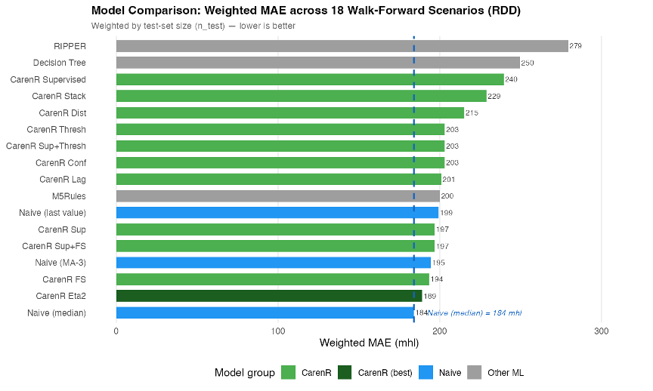
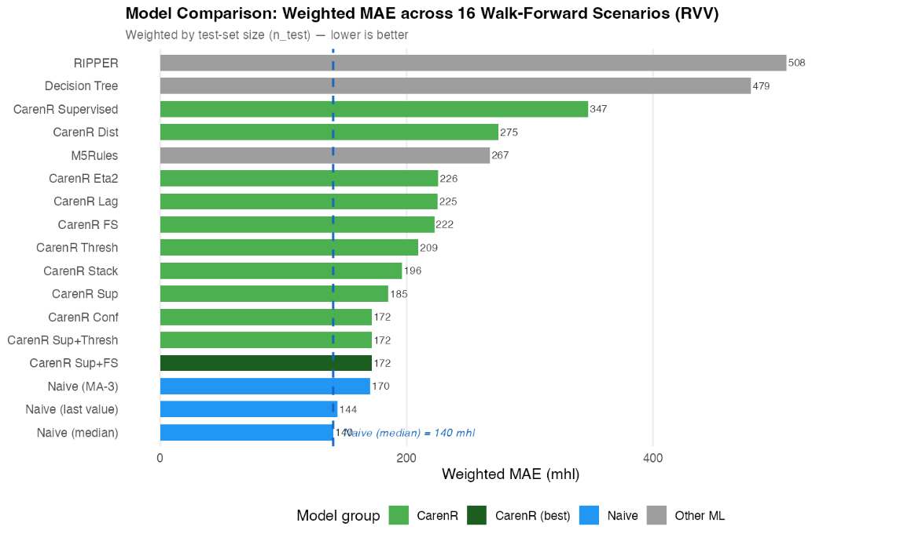
RESULTS · PREDICTION
No rule-based model beats the median overall
RDD · 189 vs 184 mhl
3% worse · p = 0.468
RVV · 172 vs 140 mhl
22% worse · p = 0.004*
*Among the 9 scenarios where RVV rules fired, they significantly harmed prediction.
Notes:
For Vinho Verde, the prediction result is negative. The RVV weighted-MAE chart shows that even the best CarenR variants do not beat the historical median baseline overall. This supports the main interpretation: rule discovery can reveal structure, but under strong structural decline the extracted rules do not translate into reliable future forecasting.

Slide 20
RESULTS INTERPRETATION
A real association can still be too weak to forecast
Pattern discovery and forecasting answer different questions.
DISCOVERY
PREDICTION
IS THE SUBGROUP DISTRIBUTION DIFFERENT?
DOES THE RULE REDUCE FUTURE ERROR?
≠
With |r| ≈ 0.47, the association is detectable across 80–89 historical years.
Climate explains ≈22% of residual variance; ≈78% remains unobserved or noisy.
Notes:
Timing: about 50 seconds.
This slide separates two ideas that are easy to confuse. Discovery is about identifying patterns that are plausible, interpretable, and statistically supported. Prediction is about using those patterns to improve future numerical forecasts.
The thesis result is that discovery works better than prediction in this setting. That is not a failure of the thesis; it is the main diagnosis. Rule-based machine learning can explain parts of the climate-production relationship, but the current data are not sufficient for reliable regional forecasting.
Transition: the next slide formalises this diagnosis as a two-decision framework.

Slide 21
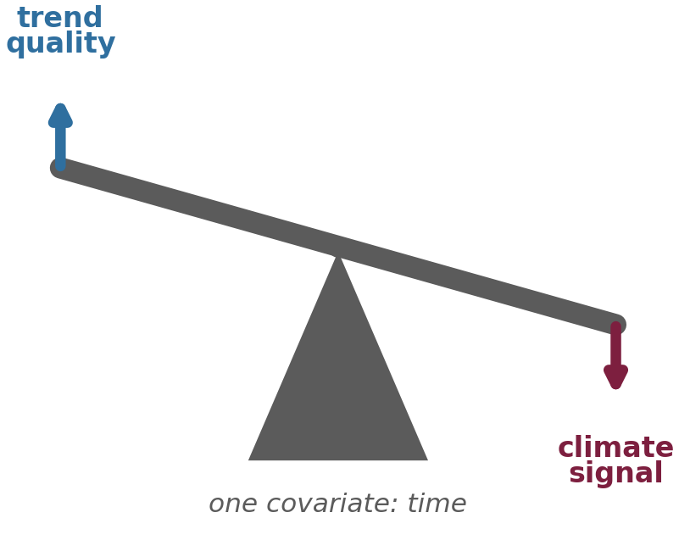
TWO-DECISION FRAMEWORK
Better detrending can remove the signal rules need
DECISION 1
DECISION 2
MODEL THE STRUCTURAL TREND
EXTRACT CLIMATE SIGNAL
TENSION
A better trend leaves smaller test residuals and lowers the naive error floor.
Stable rules need residual structure that is large enough to detect and exploit.
RVV LOESS: baseline improves 140 → 90 mhl, but rule induction falls to zero.
Time alone cannot cleanly separate industry structure from climate.
Notes:
Timing: about 1 minute.
Explain the two-decision framework as one of the methodological contributions. Decision 1 is how to remove or represent the long-term production trend. Decision 2 is how to extract the climate signal from the remaining residuals.
These decisions interact. If detrending is too weak, the climate model may learn structural drift. If detrending is too aggressive, it can remove genuine climate-related variation.
This framework is transferable beyond wine production. Any agri-climatic forecasting problem with long histories and structural non-stationarity faces the same separation problem: what is trend, and what is climate signal?

Slide 22
CONTRIBUTIONS
Five scientific contributions clarify why rules work and fail
Two-decision framework separates trend quality from residual climate-signal extraction.
1
2 · Walk-forward evaluation
3 · Sensitivity analysis
4 · Era-composition analysis
17 models, 18/16 scenarios, and all preprocessing inside each fold.
Eleven CarenR variants show the best feature-selection strategy is problem-specific.
Identifies when rule-based prediction may become viable, as hypothesis for future work.
5 · CROSS-ALGORITHM VALIDATION: RIPPER AND M5RULES INDEPENDENTLY CONFIRM CARENR FEATURE FAMILIES.
Notes:
Timing: about 1 minute.
Present the contributions as what remains scientifically useful after the negative forecasting result. First, the thesis provides a two-decision decomposition for separating trend modelling from climate signal extraction. Second, it runs a systematic walk-forward evaluation with preprocessing inside each fold.
Third, it compares sensitivity variants rather than assuming one configuration is universal. Fourth, it introduces era-composition analysis to diagnose when apparent skill depends on the historical composition of the training and test periods.
Finally, it uses cross-algorithm validation to show that key feature families - especially soil water and LAI - are not only CarenR artefacts.

Slide 23
LIMITATIONS & FUTURE WORK
The next evidence should separate climate from structure
LIMITATIONS
FUTURE WORK
Time is the only detrending covariate, so structural change and climate remain partly mixed.
The walk-forward test has only 18 and 16 scenarios; the 5/5 RDD era-balanced result is exploratory.
Regional annual aggregates hide sub-regional weather and vineyard heterogeneity.
Add structural covariates: planted area, quotas and certified producers.
Pre-register and prospectively validate the era-balanced hypothesis.
Test other regional time series with weaker trends and use higher-resolution climate data.
THE THESIS DOES NOT CLAIM AN OPERATIONAL FORECAST YET;
IT SHOWS WHEN INTERPRETABLE RULES ARE MEANINGFUL, WHEN THEY FAIL, AND WHAT EVIDENCE IS NEEDED NEXT.
Notes:
Timing: about 1 minute.
Be transparent here. The main limitations are the use of time as the main detrending covariate, small test sets, and annual regional aggregates. These choices make the problem realistic but also underpowered.
For future work, mention structural detrending with explicit covariates such as planted area, quotas, or the number of certified producers. Also mention prospective validation of the 29 percent era-balanced threshold, and testing additional regional time series, especially regions with weaker trend or less structural break.
The closing point is that the thesis identifies what must be fixed before these rules can become reliable operational forecasts.

Slide 24
NEXT STEPS
The next step is to model structure explicitly
01
02
03
04
Rules can explain the past. Structure determines whether they predict the future.
STRUCTURAL COVARIATES
PROSPECTIVE VALIDATION
HIGHER SPATIAL RESOLUTION
OTHER REGIONS
& LOWER TREND
Planted area, quotas, producers
Pre-register the era-balanced hypothesis
Capture within-region heterogeneity
Test time series with weaker structural trends
Notes:
Timing: about 45 seconds.
Close by returning to the opening question. The answer is deliberately nuanced: rule-based machine learning cannot yet forecast Portuguese wine production reliably from these annual regional series. But it can explain parts of the climate-production relationship in a way that is auditable and agronomically meaningful.
Summarise the next steps as a research path: add structural covariates, test more regions and less trend-dominated series, validate prospectively, and use subgroup methods such as EMM to understand when climate-production relationships are exceptional.
End with the main defence sentence: understanding why forecasting fails is itself a scientific contribution, because it tells us what evidence is missing for reliable deployment.

Slide 25
Thank you
Questions
Notes:
Timing: about 45 seconds.
Close by returning to the opening question. The answer is deliberately nuanced: rule-based machine learning cannot yet forecast Portuguese wine production reliably from these annual regional series. But it can explain parts of the climate-production relationship in a way that is auditable and agronomically meaningful.
Summarise the next steps as a research path: add structural covariates, test more regions and less trend-dominated series, validate prospectively, and use subgroup methods such as EMM to understand when climate-production relationships are exceptional.
End with the main defence sentence: understanding why forecasting fails is itself a scientific contribution, because it tells us what evidence is missing for reliable deployment.

