Slide 1
MSc DEFENSE · MECD · FEUP · JUNE 2026
Wine Production Forecasting Using Rule-Based Machine Learning
A Distributional Subgroup Discovery Approach for Portuguese Wine Regions
“Can a rule explain a harvest it cannot predict?”
WHAT YOU'LL LEAVE KNOWING
1 HARD
2 AUDITABLE
3 REAL
4 LAWFUL FAILURE
5 DIAGNOSIS
Hugo Filipe Queiróz Nogueira
Supervisors: Prof. João Paulo Moreira (FEUP) · Prof. Mário Campos Cunha (FCUP)
Notes:
You've read the thesis, so I won't retell it. I'll defend five claims — remember these five and you have my thesis. (Read them: Hard, Auditable, Real, Lawful Failure, Diagnosis.) The whole talk answers the question on screen: can a rule explain a harvest it cannot predict?

Slide 2
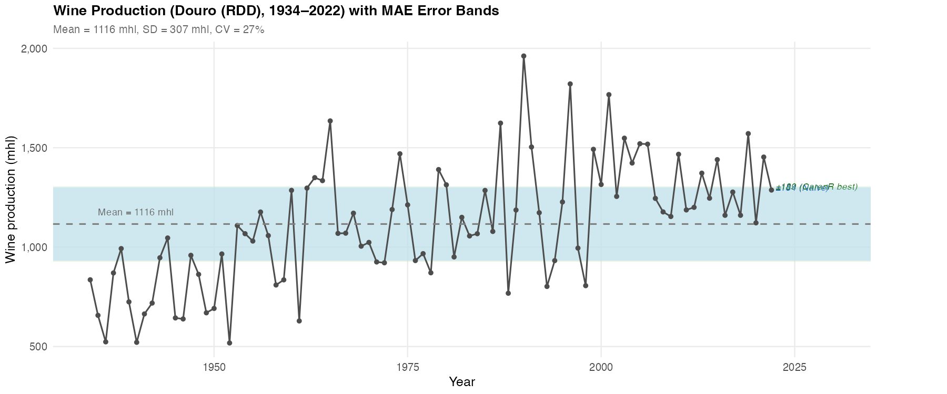
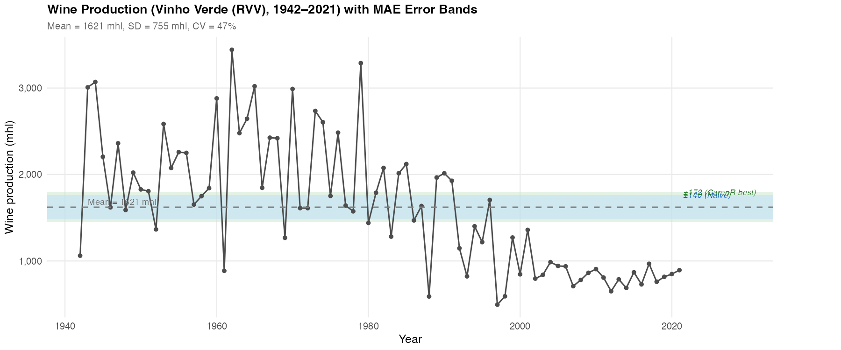
IDEA 1 · HARD
A real signal, drowning in noise
Douro (RDD) — gradual rise +80%
r ≈ 0.47
Climate–production correlation — the signal is real
~22%
of residual variance is explainable by climate
Vinho Verde (RVV) — structural fall −65%
CV ≈ 47%
Year-to-year swing — the noise the signal hides in
Thousands of growers, heterogeneous vineyards, local weather no regional index captures.
2
Notes:
Wine is Europe's most climate-sensitive crop and forecasting matters for producers, cooperatives and regulators. But the signal is real yet explains barely a fifth of the variance, in a series that swings ~47% year to year. Two regions, opposite structural directions. Easy wins don't exist here.

Slide 3
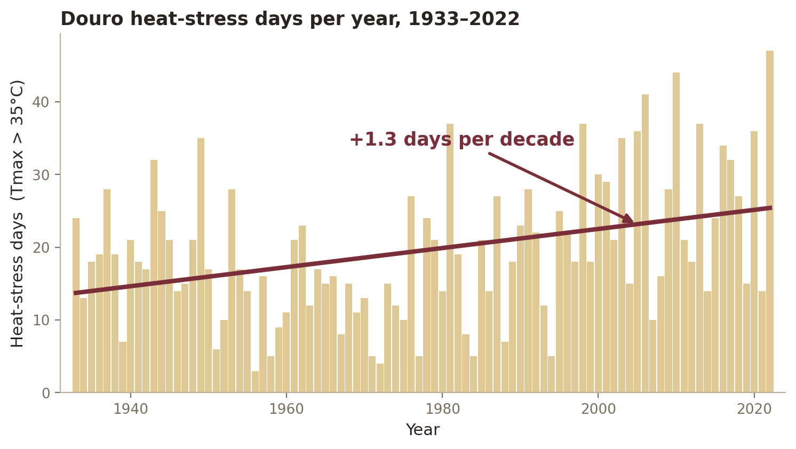
IDEA 1 · HARD
The inputs move too — the climate is non-stationary
Over the same 90 years, the Douro's climate itself has shifted. It is not only production that trends — so do the predictors.
+44%
Heat days >35°C: 17.6 → 25.4 per year
−56%
Frost days <0°C: 18.8 → 8.3 per year
−7%
Annual rainfall: 859 → 798 mm
Both the target and its drivers drift together — exactly the co-trending trap the LOESS stress-test is built to catch.
early vs late 30-year means, RDD
3
Notes:
Here is an insight the committee should sit with. It is not only production that is non-stationary — the climate itself has moved over the same 90 years. In the Douro, heat-stress days above 35°C are up about 44%, frost days have more than halved, rainfall is down ~7%. Note the link to the rules: the heat-stress-day family that CarenR selects is itself trending. This matters because when both production AND a climate feature trend over the record, the feature can look predictive just by co-trending with the era — which is precisely the trap the LOESS stress-test on the next block is designed to expose.

Slide 4
IDEA 1 · HARD
Why this is hard for the business
Annual forecasts drive harvest logistics, storage, the Port benefício quota and risk planning — for producers, cooperatives and regulators (IVDP, IVV).
1
HARD TO
2
HARD TO
3
HARD TO
Understand
Predict
Extract rules
Thousands of growers, a two-year vine memory, and an industry restructured after EU entry (1986): grubbing-up, new varieties, irrigation, professional management.
A weak climate signal, cyclical ~5.7-year production waves, and only ~17 honest test years per region.
A rule must be interpretable, statistically robust and free of era artefacts — all three at once.
An off-the-shelf accuracy model answers none of these — which is exactly what motivates the method.
4
Notes:
This is the business reality behind the numbers. A regional forecast feeds real decisions — harvest logistics, storage, the Port benefício quota, risk cover — for producers, cooperatives and the regulators. And it is hard three ways: hard to UNDERSTAND, because production is thousands of growers with a two-year vine memory on top of decades of policy change; hard to PREDICT, because the signal is weak, the production cycles are ~5.7 years, and an honest walk-forward gives me only ~17 test years; and hard to EXTRACT RULES, because a useful rule has to be interpretable, statistically robust, and free of era artefacts simultaneously. No off-the-shelf model does all three — that's why the method choice matters.

Slide 5
IDEA 1 · HARD
Two goals, one gap
GOAL 1
GOAL 2
DISCOVER
PREDICT
Can we discover interpretable climate rules that explain above- and below-trend years?
Do those same rules actually predict future production better than a naive forecast?
RQ1 — which variables? RQ2 — genuine or era-confounded?
RQ3 — beat the baseline? RQ4 — if not, when might it?
The whole thesis lives in the gap between those two verbs.
5
Notes:
Two goals. Discover rules that explain production; then test — brutally — whether those rules predict. Four research questions nest under these two. The whole talk is the gap between DISCOVER and PREDICT.

Slide 6
IDEA 1 · HARD
Two regions, opposite histories, one method
DOURO · RDD
VINHO VERDE · RVV
PERIOD
1934–2022 · 89 years
1942–2021 · 80 years
PRODUCTION TREND
+80% — gradual rise
−65% — structural collapse
STRUCTURAL DRIVER
Port benefício quota (buffered)
EU accession 1986 (grubbing-up, exodus)
NON-STATIONARITY
Moderate, smooth
Severe, non-linear break
Same algorithm on both → a natural experiment that separates climate signal from structural artefact.
6
Notes:
I chose two regions with opposite histories. The Douro rose gradually, partly buffered by the Port quota. Vinho Verde collapsed after EU accession — subsidies, training-system change, rural exodus. Same algorithm on both; that contrast is what lets me separate climate from structure later.

Slide 7
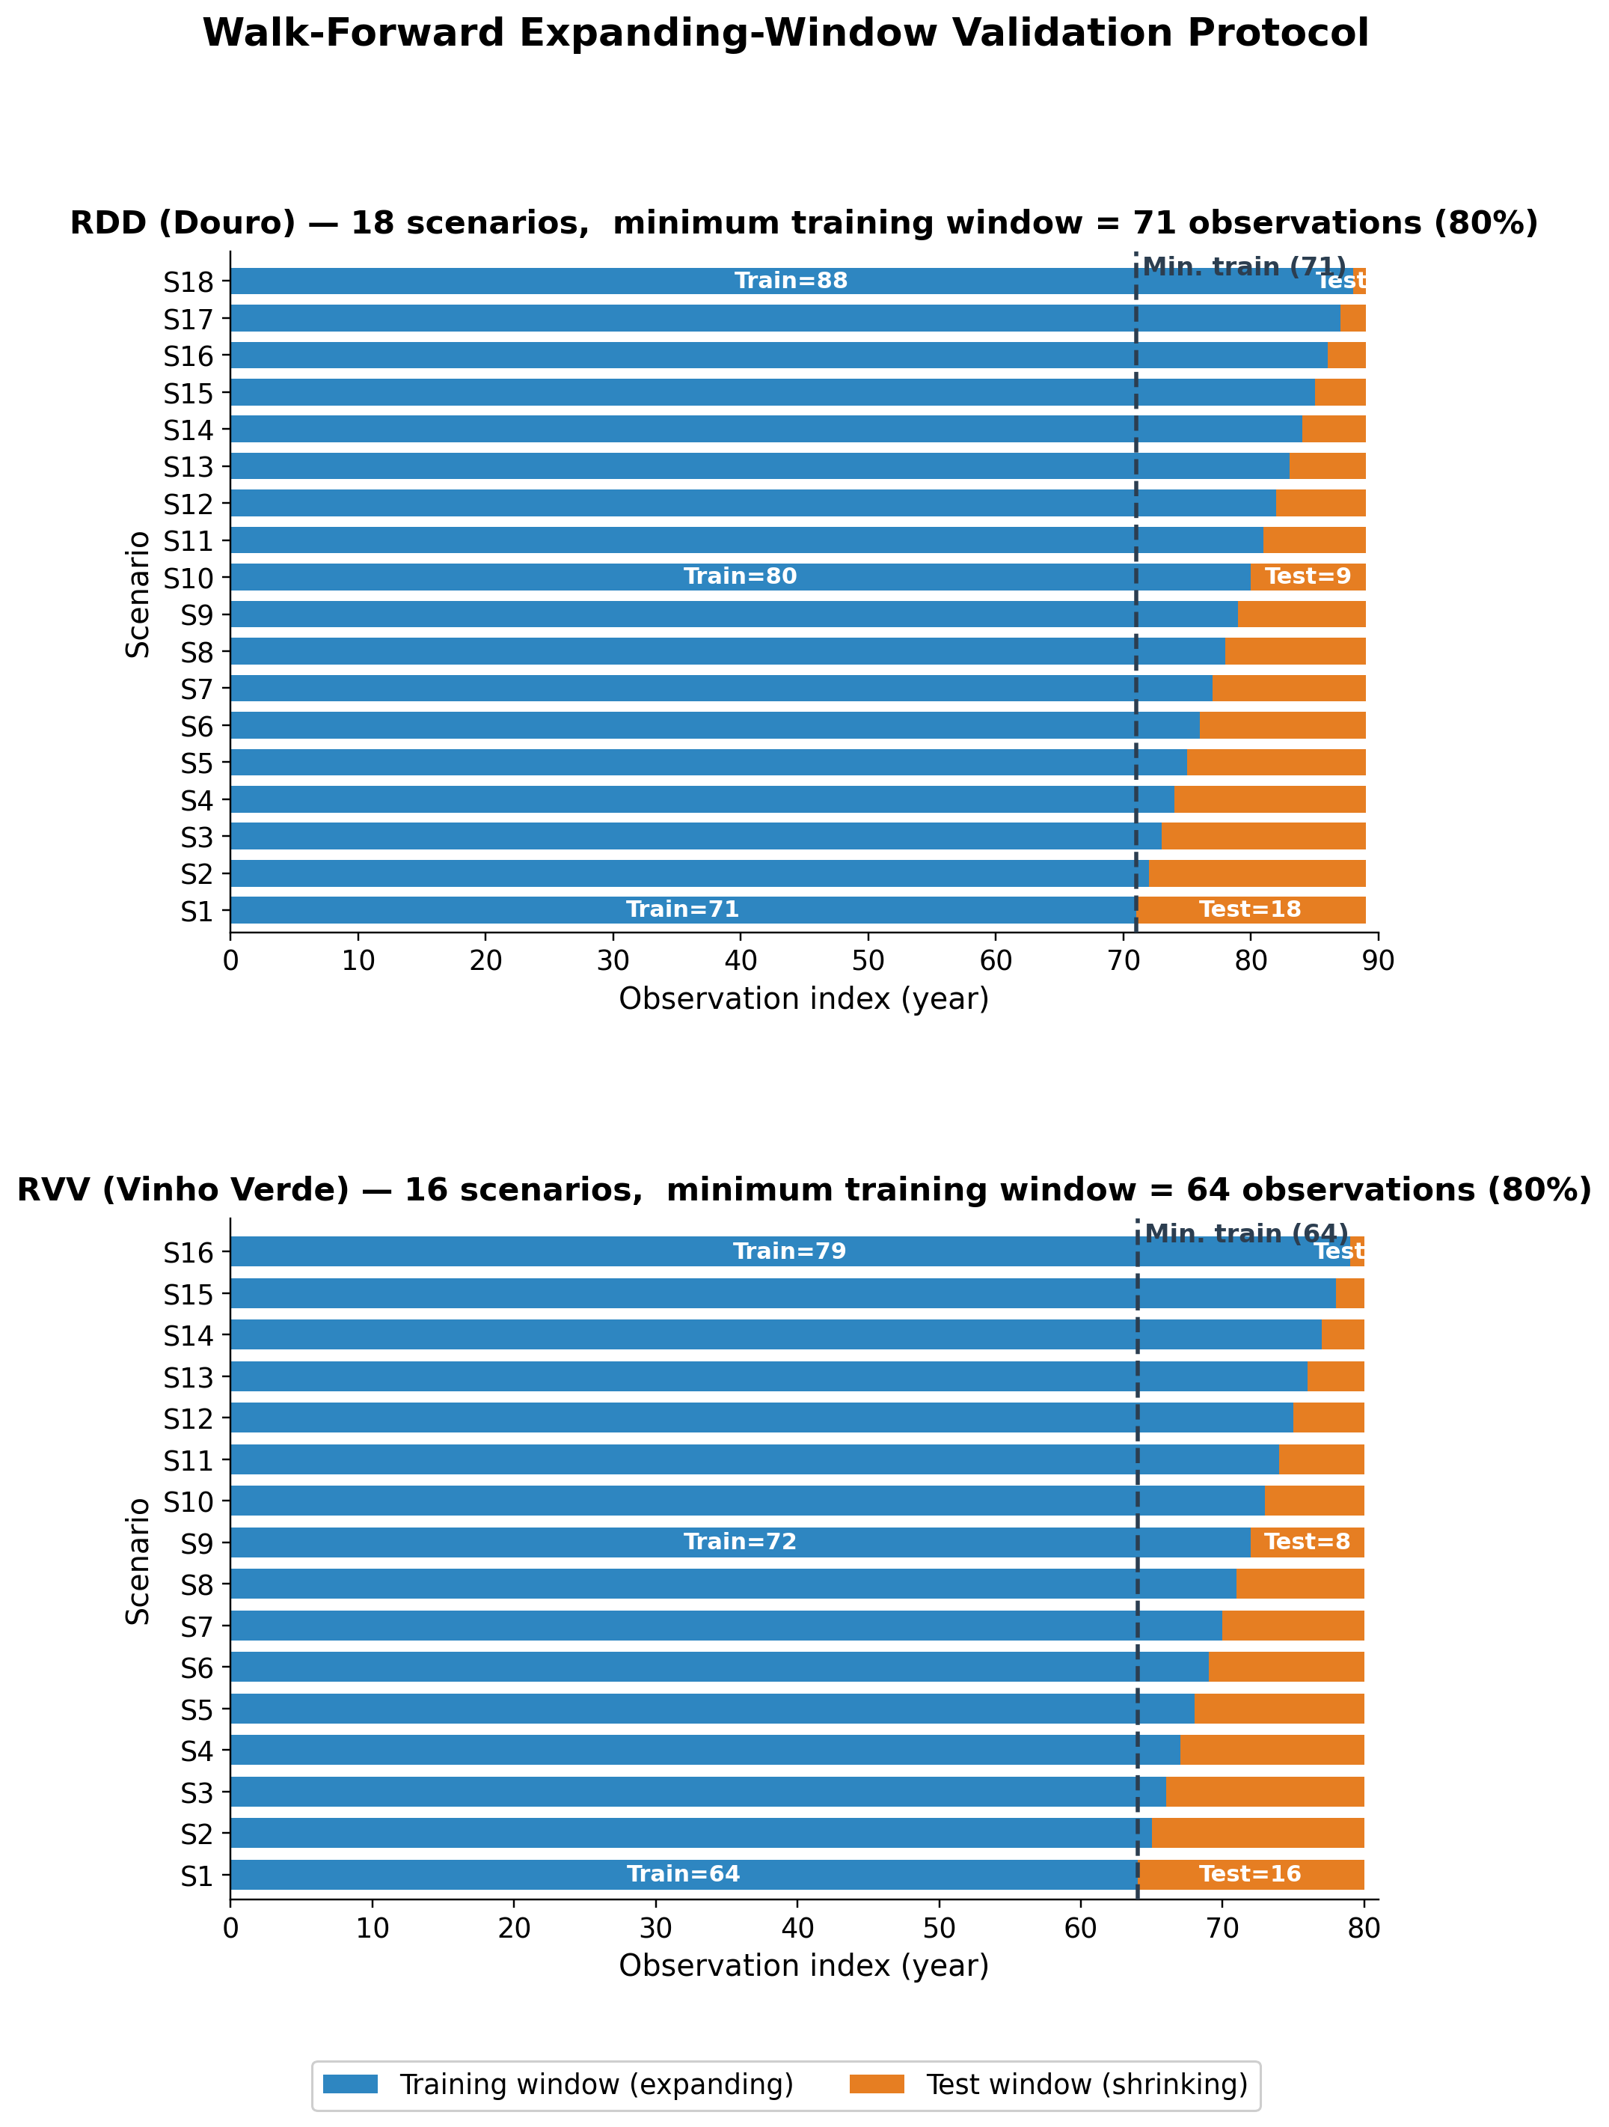
IDEA 2 · AUDITABLE
One honest pipeline
1
Detrend in-fold
Remove structural trend separately inside every training fold — no leakage.
2
Discover rules
CarenR runs on the residuals; rules kept only if p ≤ 0.10 and support ≥ 20%.
3
Walk-forward test
Expanding window: 18 scenarios (RDD) / 16 (RVV), weighted MAE on real scale.
Remember one idea →
Error = Trend (Decision 1) + Climate signal (Decision 2)
Walk-forward validation
7
Notes:
One pipeline. Expanding-window walk-forward, every preprocessing step inside the fold — no leakage. And remember one idea: error is a trend part and a signal part. I'll come back to why those two fight.

Slide 8
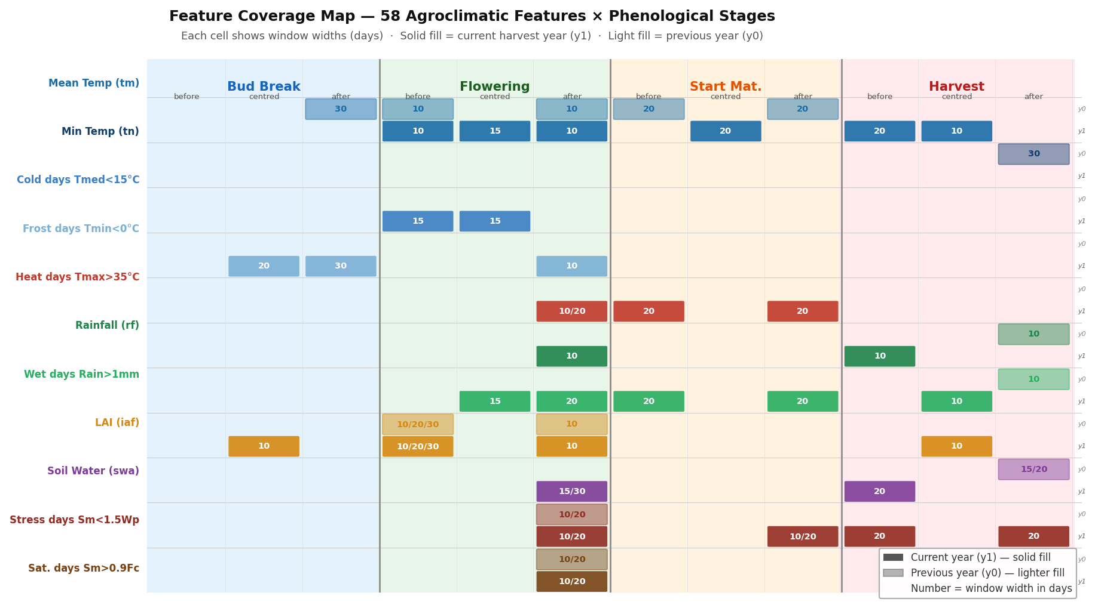
IDEA 2 · AUDITABLE
Features grounded in the vine's two-year memory
Next year's crop is partly decided this year.
Prior year (y0)
inflorescence primordia set bunch potential; carbohydrate reserves build.
Current year (y1)
flowering sets fruit; veraison → harvest sets berry concentration.
Why look back a year?
15 of 59 features (25%) are previous-year. A current-season-only dataset is fundamentally incomplete.
Each feature = variable × phenological stage × window × year offset (solid = current y1, light = prior y0)
8
Notes:
Here's the agronomic grounding, and it answers 'why two years?'. The grapevine is perennial: next year's crop is partly decided this year. In the prior season the vine forms the inflorescence primordia that cap bunch number, and it builds the carbohydrate reserves that fund next year's growth. So 15 of the 59 features — a quarter — deliberately look back a full year; a current-season-only dataset is fundamentally incomplete. This map shows every feature across the vine calendar — bud break, flowering, veraison, harvest — with solid cells for current-year and lighter cells for prior-year windows. The naming is systematic: for example swa_hv_y1_b20 is soil water in the 20 days before harvest, current year.

Slide 9
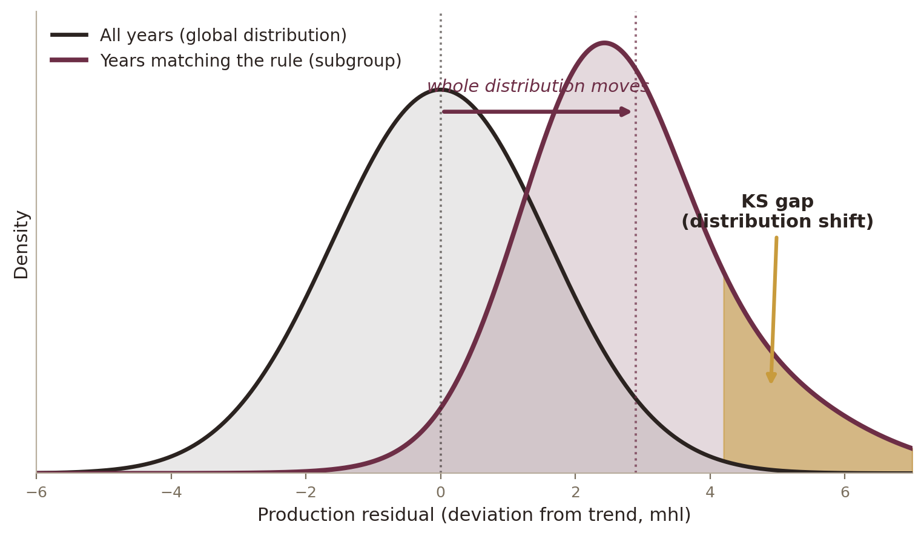
IDEA 2 · AUDITABLE
Why CarenR: rules you can question
CarenR asks: under which conditions does the whole distribution — tails included — shift? Tested by a Kolmogorov–Smirnov statistic.
A RULE YOU CAN AUDIT
IF dry post-flowering AND moderate harvest soil water
THEN
+121 mhl above trend
support 28% · p = 0.004
Falsifiable — an agronomist can challenge it.
Carries its own support and p-value.
Black box + SHAP only approximates influence.
First such application to long regional wine records.
9
Notes:
A deep model forecasts and can't explain; SHAP approximates. Where the question is which conditions drive production, that's disqualifying. CarenR asks a distributional question — does a set of conditions shift the whole distribution, tails included — and every rule reports its own evidence. That auditability is the point.

Slide 10
IDEA 3 · REAL
The rules are real — and they survive attack
68 validated rules (48 Douro + 20 Vinho Verde) · three algorithms independently agree
The stress test: signal survives era-removal, artefact collapses
SAME FEATURES, THREE CRITERIA
Harvest soil water
CarenR · RIPPER · M5Rules ✓
LAI family
CarenR · RIPPER · M5Rules ✓
Prior-year summer temp
CarenR · RIPPER · M5Rules ✓
Three unrelated optimizers converge → structure is in the data, not the method.
% of correlation retained after LOESS era-removal (>85% = genuine within-era signal)
10
Notes:
Goal 1 succeeds. 68 rules. Three unrelated optimizers land on the same features. Then I tried to break them: LOESS removes era structure — genuine features survive intact at 94–125%, era-contaminated ones collapse to 15%, which I report honestly for Vinho Verde. Real structure, not artefact.

Slide 11
IDEA 3 · REAL
What the rules actually say
The same variable — soil water 20 days before harvest — flips sign between regions:
DOURO
VINHO VERDE
+192 mhl
−338 mhl
SAME
VARIABLE
Moderate deficit = berry concentration.
A dry-climate sweet spot → above trend.
Same range = cool, wet, low-quality years.
An Atlantic-climate penalty → below trend.
CarenR detects opposite signals in each region without ever seeing them together — it resolves a sign reversal correctly. That is real domain structure, not overfitting.
11
Notes:
The rules read like agronomy. Harvest soil water dominates both regions — but in opposite directions, and CarenR detects that without seeing the regions together. A mild deficit concentrates berries in the dry Douro; the same range signals cool-wet, low-quality years in Vinho Verde. The method resolves a sign reversal correctly — that's real structure.

Slide 12
IDEA 3 · REAL
Thresholds a grower can act on
The reward for choosing rules over a black box: explicit, biologically coherent thresholds — each with a support estimate.
74–101 mm → +121 to +192 mhl above trend
Too dry
SWEET SPOT
Too wet
← soil water 20 days before harvest →
Bounded heat
Mapped to vine biology
Best vintages are warm but not extreme — heat-stress days above 35 °C must stay low.
Each threshold sits in a named phenological window — flowering, veraison, harvest — so it is agronomically legible.
12
Notes:
Interpretability pays off here. The rules don't just name variables — they give thresholds tied to vine biology: a specific soil-water band, bounded heat-stress windows, each with a support estimate. That's an auditable, actionable statement a grower or regulator can use and challenge. No SHAP plot delivers that.

Slide 13
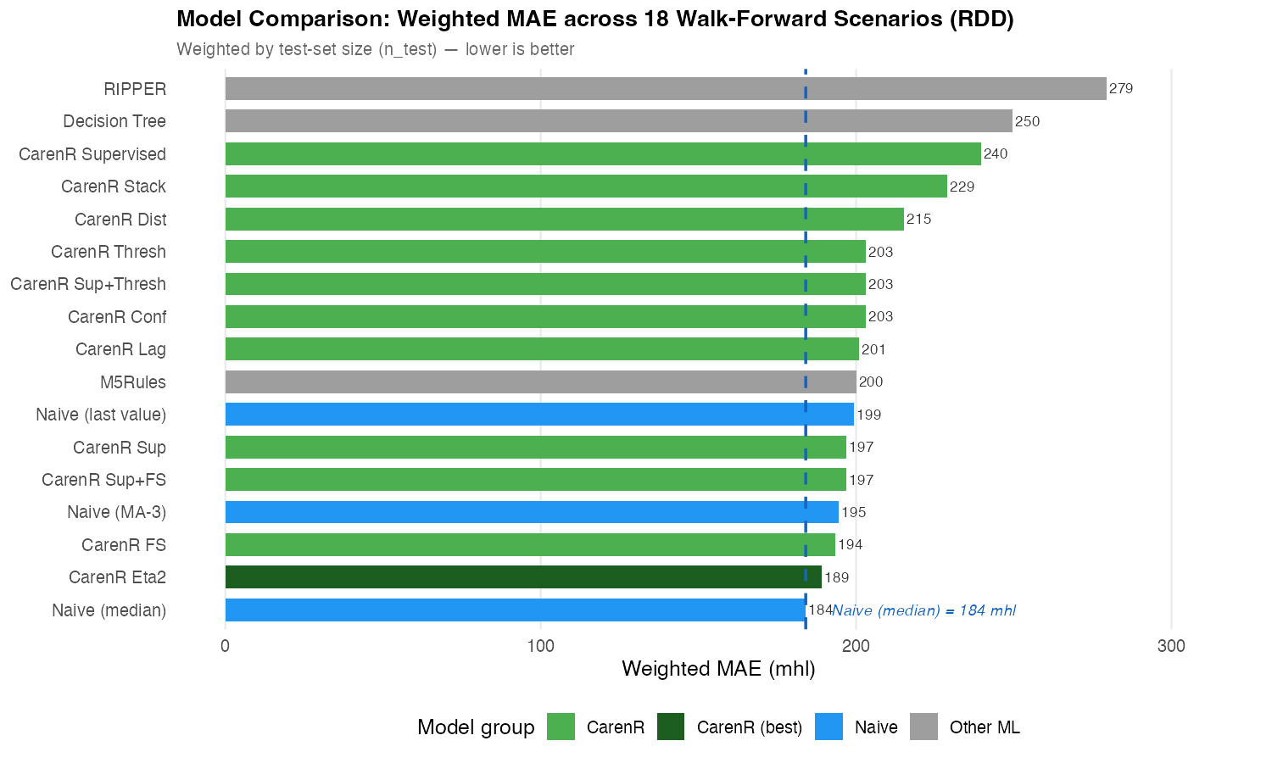
IDEA 4 · LAWFUL FAILURE
The honest result: nobody beats the median
DOURO
+3%
189 vs 184 mhl
Wilcoxon p = 0.468 (n.s.)
VINHO VERDE
+22%
172 vs 140 mhl
rules actively harm, p = 0.004
Predict the historical median → you beat every rule-based model.
Douro — weighted MAE, all 17 models (lower is better)
13
Notes:
I won't dress this up. Predict the historical median and you beat every rule model — 3% in the Douro, 22% in Vinho Verde, where firing rules makes it worse. Real rules, no forecast edge. That's the puzzle. I refused to stop at 'it didn't work,' because the failure has a shape.

Slide 14
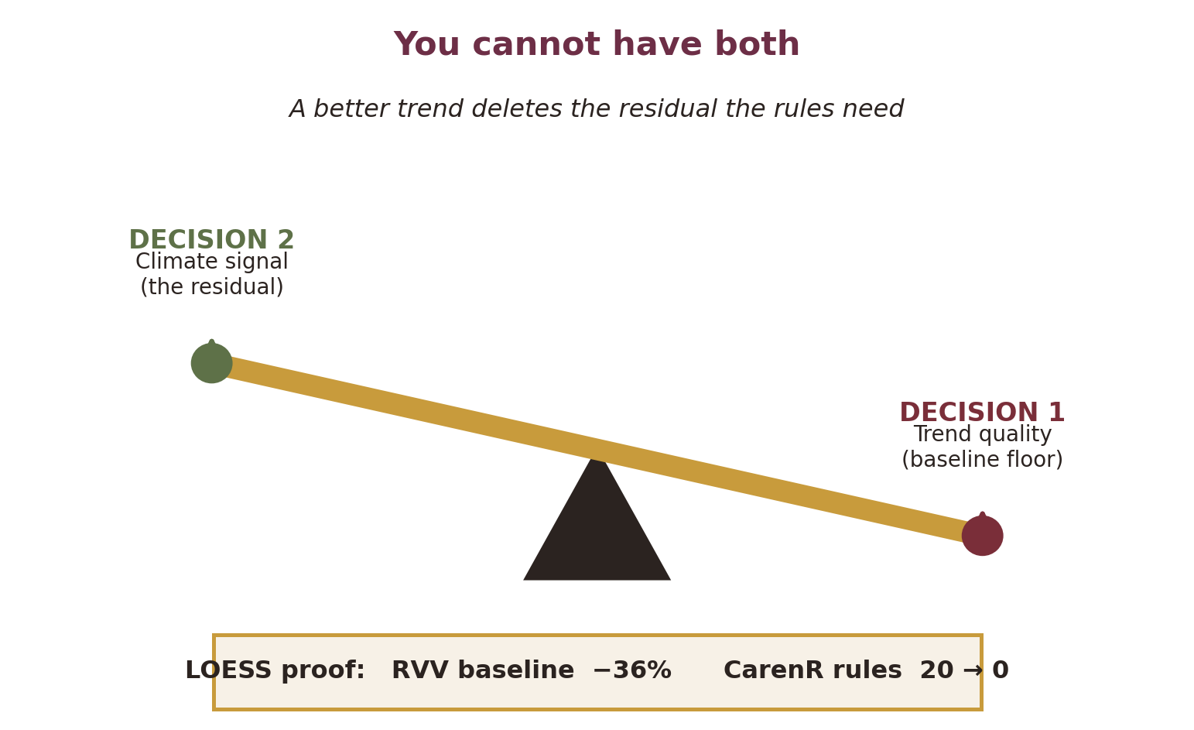
IDEA 4 · LAWFUL FAILURE
Discovery ≠ Prediction — and I can prove why
The failure is lawful, not random.
Discovery needs only that an association exists. Prediction needs it to beat the median. The same time-only detrend cannot serve both.
THE ERA MIRROR
Douro: once era-balanced (~29% modern), CarenR wins 5 / 5 scenarios.
Vinho Verde: more modern data makes it steadily worse — the mirror opposite.
14
Notes:
Here's the finding and why it's not a dead end. Make the trend more flexible with LOESS and Vinho Verde's baseline improves 36% — but every rule disappears, because the flexible trend ate the variation the rules were built from. Decision 1 and Decision 2 fight over the same variance because both are parameterized by time alone. Discovery and prediction ask different things of the same signal. That's the two-decision trade-off — the name I'd like you to remember. The p=0.031 era-balanced win is post-hoc; I lead with the pattern, which is robust. [If challenged on the negative result, cite Prof. Cunha's own review: in this field 'the statistics are usually very good, but the predictions are not useful for production' — my two-decision framework explains exactly why.]

Slide 15
IDEA 5 · DIAGNOSIS
Contributions
1
The two-decision framework — a diagnostic that explains why rule-based prediction fails even when genuine signal exists.
Structured 11-variant analysis
Era-composition regime
2
3
Optimal CarenR configuration is problem-specific — η² for Douro, Sup_FS for Vinho Verde.
A conditional window where rule-based prediction becomes competitive (Douro).
Cross-algorithm validation
A demanding real-world testbed
4
5
RIPPER and M5Rules confirm CarenR's features via different criteria.
80–90 years, genuine non-stationarity, expert-verifiable output.
15
Notes:
Five contributions. The headline is the two-decision framework — a diagnostic that explains why rule-based prediction fails even when real signal exists. Then: a systematic variant analysis showing the best configuration is region-specific; the era-composition regime; three-way cross-algorithm validation; and a demanding real-world testbed.

Slide 16
IDEA 5 · DIAGNOSIS
What I don't claim — and the fix that follows
LIMITATIONS
THE FIX THE DIAGNOSIS POINTS TO
Time-only detrending
the structural root of the whole trade-off.
n = 5 era-balanced window
post-hoc and underpowered — a hypothesis, labelled as such.
Single-region annual aggregates
no sub-regional or spatial signal available.
Structural detrending
yₜ = α + β₁t + β₂·area + β₃·quota + ε
Put planted area, quota and producer count into the trend, and the climate signal stays in the residual ε. Decisions 1 and 2 stop competing.
My own framework hands the next researcher the fix.
16
Notes:
Three limits: detrending on time alone — the structural root of the whole trade-off; the era-balanced win is five scenarios, post-hoc, underpowered — a hypothesis, and I label it so; and single-region annual aggregates. But the diagnosis is generative: put structural drivers into the trend, and Decisions 1 and 2 stop competing.

Slide 17
A negative result that knows why
1
HARD Real climate signal, buried in enormous noise.
2
AUDITABLE I chose rules you can question, not a black box.
3
REAL 68 rules · three algorithms agree · survive stress-testing.
4
LAWFUL FAILURE They don't predict — the two-decision trade-off says why.
5
DIAGNOSIS The contribution is knowing where to fix it — and it transfers.
The contribution is the diagnosis — and it transfers to any structurally non-stationary time series.
Thank you — I welcome your questions.
Notes:
Five things. It's a hard problem. I chose auditable rules. The rules are real, three ways over. They don't predict — and the two-decision trade-off says exactly why. And that diagnosis is the contribution: it transfers to any series where structure and signal are entangled. Thank you — your questions.

