Slide 1
MASTER'S DISSERTATION · FEUP · 2026
Wine production forecasting with interpretable rules
What can climate explain — and what can it reliably predict?
Hugo Filipe Queiróz Nogueira
Supervisors: João Mendes Moreira · Mário Campos Cunha
01
Notes:
Open with the practical tension: stakeholders need an early, credible forecast, but they also need to understand and audit the drivers behind it. This thesis asks whether interpretable climate rules can deliver both.

Slide 2
CONTEXT
The business question is a decision question
Can regional climate and vine development data improve the annual production forecast — early enough to change a decision?
Who uses the answer
Producers and cooperatives Regulatory bodies Supply-chain planners
Decisions affected
Harvest planning Storage and capacity Risk assessment
A useful model must add accuracy and preserve trust.
Prediction alone is insufficient when the mechanism cannot be explained or challenged.
Source: Thesis, Chapter 1 (Motivation)
02
Notes:
Make the business framing explicit. The output is not a score for its own sake. It must support harvest, storage, capacity and risk decisions. Interpretability matters because the users are agronomists, producers, cooperatives and regulators.

Slide 3
RESEARCH PROBLEM
The problem is not only forecasting, but auditable forecasting
The gap
What a rule looks like
Modern ML can predict wine yield, but decision-makers need readable rules they can challenge with domain knowledge.
IF harvest soil water is moderate
AND post-maturity wet days are low
THEN production is +192 mhl
support 21.3% · p = 0.0095
No prior work combines all five properties
Why interpretability matters
Interpretable
Long-term
Predictive
Wine region
Readable by agronomists without ML expertise
Each rule carries support and a p-value
Can be challenged and domain-validated
Useful for diagnosis even when forecasting fails
Modern ML
no
partial
yes
Subgroup discovery
yes
no
no
This thesis
yes
yes
yes
Source: Thesis, Sections 1.1-1.3 and Table 2.1
03
Notes:
This slide sharpens the motivation: the thesis is not trying to beat black-box ML on accuracy alone. It asks whether interpretable distributional rules can create auditable knowledge from long regional wine-production records. Use the rule example to make the output tangible before moving into the formal design.

Slide 4
PROBLEM
Why this is hard: the climate signal is real, but diluted
The target combines climate, physiology, human decisions and structural change in one annual regional number.
01
02
03
04
Biology spans years
Aggregation hides variation
Structure changes over time
The sample is small
Yield potential is partly set in the previous season, before the harvest year begins.
Thousands of vineyards differ in soil, altitude, practices and local weather.
Policy, planted area, producers and market conditions shift the production baseline.
Only 80–89 annual observations must support 59 engineered features.
Source: Thesis, Sections 1.1, 2.8 and 3.1
04
Notes:
Stress that regional production is an unusually noisy target. Climate is only one layer. Vineyard heterogeneity and structural breaks can be larger than the climate effect, while the sample remains fewer than 90 annual observations.

Slide 5
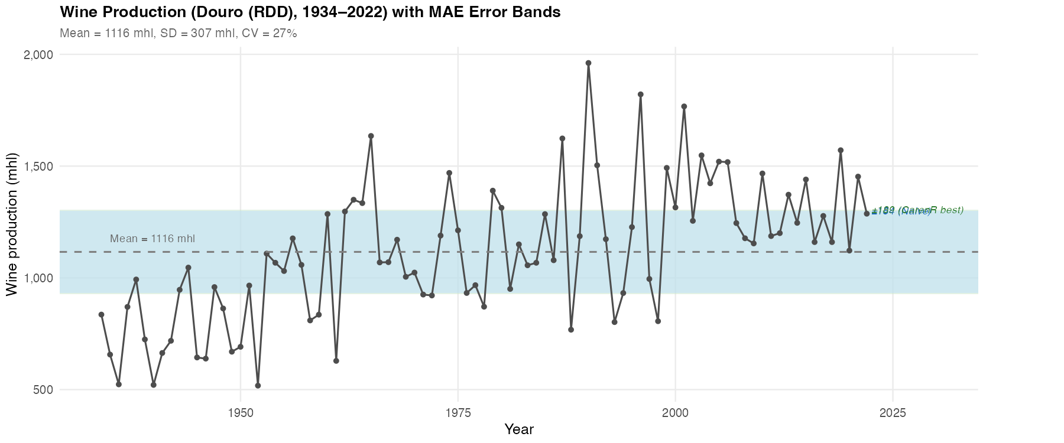
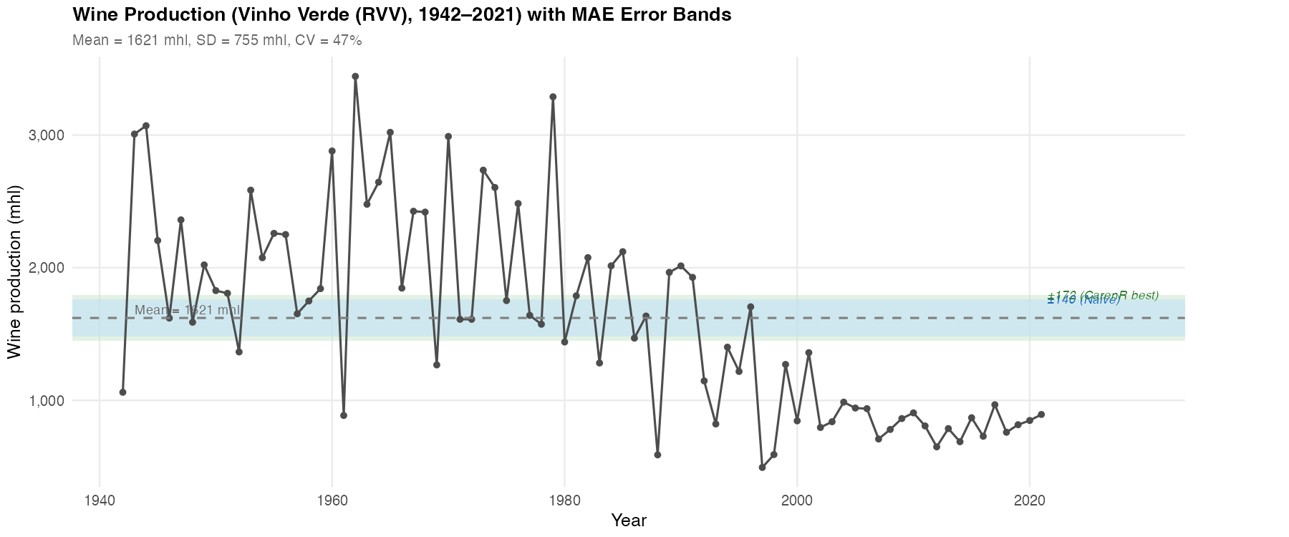
NATURAL EXPERIMENT
The same pipeline meets two different histories
DOURO · 89 years
VINHO VERDE · 80 years
Gradual +80% structural rise; CV 27%
Sharp structural decline; CV 47%
Source: Thesis, Figures 3.1–3.2 and Appendix B
05
Notes:
Present the two regions as a natural comparative experiment: same feature engineering, algorithms and validation; different structural histories and climate regimes. The difference is not cosmetic — it tests when the method succeeds or fails.

Slide 6
GRAPEVINE CYCLE
Current production begins in the previous growing season
YEAR y0 · POTENTIAL
YEAR y1 · REALISATION
Primordia formation
Bud break
Veraison to harvest
CARRY- OVER
Reserve building
Flowering & fruit set
Temperature and light set the upper bound on bunch number.
Current-year temperature, rain, canopy and soil water determine fruit set and berry development.
Prior water and thermal stress shape carbohydrate reserves.
Source: Thesis, Section 2.2 — The Two-Year Vine Development Cycle
06
Notes:
Explain the two carry-over mechanisms. Inflorescence primordia form in y0 and set an upper bound on bunch number. Reserves accumulated after the previous harvest influence reproductive investment in y1. Therefore, a current-year-only dataset is physiologically incomplete.

Slide 7
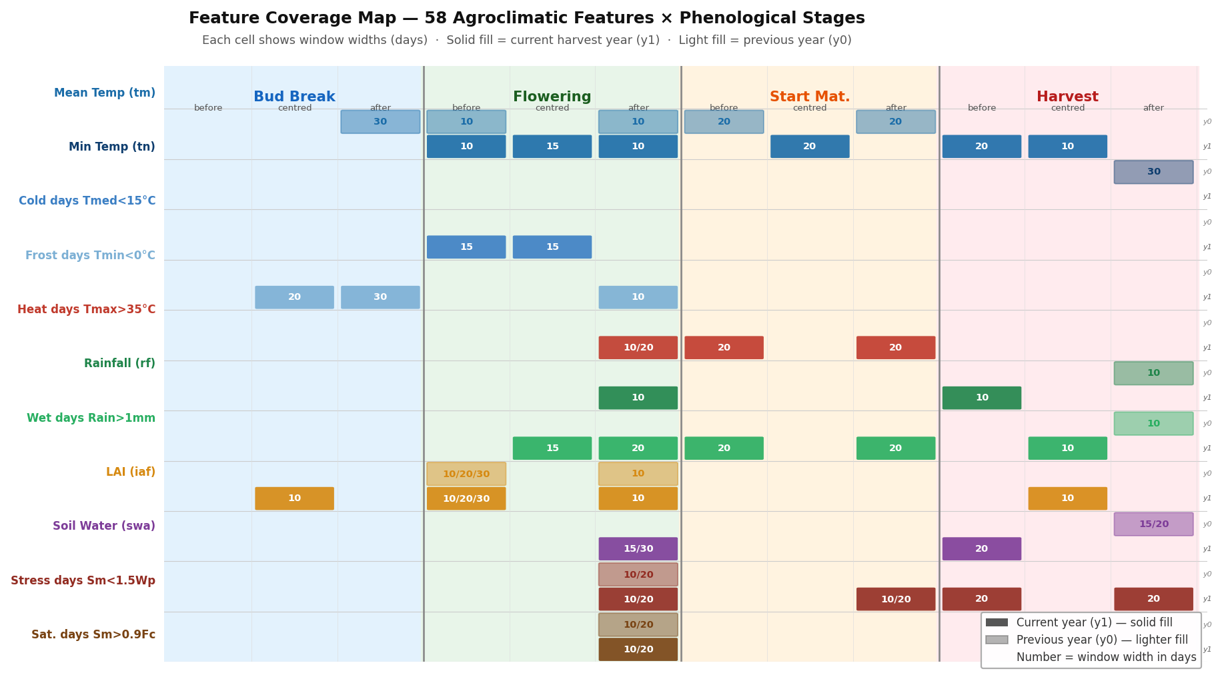
FEATURE ENGINEERING
Features follow the biology, not the calendar
32,842 / 29,902 daily records
→ 59 annual predictors
→ 4 phenological anchors
→ current + previous year
Source: Thesis, Figure D.1 and Section 3.11. The map visualises 58 agroclimatic windows; the model set contains 59 predictors in total.
07
Notes:
Use the infographic to show how daily weather is converted into windows around bud break, flowering, start of maturity and harvest. The final set contains temperature, rainfall, wet days, LAI, soil water and stress indicators, with current- and previous-year windows.

Slide 8
POSITIONING
The research gap sits between explanation and prediction
Modern machine learning
Rule-based discovery
Handles nonlinear interactions Often strong predictive accuracy Decision logic remains opaque
Produces explicit IF–THEN rules Auditable support and significance Predictive value is unproven here
Can we have both?
No prior work systematically evaluated distributional subgroup discovery in walk-forward wine production forecasting.
Source: Thesis, Sections 1.1 and 2.7
08
Notes:
The thesis is deliberately not a contest against every black-box model. It targets the missing combination: continuous target, long non-stationary data, interpretable rules and rigorous predictive validation.

Slide 9
RESEARCH DESIGN
Two goals separate historical insight from future utility
GOAL 1
GOAL 2
Discover
Validate
Which agroclimatic conditions distinguish above- and below-trend production years?
Can rule-based models beat the historical median in genuine future periods?
RQ1 · dominant variables RQ2 · genuine signal or era confound?
RQ3 · out-of-sample improvement RQ4 · conditions for success or failure
Same data and rule family — different standard of evidence.
Source: Thesis, Section 1.2
09
Notes:
Be explicit that the two goals are complementary, not interchangeable. A valid association can be valuable for understanding and still be too weak to improve future forecasts.

Slide 10
STUDY DESIGN
A controlled comparison isolates the role of data structure
SAME
DIFFERENT
2
Feature engineering Detrending logic Rule learners Evaluation metric
Climate regime Structural trajectory Noise level Era composition
regions
89 + 80
annual observations
The contrast turns two case studies into a natural experiment.
Source: Thesis, Sections 3.1 and 3.11
10
Notes:
The scientific value comes from holding the pipeline constant. Divergent outcomes can then be interpreted in relation to structural history, signal availability and noise rather than arbitrary modelling choices.

Slide 11
DATA & EXPERIMENTAL DESIGN
The comparison is controlled: same pipeline, different regional histories
Characteristic
Douro
Vinho Verde
59 agroclimatic features per region
Period
1934-2022
1942-2021
Temperature · rainfall · soil water · LAI
Heat/frost days · prior-year lags
Anchored on vine phenological dates
Observations
89 years
80 years
Climate
Semi-arid
Atlantic
CarenR
RIPPER
M5Rules
Production trend
+80% rise
-65% decline
Distributional
rules · KS
Classification
rules · FOIL
Piecewise
rules · MSE
Walk-forward
18 scenarios
16 scenarios
Walk-forward expanding-window validation
All preprocessing stays inside each training fold: detrending, discretisation, feature selection and rule induction.
Source: Thesis, Sections 3.1, 3.4-3.7 and 3.11
11
Notes:
This slide makes the experimental control explicit. Same features, same algorithms, same validation protocol; the structural histories differ. That is why divergent outcomes are informative rather than a nuisance.

Slide 12
ALGORITHMS
CarenR is the primary lens among five model families
COMPARATORS
PRIMARY METHOD
CarenR
RIPPER
Classification rules for below / on / above trend
Distributional subgroup discovery
1
Discretise
Climate features become equal-frequency bins.
M5Rules
Piecewise linear regression rules
2
Search
Beam search combines feature-bin conditions.
Decision Tree
Non-rule ML comparator using all features
3
Compare
KS test: subgroup residuals vs global residuals.
Naive baselines
Median · last value · 3-year moving average
4
Retain
Keep significant rules with sufficient support.
OUTPUT · IF climate conditions → shifted production-residual distribution
11 CarenR variants test feature selection and prediction aggregation — not 11 different algorithms.
Source: Thesis, Sections 3.4 and Tables 3.2–3.4
12
Notes:
Introduce the complete algorithm set, then focus on CarenR. CarenR does not predict by fitting one global equation: it searches for recurring climate-defined subgroups whose residual distribution differs from the full historical distribution. RIPPER, M5Rules and the Decision Tree answer different optimisation questions; the naive models establish whether climate adds value at all.

Slide 13
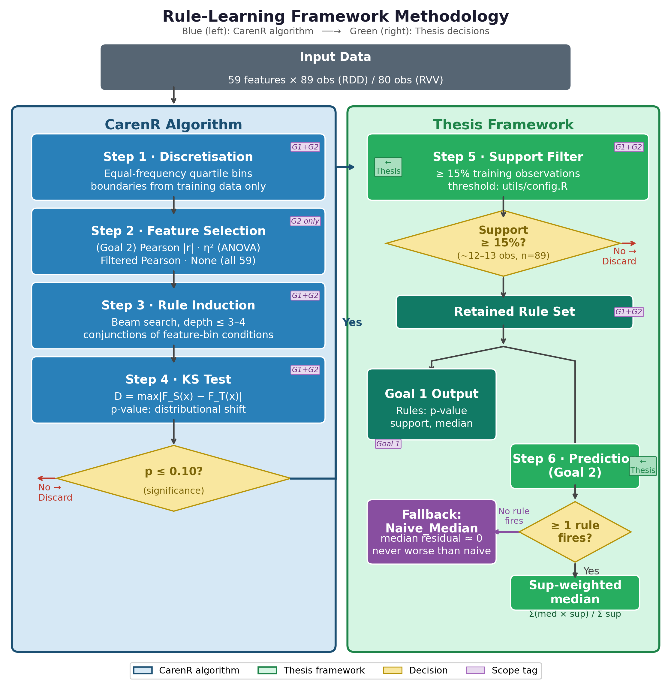
METHOD · DISCOVERY
Goal 1 finds statistically exceptional subgroups
CarenR asks a distributional question
Do years matching these climate conditions have a production-residual distribution that differs from all years?
IF
wet days after flowering are low AND post-maturity wet days are low
THEN
the residual distribution shifts
KS p ≤ 0.10 · support ≥ 20% for discovery
Source: Thesis, Figure 3.3 and Section 3.4.1
13
Notes:
Explain the algorithm at a conceptual level: discretise features, search conjunctions, compare subgroup and global residual distributions with the KS test, then retain rules with adequate significance and support. Avoid spending time on beam-search implementation details.

Slide 14
RESULTS · DISCOVERY
Goal 1 succeeded: compact rules reveal regional drivers
DOURO
VINHO VERDE
48
20
rules
rules
Harvest soil water appears in 54% of rules.
LAI at harvest appears in all 20 rules.
Dry post-flowering conditions and bounded heat repeatedly associate with above-trend production.
Canopy development, heat stress and harvest soil water dominate the regional rule set.
The same variable can have a different direction across regions — interpretation must remain context-specific.
Source: Thesis, Chapter 4
14
Notes:
Lead with rule counts and then the dominant variables. Avoid implying causality. These are statistically validated associations with agronomic coherence, not controlled experiments.

Slide 15
RESULTS · RULES
The strongest CarenR rules point to water and canopy structure
DOURO · top 5 CarenR rules
VINHO VERDE · top 5 CarenR rules
4 of 5 are above-trend: dry flowering and bounded heat define good years.
4 of 5 are below-trend: cool, moist conditions dominate the Atlantic region.
1
Dry flowering + dry maturity
+121 mhl
1
Moist harvest + no heat stress
-338 mhl
28.1% support · p=0.0043
21.2% support · p=0.0198
2
High LAI + wet flowering
-131 mhl
2
Cool flowering + prior soil saturation
-268 mhl
20.2% support · p=0.0084
21.2% support · p=0.0216
3
Dry + moderate heat after flowering
+113 mhl
3
Moist post-flowering + low heat
-365 mhl
25.8% support · p=0.0089
27.5% support · p=0.0294
4
Harvest water + carry-over dryness
+192 mhl
4
Warm prior budburst + mild flowering
+311 mhl
21.3% support · p=0.0095
25.0% support · p=0.0298
5
Dry flowering + bounded heat
+115 mhl
5
Cool post-flowering + wet carry-over
-292 mhl
24.7% support · p=0.0110
23.8% support · p=0.0299
Cross-algorithm finding
Across methods: harvest soil water and LAI/canopy survive.
CarenR, RIPPER and M5Rules all select them, so the signal is not tied to one optimisation criterion.
Source: Thesis, Tables 4.1-4.2 and 4.9
15
Notes:
Use this slide to make the rules concrete. In Douro, the top rules mostly describe above-trend years: dry post-flowering and post-maturity windows, moderate pre-harvest soil water, and bounded heat. In Vinho Verde, four of the top five rules are below-trend and describe cool, moist conditions; the one above-trend rule is the warm-but-not-extreme carry-over case. Then make the robustness point: harvest soil water and the LAI/canopy family are selected across CarenR, RIPPER and M5Rules, so these are not just CarenR artefacts. Previous-year summer temperature is a secondary all-method carry-over signal, but the two easiest findings to defend are water status and canopy vigour.

Slide 16
CROSS-ALGORITHM VALIDATION
Three optimisation criteria recover the same feature families
Feature
CarenR
RIPPER
M5Rules
Confidence
Harvest soil water
54% of RDD rules
25% of RVV rules
RVV Rule 3
-2.3/mm RDD
-8.1/mm RVV
HIGH
universal
LAI / canopy family
All 20 RVV rules
minor RDD signal
RVV Rules 1-2
-2064/unit RVV
variable selected
HIGH
universal
Previous-year
summer temperature
RVV carry-over
RVV Rule 3
+17.2/C RVV
HIGH
RVV focus
Wet days
after flowering
21% of RDD rules
not selected
not selected
MODERATE
CarenR-specific
Agreement across three independent methods is the strongest evidence that the rule features reflect real data structure, not algorithmic noise.
Source: Thesis, Table 4.9 and Section 4.5
16
Notes:
Use this slide to show that the rule findings are not fragile. CarenR, RIPPER and M5Rules optimise different objectives, yet converge on harvest soil water, LAI/canopy and previous-year summer temperature. Wet days after flowering is useful as a contrast: CarenR finds a distributional shift that the other methods miss.

Slide 17
RESULTS · VALIDATION
Two checks confirm the discovered signal
01
02
Aggressive detrending
Independent algorithms
RDD signals persist after LOESS; in RVV, wet-days persist while LAI and soil water are era-linked.
RIPPER and M5Rules converge on harvest soil water, LAI and previous-year temperature.
→ The signal is real, but not equally stable across regions.
→ The signal is not CarenR-specific.
Discovery is credible — but credibility is not yet predictive utility.
Source: Thesis, Sections 4.2 and 4.5
17
Notes:
This slide answers RQ2 with nuance. LOESS confirms that the Douro signals, and the RVV wet-days signal, are not merely era labels. But RVV LAI and harvest soil-water collapse under LOESS, which is itself informative: some discovered structure is climate signal, and some is entangled with regional structural change. Cross-algorithm convergence gives a second robustness check because the three methods optimise different criteria.

Slide 18
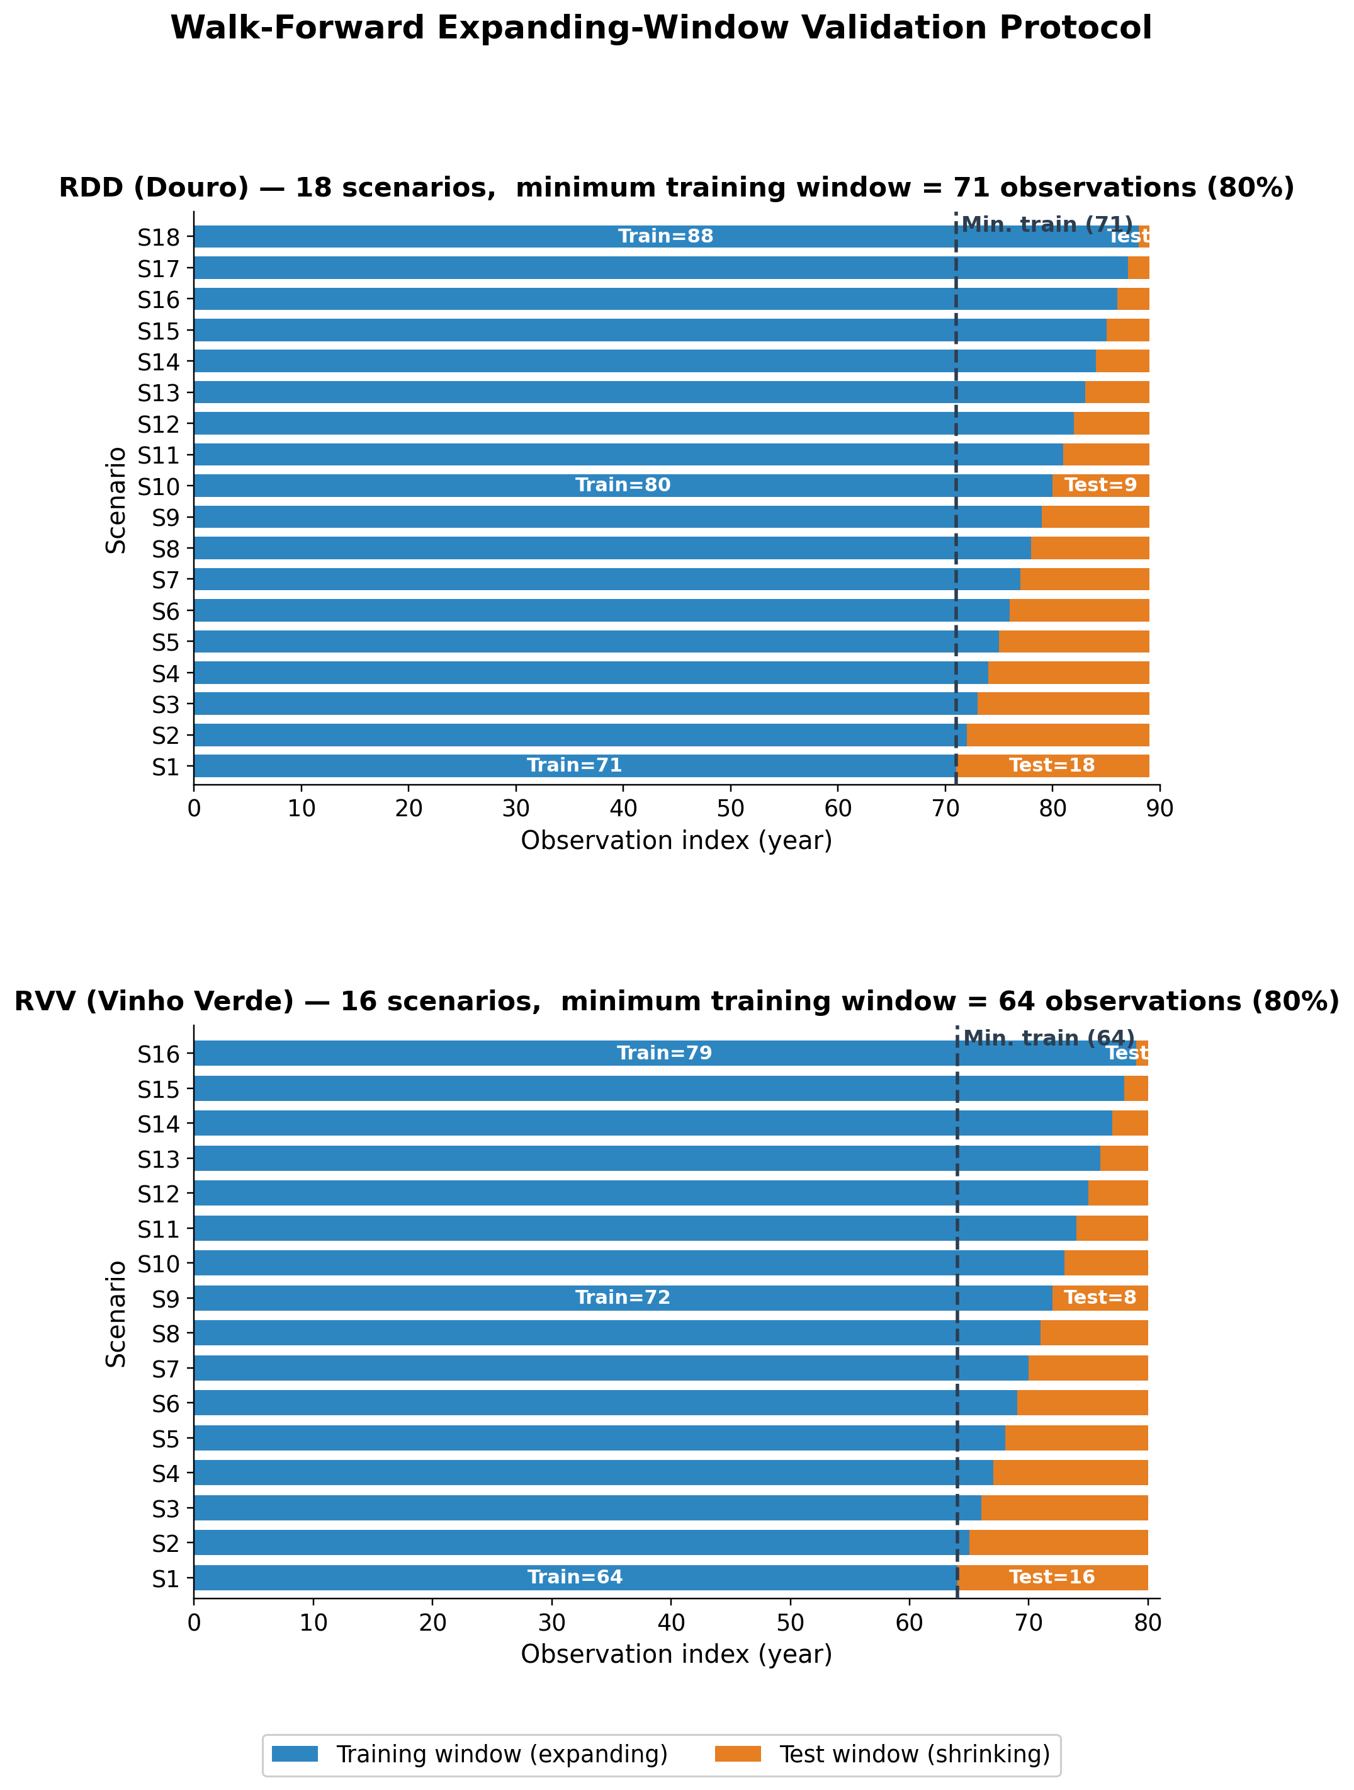
METHOD · PREDICTION
Goal 2 recreates prediction-time information
Expanding-window validation
18 scenarios · Douro 16 scenarios · Vinho Verde
All preprocessing stays inside each training fold:
• detrending • discretisation • feature selection • rule induction
17 models · weighted MAE · lower is better
Source: Thesis, Figure 3.4 and Sections 3.5–3.7
18
Notes:
Emphasise leakage prevention. Each scenario behaves like a real historical forecast: all thresholds, features and rules are learned only from the past. The primary comparator is the training median because it is the optimal constant forecast under MAE.

Slide 19
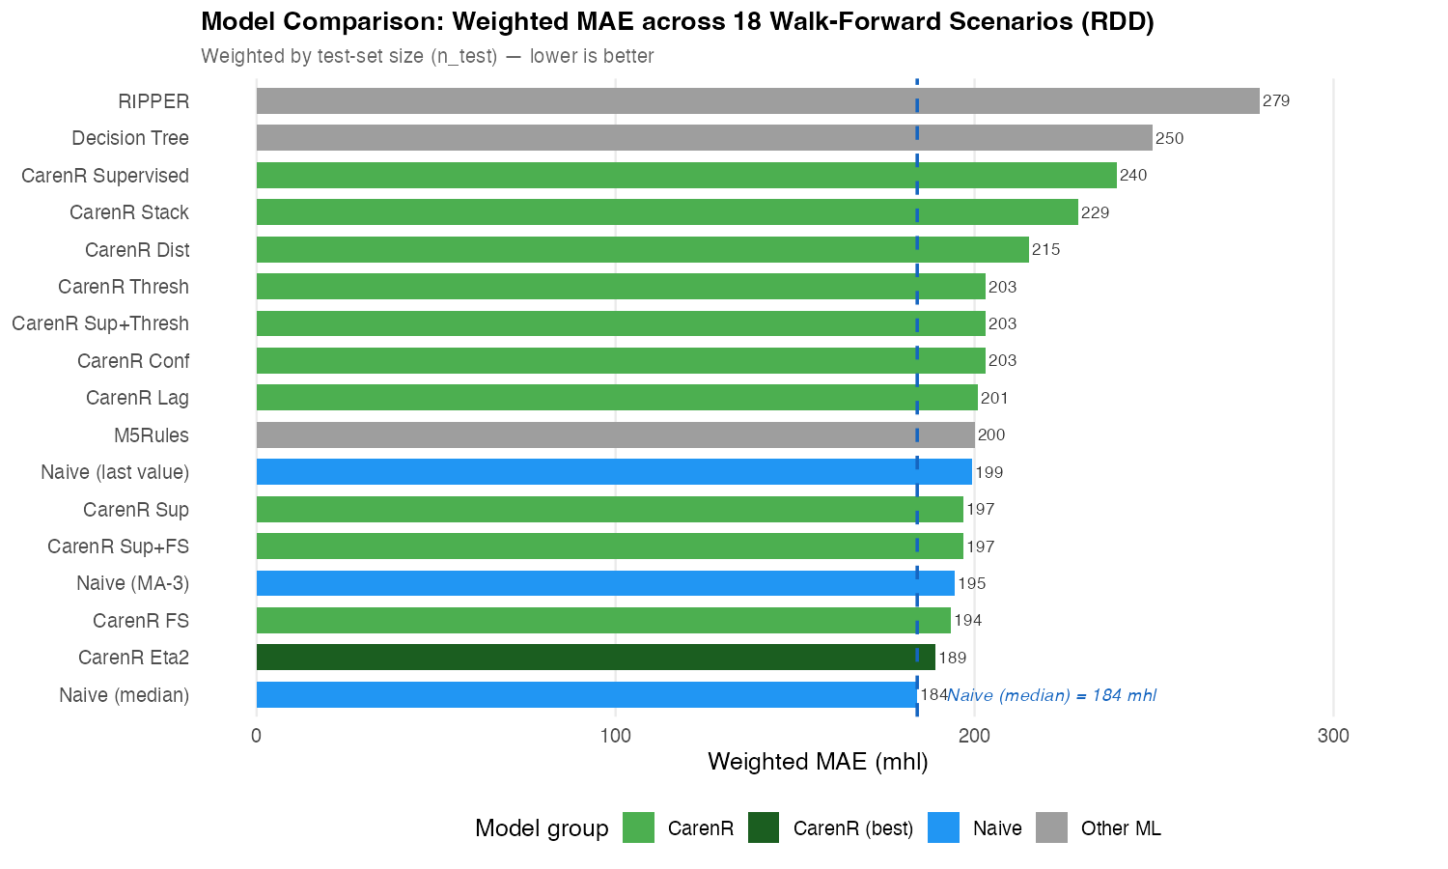
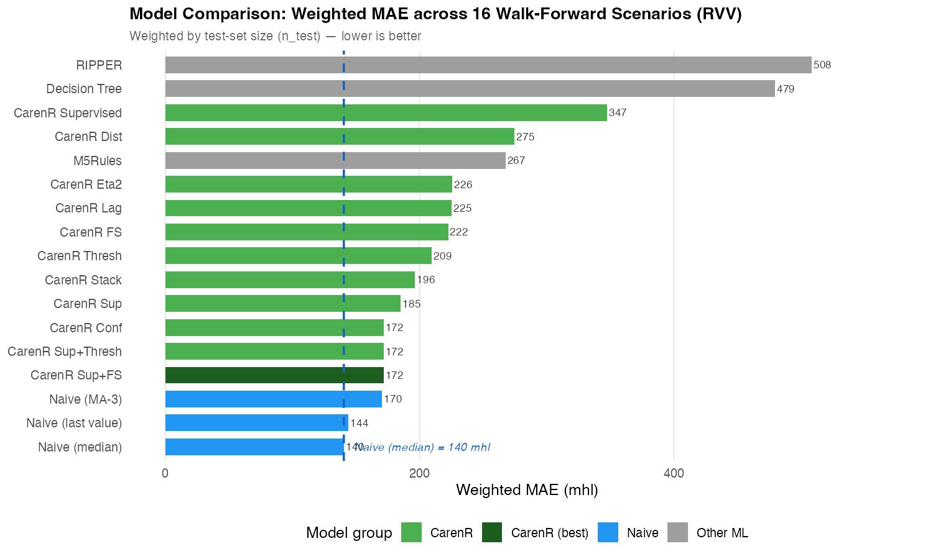
RESULTS · PREDICTION
No rule-based model beats the median overall
RDD · 189 vs 184 mhl
3% worse · p = 0.468
RVV · 172 vs 140 mhl
22% worse · p = 0.004*
*Among the 9 scenarios where RVV rules fired, they significantly harmed prediction.
Source: Thesis, Figures 5.1–5.2 and Table 5.6
19
Notes:
State the negative result directly. In Douro the best CarenR variant is close but not significantly different from the median. In Vinho Verde the gap is large, and when rules fire they actively worsen forecasts. Goal 2 is not achieved in aggregate.

Slide 20
INTERPRETATION
A real association can still be too weak to forecast
DISCOVERY
PREDICTION
Is the subgroup distribution different?
Does the rule reduce future error?
≠
With |r| ≈ 0.47, the association is detectable across 80–89 historical years.
Climate explains ≈22% of residual variance; ≈78% remains unobserved or noisy.
Pattern discovery and forecasting answer different questions.
Source: Thesis, Section 6.1
20
Notes:
This is the conceptual heart of the thesis. Statistical association only requires a consistent shift in distribution. Prediction requires the shift to be large enough to reduce error in unseen years. The remaining variance includes disease, local weather, logistics and measurement noise.

Slide 21
TWO-DECISION FRAMEWORK
Better detrending can remove the signal rules need
DECISION 1
DECISION 2
Model the structural trend
Extract climate signal
TENSION
A better trend leaves smaller test residuals and lowers the naive error floor.
Stable rules need residual structure that is large enough to detect and exploit.
RVV LOESS: baseline improves 140 → 90 mhl, but rule induction falls to zero.
Time alone cannot cleanly separate industry structure from climate.
Source: Thesis, Sections 3.3, 5.5 and 6.2
21
Notes:
Explain the original two-decision contribution. Flexible detrending improves the baseline, but can remove the residual signal required for rules. With time as the only structural covariate, these objectives compete. This diagnoses the failure rather than merely reporting it.

Slide 22
REGIONAL CONTRAST
The two regions diverge because structure contaminates the signal
Dimension
Douro
Vinho Verde
Implication
Production trend
+80% gradual rise
-65% structural decline
RVV era confound is stronger
Climate signal after LOESS
Retained in top RDD features
LAI and soil-water collapse
Some RVV rules are era-linked
Prediction outcome
3% gap; competitive in era-balanced window
22% gap; 0/16 wins
Structure removes the climate advantage
Interpretation
Rules can diagnose historical regimes
Rules fire in the wrong era context
Forecasting needs structural covariates
The same algorithm produces different outcomes because the production histories are genuinely different.
Source: Thesis, Sections 5.2-5.5 and 6.2-6.3
22
Notes:
This is the confound slide. It matters because it explains why the negative forecast result is scientifically useful: the model is not simply bad; it is revealing that structural history controls whether climate rules transfer prospectively.

Slide 23
CONTRIBUTIONS
Five scientific contributions clarify why rules work and fail
1
Two-decision framework separates trend quality from residual climate-signal extraction.
2 · Walk-forward evaluation
3 · Sensitivity analysis
4 · Era-composition analysis
17 models, 18/16 scenarios, and all preprocessing inside each fold.
Eleven CarenR variants show the best feature-selection strategy is problem-specific.
Identifies when rule-based prediction may become viable, not just whether it wins overall.
5 · Cross-algorithm validation: RIPPER and M5Rules independently confirm CarenR feature families.
Source: Thesis, Section 7.2
23
Notes:
Frame the negative predictive result as useful boundary-setting. The work contributes a transferable way to diagnose rule-based forecasting on non-stationary series. For business, the rules support learning and scenarios today, but not automated forecast replacement.

Slide 24
LIMITATIONS & FUTURE WORK
The next evidence should separate climate from structure
Limitations
Future work
Time is the only detrending covariate, so structural change and climate remain partly mixed.
The walk-forward test has only 18 and 16 scenarios; the 5/5 RDD era-balanced result is exploratory.
Regional annual aggregates hide sub-regional weather and vineyard heterogeneity.
Add structural covariates: planted area, quotas and certified producers.
Pre-register and prospectively validate the era-balanced hypothesis.
Test other regional time series with weaker trends, and use higher-resolution climate data.
The thesis does not claim an operational forecast yet; it shows when interpretable rules are meaningful, when they fail, and what evidence is needed next.
Source: Thesis, Sections 7.3-7.5
24
Notes:
This is worth saying explicitly in the defence. The limitations are not afterthoughts; they point directly to the next experiment: explicit structural detrending, prospective validation, more granular data and regions with weaker long-run production trends.

Slide 25
NEXT STEPS
The next step is to model structure explicitly
01
02
03
04
Rules can explain the past. Structure determines whether they predict the future.
Structural covariates
Prospective validation
Higher spatial resolution
Other regions
& lower trend
Planted area, quotas, producers
Pre-register the era-balanced hypothesis
Capture within-region heterogeneity
Test time series with weaker structural trends
Thank you
Questions
Source: Thesis, Sections 7.4–7.5
25
Notes:
Close by returning to the opening question. The rules reveal credible agroclimatic structure, but operational prediction requires explicit structural covariates and prospective validation. A key next test is whether CarenR performs better on other wine regions or agricultural time series where the long-run structural trend is weaker, because that would reduce the era confound and let the climate signal be evaluated more cleanly.

