Slide 1
Portfolio Website
Harry Frankel

Slide 2
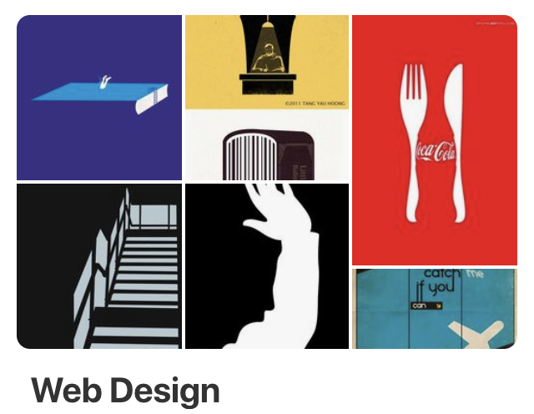
Design
Mood (Pintrest)
Inspiration other portfolio pages
Wireframes
Research trends (bold colours, asymmetrical design, etc.)
Refine UI

Slide 3
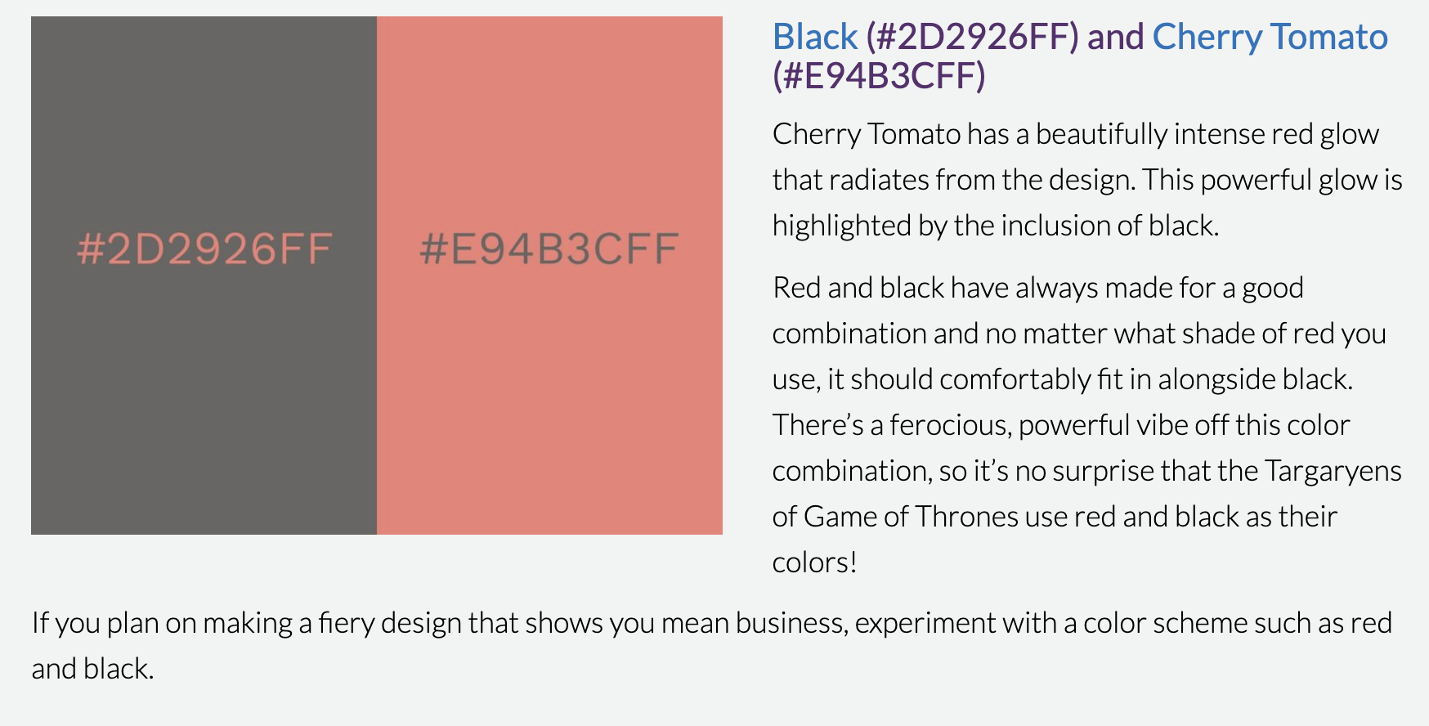
Design

Slide 4
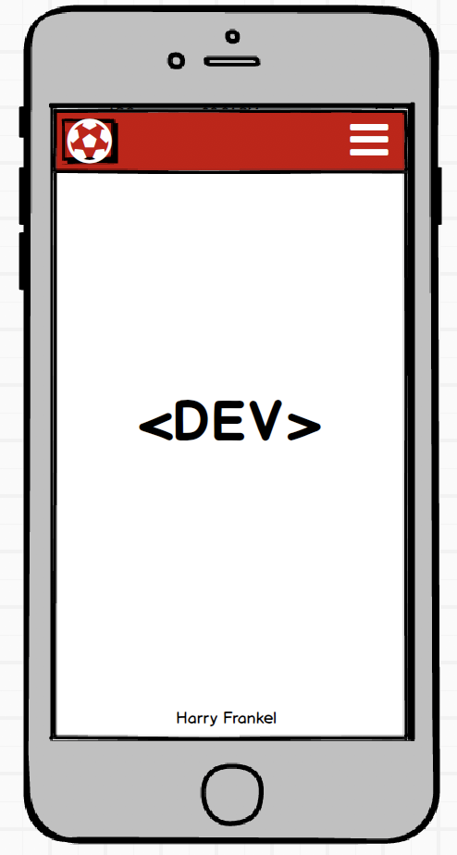
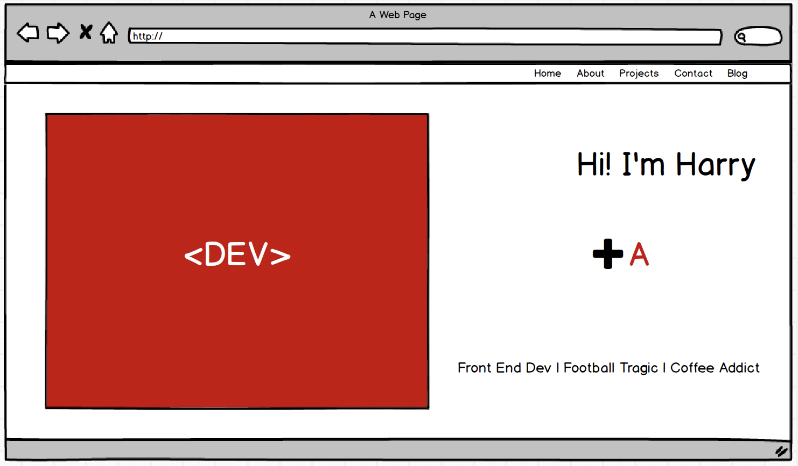
Design

Slide 5
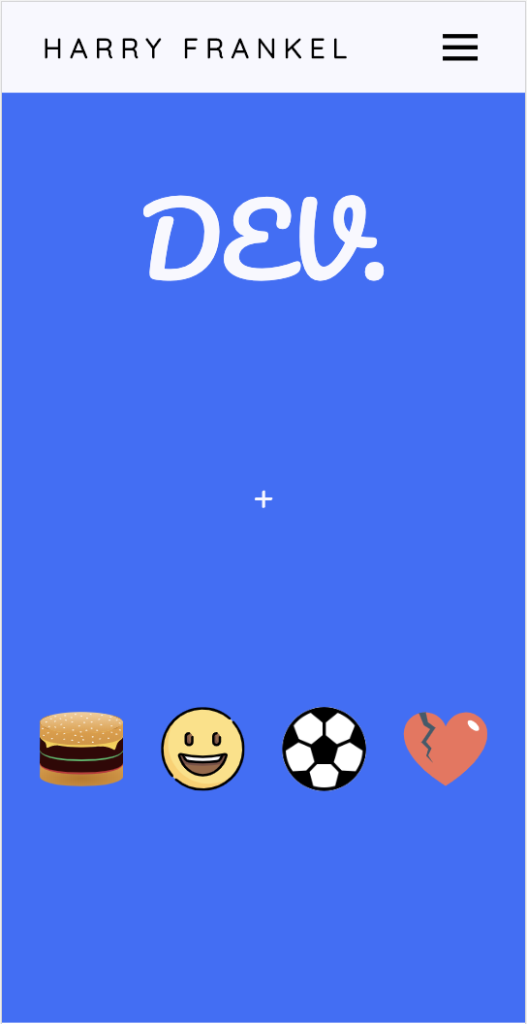
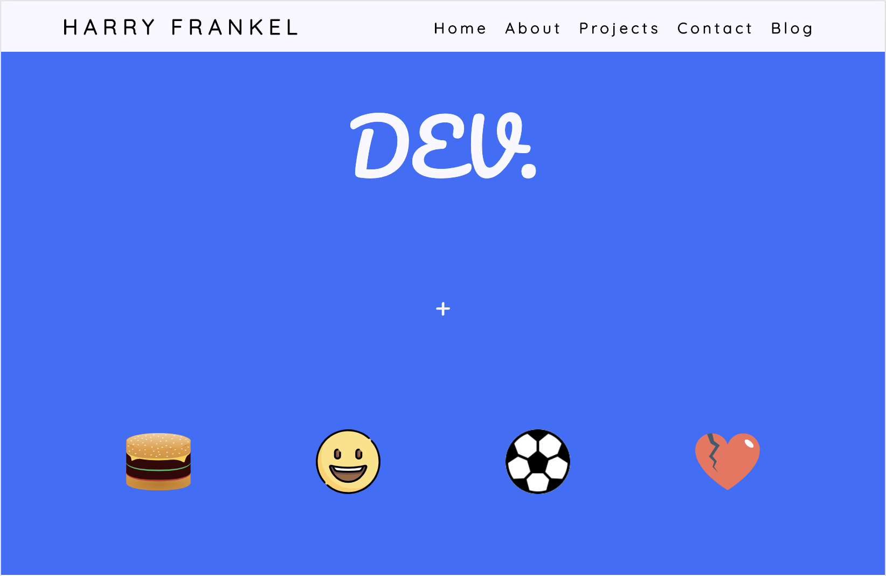
Design

Slide 6
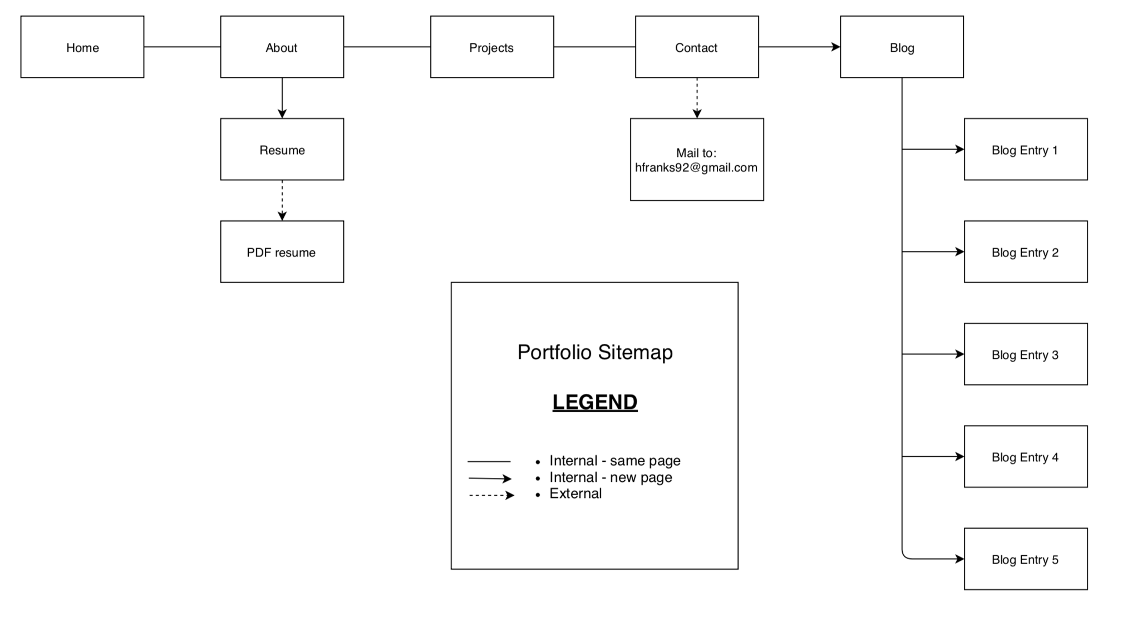
Build
Sitemap

Slide 7
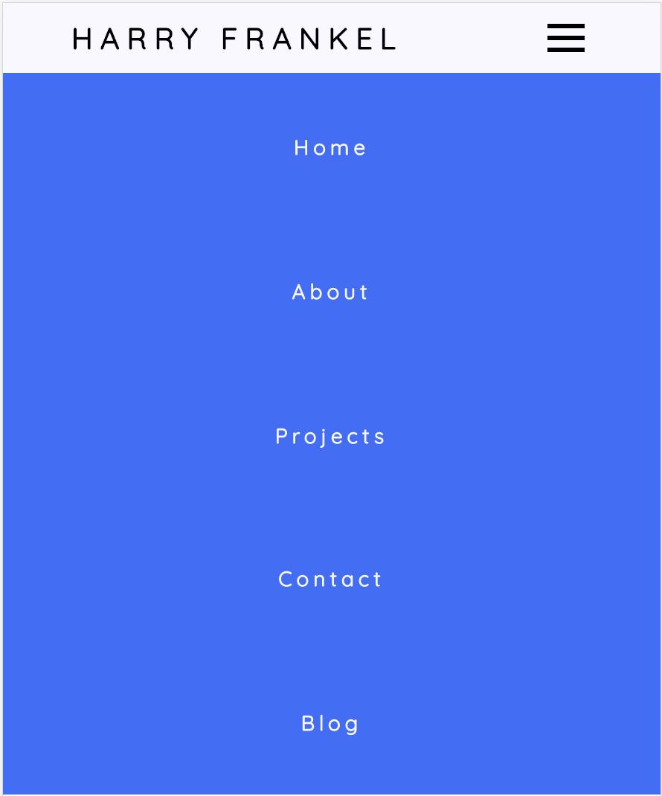

Build
Components

Slide 8
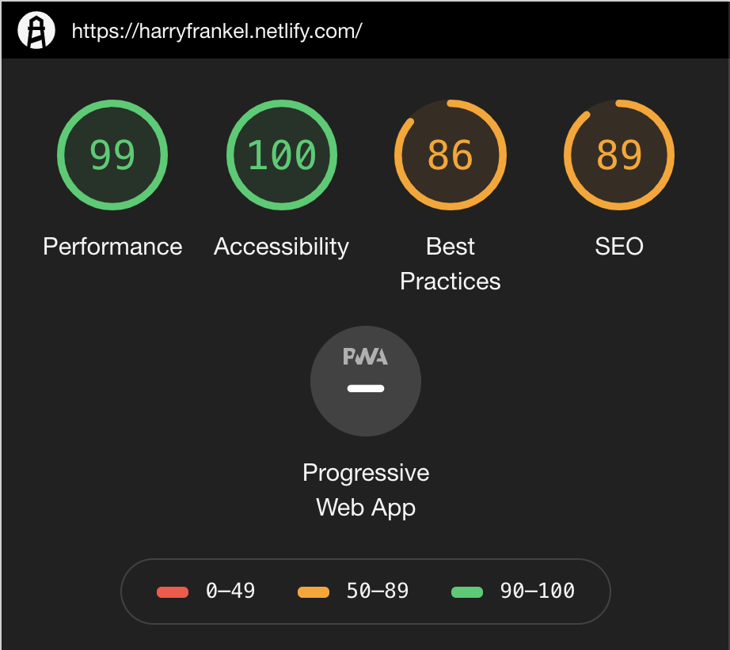
Build
Chrome Audit

Slide 9
</wrap>
UI is incredibly important
Chrome dev tools are awesome
Site made in less than a week

