Slide 1
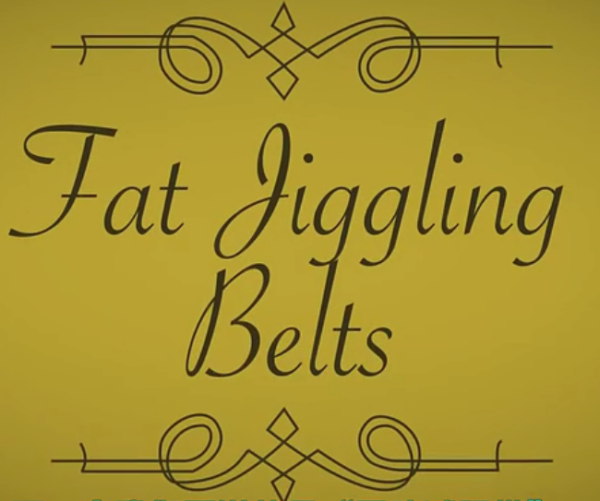
fat jiggling belts

Slide 2
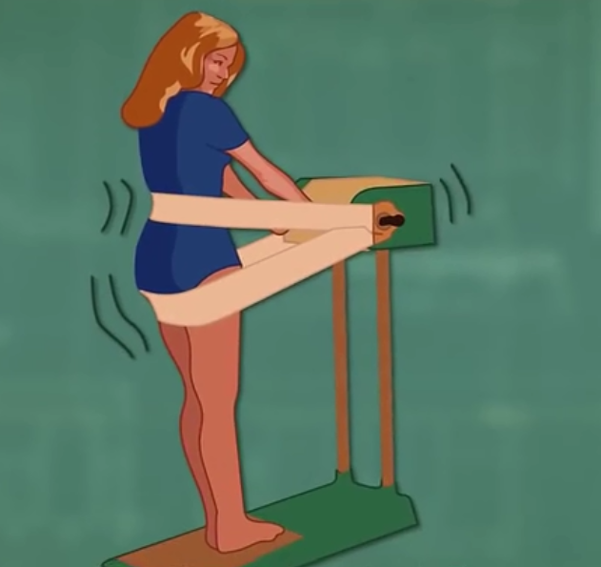
Why is useless？？？

Slide 3
solution
make your body flush away fat
CRYOLIPOLYSIS(冰冻溶脂)
body-shaking techniques
Exercise
Burns fat if your body’s breaking it down for energy

Slide 4
Support&Subscribe

