Slide 1

NAS Parallel Benchmarks on GPGPUs using a Directive-based Programming Model
Presented by Rengan Xu
rxu6@uh.edu
LCPC 2014
09/16/2014
Rengan Xu, Xiaonan Tian, Sunita Chandrasekaran,
Yonghong Yan, Barbara Chapman
HPC Tools group (http://web.cs.uh.edu/~hpctools/)
Department of Computer Science
University of Houston
Notes:
Give your email id or mine in the first and last slides.

Slide 2
Outline
Motivation
Overview of OpenACC and NPB benchmarks
Parallelization and Optimization Techniques
Performance Evaluation
Conclusion and Future Work

Slide 3
Motivation
Provide an open source OpenACC compiler
Evaluation of our open source OpenACC compiler with some real application
NPB is the benchmark suite close to real applications
Identifying parallelization techniques to improving performance without losing portability

Slide 4
Overview of OpenACC
Standard, a high-level directive-based programming model for accelerators
OpenACC 2.0 released late 2013
Data Directive: copy/copyin/copyout/……
Data Synchronization directive
update
Compute Directive
Parallel: more control to the user
Kernels: more control to the compiler
Three levels of parallelism
Gang
Worker
Vector

Slide 5












OpenUH: An Open Source OpenACC Compiler
Link: http://web.cs.uh.edu/~openuh/
FRONTENDS (C, OpenACC)
Source Code with OpenACC Directives
IPA(Inter Procedural Analyzer)
PRELOWER
(Preprocess OpenACC)
GPU Code
NVCC
Compiler
WOPT
(Global Scalar Optimizer)
LOWER
(Transformation of OpenACC)
CPU Binary
PTX
Assembler
Loaded Dynamically
LNO
(Loop Nest Optimizer)
Runtime Library
WHIRL2CUDA
Linker
CG(Code for IA-32,IA-64,X86_64)
Executable
Notes:
Pre-lower verify the region correctness
Lower phase transform the OpenACC directives into IR

Slide 6
NAS Parallel Benchmarks (NPB)
Well recognized for evaluating current and emerging multi-core/many-core hardware architectures
5 parallel kernels
IS, EP, CG, MG and FT
3 simulated computational fluid dynamics (CFD) applications
LU, SP and BT
Different problem sizes
Class S: small for quick test purpose
Class W: workstation size
Class A: standard test problem
Class E: largest test problem
Notes:
~16x larger than the previous problem size

Slide 7
Steps to parallelize an application
Profile to find the hotspot
Analyze compute intensive loops to make it parallelizable
Add compute directives to these loops
Add data directive to manage data motion and synchronization
Optimize data structure and array access pattern
Apply Loop scheduling tuning
Apply other optimizations, e.g. async and cache

Slide 8
Parallelization and Optimization Techniques
Array privatization
Loop scheduling tuning
Memory coalescing optimization
Data motion optimization
Cache optimization
Array reduction optimization
Scan operation optimization

Slide 9
Array Privatization
Before array privatization
(has data race)
After array privatization
(no data race, increased memory)
#pragma acc kernels
for(k=0; k<=grid_points[2]-1; k++){
for(j=0; j<grid_points[1]-1; j++){
for(i=0; i<grid_points[0]-1; i++){
for(m=0; m<5; m++){
rhs[j][i][m] = forcing[k][j][i][m];
}
}
}
}
#pragma acc kernels
for(k=0; k<=grid_points[2]-1; k++){
for(j=0; j<grid_points[1]-1; j++){
for(i=0; i<grid_points[0]-1; i++){
for(m=0; m<5; m++){
}
}
}
}
rhs[j][i][m] = forcing[k][j][i][m];
rhs[k][j][i][m] = forcing[k][j][i][m];
Notes:
It is a technique of taking some data that is common or shared among parallel tasks and duplicating it so that different parallel tasks can have a private copy to operate
The compiler implementation is not mature yet to guarantee the result correctness
Thousands of threads will easily cause memory overflow
It limits us to apply optimization only to this kernel

Slide 10
Loop Scheduling Tuning
Before tuning
After tuning
#pragma acc kernels
for(k=0; k<=grid_points[2]-1; k++){
for(j=0; j<grid_points[1]-1; j++){
for(i=0; i<grid_points[0]-1; i++){
for(m=0; m<5; m++){
rhs[k][j][i][m] = forcing[k][j][i][m];
}
}
}
}
#pragma acc kernels loop gang
for(k=0; k<=grid_points[2]-1; k++){
#pragma acc loop worker
for(j=0; j<grid_points[1]-1; j++){
#pragma acc loop vector
for(i=0; i<grid_points[0]-1; i++){
for(m=0; m<5; m++){
rhs[k][j][i][m] = forcing[k][j][i][m];
}
}
}
}

Slide 11
Memory Coalescing Optimization
Non-coalesced memory access
Coalesced memory access
(loop interchange)
#pragma acc kernels loop gang
for(j=1; j <= gp12; j++){
#pragma acc loop worker
for(i=1; I <= gp02; i++){
#pragma acc loop vector
for(k=0; k <= ksize; k++){
fjacZ[0][0][k][i][j] = 0.0;
}
}
}
#pragma acc kernels loop gang
for(k=0; k <= ksize; k++){
#pragma acc loop worker
for(i=1; i<= gp02; i++){
#pragma acc loop vector
for(j=1; j <= gp12; j++){
fjacZ[0][0][k][i][j] = 0.0;
}
}
}

Slide 12
Memory Coalescing Optimization
Non-coalescing memory access
Coalesced memory access
(change data layout)
#pragma acc kernels loop gang
for(k=0; k<=grid_points[2]-1; k++){
#pragma acc loop worker
for(j=0; j<grid_points[1]-1; j++){
#pragma acc loop vector
for(i=0; i<grid_points[0]-1; i++){
for(m=0; m<5; m++){
rhs[k][j][i][m] = forcing[k][j][i][m];
}
}
}
}
#pragma acc kernels loop gang
for(k=0; k<=grid_points[2]-1; k++){
#pragma acc loop worker
for(j=0; j<grid_points[1]-1; j++){
#pragma acc loop vector
for(i=0; i<grid_points[0]-1; i++){
for(m=0; m<5; m++){
}
}
}
}
rhs[m][k][j][i] = forcing[m][k][j][i];

Slide 13
Data Movement Optimization
In NPB, most of the benchmarks contain many global arrays live throughout the entire program
Allocate memory at the beginning
Update directive to synchronize data between host and device

Slide 14
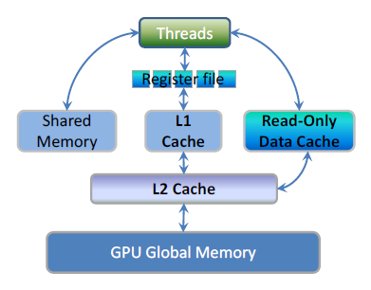
Cache Optimization
Utilize the Read-Only Data Cache in Kepler GPU
High bandwidth and low latency
Full speed unaligned memory access
Compiler annotates read only data automatically
Compiler scan the offload computation region and extract read-only data list
Alias issue: users need give more information to compiler.
Kernels region: “independent” clause in loop directive
Parallel region: users take full responsibility to control the transformation.
Notes:
Kepler what? 20 ?

Slide 15
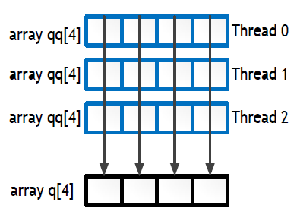
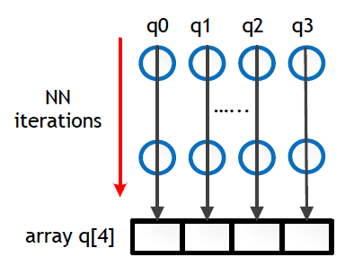
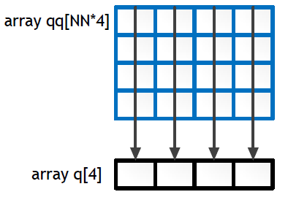
Array Reduction Optimization
Array reduction issue – every element of an array needs reduction
(a) OpenMP solution
(b) OpenACC solution 1
(c) OpenACC solution 2

Slide 16
Scan Operation Optimization
Input:
Inclusive scan output:
Exclusive scan output:
In-place scan: the input array and output array are the same
Proposed scan clause extension:
#pragma acc loop scan(operator:in-var,out-var,identity-var,count-var)
By default the scan is not in-place, which means the input array and output array are different
For inclusive scan, the identity value is ignored
For exclusive scan, the user has to specify the identity value
For in-place inclusive scan, the user must pass IN_PLACE in in-var
For in-place exclusive scan, the user must pass IN_PLACE in in-var and specify the identity value. The identity value must be the same as the first value of the provided array

Slide 17
Performance Evaluation
16 cores Intel Xeon E5-2640 x86_64 CPU with 32 GB memory
Kepler 20 GPU with 5GB memory
NPB 3.3 C version¹
GCC4.4.7, OpenUH
Compare to serial, OpenCL and CUDA version

Slide 18
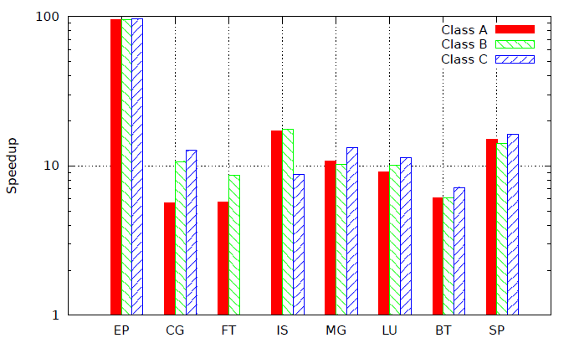
Performance Evaluation of OpenUH OpenACC NPB – compared to serial
Notes:
FT C is not executed since memory is limited
IS C speedup is slower because of contention to buckets

Slide 19
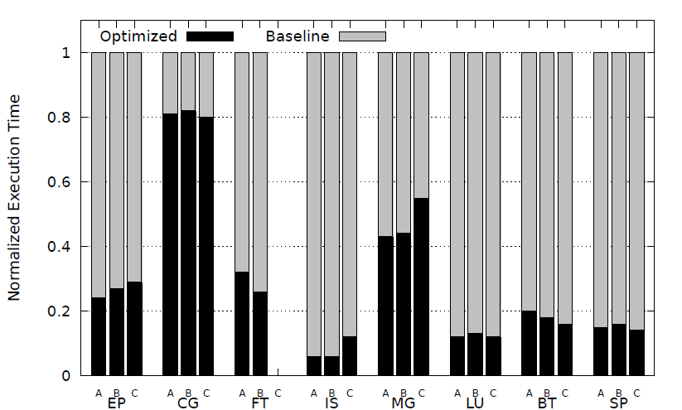
Performance Evaluation of OpenUH OpenACC NPB – effectiveness of optimization
Notes:
CG benefit from the cache optimization
FT: AoS to SoA transformation to enable memory coalescing
LU and BT improved 50% and 13% from cache optimization because they reuse the read-only data.
LU, BT and SP benefit from the coalesced memroy access, because the data layout in the CPU code is not coalesced for GPU
Loop scheduling tuning is important for MG, BT and SP

Slide 20
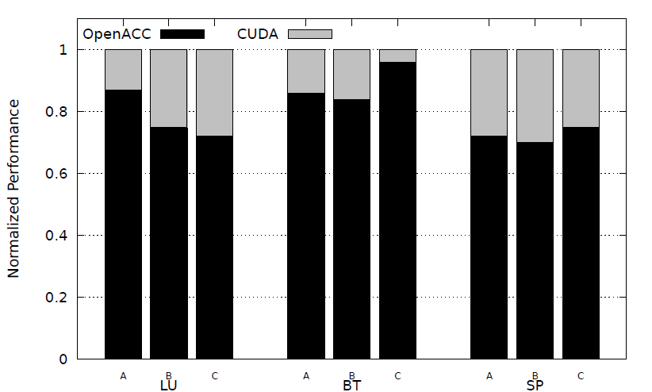
Performance Evaluation OpenUH OpenACC NPB – OpenACC vs CUDA¹
Notes:
72%-87%, 86-96%, 72-75%, performance gap is small
The gap is because each thread needs a small array. OpenACC uses array privatization thus uses global memory. CUDA these arrays are allocated in registers or spilled in L1 cache.

Slide 21
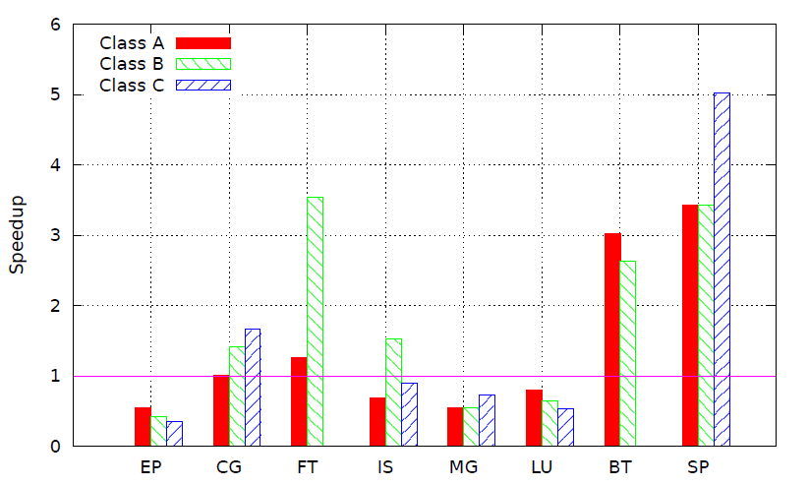
Performance Evaluation OpenUH OpenACC NPB – OpenACC vs OpenCL¹
Notes:
For EP, OpenACC is 50% slower than OpenCL. This is because of the array privatization which increased the requirement of global memory that exceed the limit of Kepler. So we have to use blocking algorithm to divide the data into chunks and process each chunk one by one. This needs to launch the kernel many times. OpenCL uses shared memory and therefore no privatization and just need to launch kernel once. OpenCL has faster memory access and less kernel launch overhead.
CG is because of cache optimization.
FT used AoS to SoA but OpenCL not.
MG, many routines have temporary data. OpenACC allocate and free the memory dynamically in each routine.
BT C has no result because the OpenCL code changed the code significantly. It allocates all the data at the beginning and free them at the end
But in OpenACC code, the lifetime of some data is within the subroutine, so those data is only active in the routine and therefore requires less global memory
BT and SP OpenCL data layout not changed. didn’t use coalesced memory access optimization. And no loop fission. Large kernel, the loops are executed sequentially

Slide 22
Conclusion and Future Work
Conclusion
Discussed different parallelization techniques for OpenACC
Demonstrated speedup of OpenUH OpenACC over serial code
Compared the performance between OpenUH OpenACC and CUDA and OpenCL
Contributed 4 NPB benchmarks to SPEC ACCEL V1.0 (released on March 18, 2014)
http://www.hpcwire.com/off-the-wire/spechpg-releases-new-hpc-benchmark-suite/
Looking forward to making more contributions to future SPEC ACCEL suite
Future Work
Explore other optimizations
Automate some of the optimizations in OpenUH compiler
Support Intel Xeon Phi, AMD GPU APU

