Slide 1
MARKETING STRATEGY DURING PANDEMIC
DATA ANALYSIS AND INSIGHT

Slide 2

PROBLEM STATEMENT
Due to COVID-19 Pandemic, a new marketing strategy must be employed amidst the budget cut. The presentation shall include:
Analysis of the travel behavior of the customers and the non-customers
Marketing target identification using data
Insight and recommendation

Slide 3
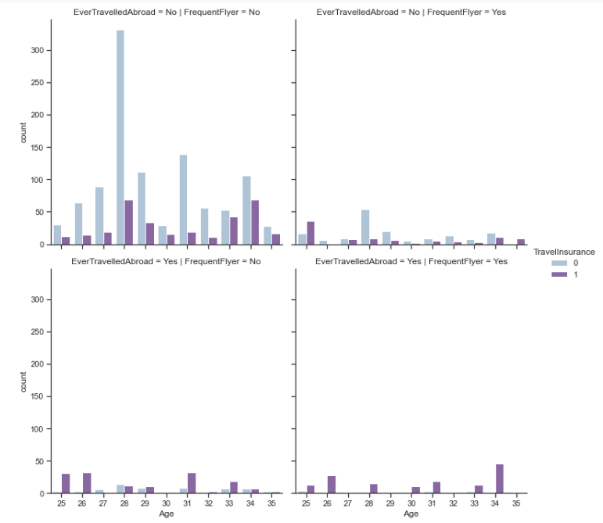
CUSTOMER TRAVEL BEHAVIOR
68% of the respondents have never travelled abroad nor fly frequently
Majority of the customers are at the age of 28 and 34

Slide 4
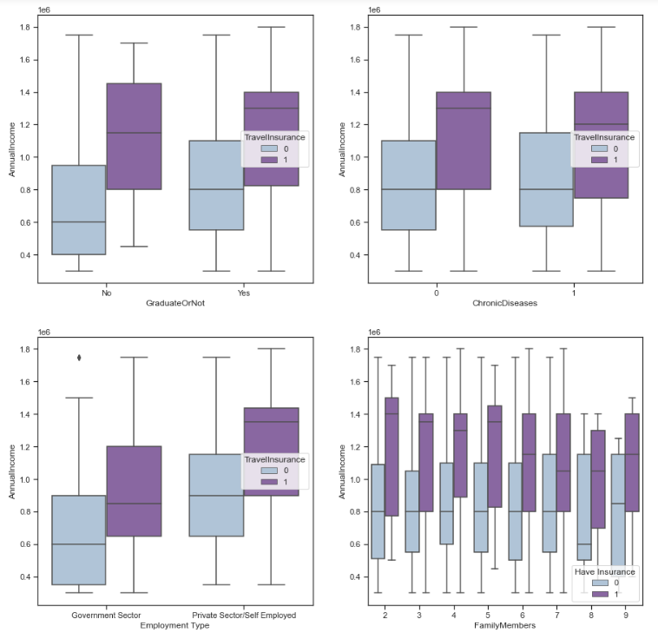
WHERE TO LOOK AT?
65% of the customers are people with annual income >= 800k
On average, people with high annual income buy the travel insurance

Slide 5
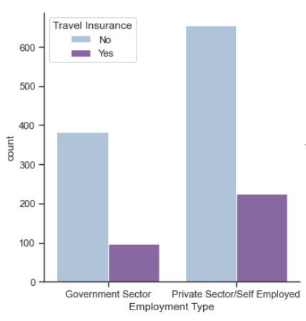
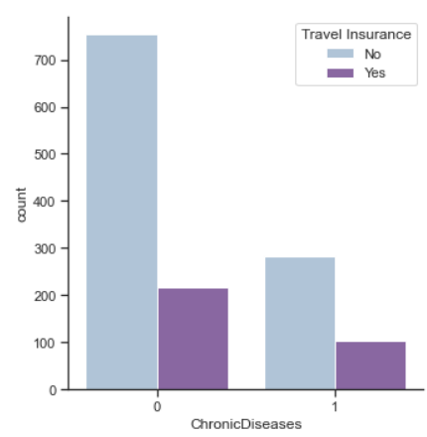
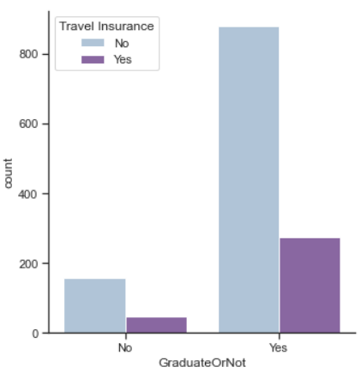
TARGET GROUP ANALYSIS
EMPLOYMENT TYPE
CHRONIC DISEASE
COLLEGE DEGREE
Private sector worker tends to buy travel insurance
Respondent with chronic disease tends not to buy travel insurance
People with college degree tends to buy insurance

Slide 6
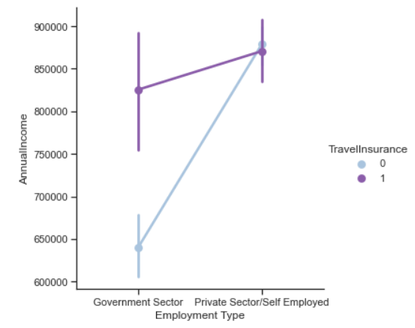
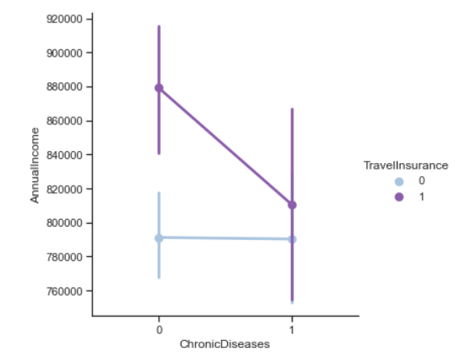
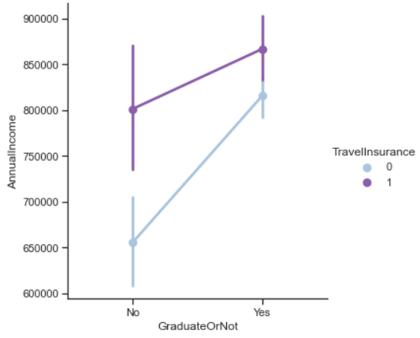
TARGET GROUP ANALYSIS
EMPLOYMENT TYPE
CHRONIC DISEASE
COLLEGE DEGREE
879k
866k
871k
879k
826k
815k
801k
791k
811k
790k
641k
655k
Workers with higher annual income tends to buy travel insurance
People with chronic diseases tend to have lower annual income
People with college degree tends to have higher annual income

Slide 7
FOCUS ON HIGH INCOME CUSTOMERS
AGE RANGE BETWEEN 28-34
TARGET COLLEGE GRAD AND PRIVATE SECTOR
PROPOSED STRATEGY
65% of customers have annual income >=800k
Majority of customers are in this age range
Higher income and higher preferences to buy insurance

Slide 8
THANK YOU

