Slide 1
CPMD dynamic
orientation.f95
Data files about desired system (no information lost, only rewrote)
lifetime.f95
orientation_proj.awk
orientation.awk
angle_proj.awk
angle.awk
Some data are sorted
lifetime.awk
Average / statistics done (information lost)
The information provided are contained in the header of each file.
orientation_proj.gnuplot
orientation.gnuplot
angle_proj.gnuplot
angle.gnuplot
lifetime.gnuplot
2D / 3D / … / 9D graphs

Slide 2
Practice

Slide 3
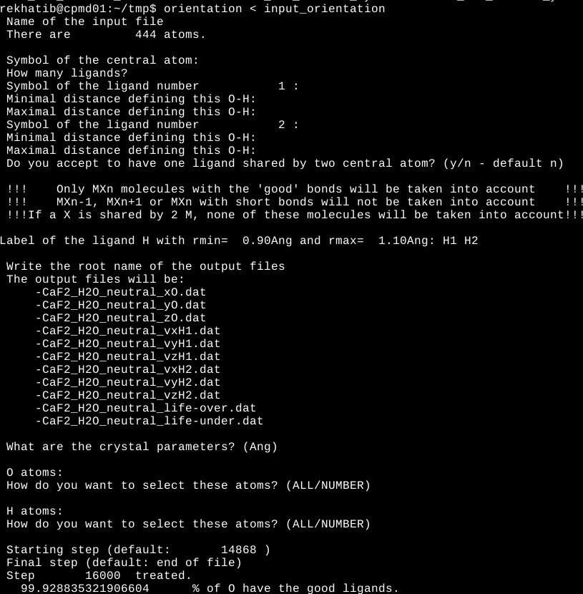
This is how the molecules are selected. The 3rd line can not appear (depends on you)
Explanation about the ligand / file names

Slide 4
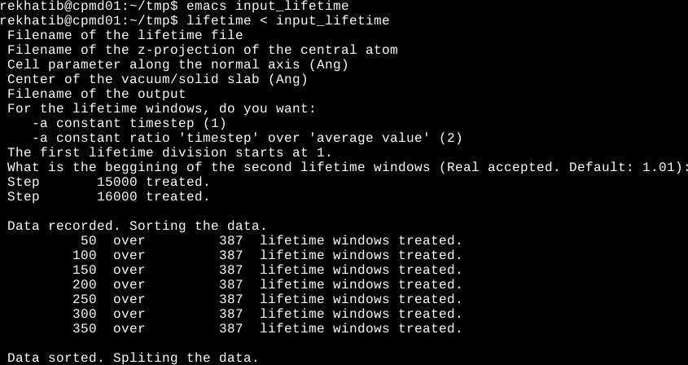
The sorting algorithm is an insertion algorithm (VERY slow when we have many values). If you select a huge timestep, maybe you will need several hours to treat your data. I will try to change the algorithm.
A kind of “bar chart” will be done. To calculate the width of each bar there are two possibilities:
-The width is constant (very intuitive way to split the data)
-The width is proportional to the average lifetime of the bar
In the first case, we will have, for example, 1) a bar to describes the lifetime between 10 and 20 steps and 2) another one to describe the lifetime between 1000 and 1010 steps.
In the second case, we will have for example, 1) a bar to describes the lifetime between 10 and 20 steps and 2) another one to describe the lifetime between 1000 and 2000 steps.

Slide 5
Awk commands without bash script
The scripts work only for MX2 molecules (like H2O for example)
awk -f ~/bin/__gnuplot/lifetime.awk CaF2_H2O_neutral_lifetime.dat > CaF2_H2O_neutral_life_boxplot.dat
awk -v a=34 -v b=11.59 -v c=13.38 -v div=0.1 -v x0=CaF2_H2O_neutral_xO.dat -v y0=CaF2_H2O_neutral_yO.dat -v z0=CaF2_H2O_neutral_zO.dat -v x1=CaF2_H2O_neutral_vxH1.dat -v y1=CaF2_H2O_neutral_vyH1.dat -v z1=CaF2_H2O_neutral_vzH1.dat -v x2=CaF2_H2O_neutral_vxH2.dat -v y2=CaF2_H2O_neutral_vyH2.dat -f ~/bin/__gnuplot/orientation.awk CaF2_H2O_neutral_vzH2.dat > orientation.dat
awk -v param=34 -v div=0.1 -v axis=CaF2_H2O_neutral_xO.dat -v x1=CaF2_H2O_neutral_vxH1.dat -v y1=CaF2_H2O_neutral_vyH1.dat -v z1=CaF2_H2O_neutral_vzH1.dat -v x2=CaF2_H2O_neutral_vxH2.dat -v y2=CaF2_H2O_neutral_vyH2.dat -f ~/bin/__gnuplot/orientation_proj.awk CaF2_H2O_neutral_vzH2.dat > orientation_proj.dat
awk -v a=34 -v b=11.59 -v c=13.38 -v div=0.1 -v x0=CaF2_H2O_neutral_xO.dat -v y0=CaF2_H2O_neutral_yO.dat -v z0=CaF2_H2O_neutral_zO.dat -v x1=CaF2_H2O_neutral_vxH1.dat -v y1=CaF2_H2O_neutral_vyH1.dat -v z1=CaF2_H2O_neutral_vzH1.dat -v x2=CaF2_H2O_neutral_vxH2.dat -v y2=CaF2_H2O_neutral_vyH2.dat -f ~/bin/__gnuplot/angle.awk CaF2_H2O_neutral_vzH2.dat > angle.dat
awk -v param=34 -v div=0.1 -v axis=CaF2_H2O_neutral_xO.dat -v x1=CaF2_H2O_neutral_vxH1.dat -v y1=CaF2_H2O_neutral_vyH1.dat -v z1=CaF2_H2O_neutral_vzH1.dat -v x2=CaF2_H2O_neutral_vxH2.dat -v y2=CaF2_H2O_neutral_vyH2.dat -f ~/bin/__gnuplot/angle_proj.awk CaF2_H2O_neutral_vzH2.dat > angle_proj.dat

Slide 6
Awk commands with bash script (optional but so useful)
The scripts work only for MX2 molecules (like H2O for example)
awk -f ~/bin/__gnuplot/lifetime.awk CaF2_H2O_neutral_lifetime.dat > CaF2_H2O_neutral_life_boxplot.dat
~/bin/__gnuplot/orientation.sh 34 11.59 13.38 0.1 CaF2_H2O_neutral_xO.dat CaF2_H2O_neutral_yO.dat CaF2_H2O_neutral_zO.dat CaF2_H2O_neutral_vxH1.dat CaF2_H2O_neutral_vyH1.dat CaF2_H2O_neutral_vzH1.dat CaF2_H2O_neutral_vxH2.dat CaF2_H2O_neutral_vyH2.dat CaF2_H2O_neutral_vzH2.dat > orientation.dat
~/bin/__gnuplot/orientation_proj.sh 34 0.1 CaF2_H2O_neutral_xO.dat CaF2_H2O_neutral_vxH1.dat CaF2_H2O_neutral_vyH1.dat CaF2_H2O_neutral_vzH1.dat CaF2_H2O_neutral_vxH2.dat CaF2_H2O_neutral_vyH2.dat CaF2_H2O_neutral_vzH2.dat > orientation_proj.dat
~/bin/__gnuplot/angle.sh 34 11.59 13.38 0.1 CaF2_H2O_neutral_xO.dat CaF2_H2O_neutral_yO.dat CaF2_H2O_neutral_zO.dat CaF2_H2O_neutral_vxH1.dat CaF2_H2O_neutral_vyH1.dat CaF2_H2O_neutral_vzH1.dat CaF2_H2O_neutral_vxH2.dat CaF2_H2O_neutral_vyH2.dat CaF2_H2O_neutral_vzH2.dat > angle.dat
~/bin/__gnuplot/angle_proj.sh 34 0.1 CaF2_H2O_neutral_xO.dat CaF2_H2O_neutral_vxH1.dat CaF2_H2O_neutral_vyH1.dat CaF2_H2O_neutral_vzH1.dat CaF2_H2O_neutral_vxH2.dat CaF2_H2O_neutral_vyH2.dat CaF2_H2O_neutral_vzH2.dat > angle_proj.dat

Slide 7
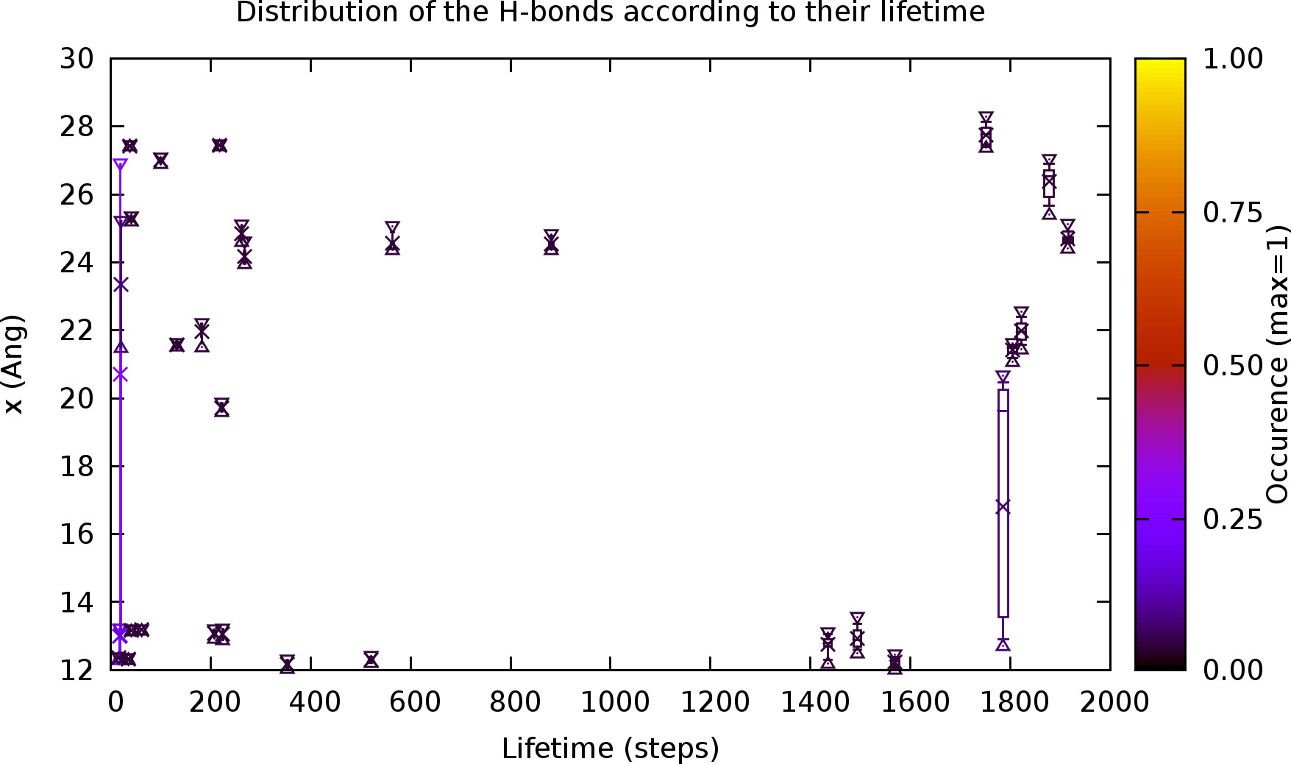
Gnuplot scripts
The color gives an information about the number of time when this lifetime were obtained
Lifetime.gnuplot
Triangles: maximal/minimal position
Boxplot: 1st decile / 1st quartile / median / 3rd quartile / 9th decile
Cross: average position

Slide 8
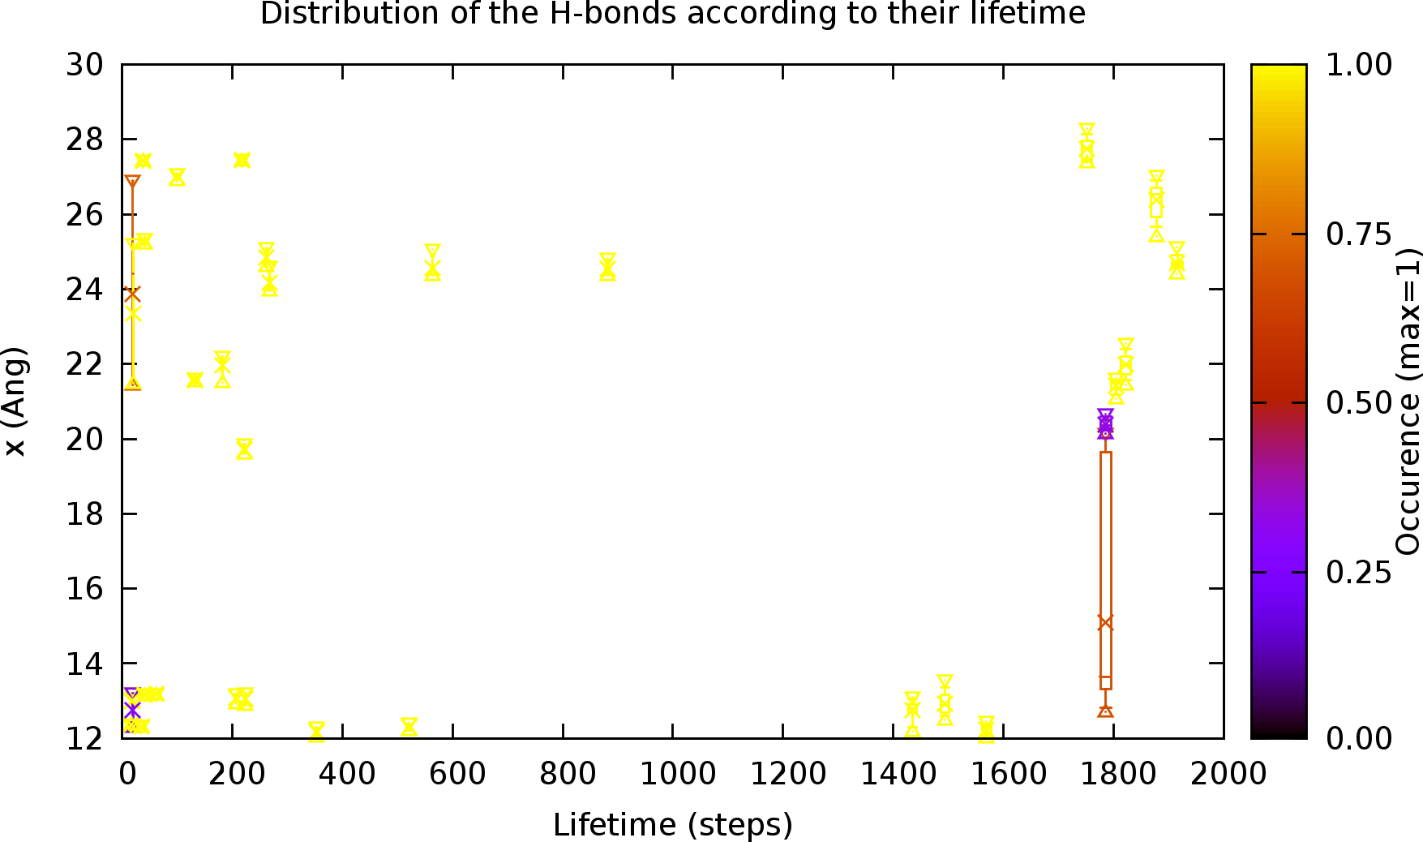
Gnuplot scripts
The color gives an information about the distribution of the molecules in the two half of the slab
Lifetime.gnuplot + 1 left-click
Since I have two interface in my box I split the data in two half. These two boxplots have the same lifetime but the molecules are not in the same half.

Slide 9
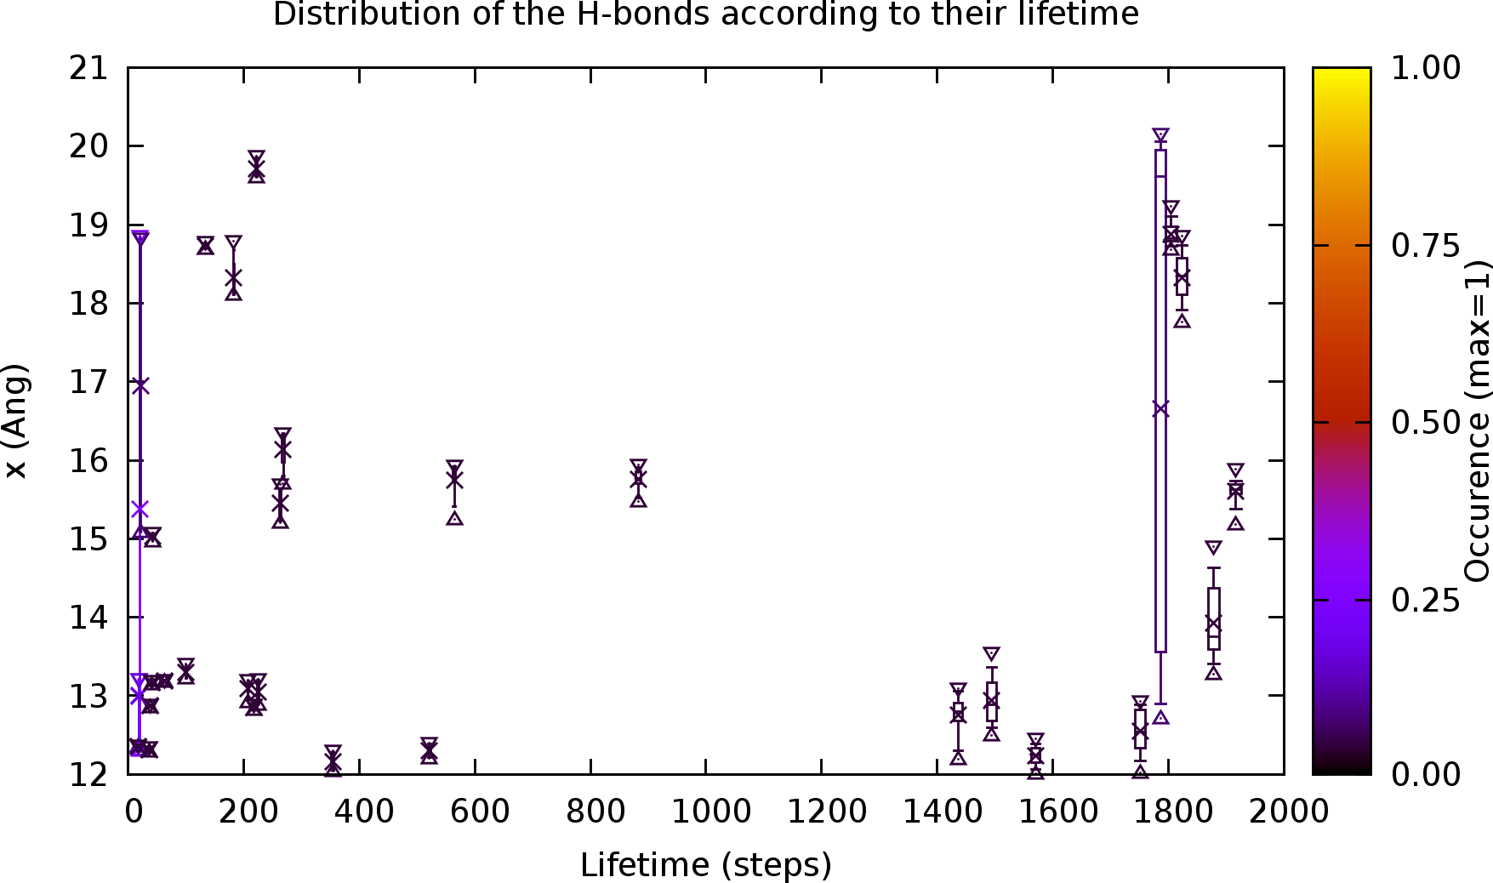
Gnuplot scripts
Same meaning than for the first graph.
Lifetime.gnuplot + 2 left-clicks
Since the two interfaces are symmetrical, I can symmetrize the data too. This is what I do with this 3rd graph.

Slide 10
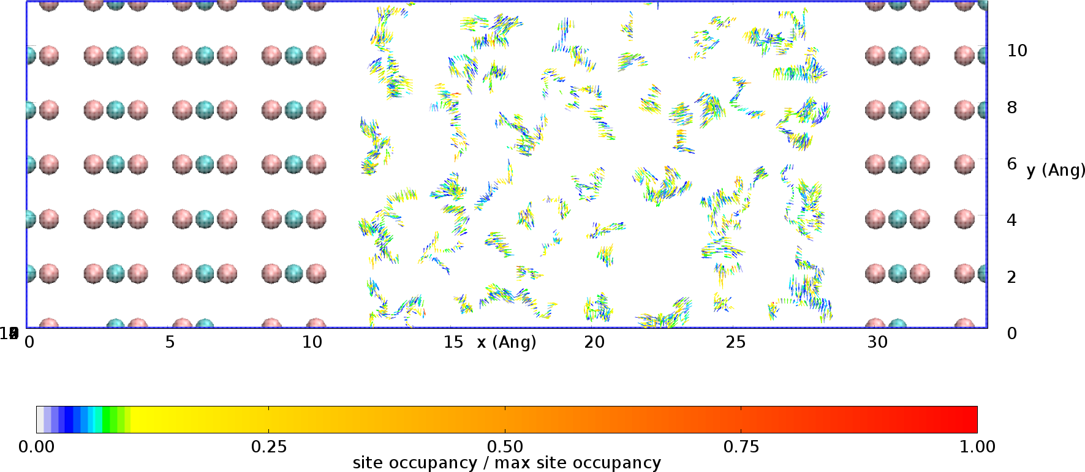
Gnuplot scripts
orientation.gnuplot
Average orientation over the time of MX2 according to x,y,z. It represents the dipole orientation.
The color is associated with the time spent by the molecule in the region

Slide 11
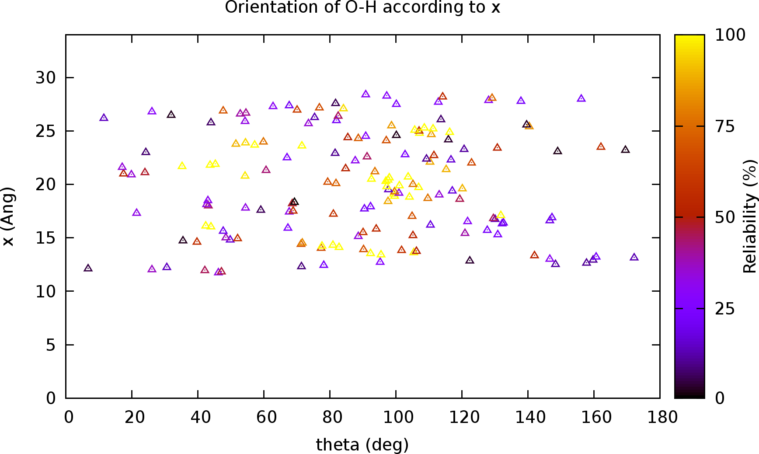
Gnuplot scripts
Average orientation over the time of MX2 according to x.
!!! The reliability factor has not yet a signification and will be certainly improved!!!

Slide 12
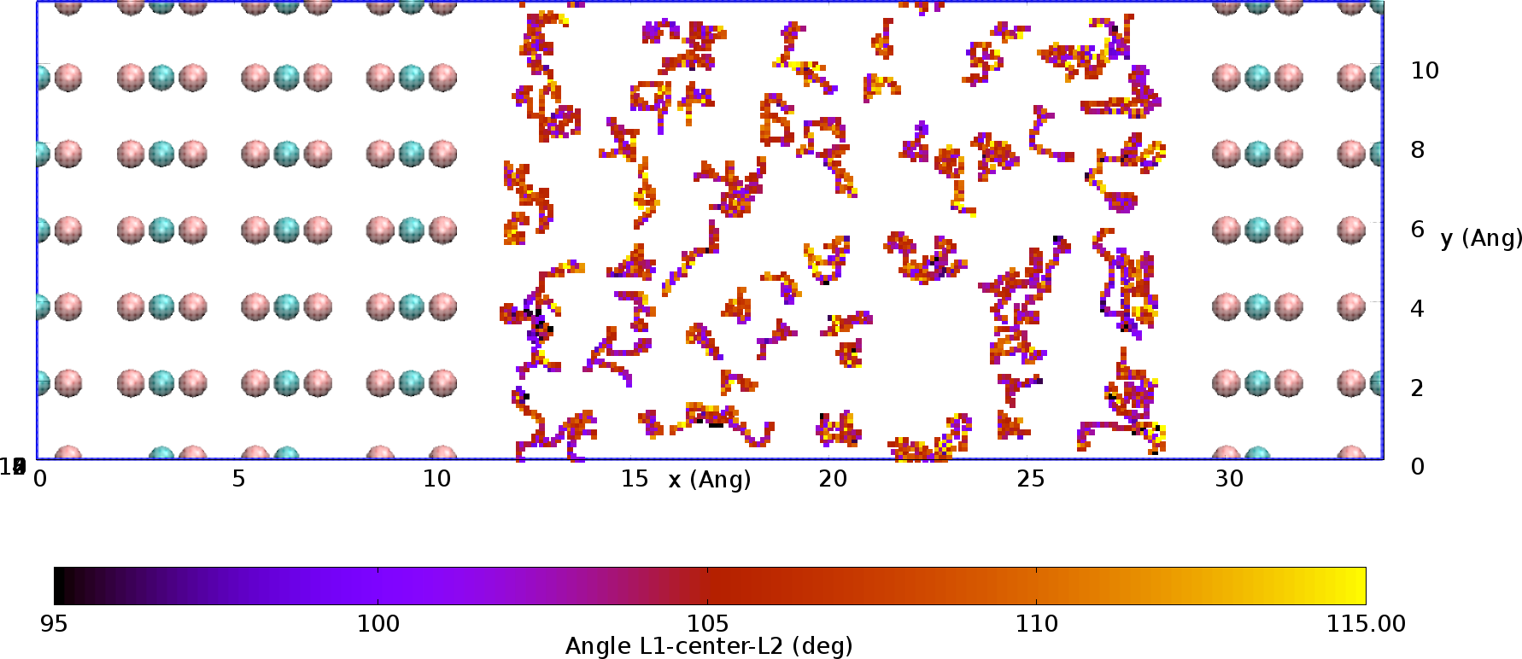
Gnuplot scripts
Average angle over the time of MX2 according to x,y,z. Especially useful for H-bond (O-H---O).

Slide 13
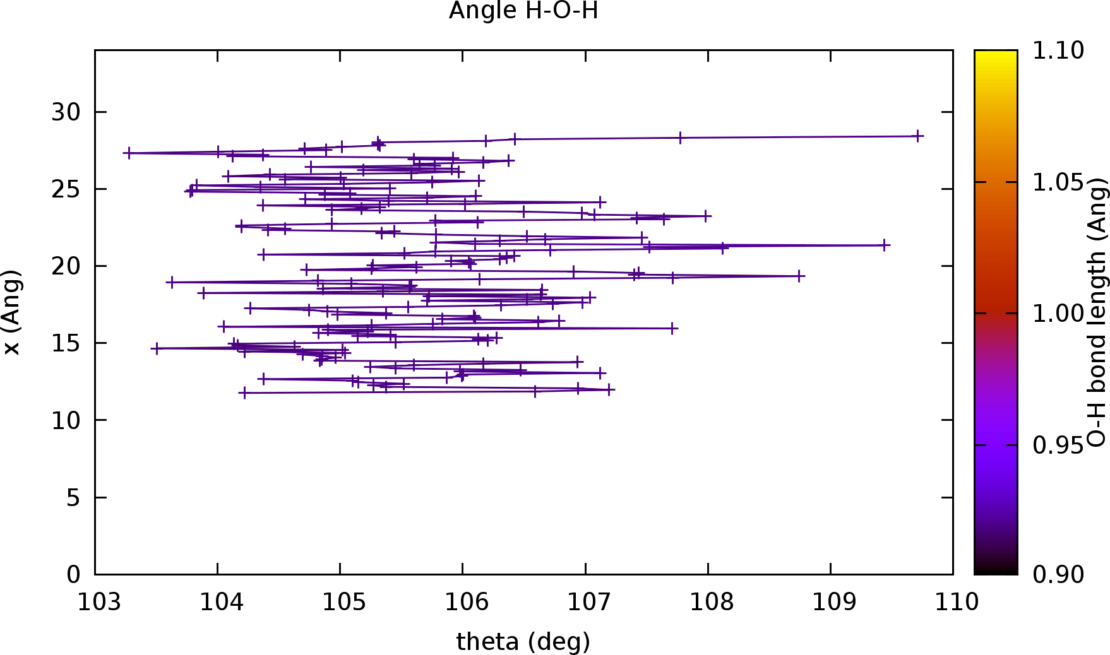
Gnuplot scripts
Average angle over the time of MX2 according to x. Especially useful for H-bond (O-H---O).

Slide 14
Real examples from my systems

Slide 15
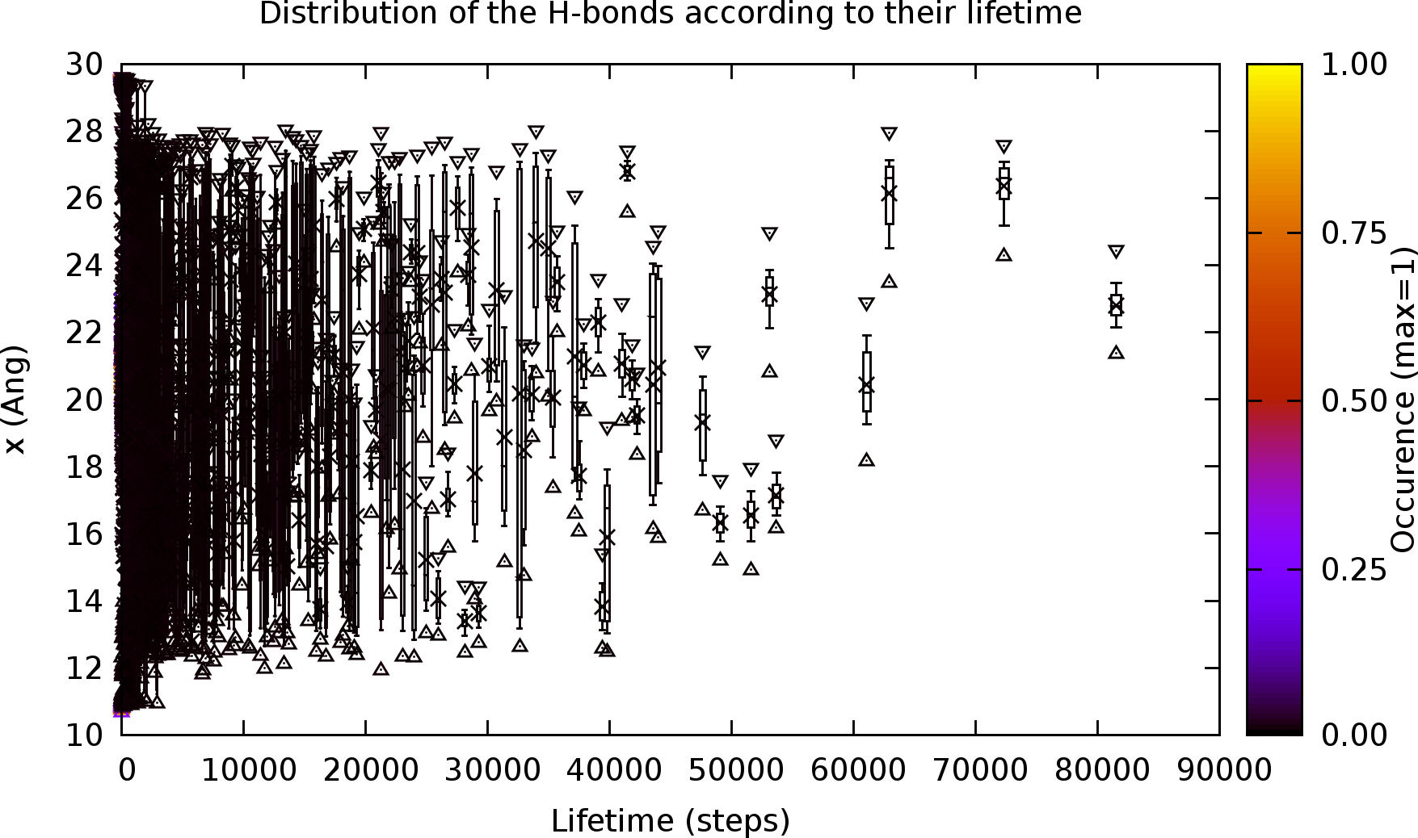
Here, I can see that at the interface, the lifetime of the water molecule is really short.

Slide 16
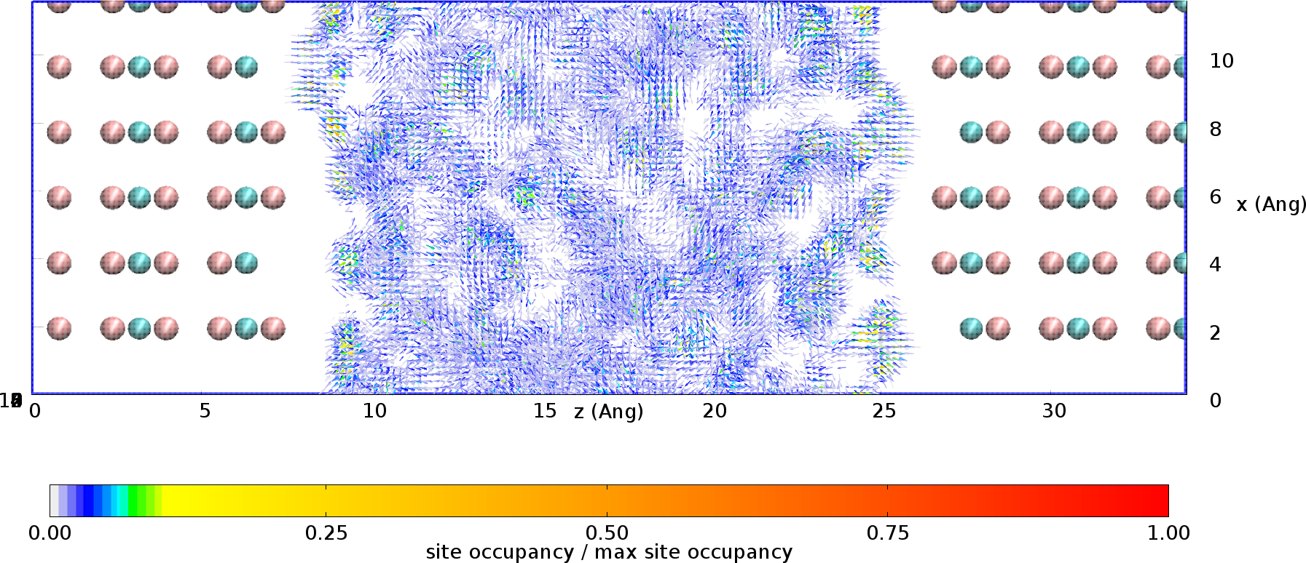
The water molecules fills 3 over 4 vacancies. Maybe because in the last one there is a O-H group

Slide 17
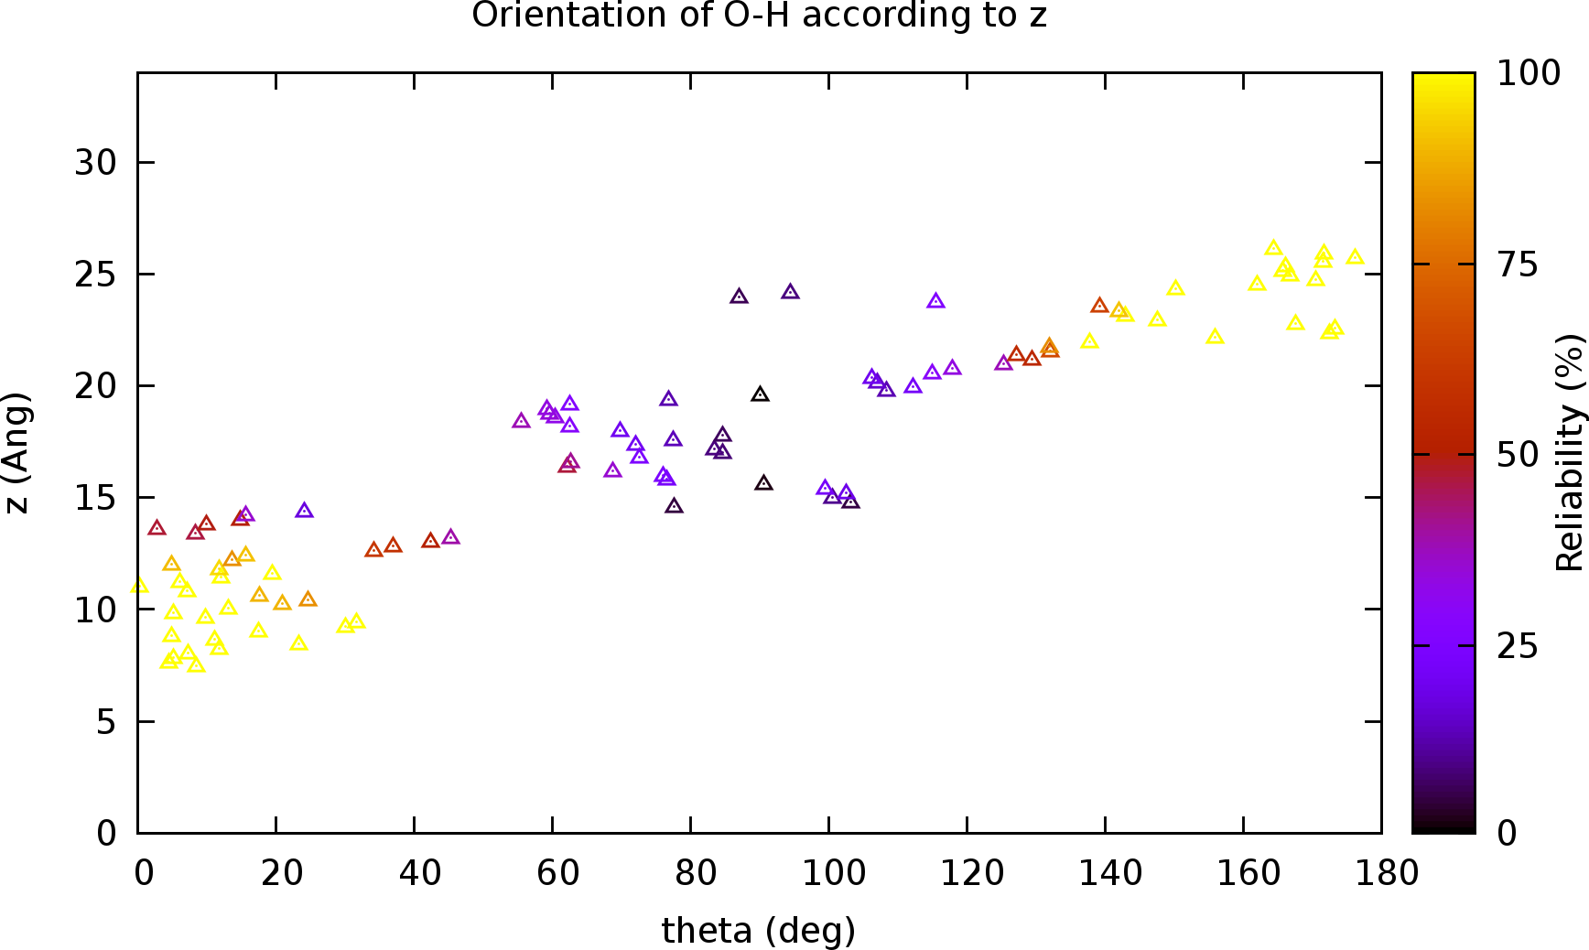
In this case, I can see that at the interface the dipole is oriented to the interface (and not to the bulk)
CaF2(δ+)
CaF₂(δ+)
H
H
O
O
H
H
F-
F⁻
F⁻
F⁻
H
H
O
O
H
H
CaF₂(δ+)
CaF₂(δ+)

Slide 18
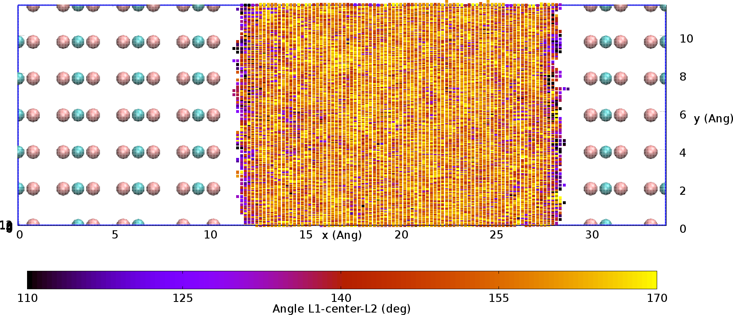
H
H
O
H
H
θ
O
The angle between O-H---O is smaller at the interface (purple/black) than in the bulk (red/yellow).

Slide 19
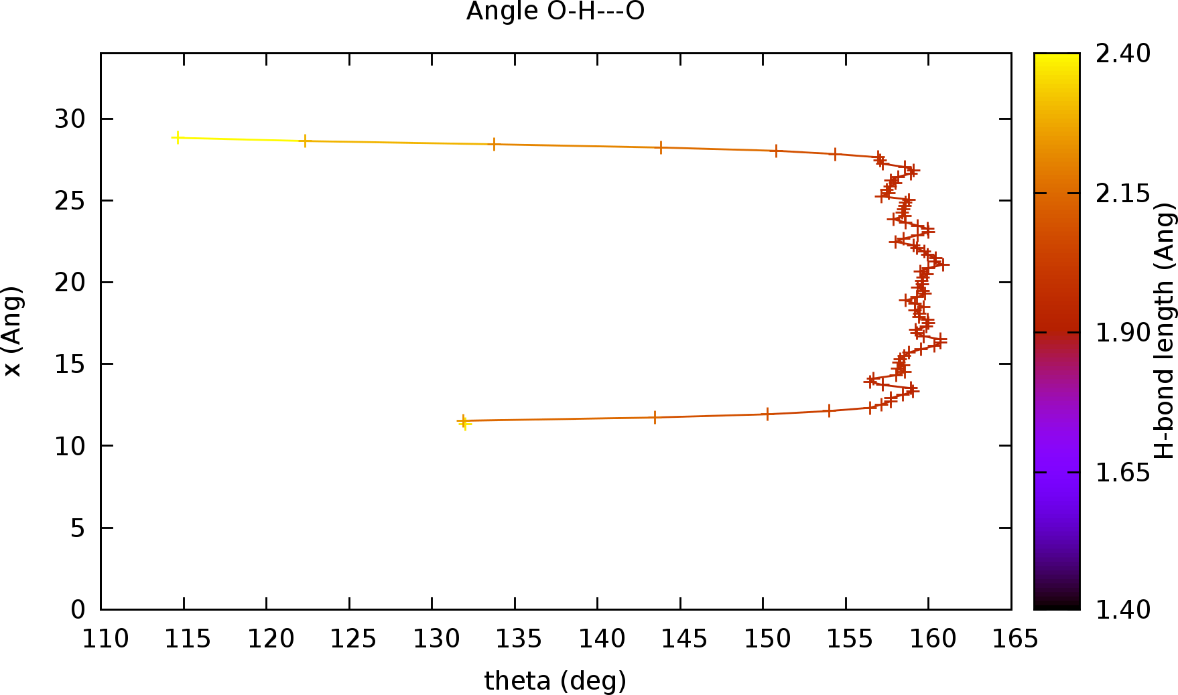
H
H
d
O
H
H
θ
O
Confirmation of the previous graph thanks to the length bond. The smaller angle, the weaker H-bond. So it is not surprising to see the length bond which increase at the interface.

