Slide 1
BUG model 3DFEM and beam model comparison
Baseline model: GuessV12.inc (01/04/2016)

Slide 2
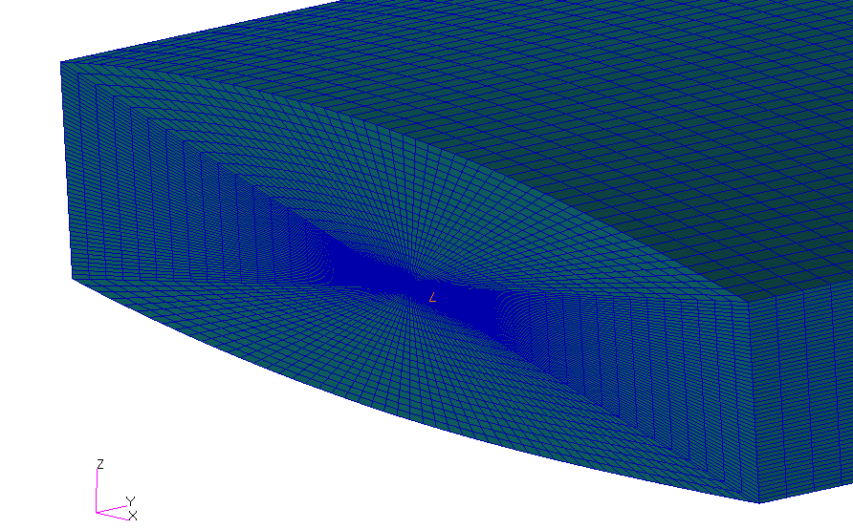
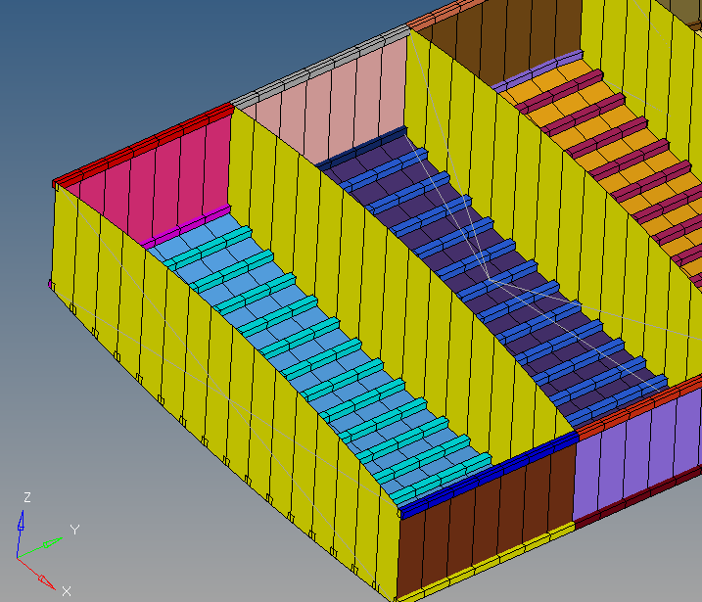
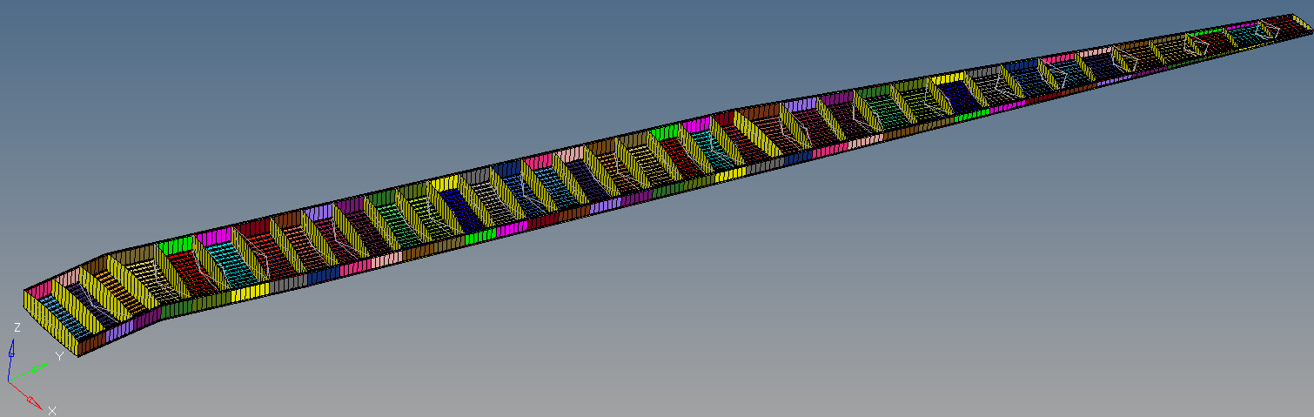
3D FEM
Original 3D mesh from NEOCASS (207360 nodes) Note: rib elements were badly shaped, causing NASTRAN error
Re-meshed in Hypermesh (8125 nodes) Based on skin geometry (iges) extracted from NEOCASS fine mesh

Slide 3
Mass / Property comparison
 | MASS (kg) | X-C.G. | Y-C.G. | Z-C.G.
3DFEM | 1.62E+03 | 1.28E+00 | 7.99E+00 | -1.47E-01
3DFEM with 3mm ribs | 1.71E+03 | 1.30E+00 | 8.08E+00 | -1.49E-01
Beam | 1.59E+03 | 1.23E+00 | 7.85E+00 | -1.46E-01
3DFEM Error | 2% | 4% | 2% | 0%
3DFEM with 3mm ribs Error | 7% | 6% | 3% | 2%
Note: Wing structural mass retained only
Stringer pitch = 0.1m (15str max) Rib pitch = 0.66m (38ribs)
Root chord = 1.608m; Tip chord = 0.575m

Slide 4
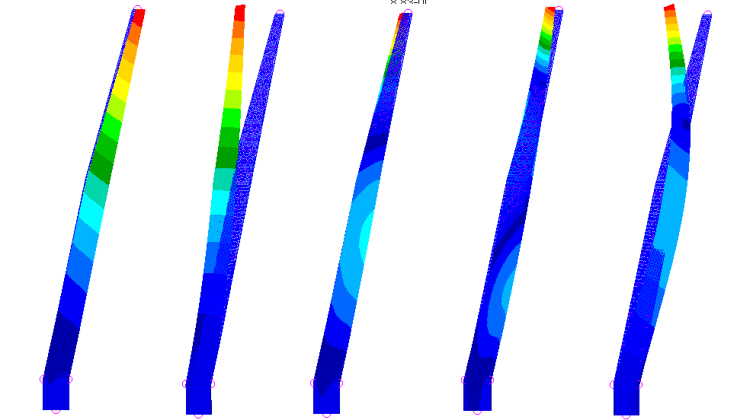

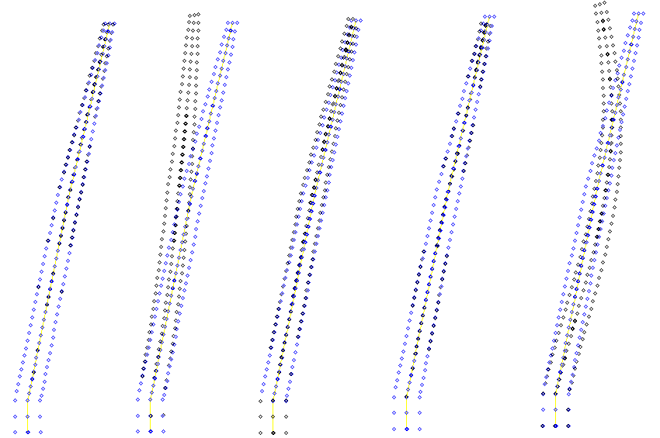
Modes Comparison
3DFEM
Mode 1
Mode 2
Mode 3
Mode 4
Mode 5
Twist due to BC
Mode | Beam (Hz) | 3DFEM (Hz) | 3DFEM (Hz) with 3mm ribs | 3DFEM Error | 3DFEM (Hz) with 3mm ribs Error
1 | 1.88E+00 | 1.89E+00 | 2.13E+00 | 1% | 14%
2 | 5.13E+00 | 5.10E+00 | 4.93E+00 | -1% | -4%
3 | 6.05E+00 | 7.50E+00 | 7.92E+00 | 24% | 31%
4 | 1.32E+01 | 1.69E+01 | 1.74E+01 | 28% | 32%
5 | 1.84E+01 | 1.83E+01 | 1.84E+01 | 0% | 0%
6 | 2.39E+01 | 2.36E+01 | 3.25E+01 | -1% | 36%
7 | 3.72E+01 | 3.03E+01 | 3.45E+01 | -19% | -7%
8 | 4.14E+01 | 3.71E+01 | 3.81E+01 | -10% | -8%
9 | 5.49E+01 | 3.88E+01 | 5.08E+01 | -29% | -7%
10 | 7.43E+01 | 4.01E+01 | 6.09E+01 | -46% | -18%
First 5 mode shapes match well, but 3DFEM has higher frequency bending modes, even without ribs included
Boundary conditions:
Symmetry plane constraint in 246 (Node 2000) Fuselage/Wing joint constraint in 135 (Node 2002)

Slide 5

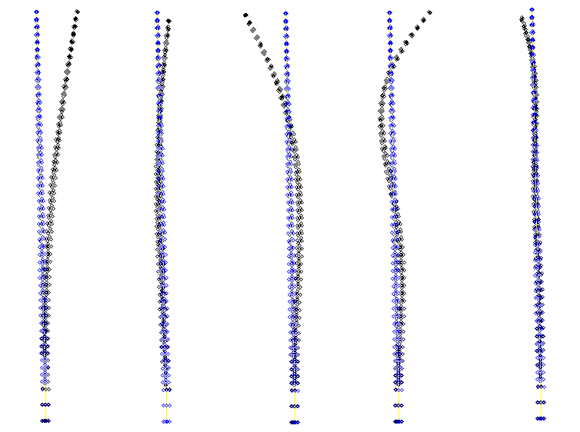
Modes Comparison
3DFEM
Mode 1
Mode 2
Mode 3
Mode 4
Mode 5
Mode | Beam (Hz) | 3DFEM (Hz) | 3DFEM (Hz) with 3mm ribs | 3DFEM Error | 3DFEM (Hz) with 3mm ribs Error
1 | 1.88E+00 | 1.89E+00 | 2.13E+00 | 1% | 14%
2 | 5.13E+00 | 5.10E+00 | 4.93E+00 | -1% | -4%
3 | 6.05E+00 | 7.50E+00 | 7.92E+00 | 24% | 31%
4 | 1.32E+01 | 1.69E+01 | 1.74E+01 | 28% | 32%
5 | 1.84E+01 | 1.83E+01 | 1.84E+01 | 0% | 0%
6 | 2.39E+01 | 2.36E+01 | 3.25E+01 | -1% | 36%
7 | 3.72E+01 | 3.03E+01 | 3.45E+01 | -19% | -7%
8 | 4.14E+01 | 3.71E+01 | 3.81E+01 | -10% | -8%
9 | 5.49E+01 | 3.88E+01 | 5.08E+01 | -29% | -7%
10 | 7.43E+01 | 4.01E+01 | 6.09E+01 | -46% | -18%
First 5 mode shapes match well, but 3DFEM has higher frequency bending modes, even without ribs included
Boundary conditions:
Symmetry plane constraint in 246 (Node 2000) Fuselage/Wing joint constraint in 135 (Node 2002)

Slide 6
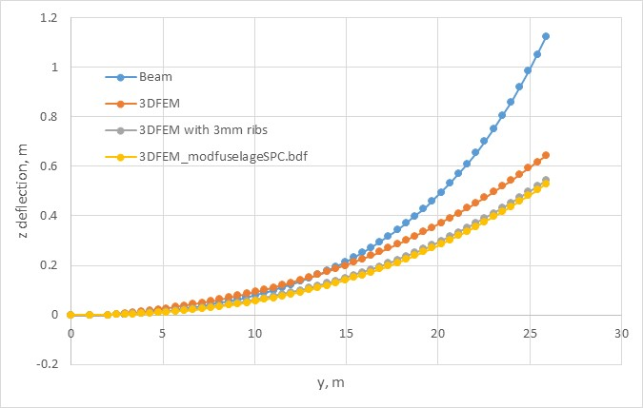
Static deflection
10000N Tip load (FZ @ Node 2052)
3DFEM modfuselage SPC
3DFEM with 3mm ribs
3DFEM

