Slide 1
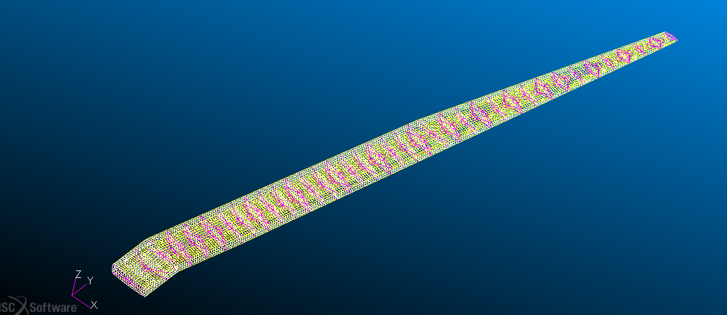
sol101_bug_coarse_test_final.bdf
sol101_bug_coarse_test_final_modfuselageSPC.bdf
sol101_bug_coarse_test_final_withribs.bdf

Slide 2
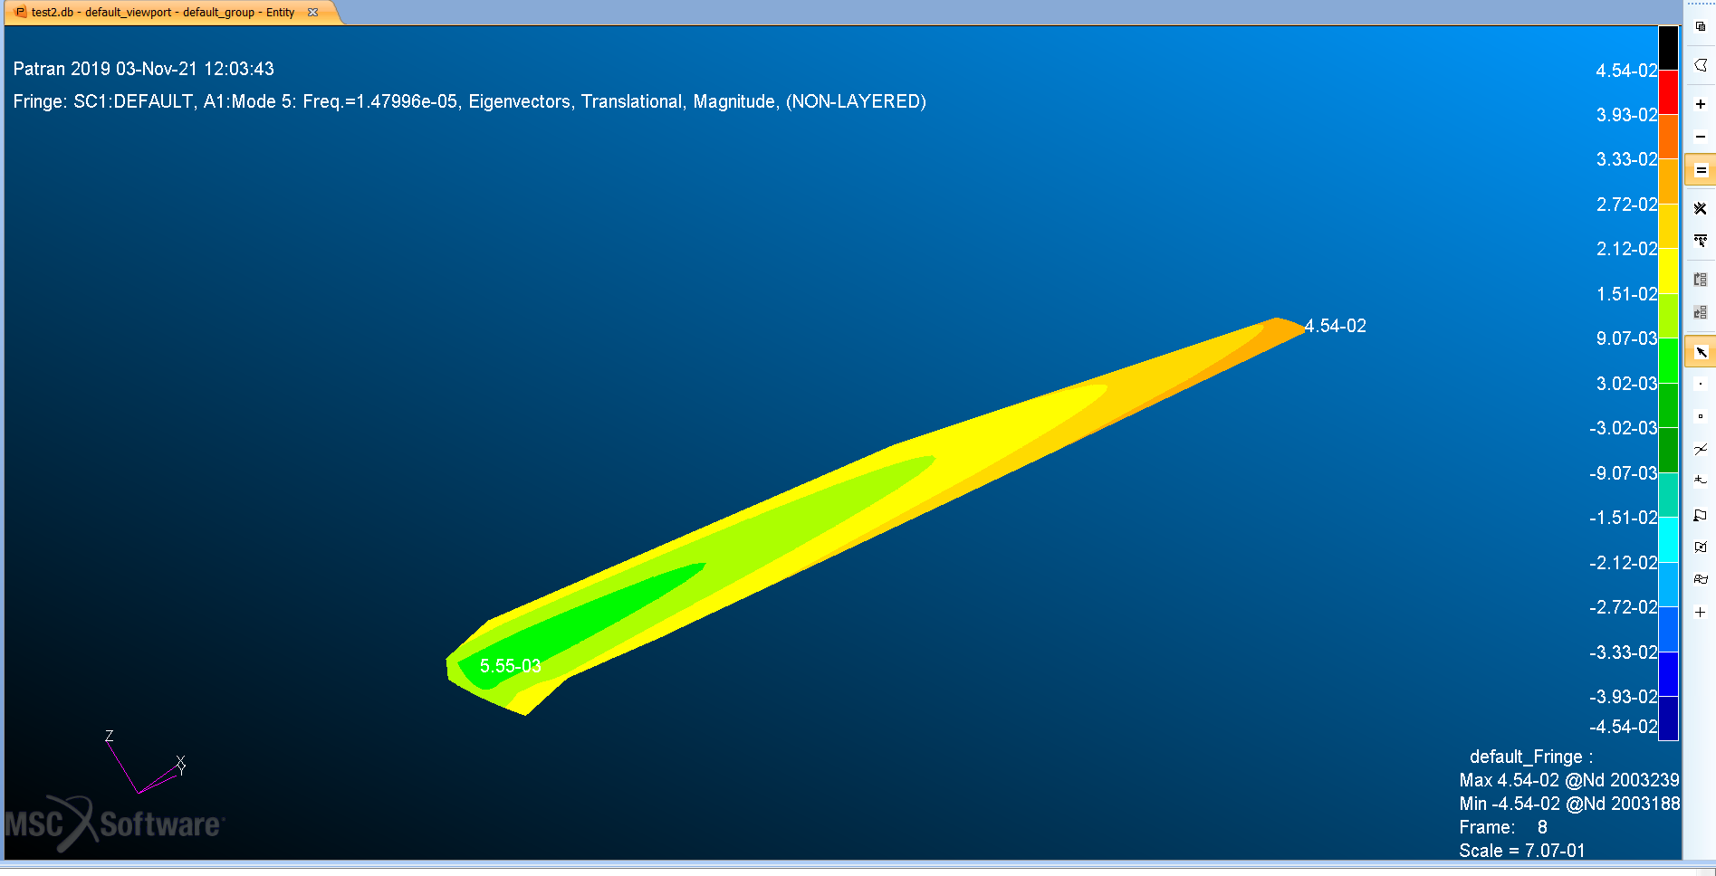
sol101_bug_coarse_test_final.bdf
sol101_bug_coarse_test_final_modfuselageSPC.bdf
sol101_bug_coarse_test_final_withribs.bdf

Slide 3

SOL101_GuessV12_wing_only_final.bdf

