Slide 1
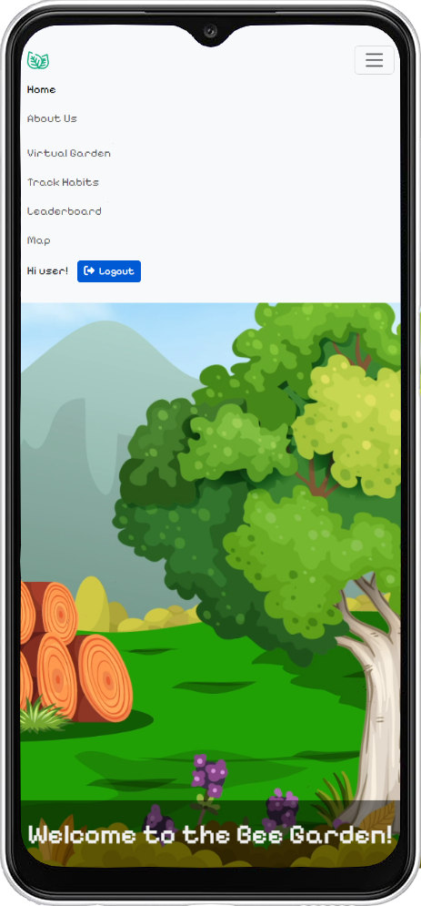
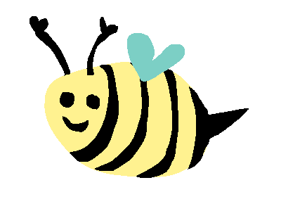

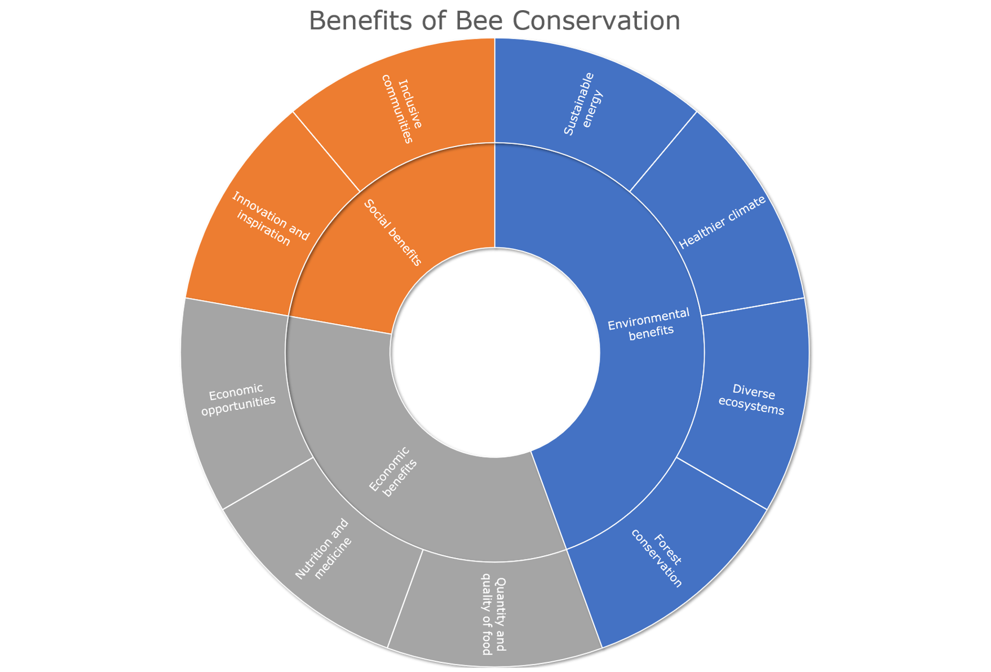
Syntax Evasion
Harry Gammie, Iona Cessford, Nur Deeni Binti Deti Affendi, Pawarisa Saiyut, Saida Amirova, Aisha Farouk
Virtual Garden
Features a virtual bee pet with changing emotions.
Users can plant seeds which they obtain by using the website.
Habit Tracker
Gives the user a list of sustainable goals to complete daily.
Users receive rewards for completing these goals.
Leaderboard
Seasonal Changes
Location Feature
Users may accumulate points by using the website.
The leaderboard displays the users with the highest scores.
Users may receive seeds for the Virtual Garden by going to a physical on-campus location of environmental significance.
The visuals and theme of the website will change throughout the real-time seasons.
Group website
http://hg510.pythonanywhere.com/
Notes:
Each poster should contain:
Screen shot(s) of the main interface(s) and annotated feature
Market research that supports the app design
Website and QR code if hosted publicly
- QR code can be generated here https://www.qr-code-generator.com/

