Slide 1
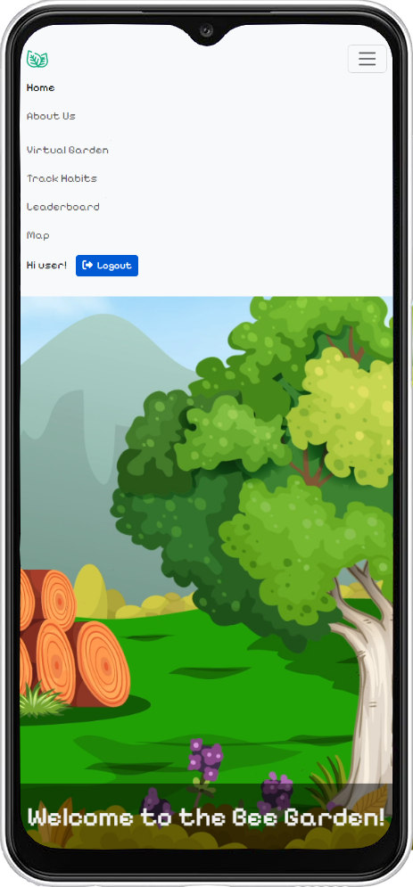
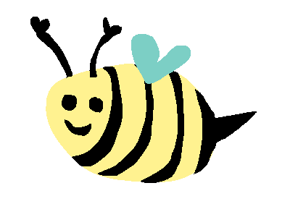
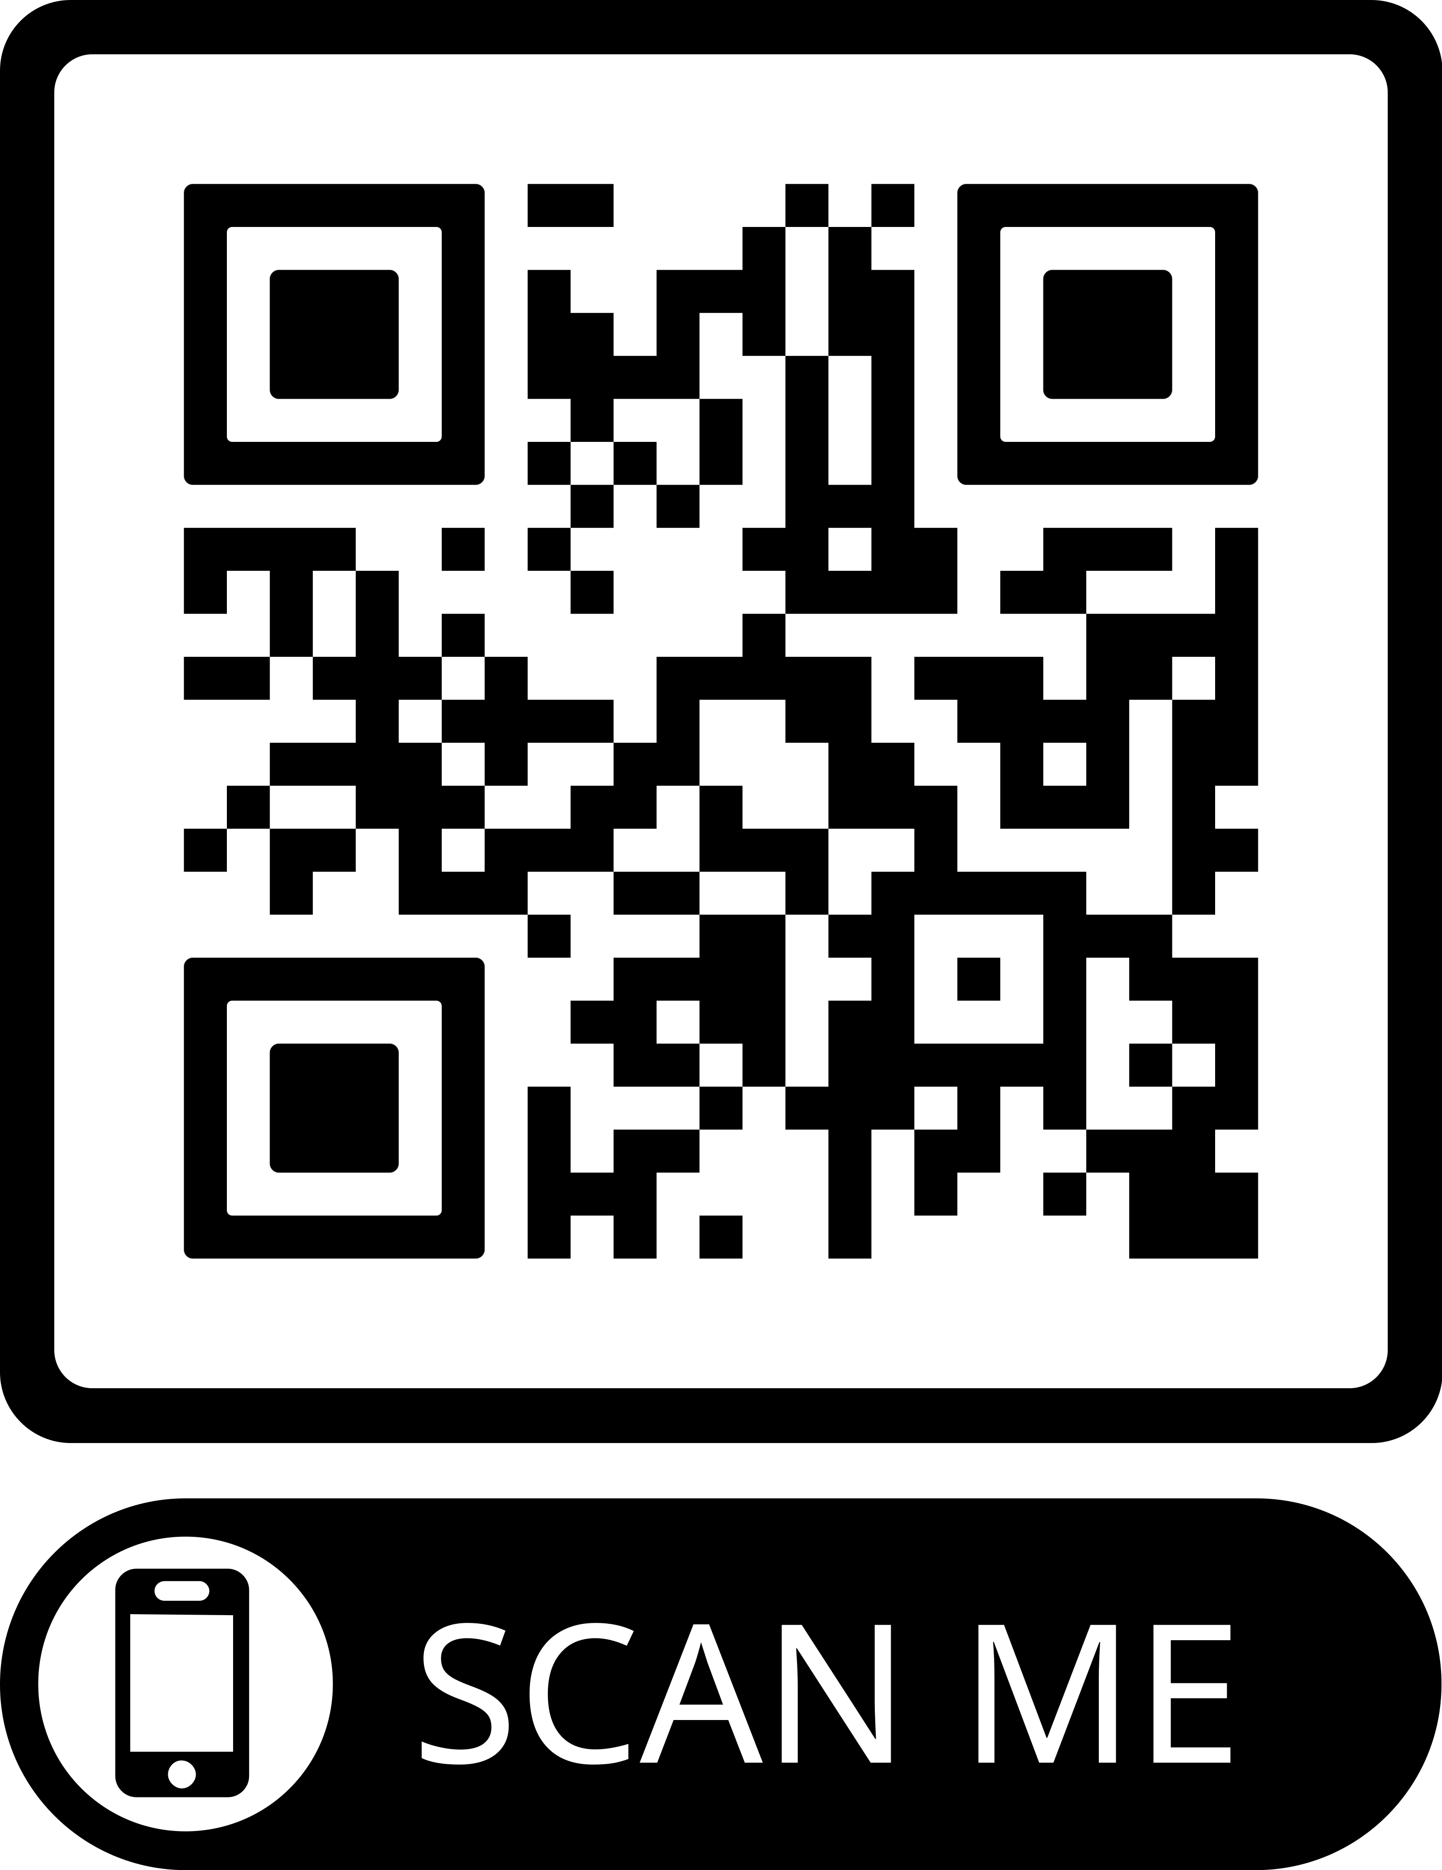
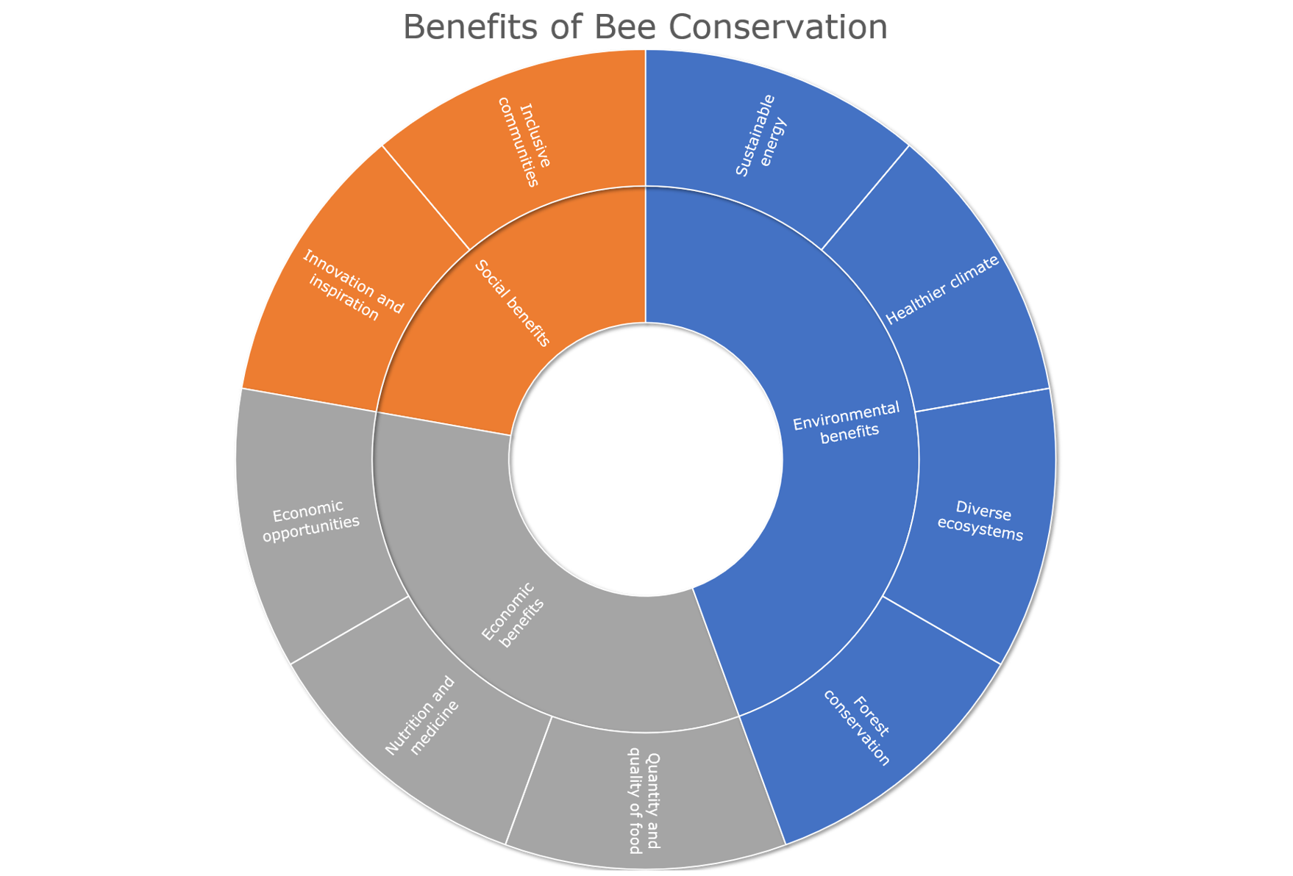
Syntax Evasion
Harry Gammie, Iona Cessford, Nur Deeni Binti Deti Affendi, Pawarisa Saiyut, Saida Amirova, Aisha Farouk
Virtual Garden
Features a virtual bee pet that changes emotions based on the user’s score
Users can plant seeds which are obtained by completing tasks.
Habit Tracker
Gives the user a list of sustainable goals to complete daily.
Users receive rewards for completing goals.
Leaderboard
Game Master/Admin Feature
Location Feature
The leaderboard displays the users ranked by users with the highest scores.
Users may receive seed packs for the Virtual Garden by going to a physical on-campus location of environmental significance.
Admin could accept or reject a user’s request when a user completes at least four daily habits at the “Habit Tracker” form.
If accepted, a random seed would be assigned to the user to be planted at the Virtual Garden.
Group website
http://hg510.pythonanywhere.com/
Notes:
Each poster should contain:
Screen shot(s) of the main interface(s) and annotated feature
Market research that supports the app design
Website and QR code if hosted publicly
- QR code can be generated here https://www.qr-code-generator.com/

