Slide 1

What is RethinkDB ?

Slide 2
Agenda
Intro why interesting?)
What did I want to and why
Demo
What did I learn
Questions
Resources

Slide 3
What is RethinkDB ?
‘RethinkDB is the first open-source, scalable JSON database built from the ground up for the realtime web. It inverts the traditional database architecture by exposing an exciting new access model – instead of polling for changes, the developer can tell RethinkDB to continuously push updated query results to applications in realtime. RethinkDB’s realtime push architecture dramatically reduces the time and effort necessary to build scalable realtime apps’
From RethinkDB.com

Slide 4
What does that mean?
It’s just a document DB but,
No polling for updates
Updated query results are continuously pushed to the client
Subscribe to changes in any query
Powerful ReQL query language
Support for things like joins, subqueries, geo queries and map-reduce
Distributed
Easy clustering / sharding etc.
Notes:
Origin (based on thoughts on SSD)
Turned out regular DB did quite well on SSD
New generation of Document databases
A database for the reactive …
Event driven instead of request / response

Slide 5
Why should I care?
Any time you think about pushing stuff (mobile)
Pub/Sub (can eliminate middleware)
Collaborative applications (places where we use SignalR)
IOT

Slide 6
What I wanted to achieve
Build something real in the 2 days of PD I did
Solve a ‘real’ problem
Utilize the ‘Changes Feed’ feature
The rest of this talk will be on what I did and what I learned doing it.

Slide 7
RethinkLogs
Build logging dashboard around RethinkDB with SignalR
Serilog already has a RethinkDB sink (I ended up branching)
Plugged it into an existing app

Slide 8
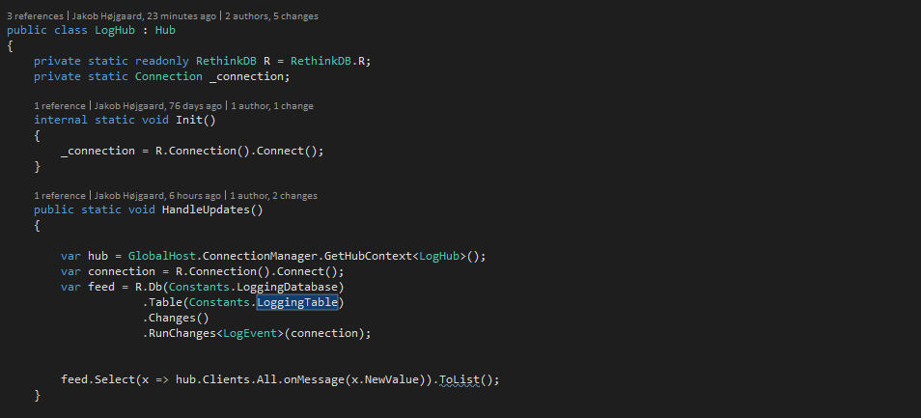
Demo
Notes:
Start RethinkDB
Run the app
Show the code
Intro to the C# driver syntax
Look at query examples in LinqPad
Go to the RethinkDB admin dash for further demo

Slide 9
Getting started
Installing
Supports Mac/Linux and Window and of course Docker?
Running
Run Rethinkdb.exe and point do data folder
The Admin tool
Http://localhost:8080
Documentation
Very detailed
Easy to navigate
The .Net Driver(s)
I picked the one maintained by (bchavez)

Slide 10
CAP Theorem (tribute to Pawel)
Very good description on RethinkDB.com
The gist…
“The essential tradeoff exposed by the CAP theorem is this: in case of network partitioning, does the system maintain availability or data consistency? (Jumping ahead, RethinkDB chooses to maintain data consistency).”
From :https://rethinkdb.com/docs/architecture/#cap-theorem
CAP – Consistency, Availability, Partition tolerance

Slide 11
Horizon
“Horizon is distributed as a standalone server for browser-based JavaScript apps. When you're ready to write custom backend code, you can load the Horizon modules directly in Node.js. RethinkDB is bundled with Horizon, so you can make direct database queries on the backend using the powerful query language ReQL, for flexible joins, aggregations, binary file support, and rich querying.”
From: https://horizon.io/

Slide 12
Questions?

Slide 13
Resources
RethinkDB.com (https://www.rethinkdb.com/)
Changelog with Slava (https://changelog.com/181/)
Pluralsight on RethinkDB with Rob Conery (https://www.pluralsight.com/courses/rethinkdb-fundamentals)
RethinkDB .Net driver (https://github.com/bchavez/RethinkDb.Driver)

Slide 14
Other material
RethinkLogs on Github (https://github.com/hgaard/rethinklogs)
Blogpost on the Bearded Code Monkey (TBD) ☺

