Slide 1
CPU Scheduling Simulation
Hannah Gamiel, Brady Huston, Tommy Glasser, Wilo Muyoma

Slide 2
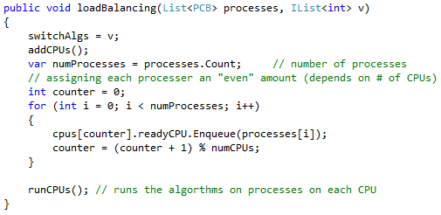
Multicore process distribution
Load sharing
Processes are split [as evenly as possible] to each CPU
500 processes between 2 CPUs = cpu1 → 250, cpu2 → 250
500 processes between 3 CPUs = cpu1 → 167, cpu2 → 167, cpu3 → 166
500 processes between 4 CPUs = cpu1 → 125, cpu2 → 125, cpu3 → 125, cpu4 → 125
Etc…

Slide 3
Uniprocessor Multiprogramming Dispatch Scheduler
Used 9 different algorithms, all with context switching factored in
FCFS
RR₁ with quantum = 10 (set at beginning of sim)
RR₂ with quantum = 20 (set at beginning of sim)
Feedback₁ with quantum = 1
Feedback₂ with quantum = 2^{i}
“Priority” algorithm: priority increased by 5 (priorityNumber -= 5) every time a process is finished
SRT
SPN
HRRN

Slide 4
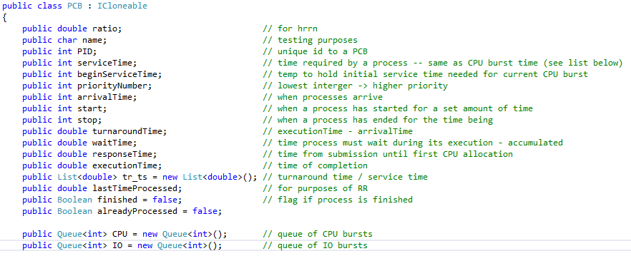
Process Control Block

Slide 5
Assumptions
A context switch has a cost of about 1 or 2
We will assume that a CPU service time will be used first followed by the I/O service time
There will be ready and wait queues for both the I/O and CPU
IO bursts are taken care of with FCFS
In terms of the load balance approach, we will be evaluating this on the basis of the same amount (number) of processes per processor.
In the feedback algorithm, we’re assuming the first process will not finish before the next process comes in

Slide 6
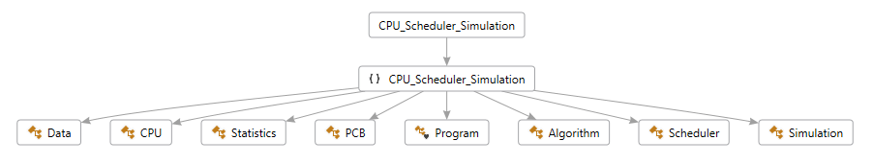
Approach
Language: C#

Slide 7
Demo

