Slide 1
9 Window functions
Window functions operate on a set of rows and return a single aggregated value for each row. Unlike GROUP BY, window functions return row-level results while allowing you to calculate aggregates across related rows.
window ranking functions
window aggregate functions

Slide 2
9 Window functions
FUNCTION(...) OVER (
PARTITION BY column1
ORDER BY column2
)

Slide 3
9 Window functions
ROW_NUMBER(): Assign a unique row ID within each group
SELECT
ticker,
date,
close,
ROW_NUMBER() OVER (PARTITION BY ticker ORDER BY date) AS row_num
FROM stocks_price;

Slide 4
9 Window functions
RANK() / DENSE_RANK(): Ranking by value
SELECT
ticker,
date,
close,
RANK() OVER (PARTITION BY ticker ORDER BY close DESC) AS price_rank
FROM stocks_price;

Slide 5
9 Aggregations functions
Sum
Count
Avg
Min
Max

Slide 6
9 Aggregations functions
Sum(val)over():grand total of all rows in the underlying query
Sum(val)over(partition by “column”):total for each value in “column”
Sum(val)over(partition by “column1” order by column2): running total for each partition

Slide 7
9 Aggregations functions
Sum(val)over():grand total of all rows in the underlying query
SELECT
ticker,
date,
close,
volume,
SUM(volume) OVER () AS total_volume
FROM stocks_price;

Slide 8
9 Aggregations functions
Sum(val)over(partition by “column”):total for each value in “column”
SELECT
ticker,
date,
close,
volume,
SUM(volume) OVER (PARTITION BY ticker ) AS ticker_total_volume
FROM stocks_price;

Slide 9
9 Aggregations functions
Sum(val)over(partition by “column1” order by column2): running total for each partition
SELECT
ticker,
date,
close,
volume,
SUM(volume) OVER (PARTITION BY ticker ORDER BY date) AS running_volume
FROM stocks_price;

Slide 10
9 Exercises
Sum(val)over(partition by “column1” order by column2): running total for each partition
SELECT
ticker,
date,
close,
volume,
SUM(volume) OVER (PARTITION BY ticker ORDER BY date) AS running_volume
FROM stocks_price;

Slide 11
10 Conditional Logic in SQL
CASE WHEN
IFNULL()
Conditional aggregation with CASE

Slide 12
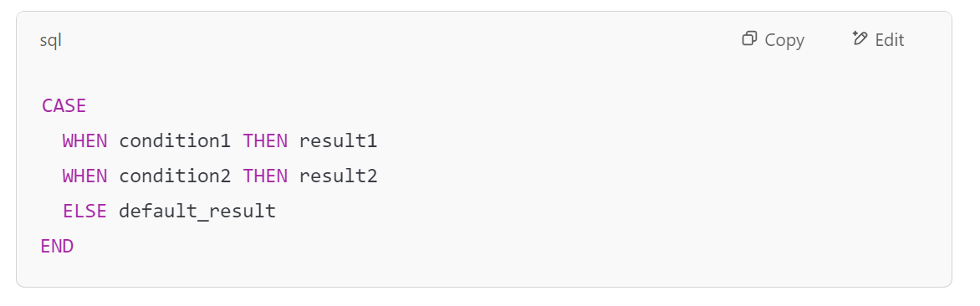
10 Conditional Logic in SQL
CASE WHEN：–General Conditional Logic

Slide 13
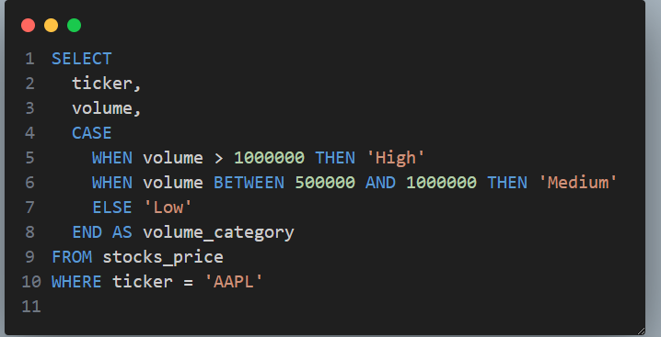
10 Conditional Logic in SQL
CASE WHEN：General Conditional Logic

Slide 14
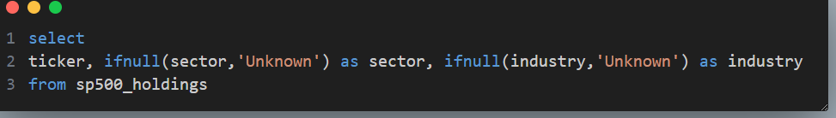
10 Conditional Logic in SQL
IFNULL：handle null values

Slide 15
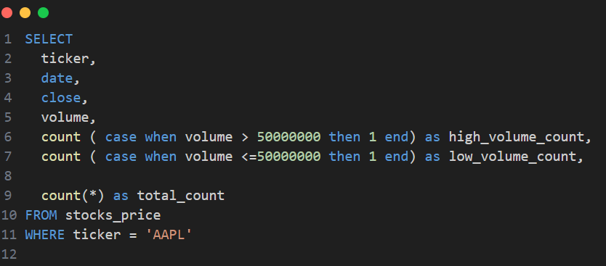
10 Conditional Logic in SQL
conditional aggregation with case when

Slide 16
10 Exercise
10.1 Calculate the net position of each ticker in trade_order table. The result should be Ticker, Net Position.
10.2 Count how many trades each investor made for 'TSLA'
10.3 label ticker in tickerinfo table as high if peratio > 50, medium if peratio between 20 and 50, else low, NA if peratio is null

Slide 17
11 Subqueries
A subquery is a SQL query within a query

Slide 18
11 Subqueries
Subqueries that return a single value
SELECT productid, productname, unitprice
FROM Products
WHERE unitprice =
(SELECT MIN(unitprice)
FROM Products)

Slide 19
11 Subqueries
A subquery that returns multiple values
SELECT productid, productname, unitprice
FROM Products
WHERE supplierid IN
(SELECT supplierid
FROM Suppliers
WHERE country = 'Japan');

Slide 20
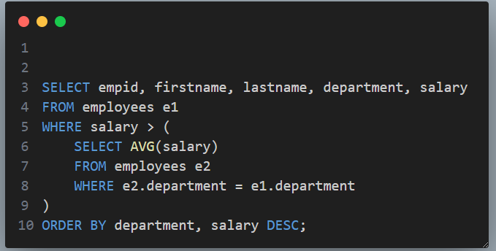
11 Subqueries
Correlated Subquery

Slide 21
11 Subqueries
Exercises
11.1 Find employees who earn more than the average salary of all employees
11.2 Find all employees who work in departments that have at least 2 employees
11.3 Find the highest paid employee in each department

Slide 22
12 Derived table
Select restaurant,category,type,
address,priceEach,priceEach*0.5 as SummerDelicious_Price,website
from toronto_restaurants
where SummerDelicious_Price <20 --Invalid column name 'SummerDelicious_Price'.

Slide 23
12 Derived table
select restaurant,category,type,address,priceEach,
SummerDelicious_Price,website
from(select restaurant,category,type,address,priceEach,priceEach *0.5 as SummerDelicious_Price,website
from toronto_restaurants
) as d1
where SummerDelicious_Price <20
Derived table

