Slide 1
SQL-Structured Query Language

Slide 2
Introduction
It is a query language designed for managing data in a database management system (DBMS).
We use database all the time whether you are aware of it or not.
(Facebook, WeChat store our data in their database)

Slide 3
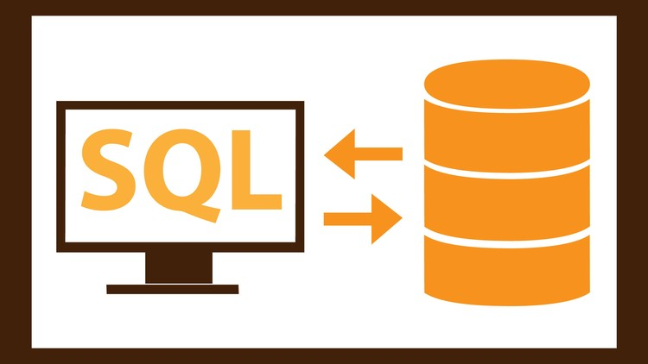
Introduction
Query language
Database server

Slide 4

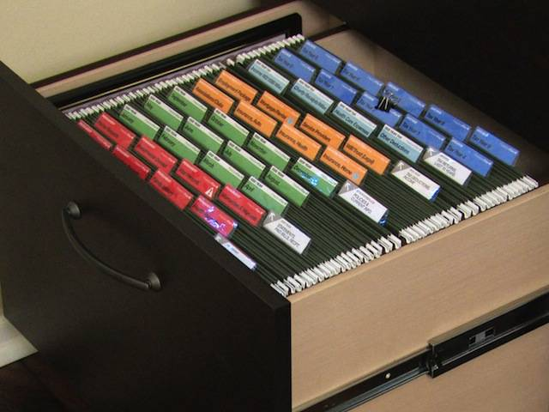
Introduction
A database is a collection of data stored in organized fashion.
Database
File cabinet

Slide 5
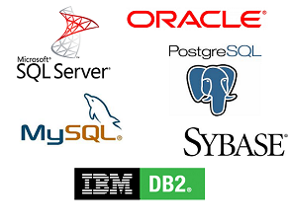

Introduction
We use database management system(DBMS) to store, modify and extract data from a database.
https://sqlite.org/download.html

Slide 6

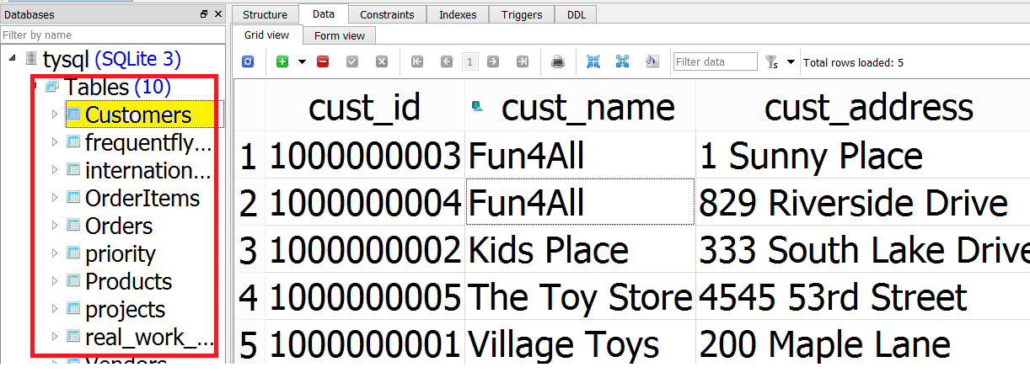
1.2 Tables
A table is a structured file that can store data of a specific type.

Slide 7
1.2 Tables
Row is a record in a table
Column is single field in a table. A table is made up of one or more columns.

Slide 8
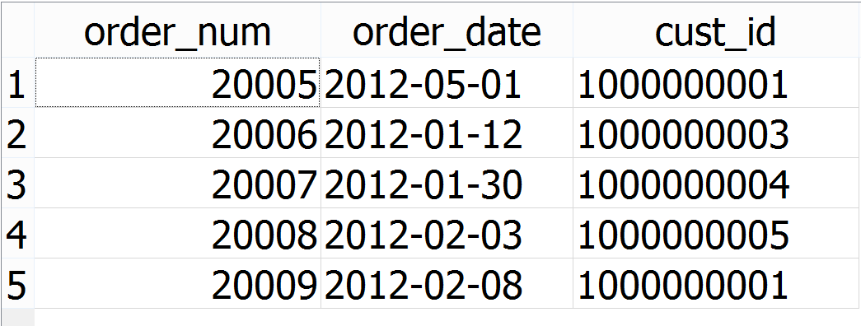
1.2 Tables
Column
Row

Slide 9
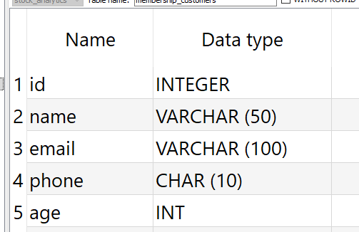
1.2 Tables
Data type restrict the type of data that can be stored in a column.

Slide 10
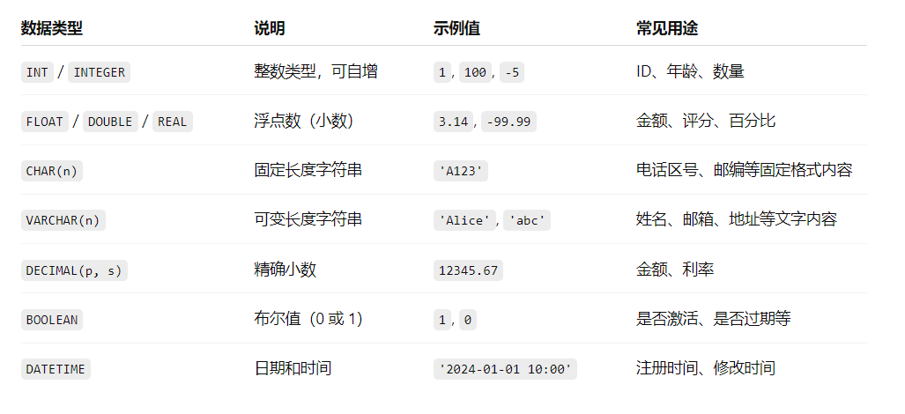
1.2 Tables
Common Data Types:

Slide 11
1.3 Primary key
Primary key is a column(multiple columns) whose values uniquely identify each row.
Primary key cannot have null value

Slide 12
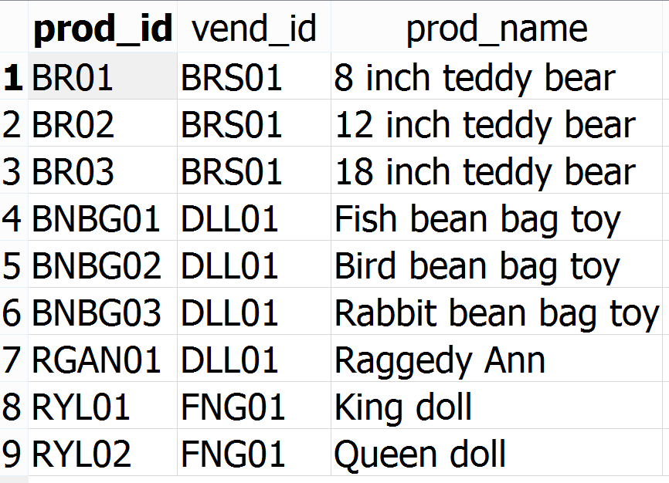
1.3 Primary key
One column

Slide 13
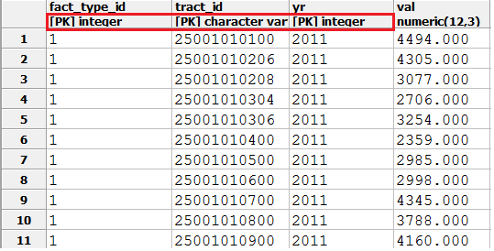
1.3 Primary key
multiple columns

Slide 14
Retrieving Data
SELECT
FROM
WHERE
GROUP BY
HAVING
ORDER BY;
Required

Slide 15
Retrieving Data
SELECT the column(s) I want
FROM these database and tables

Slide 16
Retrieving Data
SELECT statement specify what you want to select , and from where you want to select it.
SELECT ticker, close FROM stocks_price;

Slide 17
Retrieving Data
The asterisk (*) wildcard character can be used to request all columns without having to list them individually.
SELECT * FROM stocks_price;

Slide 18
Retrieving Data
DISTINCT keyword instructs database to only return distinct values
SELECT ticker FROM stocks_price;
SELECT DISTINCT ticker FROM stocks_prices;

Slide 19
Retrieving Data
DISTINCT keyword applies to all columns, not just the one it precedes
SELECT DISTINCT vend_id FROM Products;
SELECT DISTINCT vend_id,prod_name FROM Products;

Slide 20
Retrieving Data
LIMIT can be used to specify number of rows returned by user.
SELECT *
FROM stocks_price
LIMIT5

Slide 21
Retrieving Data
OFFSET can be used to skip number of rows data. Must use with limit
SELECT *
FROM stocks_price
LIMIT 4 OFFSET 3

Slide 22
Retrieving Data
Prod_name | Row_Count | Limit 4 offset 3
8 inch teddy bear | 1 | Offset 3
12 inch teddy bear | 2
18 inch teddy bear | 3
Fish bean bag toy | 1 | Limit 4
Bird bean bag toy | 2
Rabbit bean bag toy | 3
Raggedy Ann | 4
King doll
Queen doll

Slide 23
Exercise 2.1
Display a list of unique portfolio_id and security_id in trade_orders table.

Slide 24
3.Filtering Data
WHERE is used to filter data that meets certain criteria.
SELECT * FROM stocks_price WHERE ticker = 'META';

Slide 25
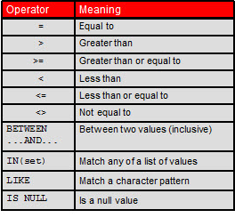
3.Filtering Data
WHERE Clause Operators

Slide 26
3.Filtering Data
Quotes are required for string value datatype
SELECT * FROM stocks_price WHERE ticker = 'META';

Slide 27
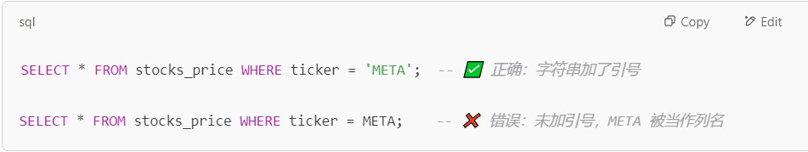
3.Filtering Data

Slide 28

3.Filtering Data
To determine if a value is NULL, we cannot use “=“.
Instead, IS NULL clause is used.
SELECT *
FROM customers
WHERE cust_email IS NULL;

Slide 29
3.Filtering Data
Checking for NULL
 | Length | Datatype
Space | 1 | String
Empty string | 0 | String
0 | 1 | Integer
NULL | NULL | Null

Slide 30
3.Filtering Data
AND Logical operator
SELECT *
FROM stocks_price
WHERE ticker = 'AAPL' AND date ='2025-01-06';

Slide 31
3.Filtering Data
OR logical operator
SELECT *
FROM stocks_price
WHERE ticker = 'AAPL' OR date ='2025-01-06';

Slide 32
3.Filtering Data
Understanding Order of Evaluation(SQL evalulate AND before OR)
SELECT *
FROM stocks_price
WHERE ticker = 'AAPL' OR ticker = 'META’
AND date = '2025-01-06';

Slide 33
3.Filtering Data
Use bracket to ensure the intended behavior
SELECT *
FROM stocks_price
WHERE (ticker = 'AAPL' OR ticker = 'META’)
AND date = '2025-01-06';

Slide 34
3.Filtering Data
IN operator
SELECT *
FROM stocks_price
WHERE ticker in ( 'AAPL','META’)
SELECT *
FROM stocks_price
WHERE ticker = 'AAPL' OR ticker = 'META’

Slide 35
3.Filtering Data
Not operator
SELECT *
FROM stocks_price
WHERE NOT ticker = 'AAPL'
SELECT *
FROM stocks_price
WHERE ticker <> 'AAPL'

Slide 36
Exercise 3
3.1 Get AAPL’s ticker, date, close, volume columns from stocks_price table. Sort data by date.
3.2 Find date, volume of AAPL’s trading volume that is greater than 3 million. Sort data by date.

Slide 37
Exercise 3
3.3 Find date,volume,ticker of AAPL, META, NVDA ’s trading volume that is greater than 3 million.

Slide 38
4.Sorting Data
ORDER BY clause takes the name of one or more columns by which to sort the output.
SELECT * FROM stocks_price ORDER BY date;

Slide 39
4.Sorting Data
ORDER BY clause takes the name of one or more columns by which to sort the output.
SELECT * FROM stocks_price ORDER BY date,close;

Slide 40
4.Sorting Data
DESC is used to instruct the database to sort data in descending order. The default sorting order is ascending.
SELECT * FROM stocks_price ORDER BY date DESC;

Slide 41
4.Sorting Data
Sort Data by multiple columns in different order.
SELECT * FROM Stocks ORDER BY date DESC,close;

Slide 42
4.Sorting Data
LIMIT can be used to specify number of rows returned by user.
SELECT *
FROM stocks_price
ORDER BY close
LIMIT5

Slide 43
4.Sorting Data
OFFSET can be used to skip number of rows data. Must use with limit
SELECT *
FROM stocks_price
ORDER BY close
LIMIT 5 OFFSET 3

Slide 44
4.Sorting Data
Prod_name | Row_Count | Limit 4 offset 3
8 inch teddy bear | 1 | Offset 3
12 inch teddy bear | 2
18 inch teddy bear | 3
Fish bean bag toy | 1 | Limit 4
Bird bean bag toy | 2
Rabbit bean bag toy | 3
Raggedy Ann | 4
King doll
Queen doll

Slide 45
Exercise 4
4.1 Display a list of trader_name, portfolio_id and security_id,quantity in trade_orders table.Sort the output by trader_name first in asceding order and then by quantity in desceding order
4.2 Get top 5 customers(Name, Phonenumber, Address,PointsEarned) who earned most points.

Slide 46
Exercise 4
4.3 Get customers(Name, Phonenumber, Address, PointsEarned) who ranked 4 to 10 in points earned.

Slide 47
5.Use wildcard filtering
Wildcards are special characters used to match parts of a value.

Slide 48
5. Use wildcard filtering
The Percent Sign (%) Wildcard:match any number of different characters
SELECT *
FROM sp500_holdings
WHERE industry LIKE '%oil%';

Slide 49
5. Use wildcard filtering
The Underscore (_) Wildcard:match a single character
SELECT *
FROM sp500_holdings
WHERE industry LIKE '_echnology';

Slide 50
Exercise 5
5. Find all tickers that has the word “Software” in their Industry column in sp500_holdings.

Slide 51
6. Calculated fields: use || sign
Concatenating Fields
SELECT ticker, sector ||
' (' || industry ||')' FROM sp500_holdings;

Slide 52
6. Calculated fields
Using Aliases
SELECT ticker, sector ||
' (' || industry ||')' as sector_industry FROM sp500_holdings;

Slide 53
6. Calculated fields
Performing Mathematical Calculations
SELECT ticker, date, close, close*0.8 AS adjsuted_close FROM stocks_price

Slide 54
6. Calculated fields
SQL Mathematical Operators
Operator | Description
+ | Addition
- | Subtraction
* | Multiplication
/ | Division

Slide 55
7.Summarizing and grouping data

Slide 56
7.Summarizing and grouping data
AVG()function
SELECT AVG(close) AS avg_close FROM stocks_price;
WHERE ticker = 'AAPL'

Slide 57
7.Summarizing and grouping data
COUNT()function
COUNT(*):count the number of rows in a table, whether columns contain values or NULL.
COUNT(column):count the number of rows that have values in a specific column, ignoring NULL values.

Slide 58
7.Summarizing and grouping data
COUNT()function
SELECT COUNT(*)
FROM sp500_holdings;
SELECT COUNT(industry)
FROM sp500_holdings;;

Slide 59
7.Summarizing and grouping data
Max(),Min()function
SELECT Max(close) AS max_close FROM stocks_price;
SELECT Min(prod_price) AS min_price FROM stocks_price;

Slide 60
7.Summarizing and grouping data
SUM()function
SELECT SUM(quantity) AS items_ordered FROM trade_orders WHERE security_id = ‘AAPL’ AND side = ‘BUY’;

Slide 61
7.Summarizing and grouping data
Aggregates on Distinct Values
SELECT AVG(DISTINCT prod_price) AS avg_price FROM Products WHERE vend_id = 'DLL01';
No DISTINCT With COUNT(*)

Slide 62
7.Summarizing and grouping data
Apply multiple aggregation functions on same column
SELECT COUNT(*) AS num_items, MIN(prod_price) AS price_min, MAX(prod_price) AS price_max, AVG(prod_price) AS price_avg FROM Products;

Slide 63
7.Summarizing and grouping data
Grouping data
Grouping lets you divide data into logical sets so that you can perform aggregate calculations on each group.

Slide 64
7.Summarizing and grouping data
Grouping data
SELECT AVG(close) AS avg_close FROM stocks_price;
WHERE ticker = 'AAPL'
SELECT ticker, AVG(close) AS avg_close FROM stocks_price GROUP BY ticker;

Slide 65
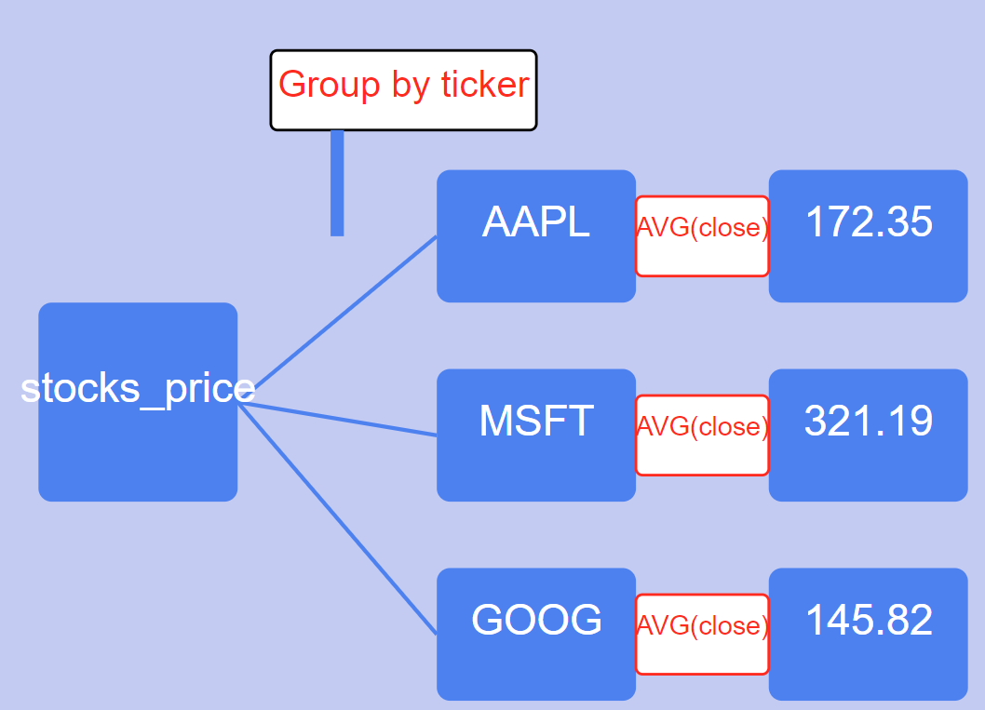
7.Summarizing and grouping data

Slide 66
7.Summarizing and grouping data
Grouping data
Every column(except for column in aggregation function) in your select statement must be present in the group by clause.

Slide 67
7.Summarizing and grouping data
Filtering Groups:HAVING keyword
SELECT ticker, AVG(close) AS avg_close FROM stocks_price GROUP BY ticker
HAVING AVG(close) > 150

Slide 68
7.Summarizing and grouping data
Filtering Groups
SELECT ticker, AVG(close) AS avg_close FROM stocks_price
WHERE ticker in (‘META’,’GOOG’,’COST’) GROUP BY ticker
HAVING AVG(close) > 200

Slide 69
7.Exercise
7.1 Get maximum, minimum, average trading volume for ticker COST between 2024-01-01 to 2024-02-01 in table stocks_price.
7.2 Get each porfolio's total long position in table trade_orders
*long position = price* quantity and side is BUY

Slide 70
7.Exercise
7.3 Pull the data for porfolio that has short position in table trade_orders that meets the following criteria.
1.side is sell and quantity is greater than 500
2.portfolio’s short position is greater than 50000s

Slide 71
8 Join Tables
Cross joins
Inner joins
Outer joins

Slide 72
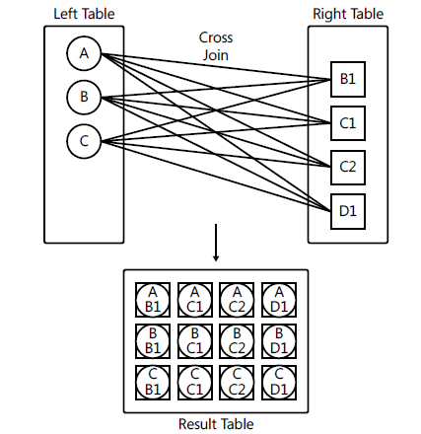
8.1 Cross Joins
Cross joins: It performs a multiplication between the tables , yielding a row for each combination of rows from both sides

Slide 73
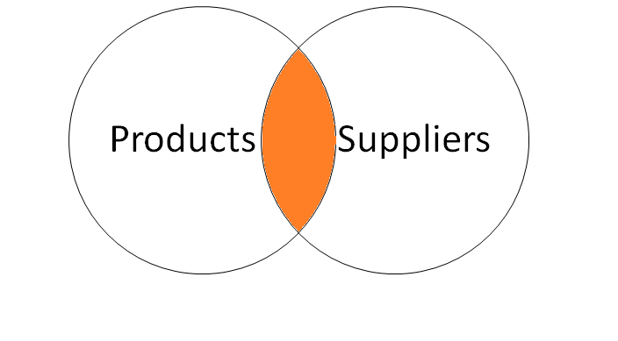
Inner Join
The INNER JOIN keyword selects records that have matching values in both tables.

Slide 74
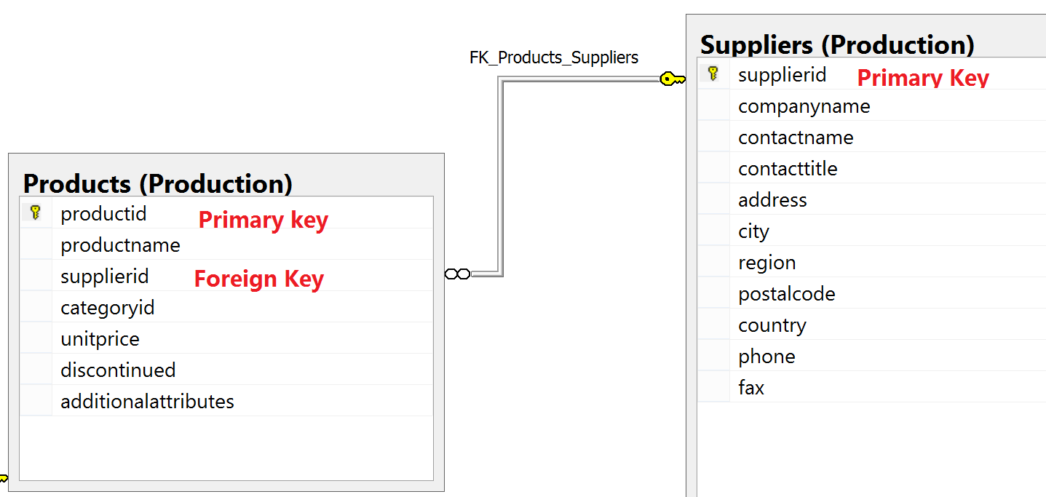
Inner Join
In this case, we want to find out our products’ supplier name. We can join Products and Suppliers table and select the records that have the same supplierid from both tables

Slide 75
Inner Join
select p.productname,p.unitprice,s.companyname as supplier_name
from production.products as p inner join production.suppliers as s
on p.supplierid=s.supplierid
Remember that an inner join does not return rows that don’t find matches

Slide 76
Self Join
select e.firstname + ' ' + e.lastname as emp,
m.firstname + ' ' + m.lastname as mgr
from hr.employees as e inner join hr.Employees as m
on e.mgrid=m.empid

Slide 77
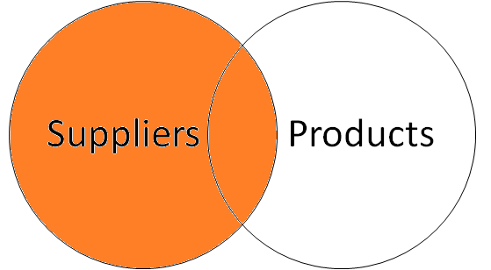
Outer Joins-Left Join

Slide 78
Outer Joins-Left Join
By using the keywords LEFT OUTER JOIN (or LEFT JOIN for short), you ask to preserve the left table. The join returns what an inner join normally would—that is, matches (call those inner rows). In addition, the join also returns rows from the left that had no matches in the right
table (call those outer rows), with NULLs used as placeholders in the right side

Slide 79
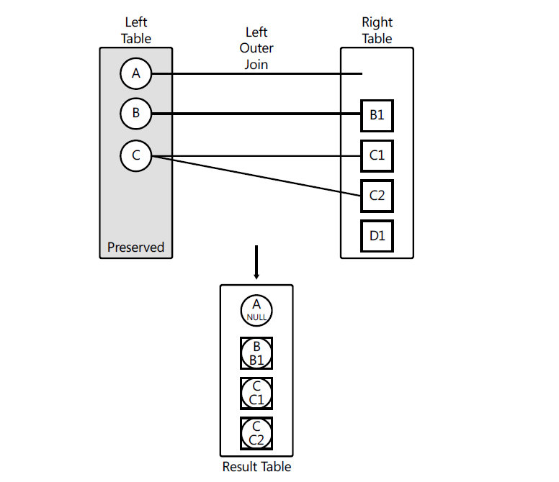
Outer Joins-Left Join

Slide 80
Outer Joins-Left Join
select s.supplierid,s.companyname as supplier_name,productname,p.unitprice
from production.suppliers as s left outer join production.products as p
on p.supplierid=s.supplierid

Slide 81

Difference between AND and WHERE in outer join
select s.supplierid,s.companyname as supplier_name,s.country,p.productname,p.unitprice
from production.suppliers as s
left outer join production.products as p
on p.supplierid=s.supplierid
and s.country= 'Japan’
select s.supplierid,s.companyname as supplier_name,s.country,p.productname,p.unitprice
from production.suppliers as s left outer join production.products as p
on p.supplierid=s.supplierid
where s.country= 'Japan'

Slide 82
Difference between AND and WHERE in outer join
In left join:
conditions after “ON” are only used to match rows from right table to the left table(preserved table).It will not filter out any rows. Thus, number of rows will not change no matter how many conditions you add after “ON” clause.
Conditions after “Where” are only used to filter out rows that do not meet the conditions. Thus, number of rows will change depending on your conditions after “WHERE” clause

Slide 83
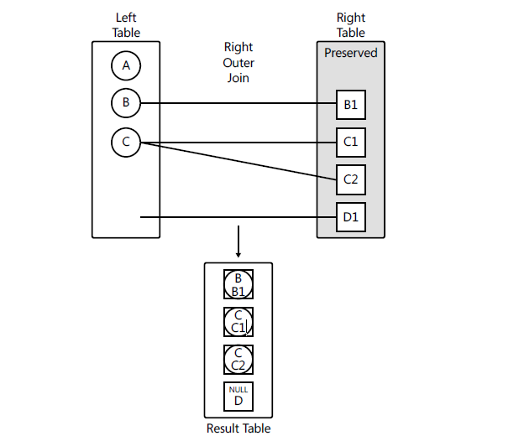
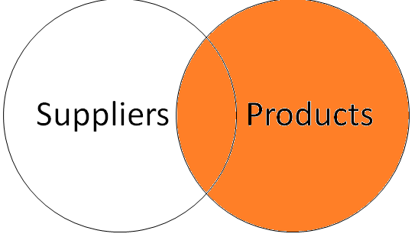
Right outer join
Just like you can use a left outer join to preserve the left side, you can use a right outer
join to preserve the right side

Slide 84
Right outer join
select s.supplierid,s.companyname as supplier_name,s.country,p.productname,p.unitprice
from production.suppliers as s right outer join production.products as p
on p.supplierid=s.supplierid
and s.country= 'Japan'

Slide 85
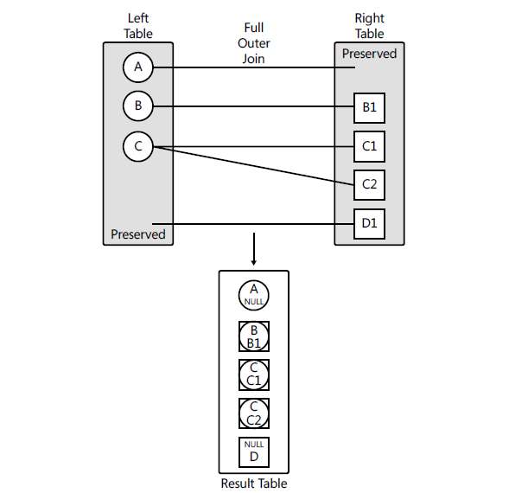
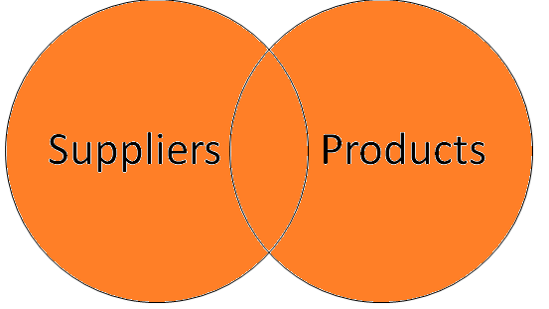
Full outer join

Slide 86
Full outer join
A full outer join returns the inner rows that are normally returned from an inner join; plus rows from the left that don’t have matches in the right, with NULLs used as placeholders in the right side; plus rows from the right that don’t have matches in the left, with NULLs used as
placeholders in the left side.

Slide 87
Full outer join
select s.supplierid,s.companyname as supplier_name,s.country,p.productname,p.unitprice
from production.suppliers as s full outer join production.products as p
on p.supplierid=s.supplierid

Slide 88
Multi-Join Queries
As an example, suppose that you wanted to return all suppliers from Japan, and matching products where relevant. For this, you need an outer join between Production.Suppliers and Production.Products, preserving Suppliers. But you also want to include product category information, so you add an inner join to Production.Categories, as follows.

Slide 89
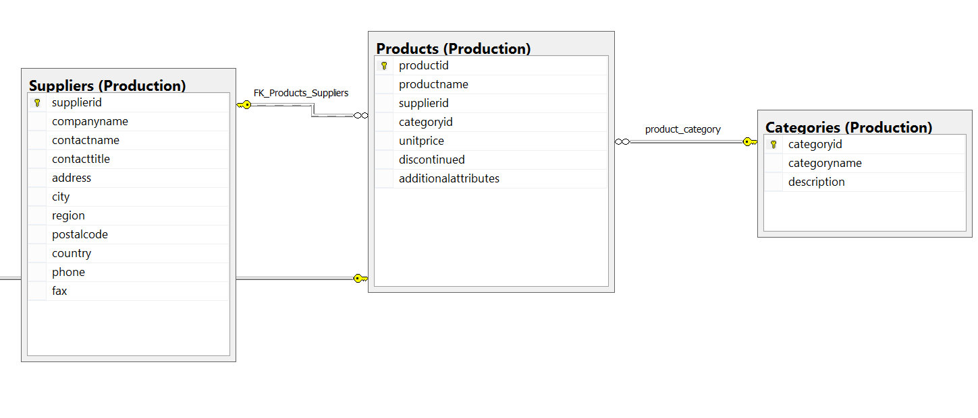
Multi-Join Queries

Slide 90

Multi-Join Queries
SELECT S.companyname AS supplier, S.country,
P.productid, P.productname, P.unitprice,
C.categoryname
FROM Production.Suppliers AS S
LEFT OUTER JOIN Production.Products AS P
ON S.supplierid = P.supplierid
INNER JOIN Production.Categories AS C
ON C.categoryid = P.categoryid
WHERE S.country = N'Japan';

Slide 91
Multi-Join Queries
SELECT S.companyname AS supplier, S.country,
P.productid, P.productname, P.unitprice,C.categoryname
FROM Production.Suppliers AS S
LEFT OUTER JOIN
(Production.Products AS P
INNER JOIN Production.Categories AS C
ON C.categoryid = P.categoryid)
ON S.supplierid = P.supplierid
WHERE S.country = N'Japan';

Slide 92
9.3Derived table
Select restaurant,category,type,
address,priceEach,priceEach*0.5 as SummerDelicious_Price,website
from toronto_restaurants
where SummerDelicious_Price <20 --Invalid column name 'SummerDelicious_Price'.

Slide 93
Derived table
select restaurant,category,type,address,priceEach,
SummerDelicious_Price,website
from(select restaurant,category,type,address,priceEach,priceEach *0.5 as SummerDelicious_Price,website
from toronto_restaurants
) as d1
where SummerDelicious_Price <20
Derived table

