Slide 1

BDD - End to end testing in the .net world using user stories

Slide 2
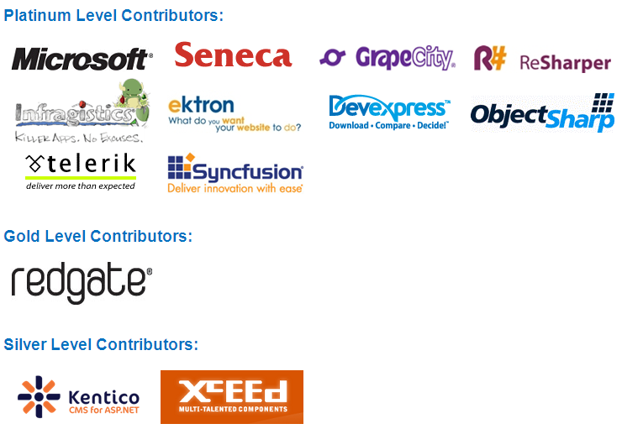

Slide 3
Hernan Garcia
15+ years.
Subscribe to alt.net principles.
Very pragmatic (most of the time).
Learning how to create better, more elegant code.
Old obsession: quality software.
New obsession: NoSql.
@theprogrammer
http://blog.dynamicprogrammer.com
hernan@dynamicprogrammer.com

Slide 4
Behaviour Driven Development
Evolution of TDD.
Focus on behaviour that is understandable to people.
Retains the red-green workflow (Actually, yellow, red, green).
Address the questions:
How much should I specify?
How should I organize and name my specs?
Can be used to test at the unit level and the integration level.

Slide 5
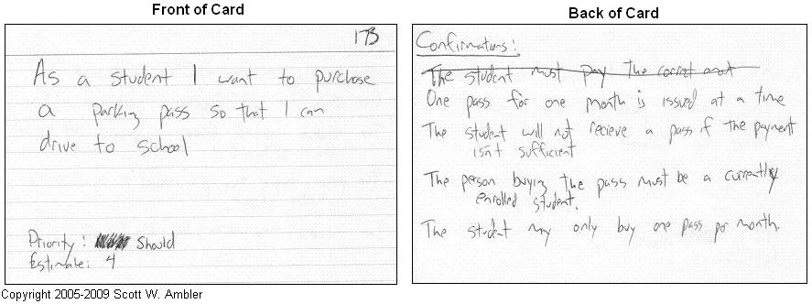
User Stories
Plain english definitions of a feature (specification).
They are not use cases, but serve the same purpose.

Slide 6
Frameworks: Context/Specification
Machine Specifications
http://github.com/machine/machine.specifications
SpecUnit.Net
http://code.google.com/p/specunit-net/

Slide 7
MSpec Demo
ReSharper and Gallio runner.
Cmd line runner.
Easily integrates with CI servers
User friendly report.

Slide 8
Frameworks: GWT or Given, When, Then
StoryQ
http://storyq.codeplex.com/
StorEvil
http://github.com/davidmfoley/storevil
Cucumber
http://cukes.info/
Can be used with IronRuby in the .net world
Or via Cuke4Nukes
SpecFlow

Slide 9
StoryQ Demo
ReSharper runner integration.
Cmd line runner.
Fluent interface.
User Story to code converter (buggy).
Easily integrates with CI servers.
User friendly report.

Slide 10
StorEvil Demo
Cmd line runner.
Some Gherkin implementation.
Easily integrates with CI servers.
User friendly report.
Good documentation via the wiki and some code examples.

Slide 11
Specflow
Open Source
BSD License
Installers for both VS 2008 and VS 2010
Use files 100% compatible with Cucumber (Gherkin)
Download
-http://specflow.org/
Training
-http://www.techtalk.at/
Support
-http://groups.google.com/group/specflow/

Slide 12
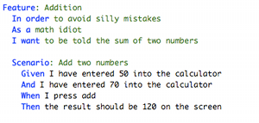
Gherkin
Used on Cucumber and SpecFlow
Localized to multiple languages
In an ideal world writen by the business

Slide 13
Demo - SpecFlow + WatiN
-Rescue (pets rescue site):
Log in
Publish
-using tables to pass more than one value
Search

Slide 14
Demo
Changing the design, ex: instead of text use images as links.
Using setups and teardown.
Capture screens to demostrate success or failure.
Running via the NUnit runner.
Running as part of your CI server.

Slide 15
Gherkin editor(s)
Auto complete
Syntax highlighting

Slide 16
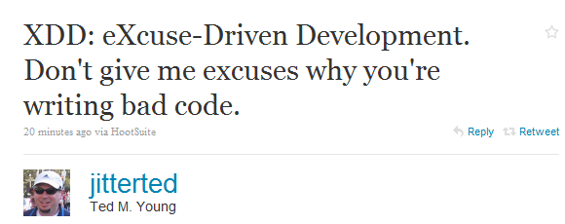
XDD

