Slide 1
Purity Calculation DDA
Two different approaches (consider m/z 350 – 1350, window size 0.5)
A) use fixed windows e.g. 350.0 – 350.5, 350.5 – 351.0, …
B) use variable windows calculated by precursor +/- 0.25 (window size / 2)
Then calculate sum of all precursor isotope intensities, divided by total intensity in matching window

Slide 2
DDA with „Filter Purity“ still has impure precursors
Example file: 20250519_Astral1_Evo_TH070_TT_THIDmulti003_pool_DDA_3ng_Gygi_ij40ms_9_PSMs.txt
Approach A: 624/6218 precursors below 70%
Approach B: 598/6218 precursors below 70%

Slide 3
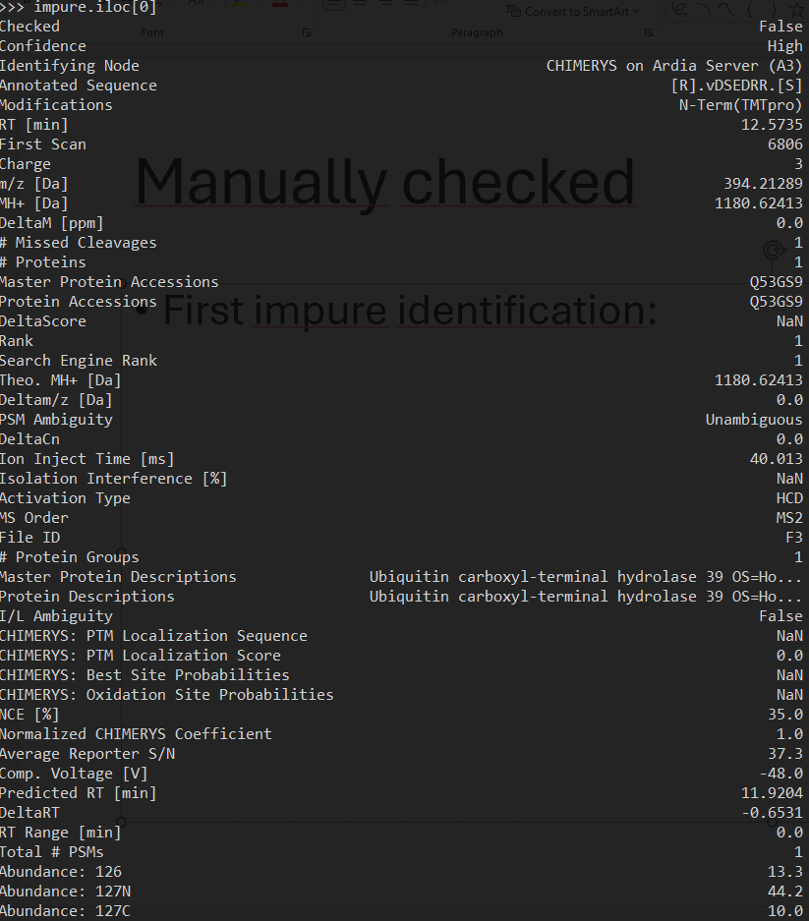
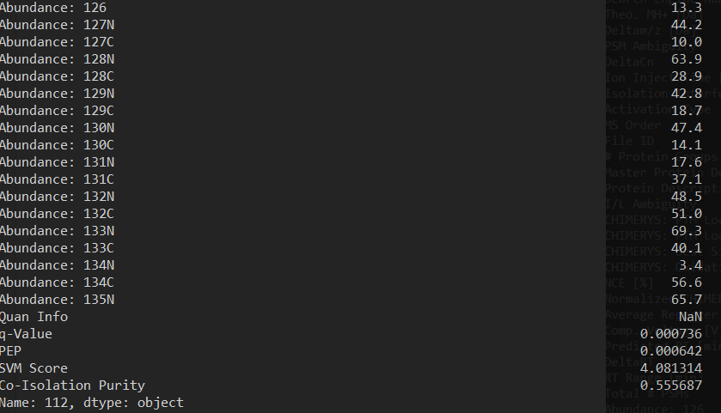
Manually checked
First impure identification:

Slide 4
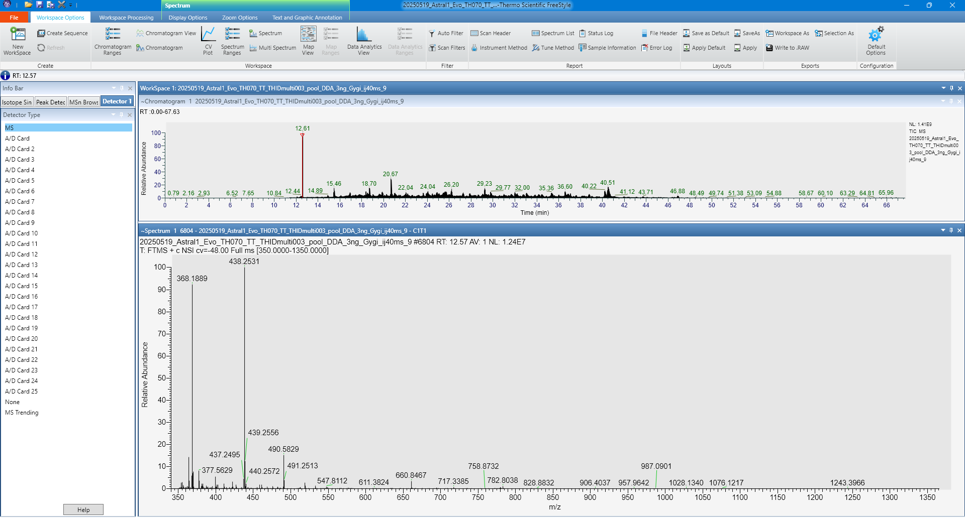
Closest MS1 spectrum

Slide 5
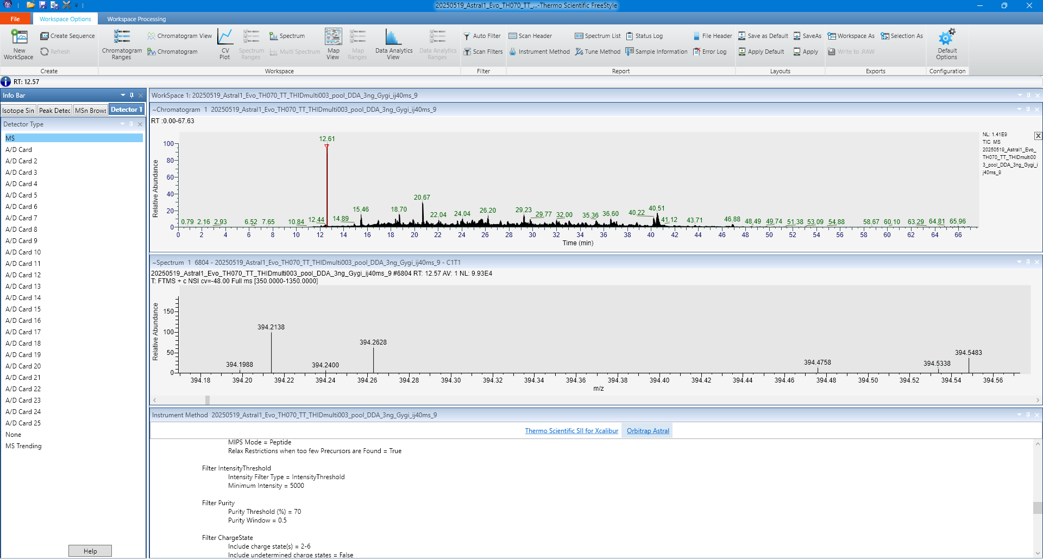
Precursor
Zoom in on peaks in window

Slide 6
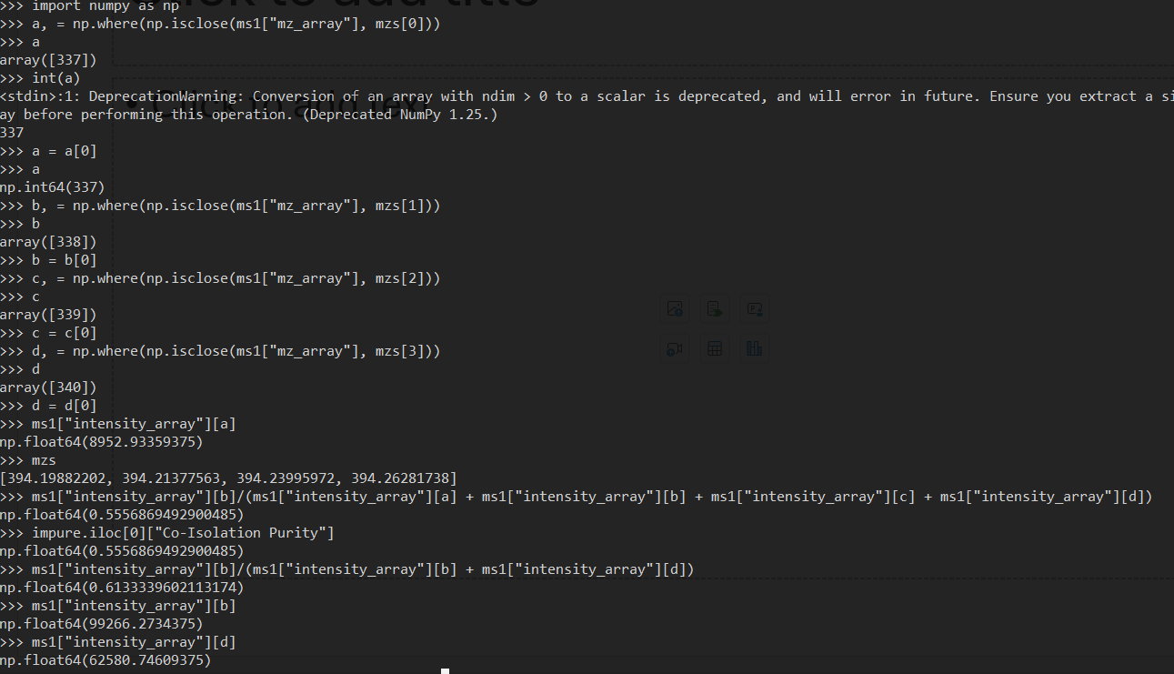
Manual purity calculation
Same as in our annotated CSV / from the script
Removing low intensity peaks does still not yield 0.7 purity

Slide 7
Conclusion
„Filter Purity“ in the method might not always trigger correctly or
Some other filter is also used that excludes peaks (noise/intensity does not make sense, because in the shown example both peaks have similar intensity) or
A different formula is used for purity calculation, e.g. precursor divided by remaining intensity in the window (instead of total intensity)

