Slide 1
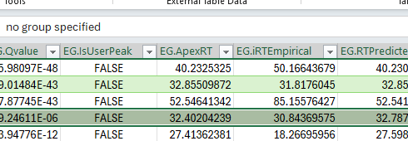
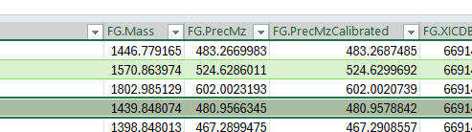
Example identification from Spectronaut result:
Identification with retention time 32.402 and precursor m/z 480.9566
However, there is no MS2 spectrum that would match to this retention time or precursor m/z. MS2 spectra at this retention time are all around 600 m/z (see next slide) and the closest MS2 spectrum with precursor ~480 m/z is more than 22 seconds RT away (see slide 3).

Slide 2
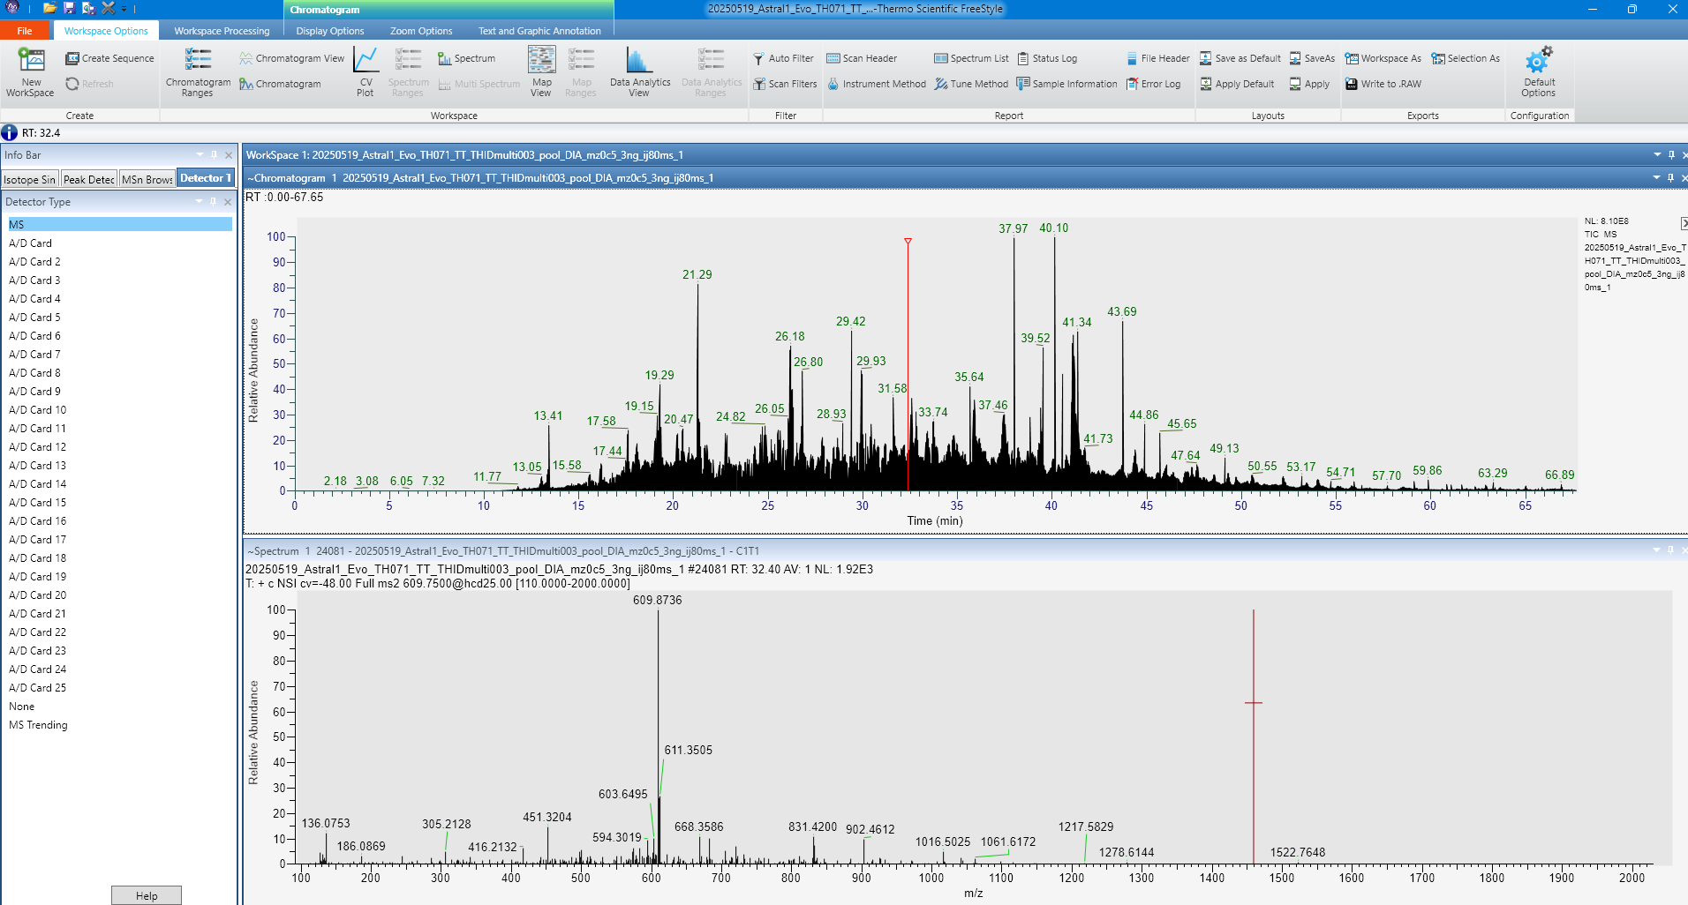
Spectra at RT 32.40 [min]

Slide 3
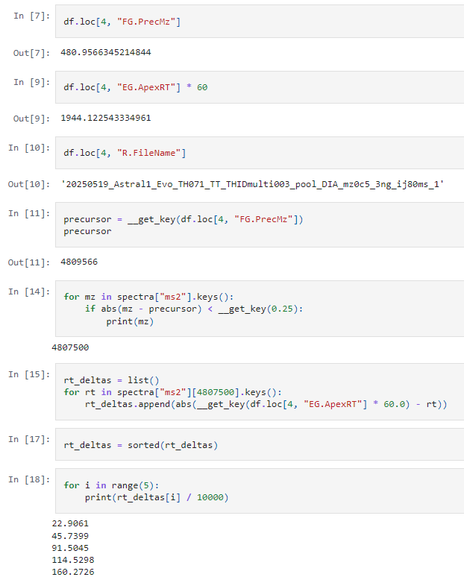
Closest precursor m/z = 480.75 (due to 0.5 m/z window)
Which is more than 22 seconds RT away

