Slide 1
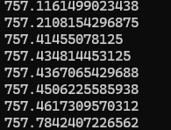
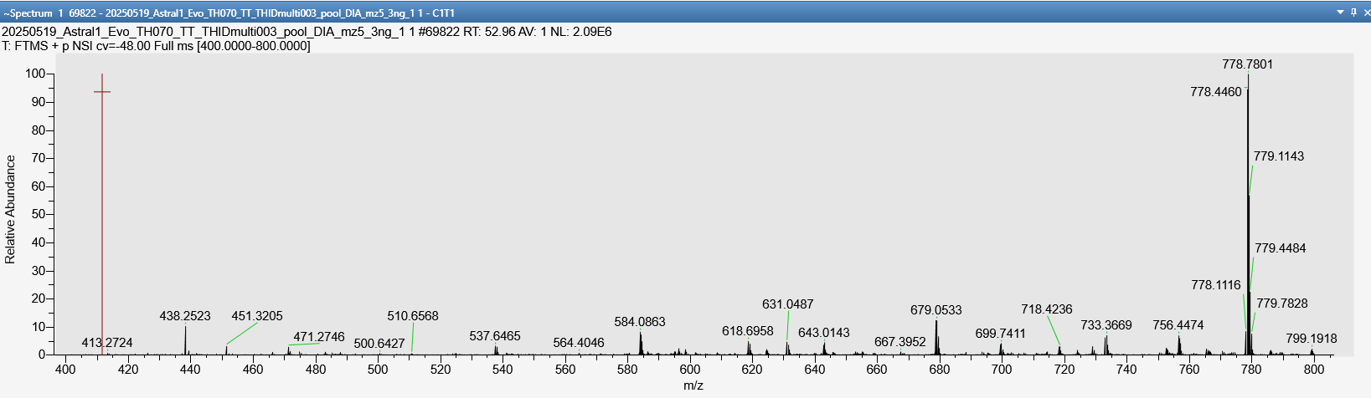
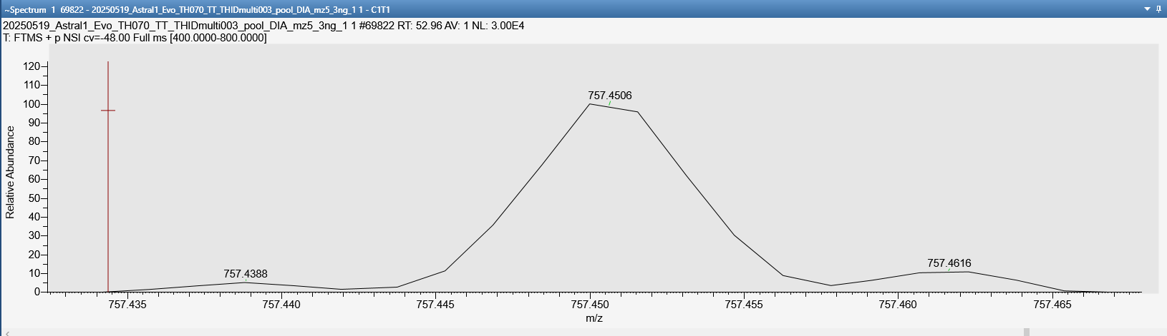

Frequency: 5198 (about a third of the identifications)

Slide 2
Possible workarounds
Use precursors with highest intensity
Use precursor with lowest m/z deviation (probably not a good solution)
Do not use the identification

Slide 3
