Slide 1
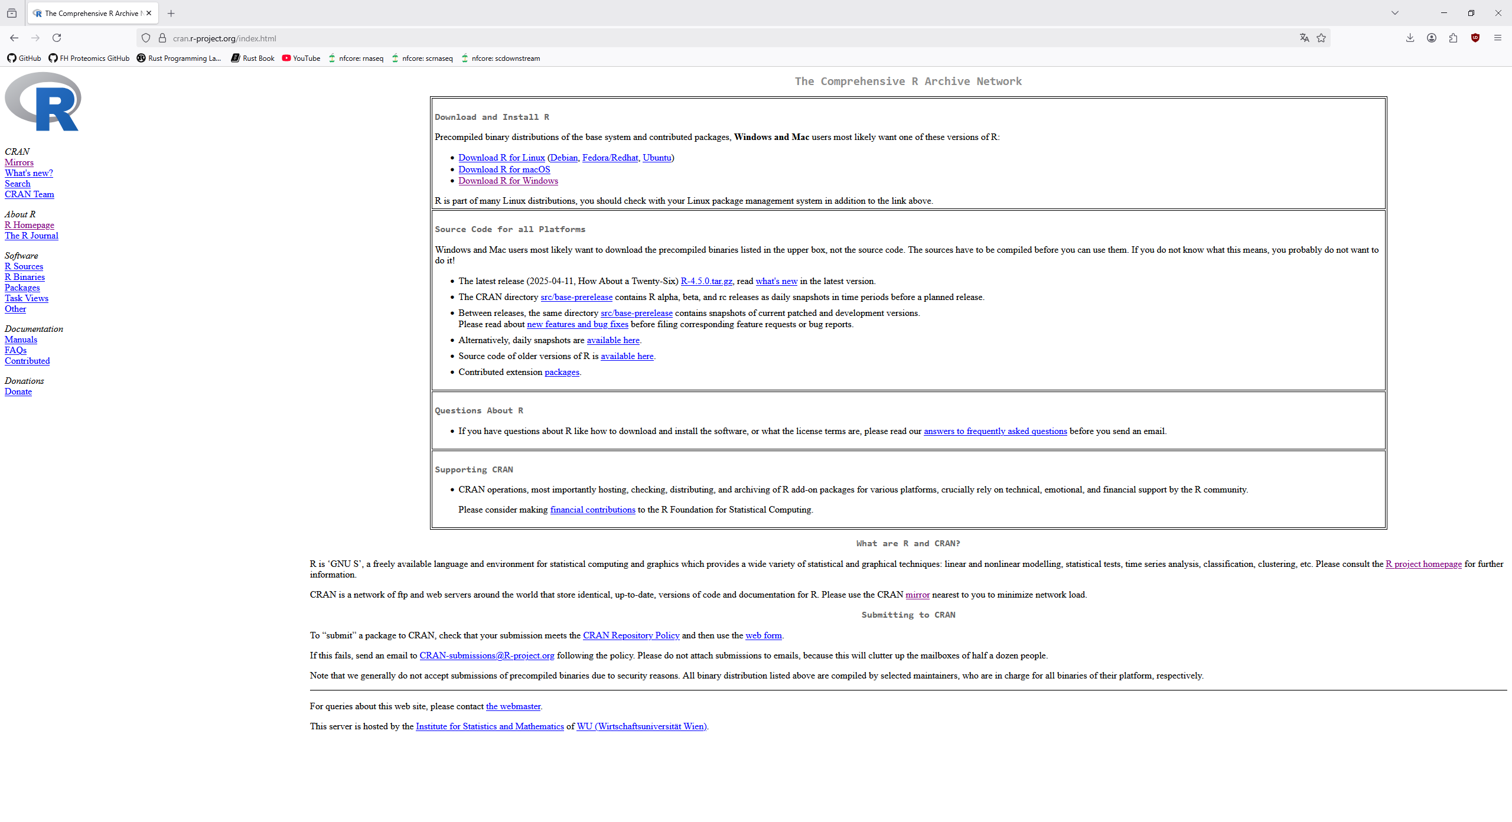
Download and install R from https://cran.r-project.org/index.html

Slide 2
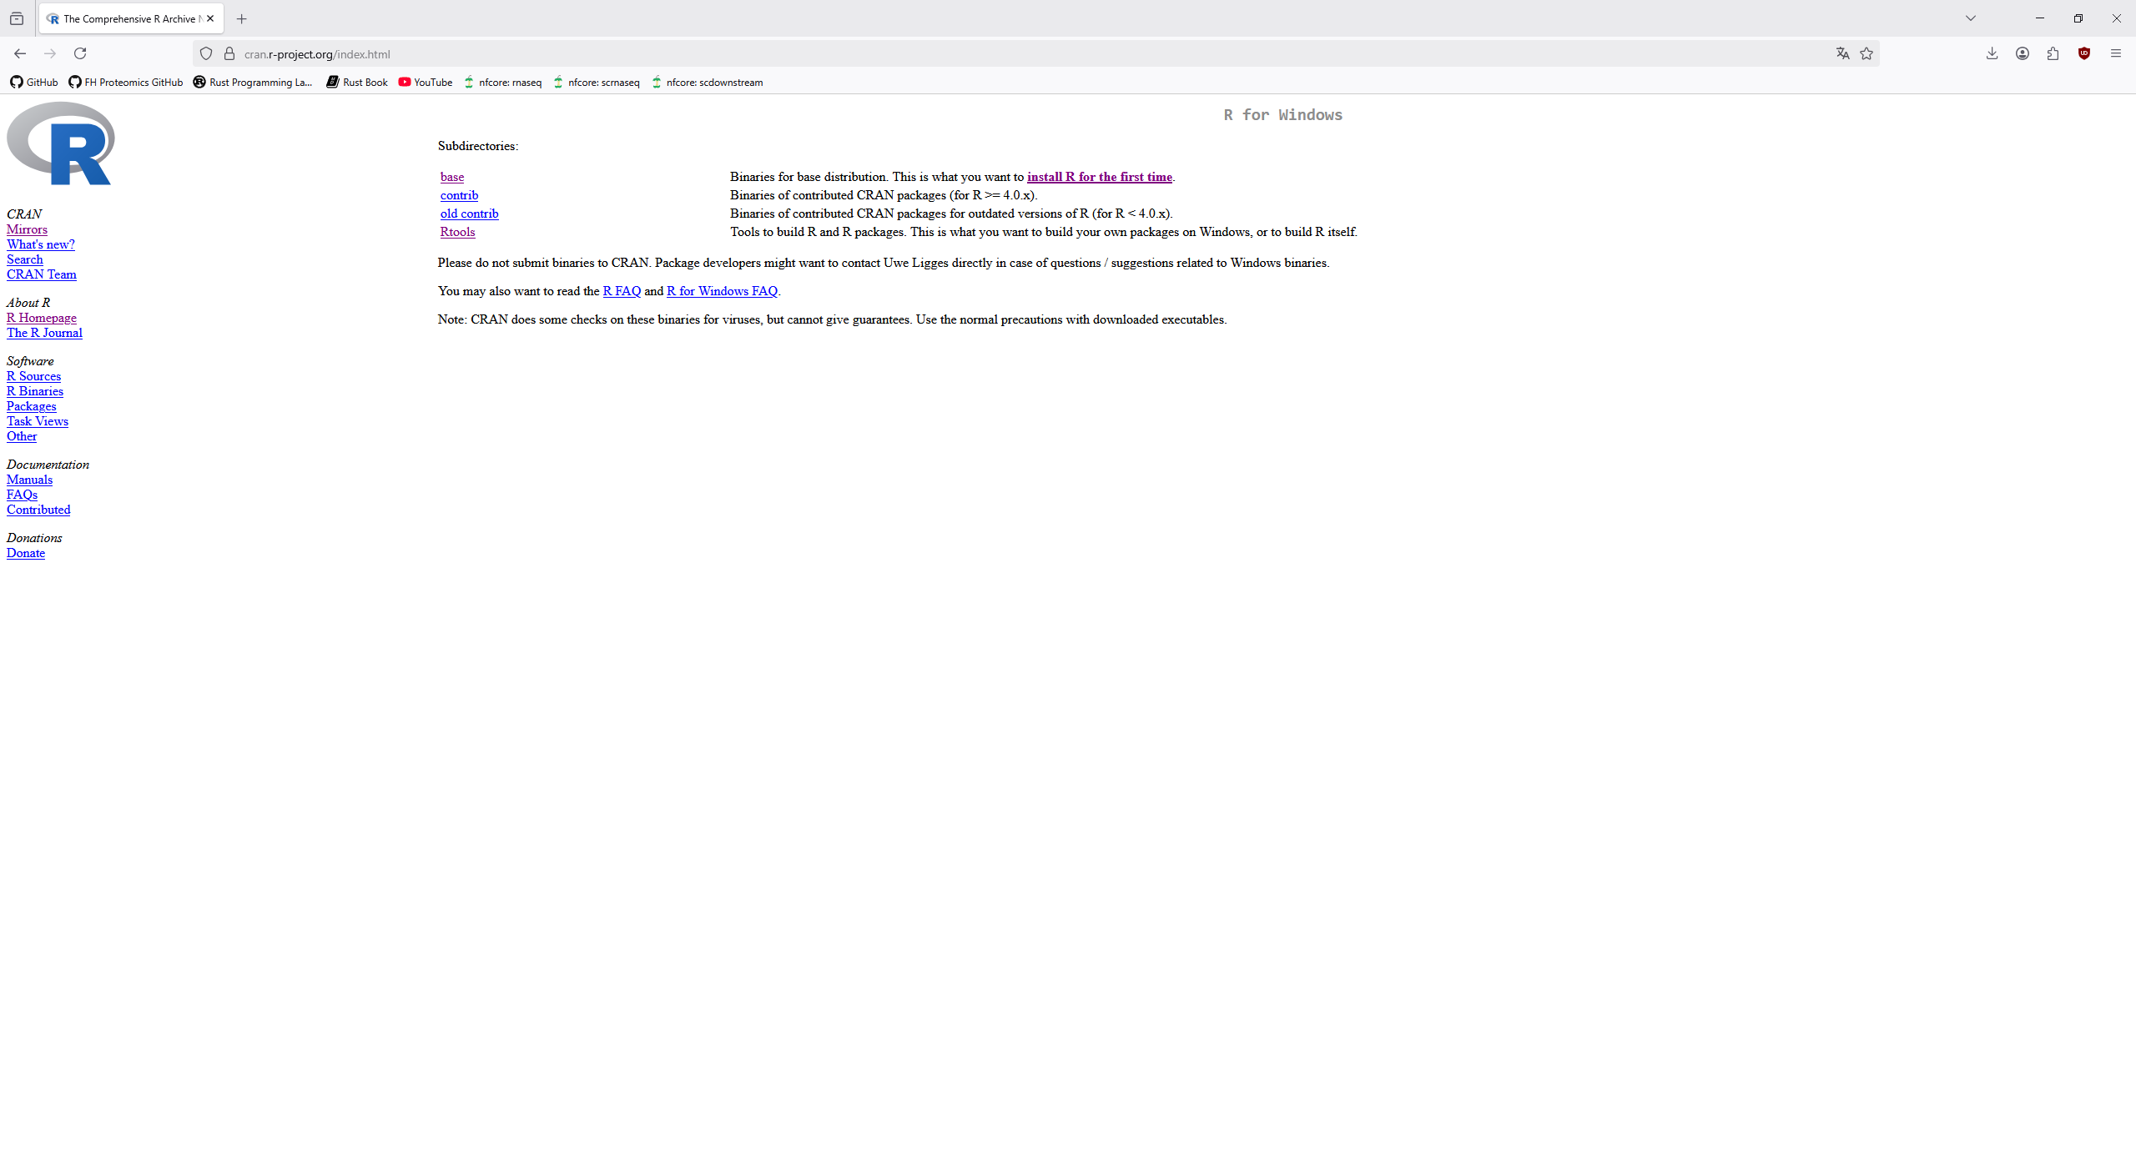
We need both „base“ and „Rtools“

Slide 3
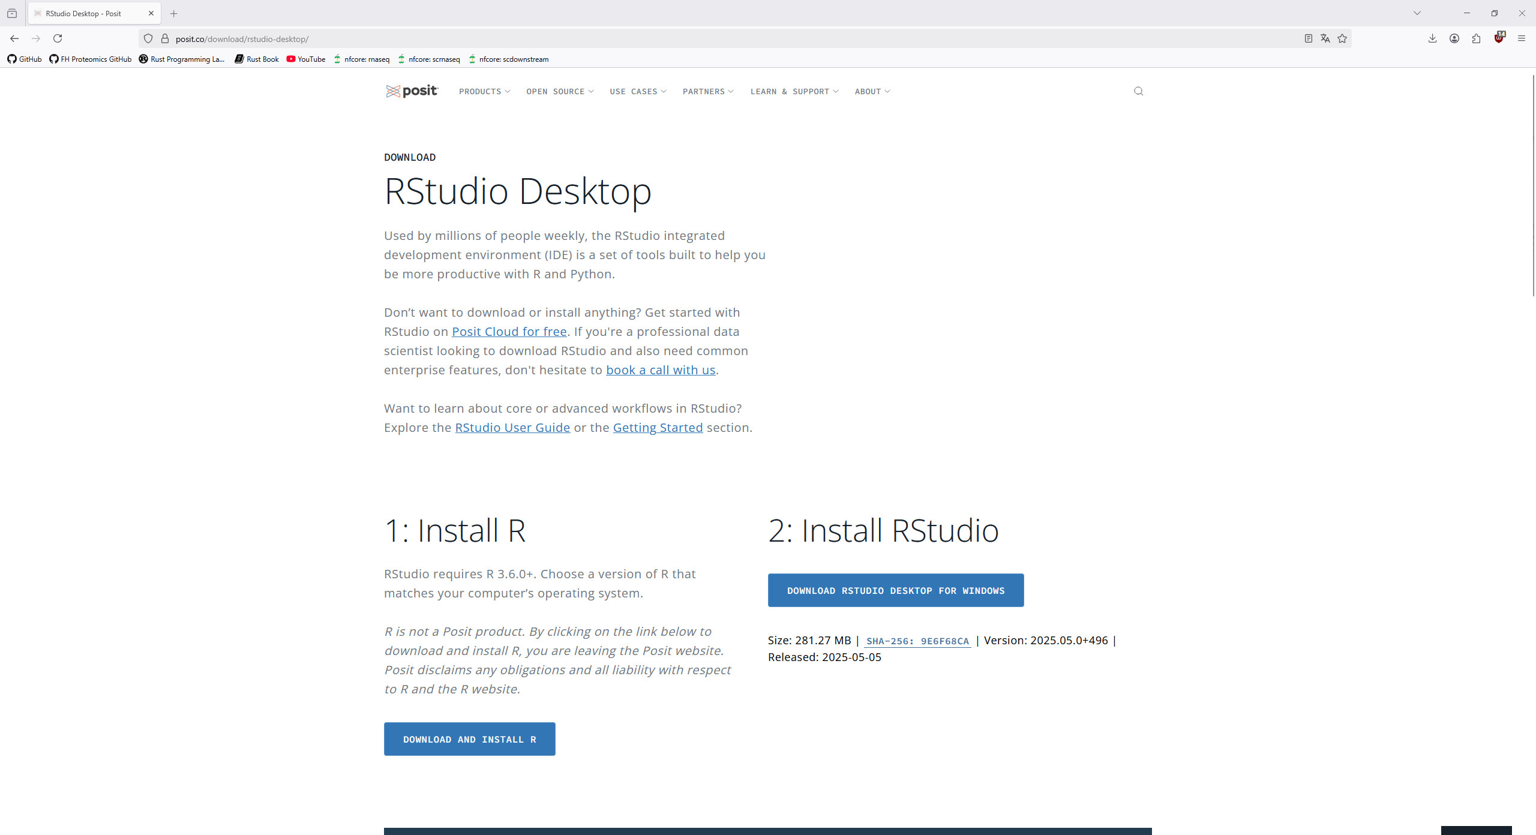
Download and install Rstudio from https://posit.co/download/rstudio-desktop/

Slide 4
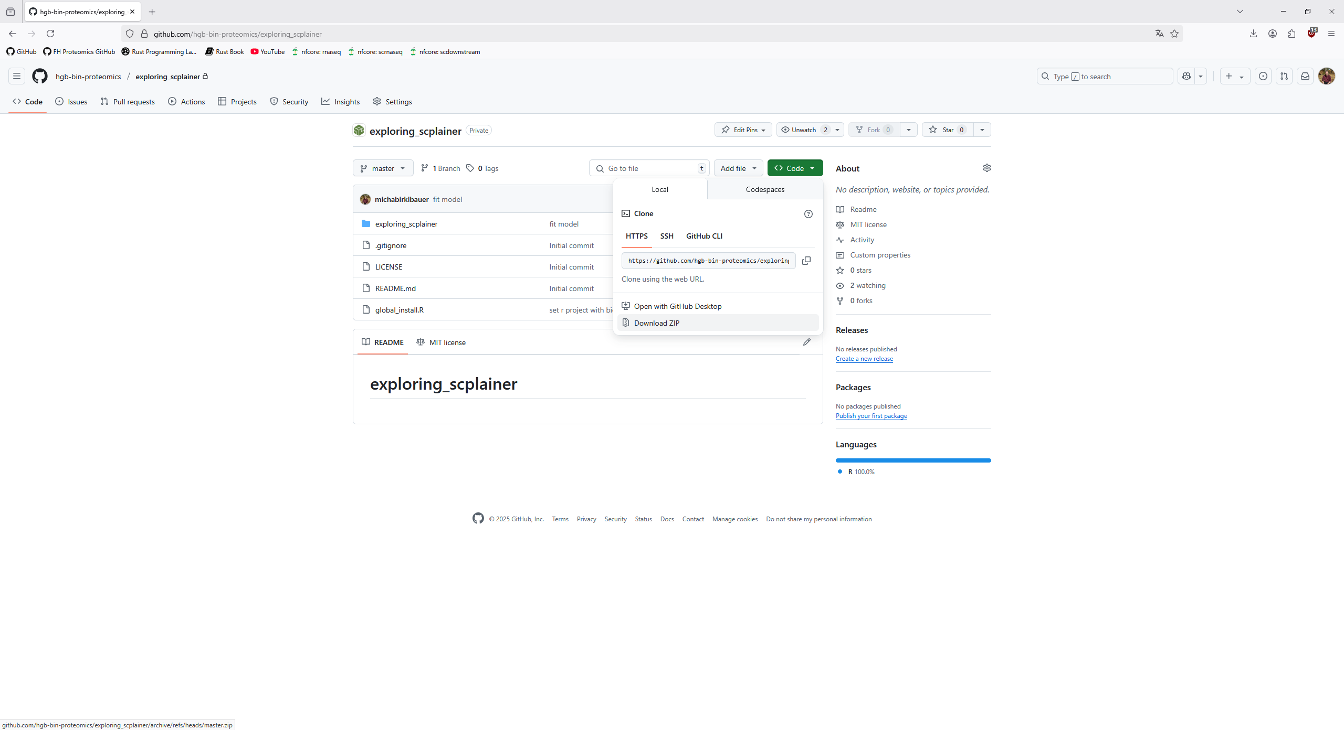
Download the project from https://github.com/hgb-bin-proteomics/exploring_scplainer

Slide 5
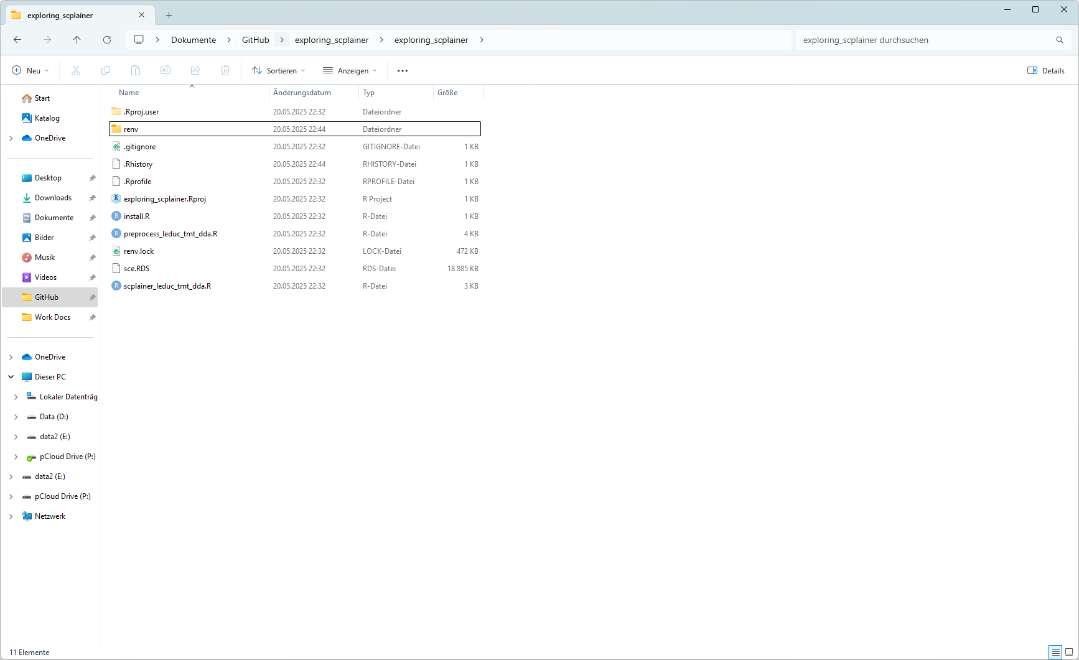
Open the .Rproj file (should by default open with RStudio)

Slide 6
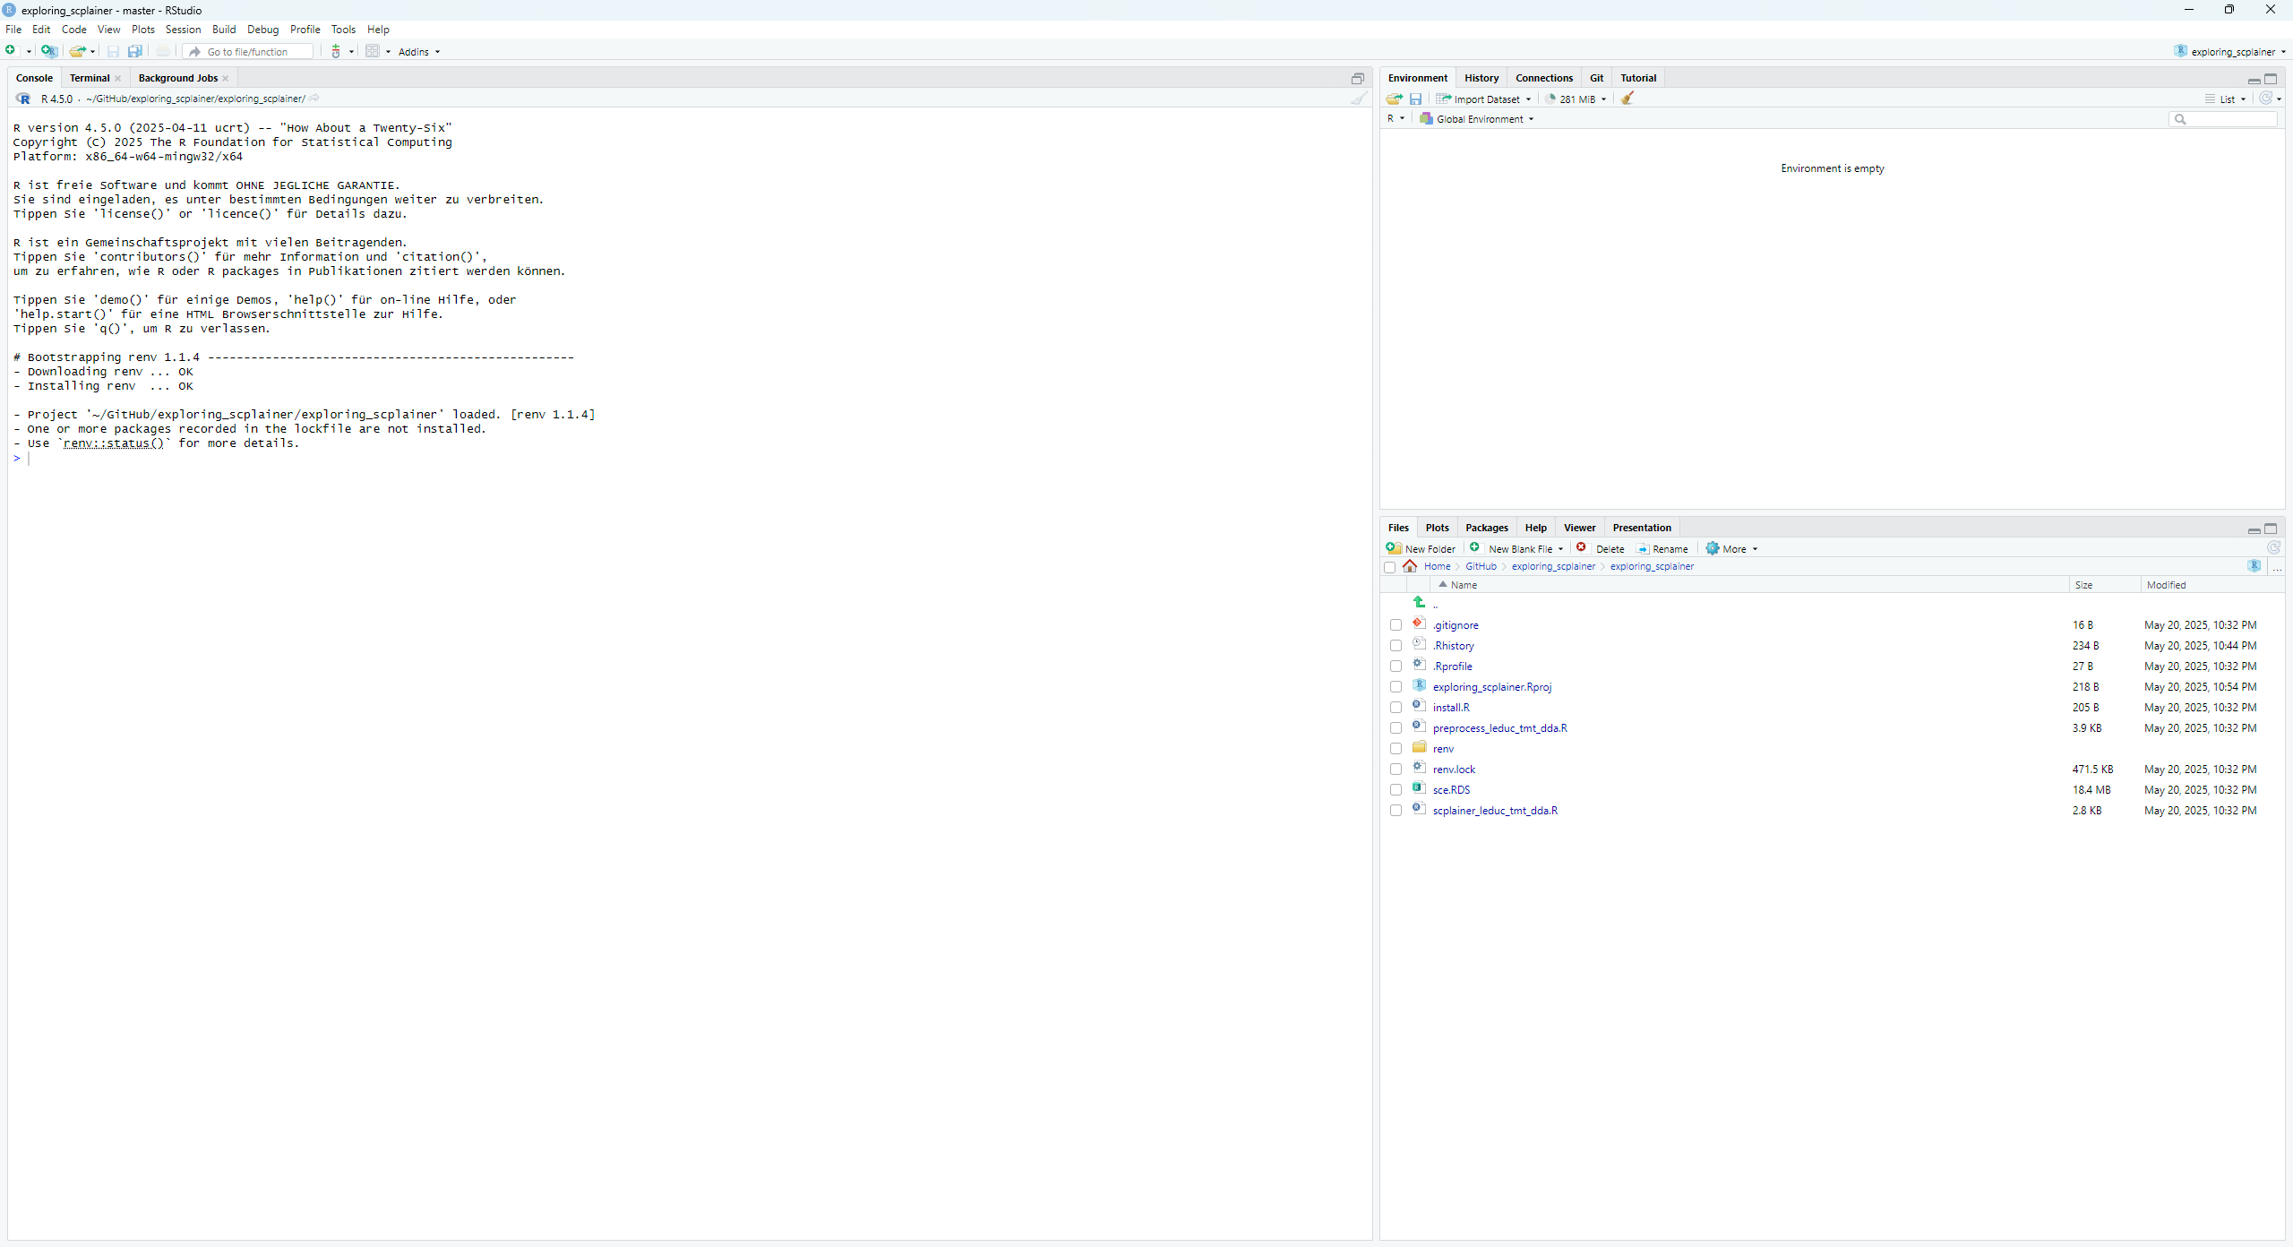
You will see something like this, a notification that not all necessary packages for this project are installed

Slide 7
Open the install.R file

Slide 8
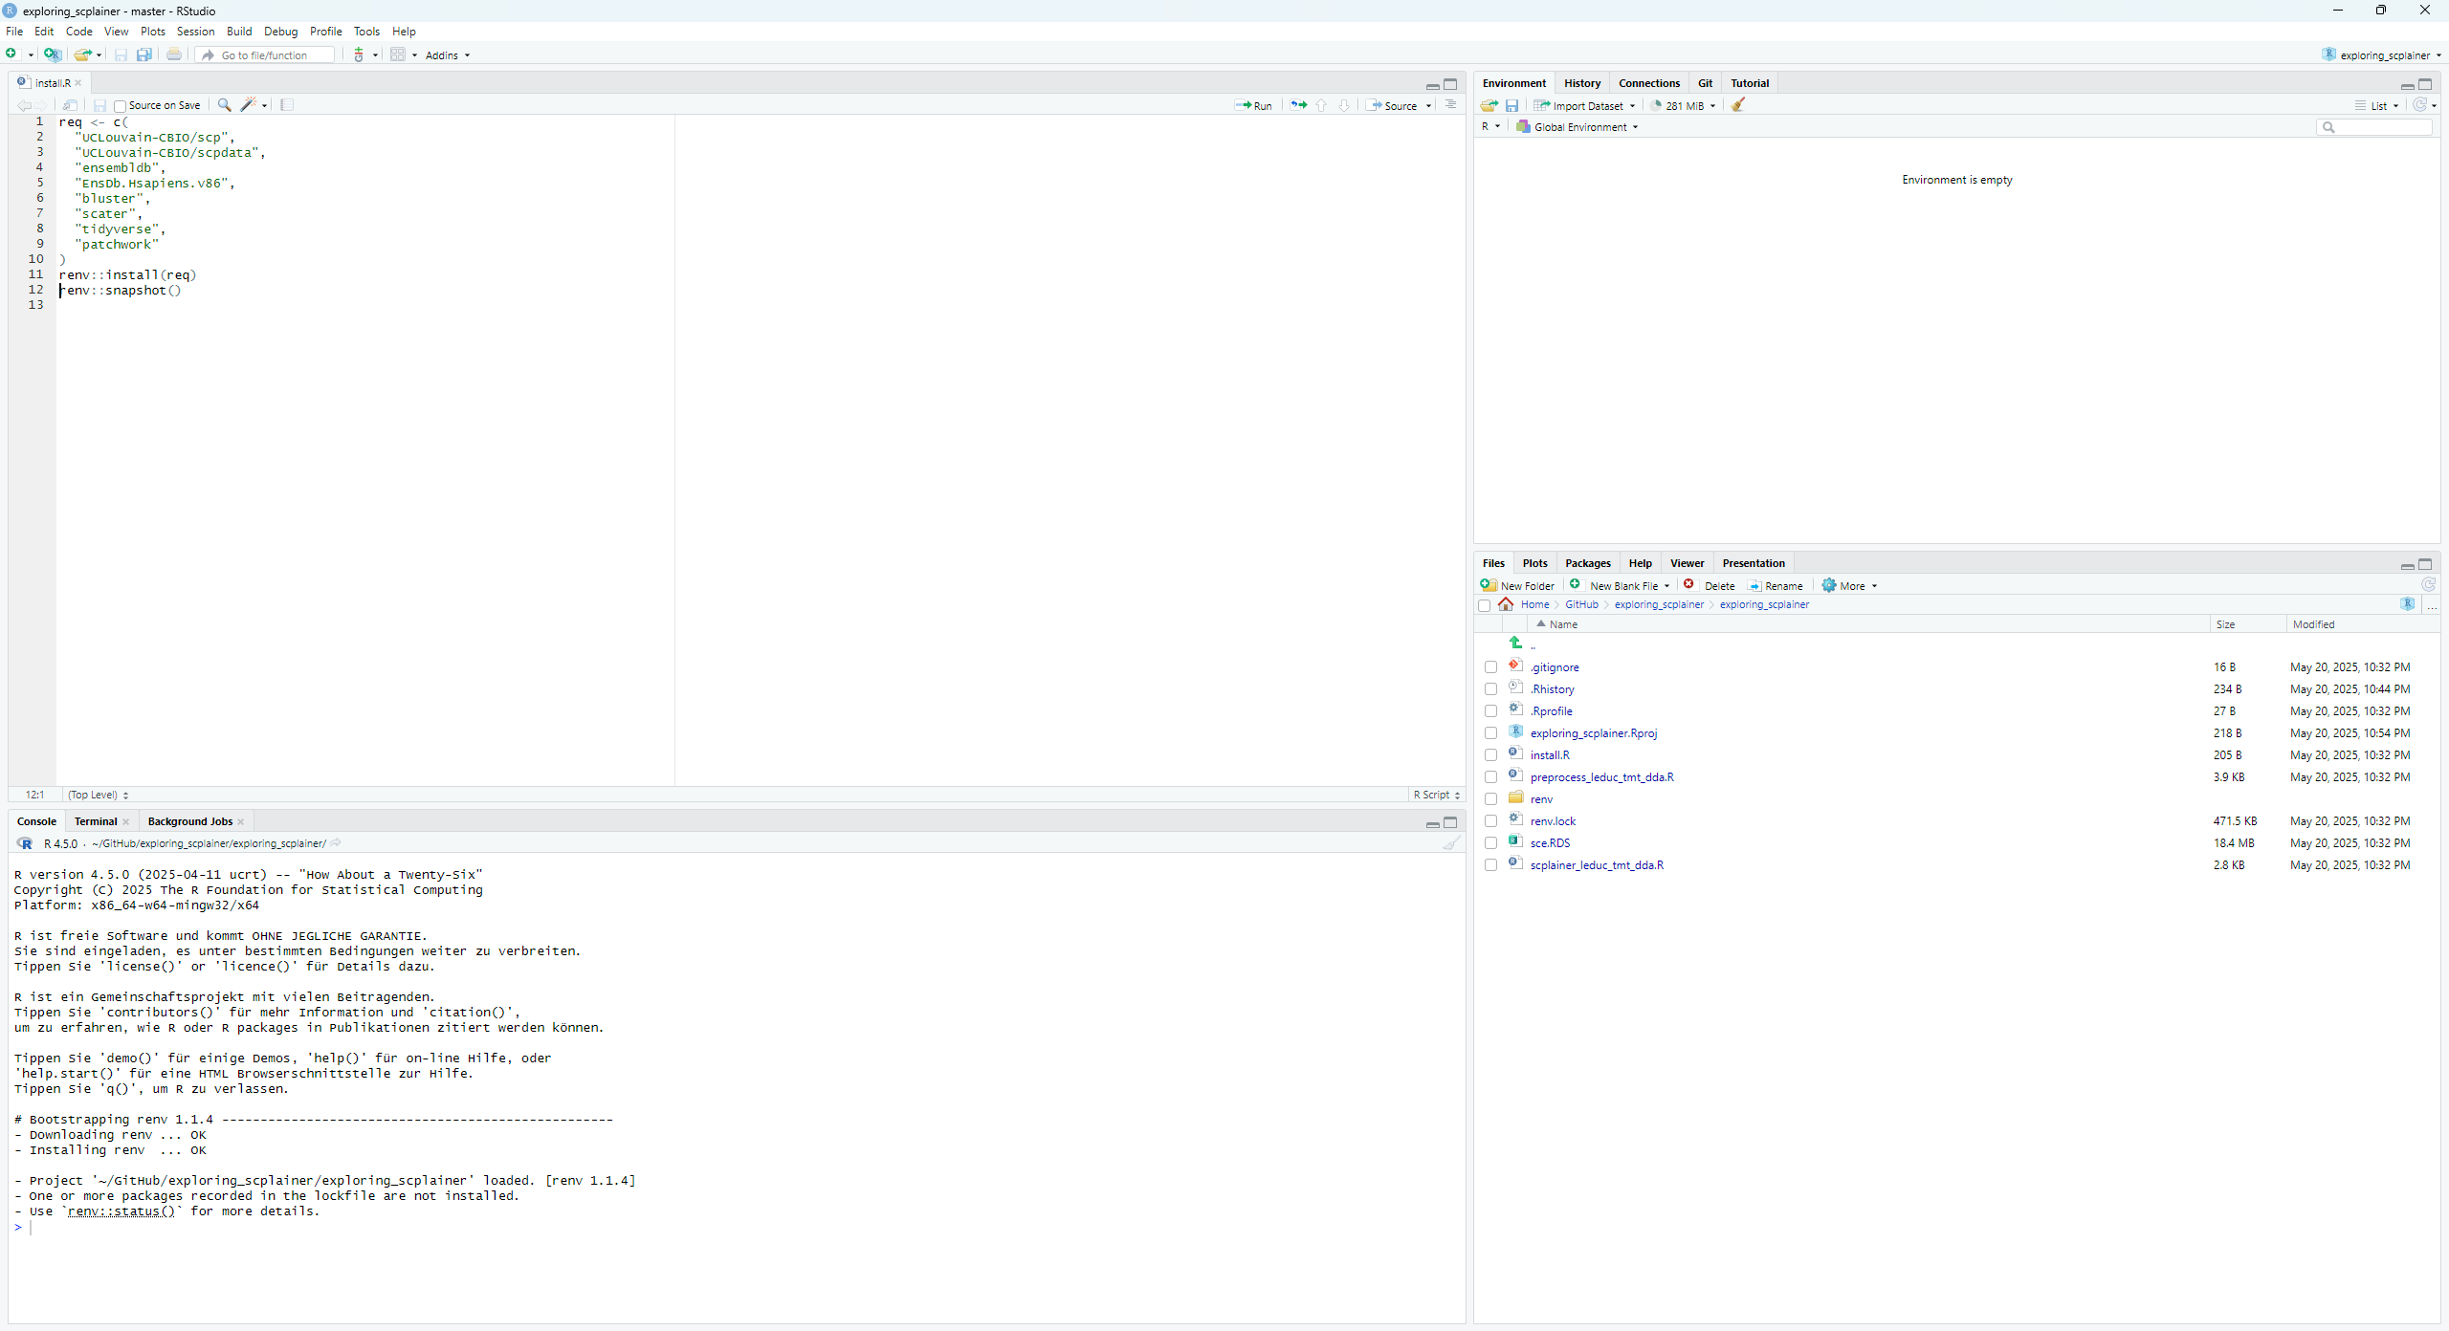
Click „Source“ to run the file and install packages

Slide 9
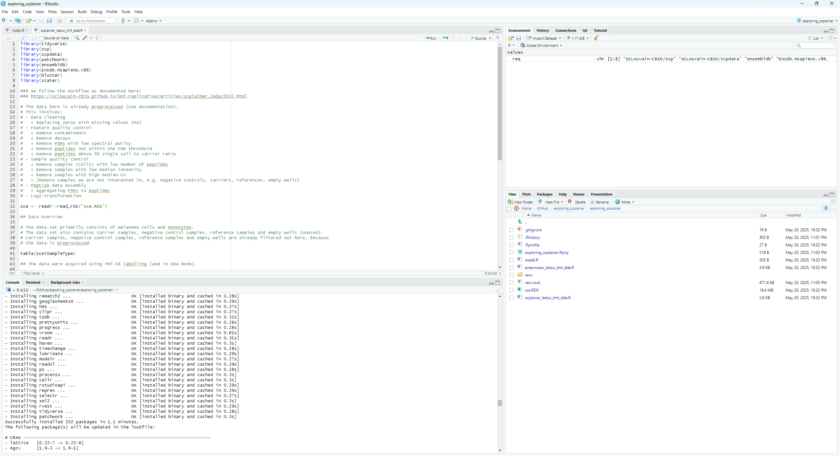
If everything worked correctly, you should see an output like this

Slide 10
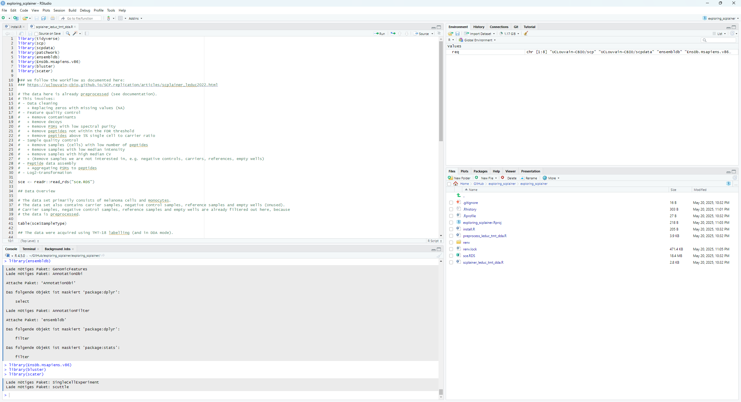
You should also be able to load all the packages in the „scplainer_leduc_tmt_dda.R“ file

