Slide 1

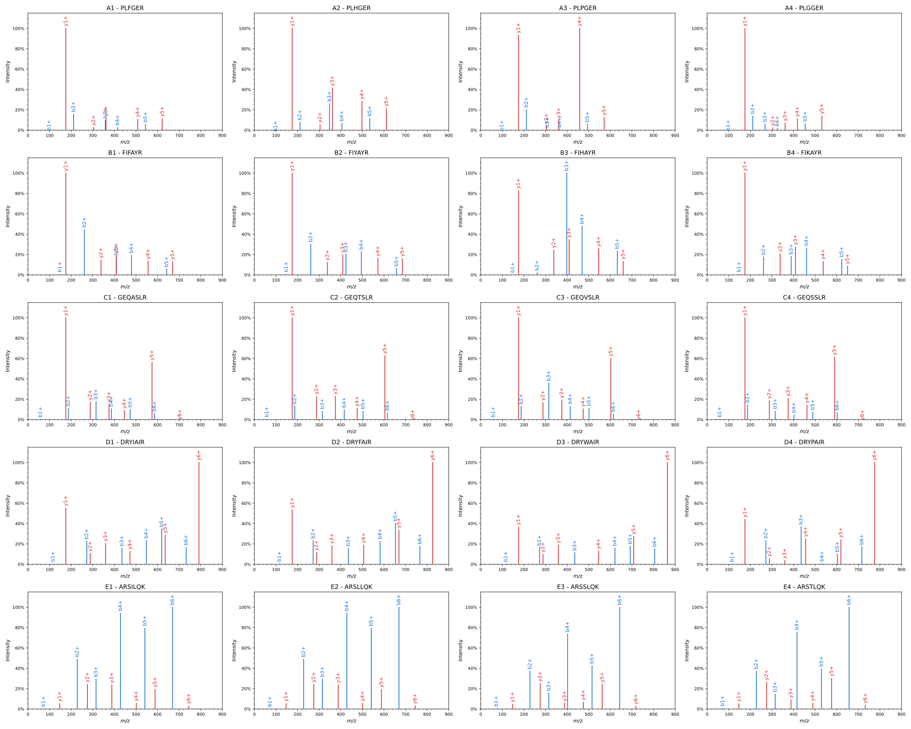
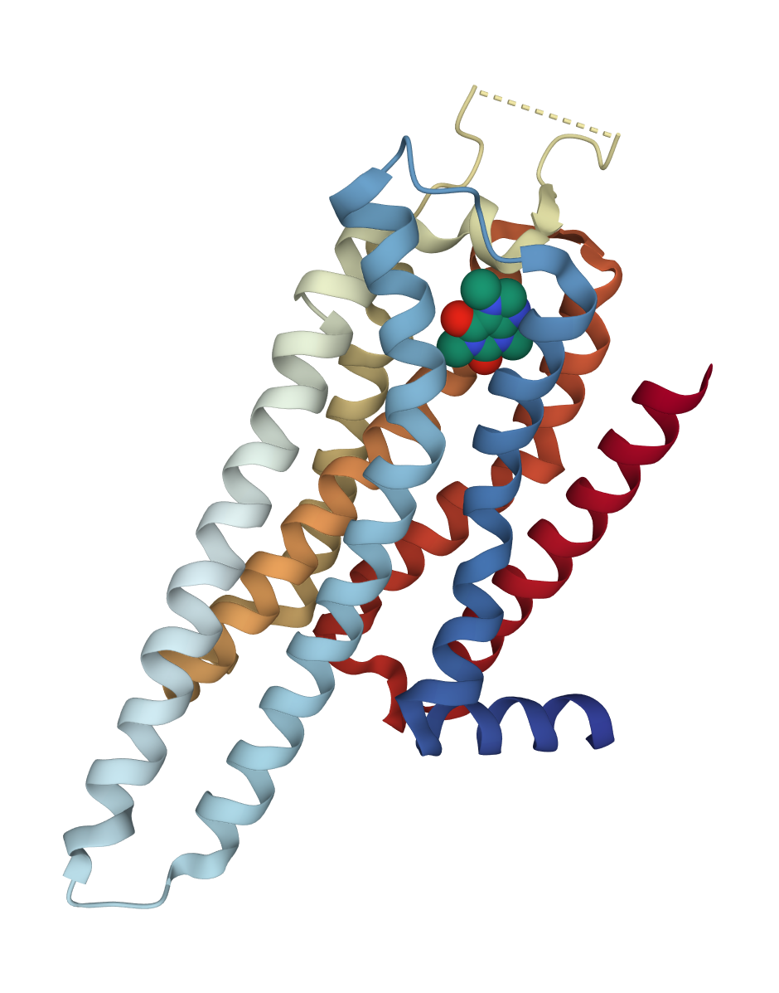


Peptide Spectrum Matching – Can you Find the Correct Peptide?
Human adenosine A2A receptor in complex with caffeine
The A2A receptor is a protein that sits partly outside and inside your cells
Small molecules (for instance adenosine) bind to the receptor and induce changes in your cells and organs
In the brain it can regulate the release of dopamine (“feel-good” hormone)
When you drink coffee, caffeine will bind to and block the receptor and prevent you from feeling tired
Scan the QR code to see more on our website
https://bioinformatics.fh-hagenberg.at

