Slide 1
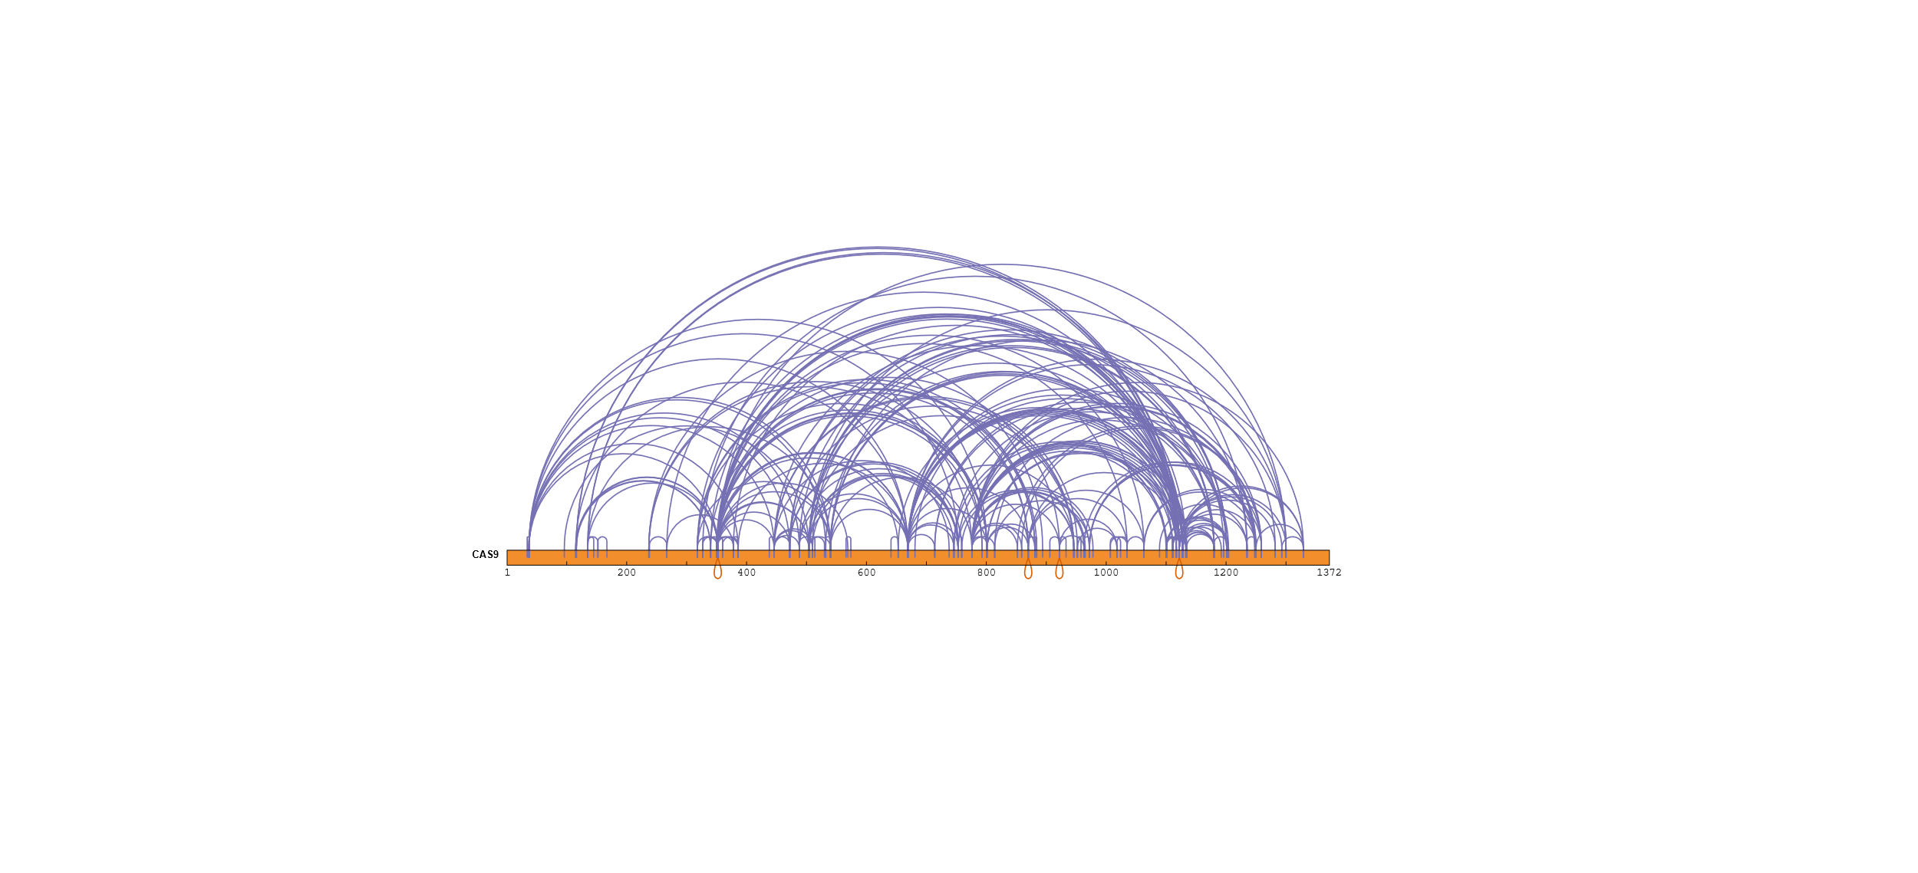
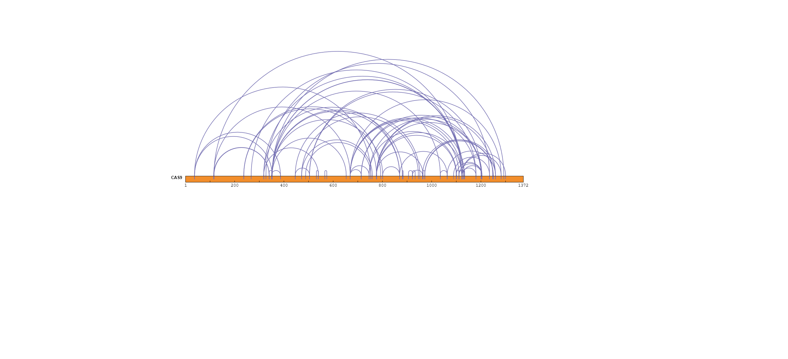
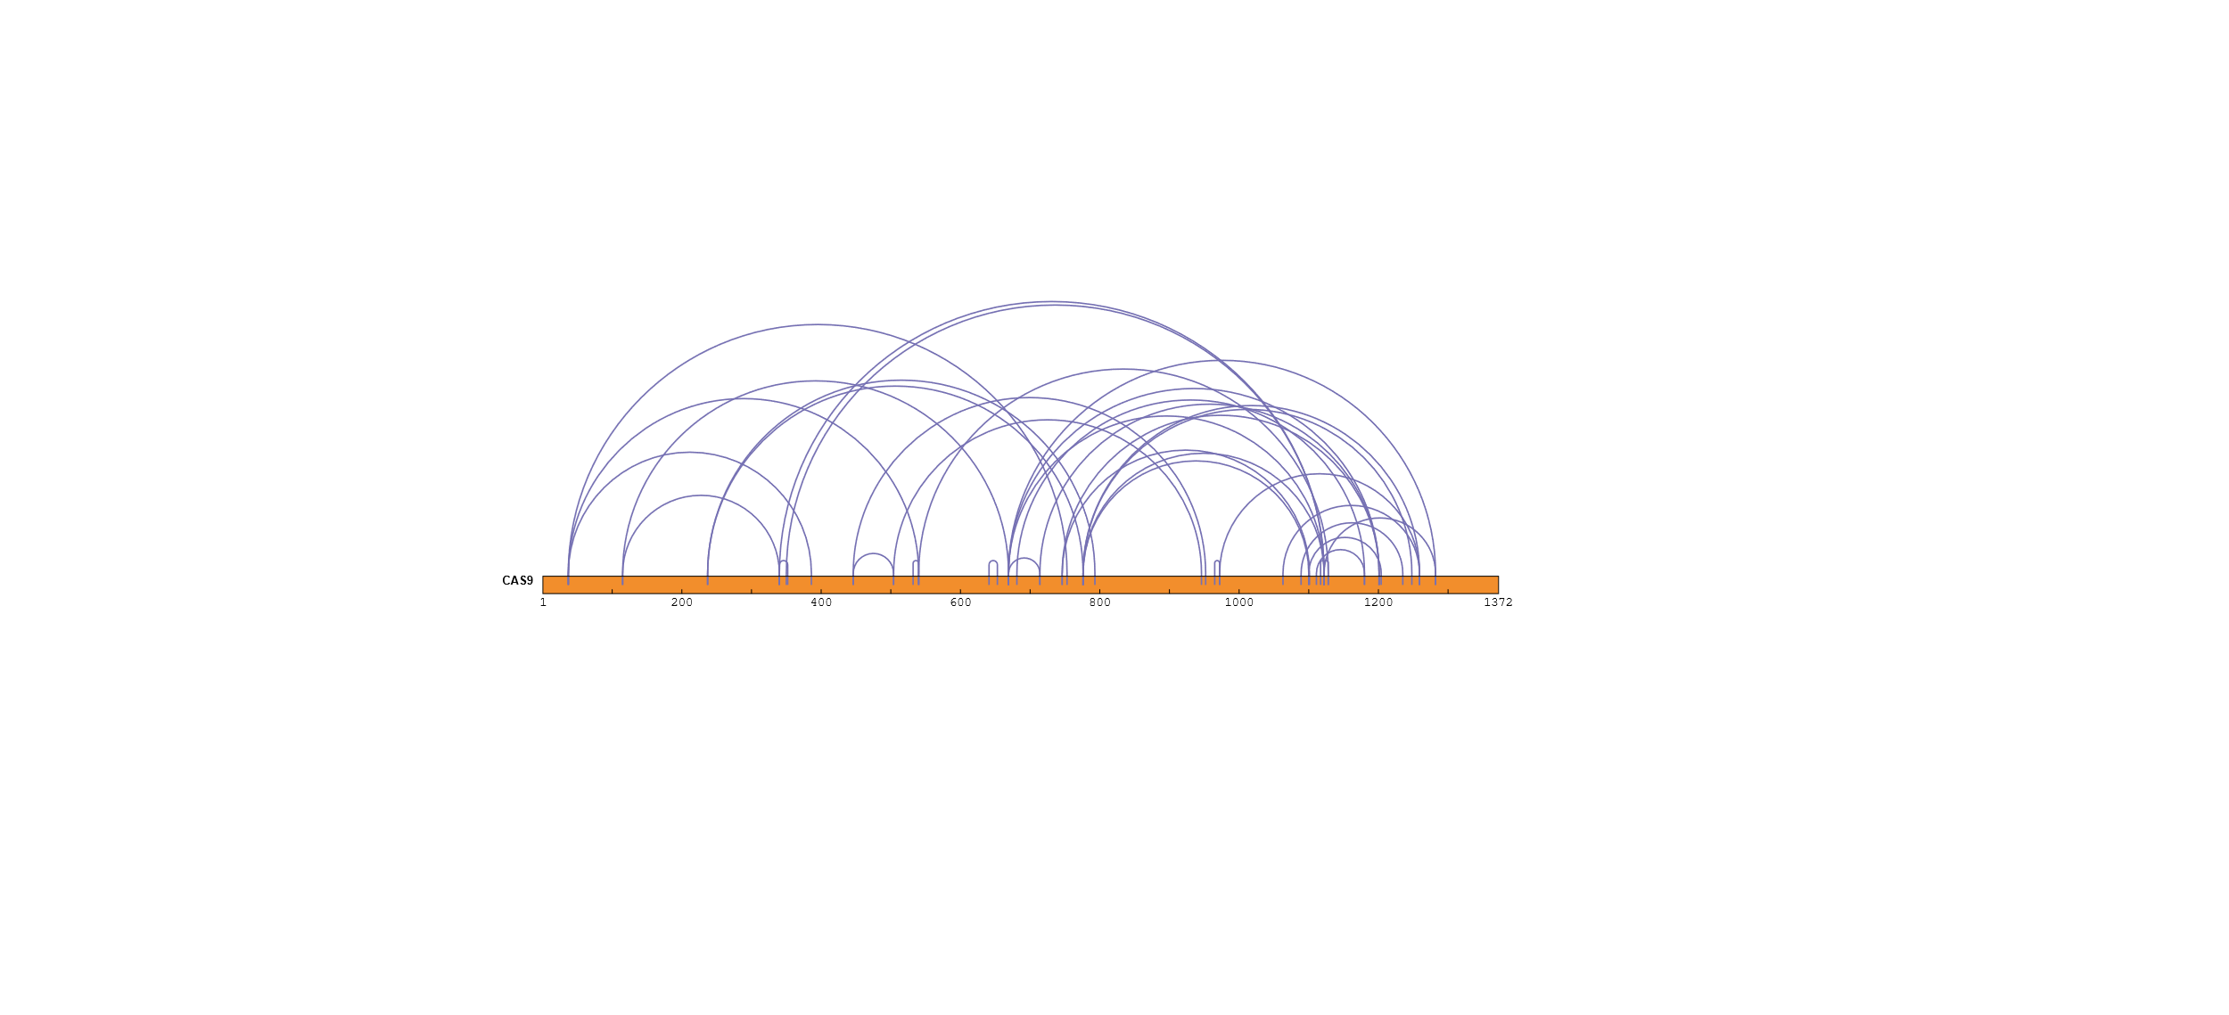
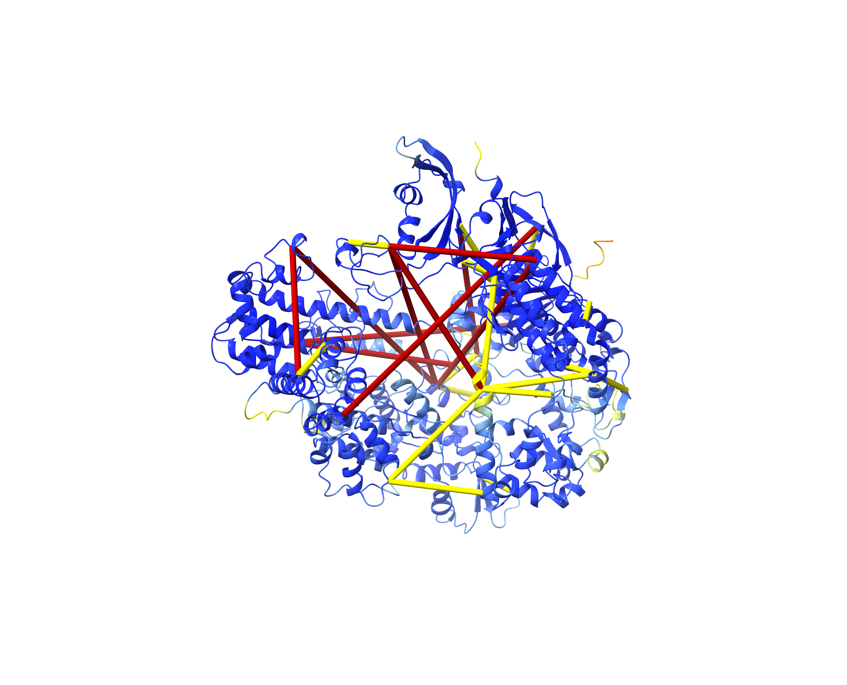
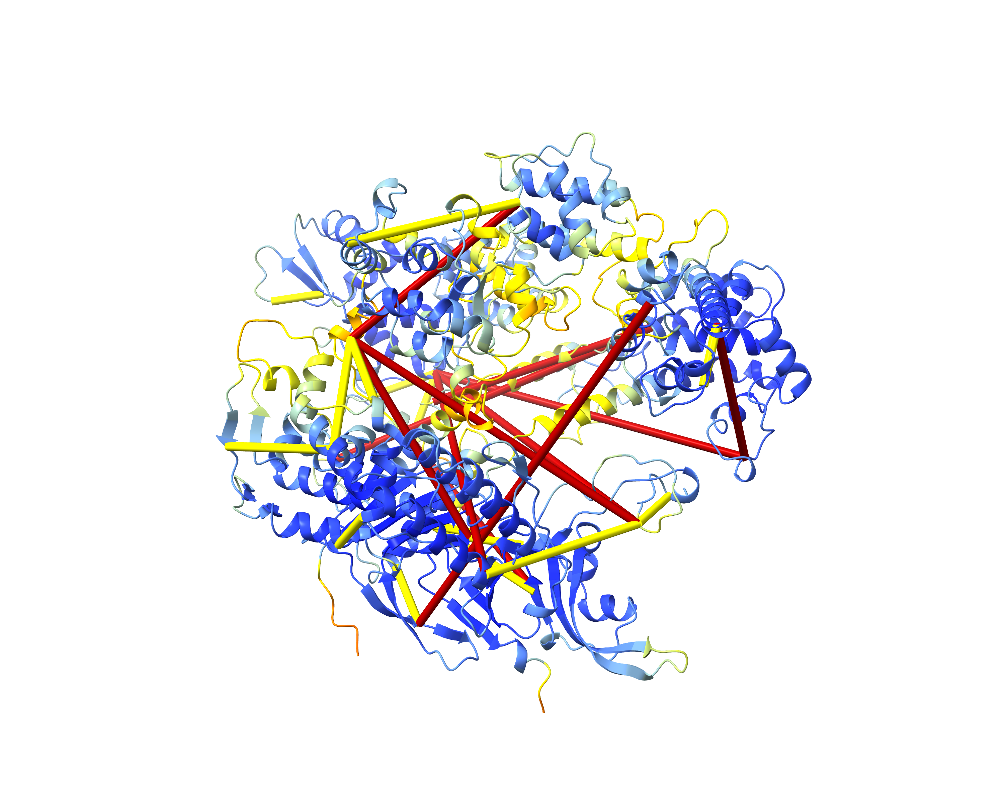
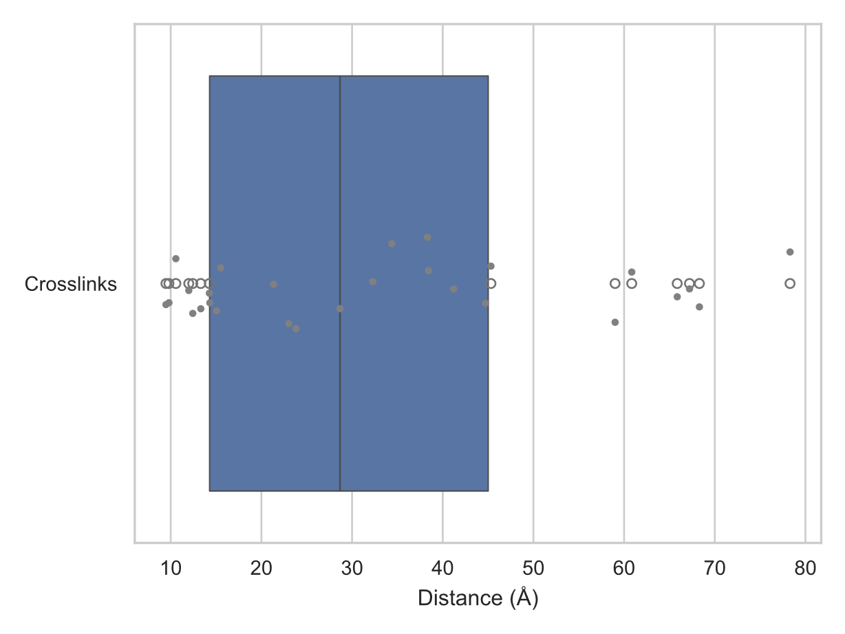
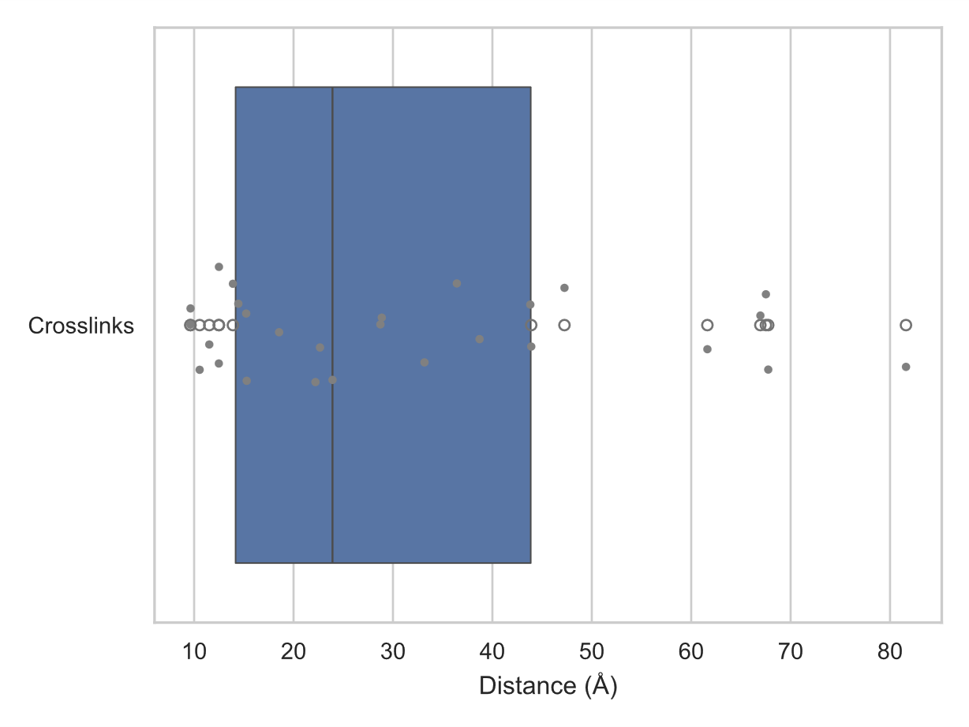
A
xiVIEW: pLink
B
xiVIEW: Scout
CAS9
CAS9
Structure Prediction
C
D
xiVIEW: XlinkX
 | AlphaFold2 | AlphaLink2
mean XL length | 33.248 Å | 31.807 Å
median XL length | 28.670 Å | 23.917 Å
Nr. XL satisfied | 16 | 17
Nr. XL violated | 11 | 10
CAS9
AlphaFold2 Structure
AlphaLink2 Structure
E
F
G
H
AlphaFold2 Crosslink Distances
AlphaLink2 Crosslink Distances

