Slide 1
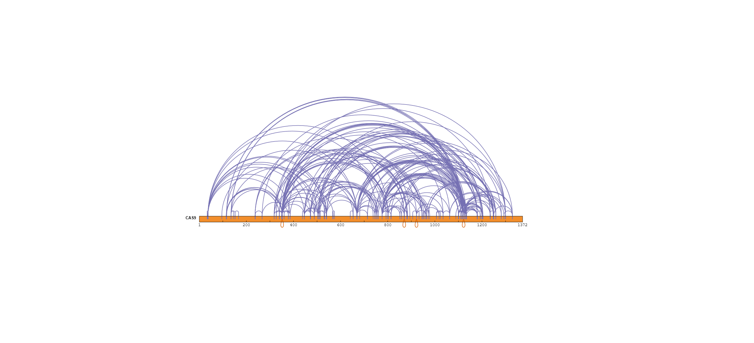
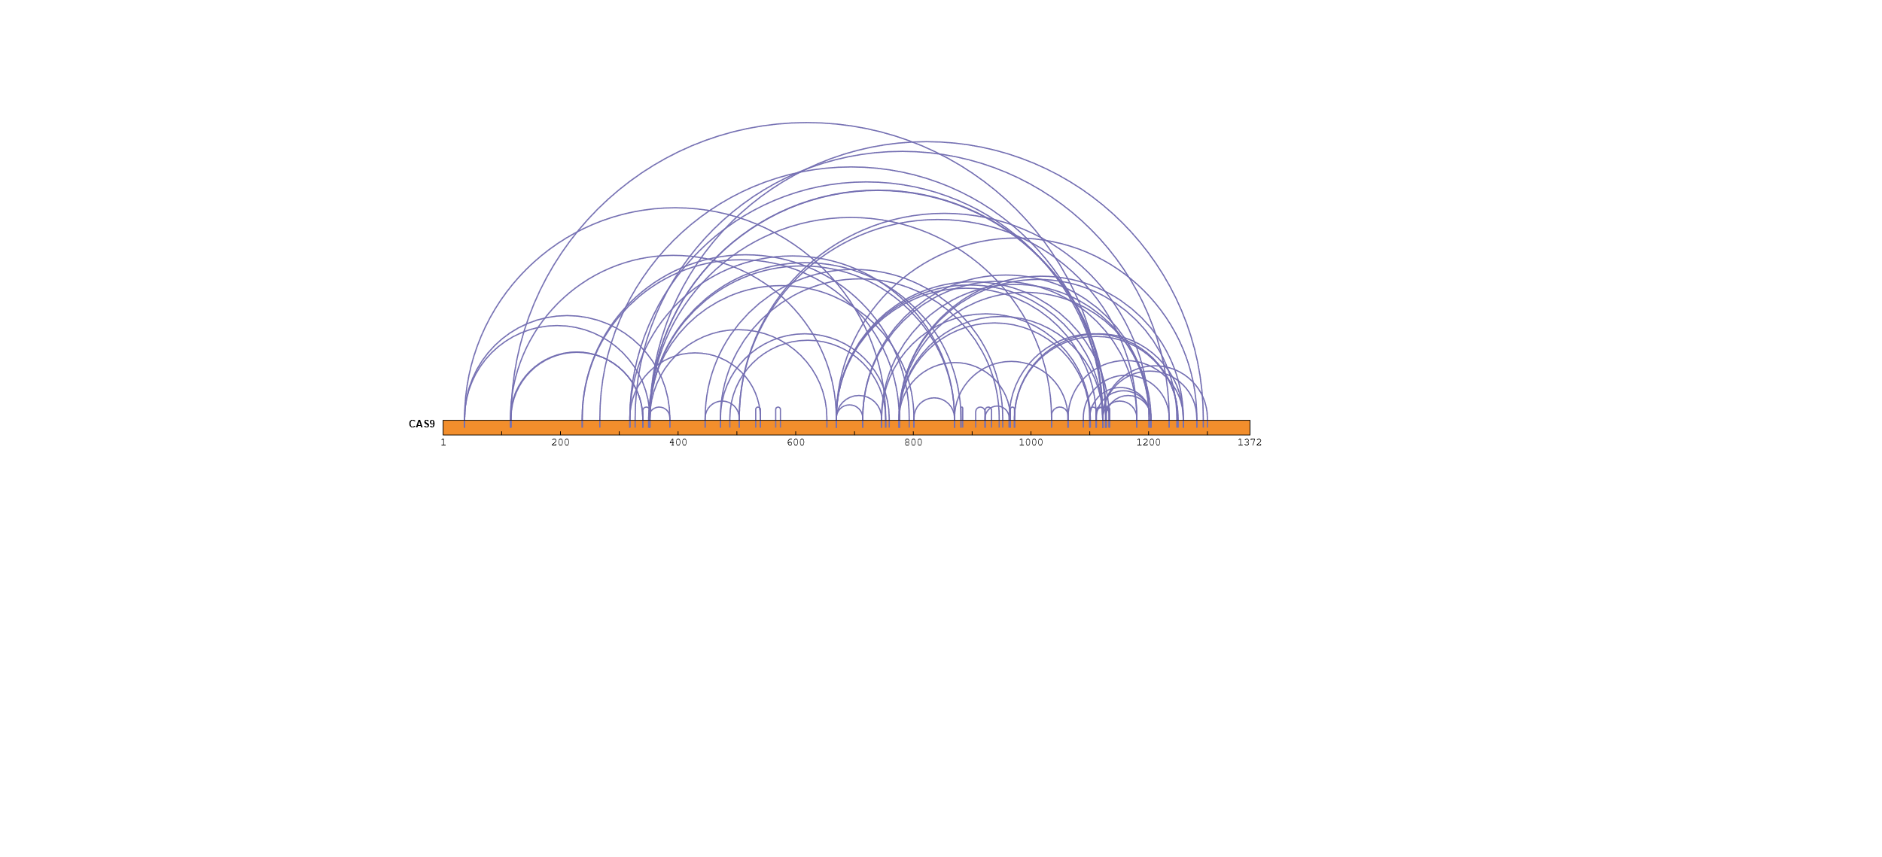
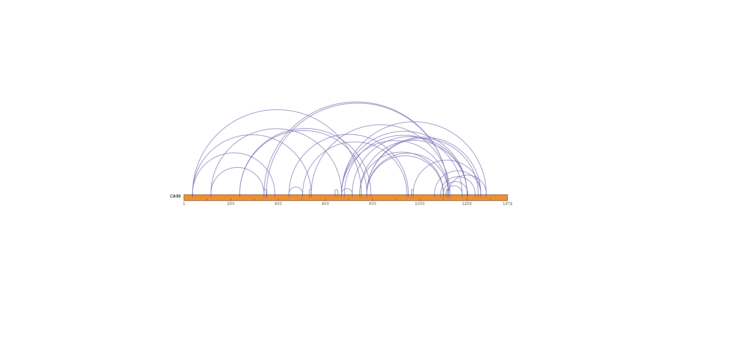
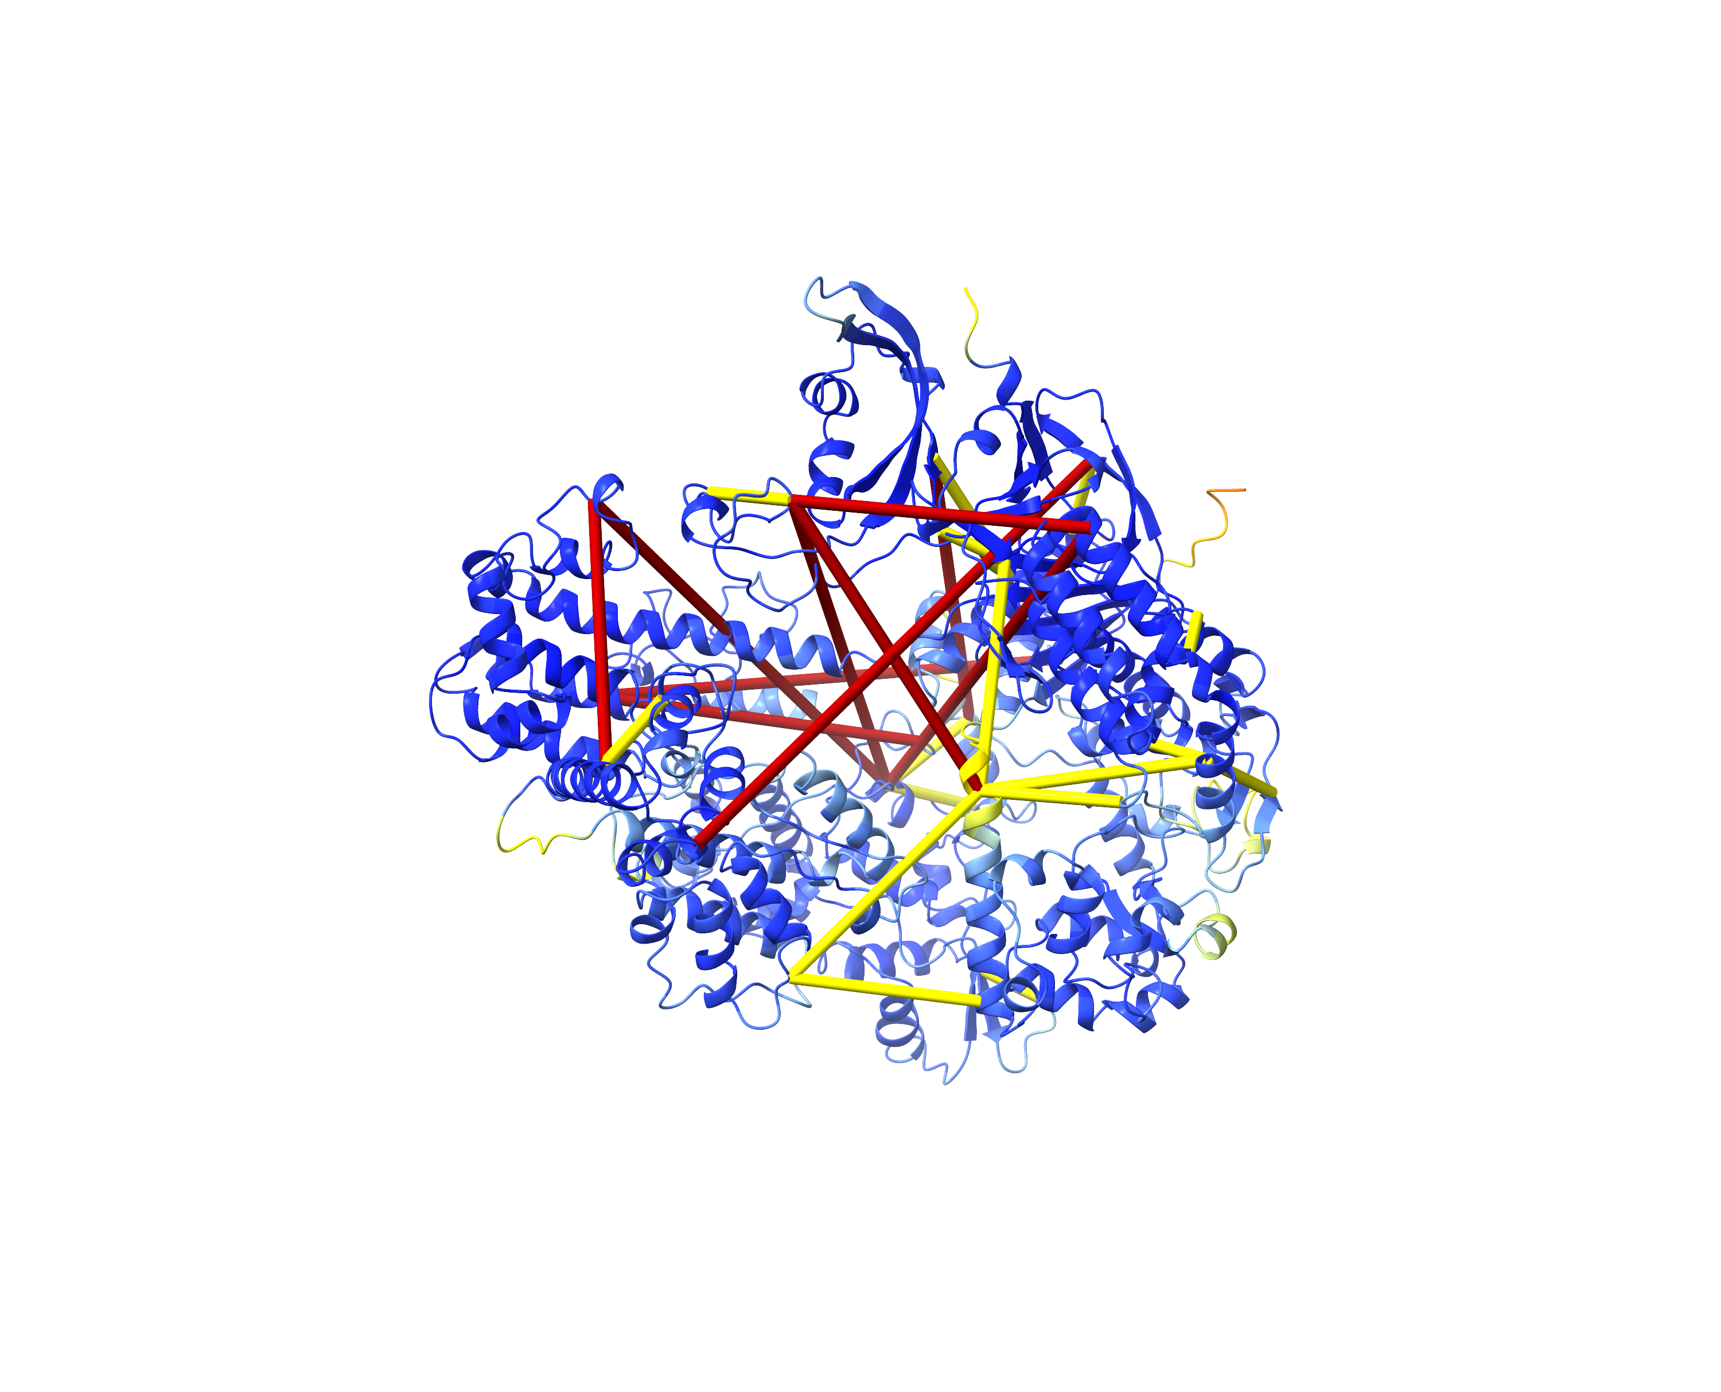
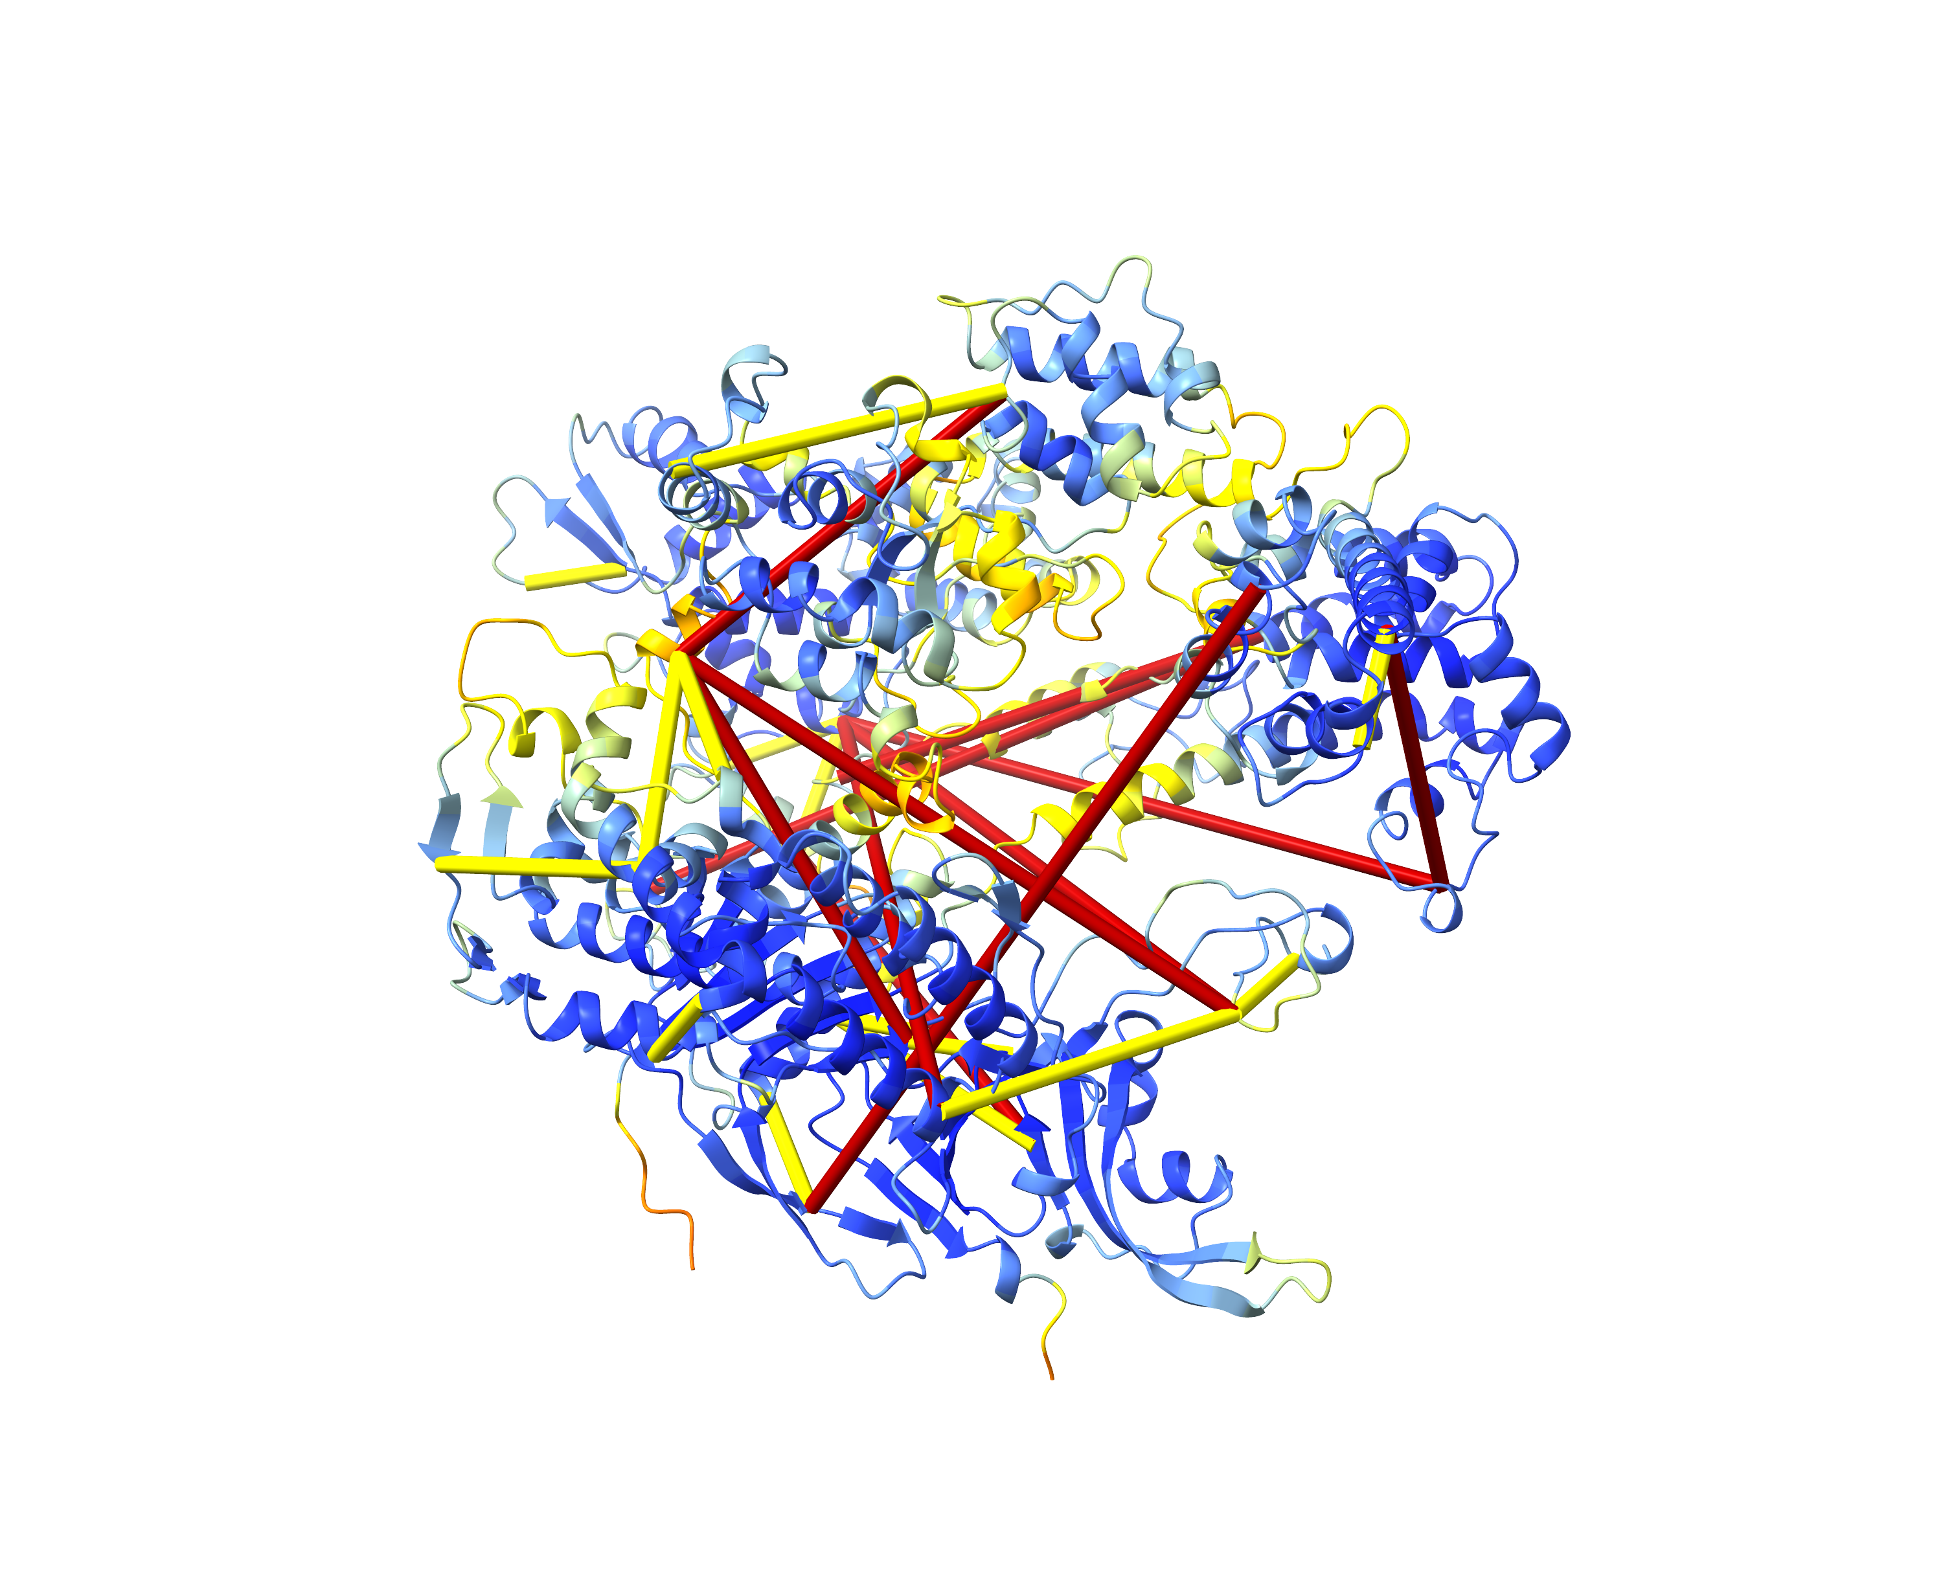
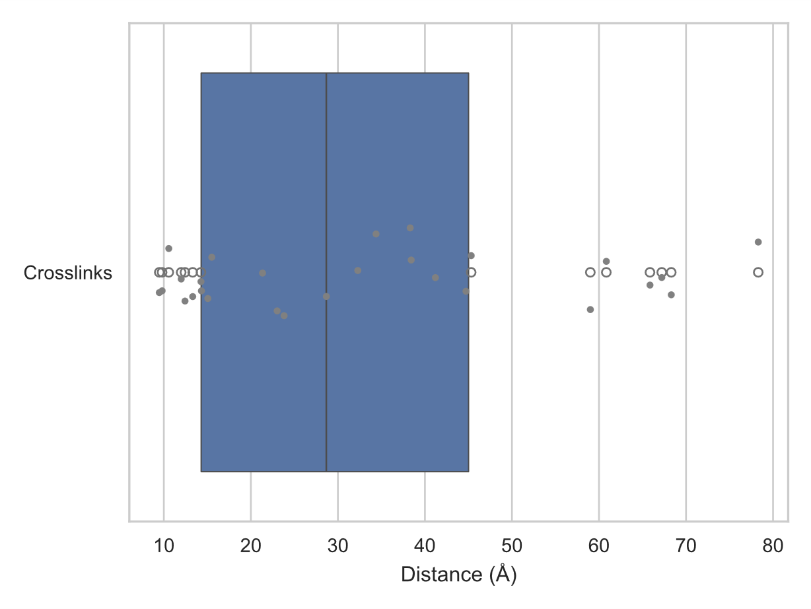
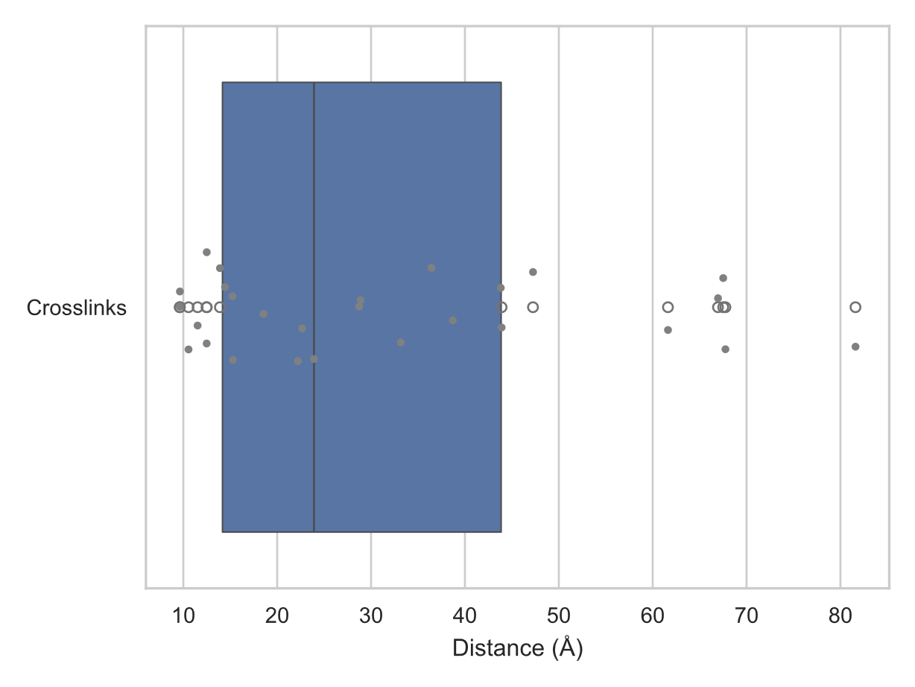
A
xiVIEW: pLink
B
xiVIEW: Scout
CAS9
CAS9
C
Structure Prediction
xiVIEW: XlinkX
D
 | AlphaFold2 | AlphaLink2
mean XL length | 33.2 Å | 31.8 Å
median XL length | 28.7 Å | 23.9 Å
Nr. XL satisfied | 16 | 17
Nr. XL violated | 11 | 10
CAS9
E
AlphaFold2 Structure
F
AlphaLink2 Structure
G
H
AlphaFold2 Crosslink Distances
AlphaLink2 Crosslink Distances

