Slide 1

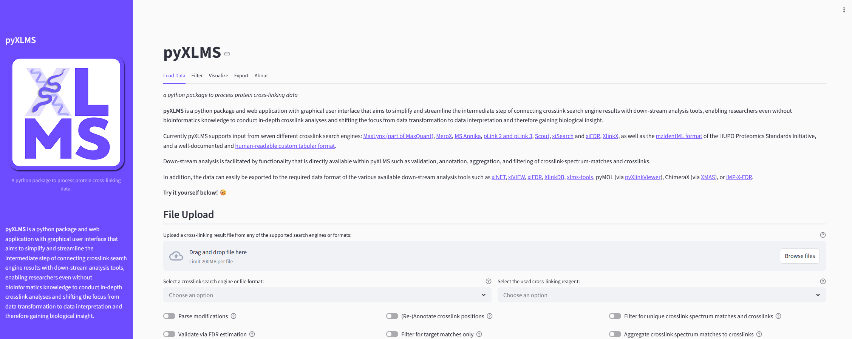
pyXLMS – python package
Input
MaxLynx/MaxQuant
MeroX
MS Annika
pLink
Scout
xiSearch/xiFDR
XlinkX
mzIdentML
Generic Tables
Output
AlphaLink2
xiNET/xiVIEW
xiFDR
XlinkDB
xlms-tools
PyXlinkViewer (pyMOL)
XMAS (ChimeraX)
IMP-X-FDR
MS Annika
Crosslink Search Engines/Formats
Exporting Options
Web App
Data Transformation
Filter
Unique
Aggregate
Validate
Annotate
Visualize
Score Distribution
Target-Decoy Type
Crosslink Type
Protein Distribution
Venn Diagrams

