Slide 1
第四部分 面向对象软件工程
第 22 章 面向对象设计
Object Oriented Design
厦门大学软件学院 林坤辉

Slide 2
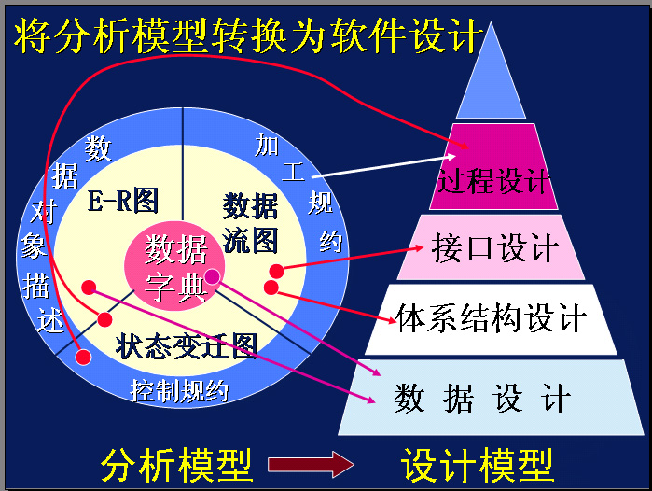
回顾结构化设计

Slide 3
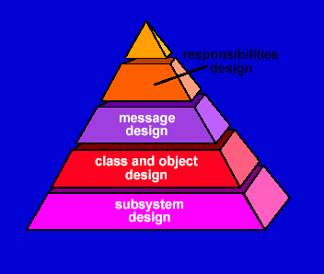
OO 设计金字塔的四个层次
责任设计

Slide 4

OO 设计金字塔的四个层次
子系统设计通过考虑整体客户需求(使用用例表示)和外部可观察的事件和状态(对象—行为模型)而导出；
子系统设计包含每个子系统的表示，这些子系统使得软件能够满足客户定义的需求，并实现支持客户需求的技术基础设施。
类和对象设计通过对包含在CRC( class – responsibility - collaborator)模型中的属性、操作和协作的描述映射得来的；
类和对象设计包含类层次，它们使得系统能够以通用化方式创建并不断逼近特殊需求，这层也包含了每个对象的设计表示。

Slide 5
消息设计由对象—关系模型导出，包含使得每个对象能够和其协作者通信的细节，本层建立了系统的外部和内部接口。
责任设计利用CRC模型中的属性、操作和协作者导出，包含针对每个对象的所有属性和操作的数据结构和算法的设计。
(协作: 类以两种方式之一完成它们的责任:
①类使用它自己的操作去操纵它自己的属 性，从而完成特殊的责任;
②类可以和其他类协作)

Slide 6
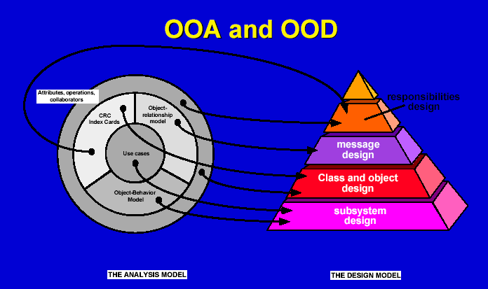
属性
操作
协作者
CRC
索引卡片
责任设计
对象－关系模型
用例
对象－行为模型

Slide 7

OOA在两个不同抽象级别上进行设计
系统设计(子系统设计):
着重于构造一个完全的产品或系统所需的构件的布局.即软件体系结构.
对象设计（类设计）:
强调个体对象的详细布局,及其相互交互的描述。

Slide 8
System Design
1. Design Goals
2. Subsystem decomposition
3. Concurrency
4. Hardware/Software Mapping
5. Specify management of data
6. Global resource handling and access methods
7. Software Control
8. Boundary conditions

Slide 9
How to use the results from the Requirements Analysis for System Design
Nonfunctional Requirements =>
1: Design Goals
Use Case Model =>
2: System decomposition
(Based on functionality)
Object Model =>
4: Hardware/software mapping
5: Data management

Slide 10
Dynamic Model =>
3: Concurrency
6: Global resource handling
7: Software control
8: Boundary conditions

Slide 11
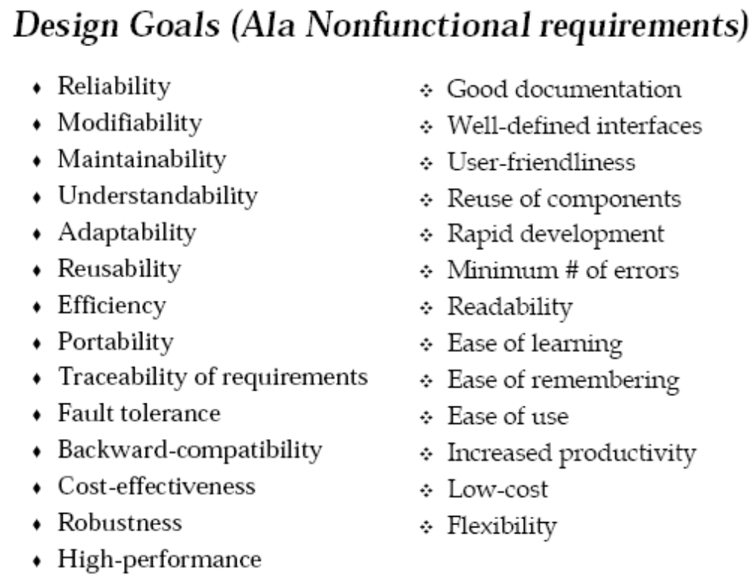
Design Goals

Slide 12
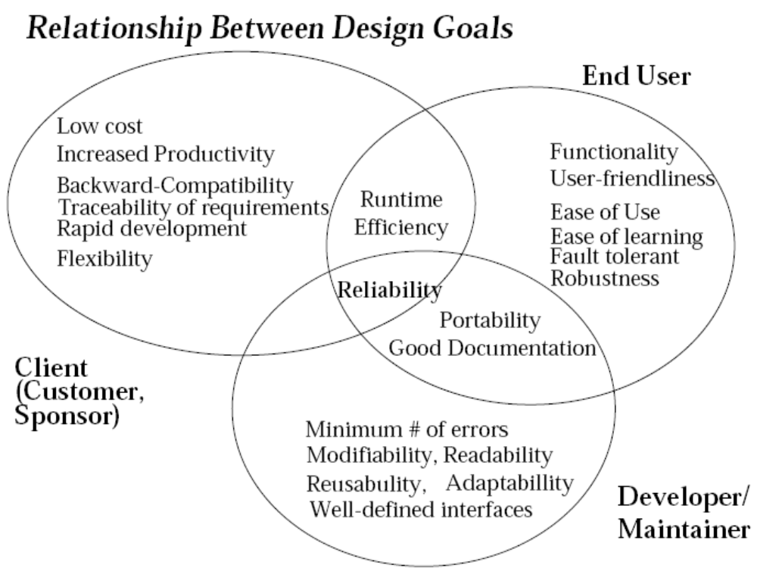
1. Design Goals

Slide 13
Typical Design Trade-offs
Functionality vs Usability
Client vs Developer
Cost vs Robustness
Client vs User
Efficiency vs Portability
Rapid development vs Functionality
Cost vs Reusability
Backward Compatibility vs Readability

Slide 14
2. System Decomposition
A large system is usually decomposed into subsystems using both, layers (分层) and partitions(划分).
Subsystem (UML: Package)
  Collection of classes, associations, operations, events and constraints that are interrelated.

Slide 15
Partitions and Layers
Partitions（划分） vertically divide a system into several independent (or weakly-coupled) subsystems that provide services on the same level of abstraction.
A layer（分层） is a subsystem that provides services to a higher level of abstraction.

Slide 16
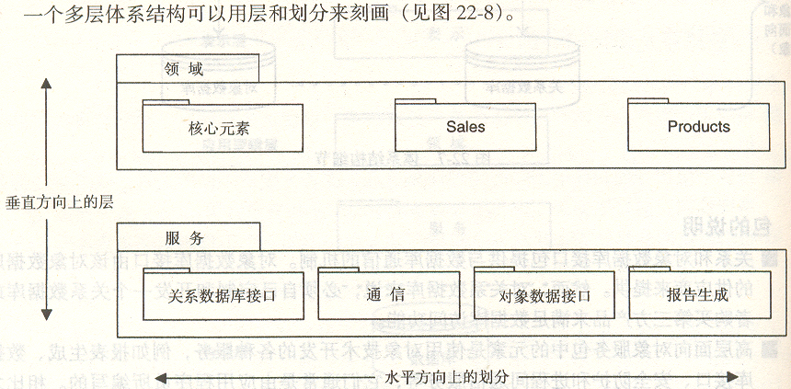
子系统举例

Slide 17
Relationships between subsystems
Layer relationship
  Layer A “Calls” Layer B (runtime)
  Layer A “Depends on” layer B
(“make” dependency, compile time)
Partition relationship
  The subsystem have mutual but not deep knowledge about each other
  Partition A “Calls” partition B and partition B “Calls” partition A

Slide 18
Layering
If a subsystem is a layer, it is usually called a virtual machine.
A system should be developed by an ordered set of virtual machines, each built in terms of the ones below it.

Slide 19
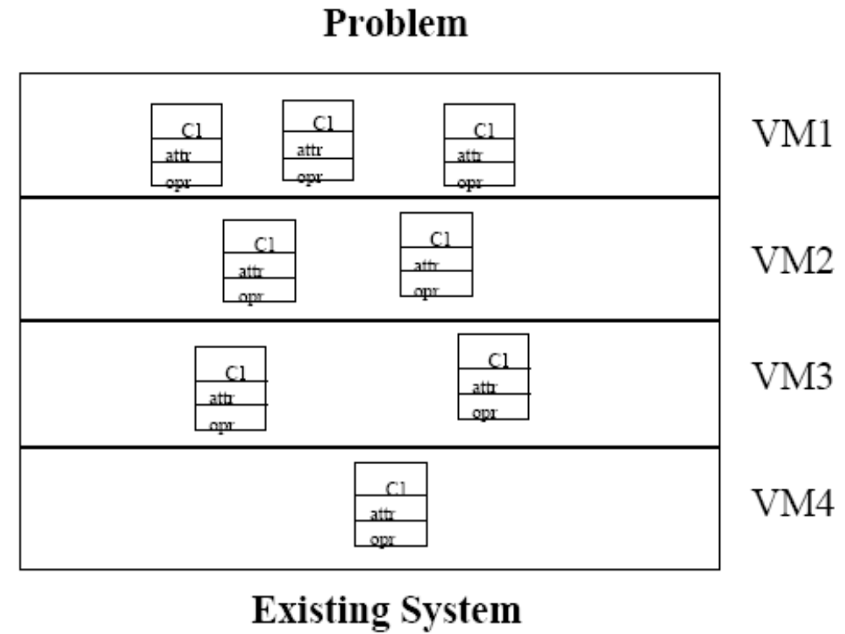

Slide 20
Virtual Machine
A virtual machine is a subsystem connected to higher and lower level virtual machines by "provides services for" associations.
A virtual machine is an abstraction that provides a set of attributes and operations.
Virtual machines can implement two types of software architecture:
closed and open architectures.

Slide 21
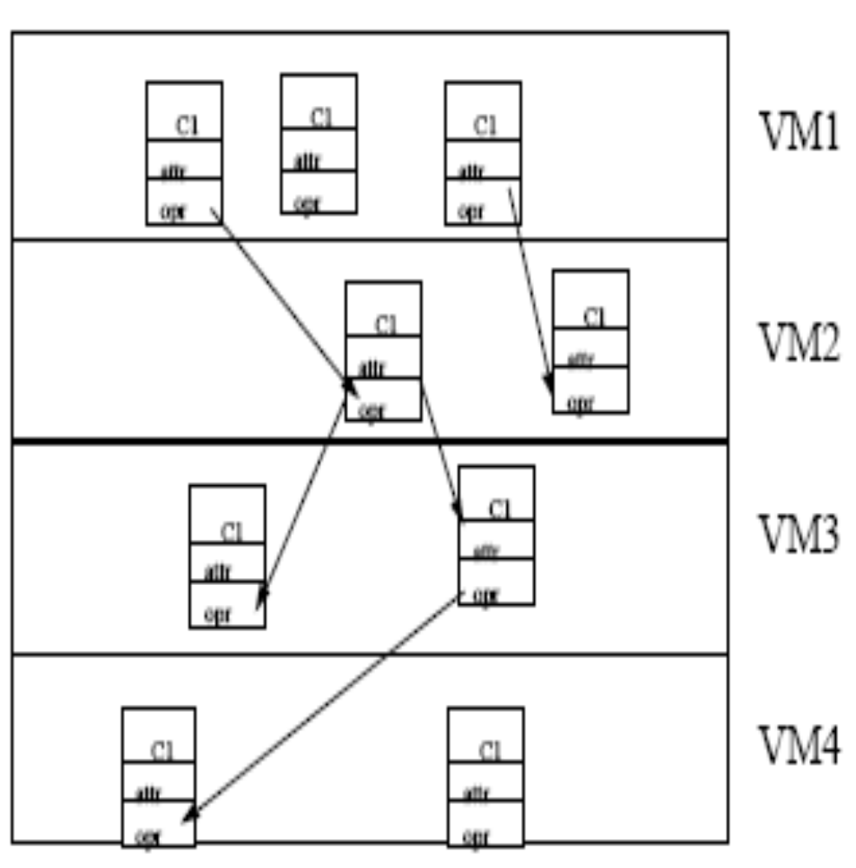
Opaque Architecture
(Closed Layering)
A virtual machine can only call operations from the layer below
Design Goal:
High Maintainability

Slide 22
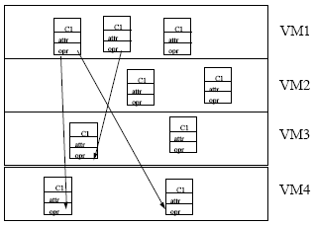
Transparent Architecture
( Open Layering)
A virtual machine can call operations from any layers below
Design Goal: Runtime Efficiency

Slide 23
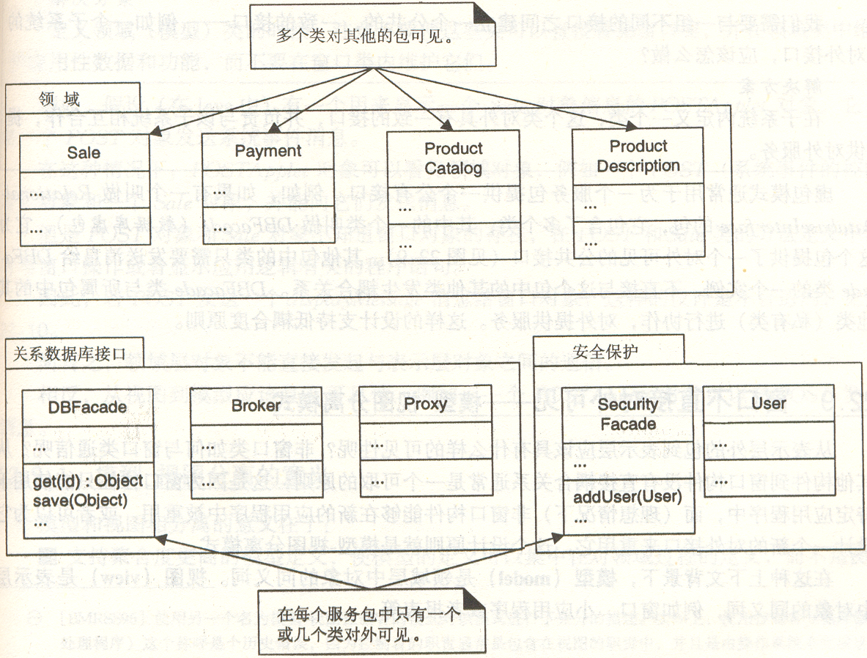
类的可见性举例

Slide 24
Properties of Layered & Partitioned Systems
Decomposition reduces complexity of system;
Closed architectures are more portable;
Open architectures are more efficient;

Slide 25
Other relationships between subsystems
Client-Server relationship
(Also called Client-Supplier)
  Client calls on the server, which performs some service and returns the result.
  Client knows the interface of the server (its service)
  Server does not need to know the interface of the client.

Slide 26
Peer-to-Peer relationship
  Each of the subsystems may call on the
others
  More complicated than client/server
  Deadlocks are possible:
"Communication cycles"
Client/server architectures easier to build

Slide 27
Peer-to-Peer Architectures
Layered systems do not provide peer-to-peer communication
Peer-to-peer communication is often needed
  Example: Database receives queries from application but also sends notifications to application when data have changed
Most important in peer-to-peer architectures: Protocol between subsystems

Slide 28
Example 1 a Peer-to-Peer Architecture
ISO’s OSI Reference Model
  ISO = International Standard Organization
  OSI = Open System Interconnection
Reference model defines 7 layers of network protocols and strict methods of communication between the layers.

Slide 29
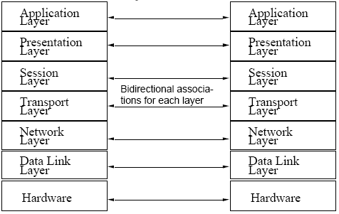

Slide 30
Example 2 How Peer-to-peer File-sharing Clients Work
downloaded and installed a P2P client,
connected to the Internet and logged into a central indexing server.
This central server indexes all users who are currently online connected to the server.
The P2P client will queries the index server to find other connected users with the file you are looking for.

Slide 31
When a match is found the central server will tell you where to find the requested file.
You can then choose a result from the search query and your utility when then attempt to establish a connection with the computer hosting the file you have requested.
If a successful connection is made, you will begin downloading the file.
Once the file download is complete the connection will be broken.

Slide 32
Example 1 Client/Server Architecture
Often used in database systems:
  Front end: User application (client)
  Back end: Database access and manipulation (server)
Functions performed by client:
  Customized user interface
  Front-end processing of data
  Initiation of server remote procedure calls
  Access to database server across the network

Slide 33
Functions performed by the database server:
 Centralized data management
 Data integrity and database consistency
 Database security
 Concurrent operations (multiple user access)
 Centralized processing (for example archiving)

Slide 34
Example 2 ISO-OSI层次模型
层次间的调用关系
  底层为上层提供服务访问点(SAP)作为接口
  上层通过统一的SAP使用底层的功能
SAP(n+1)
N+1层
SAP(n)
N层

Slide 35
Design Goals for Client/Server Systems
Portability:
  Server can be installed on a variety of machines and operating systems and functions in a variety of networking environments
Transparency:
  The server might itself be distributed (why?), but should provide a single "logical" service to the user

Slide 36
Performance:
  Client should be customized for interactive display-intensive tasks
  Server should provide CPU-intensive operations
Scalability:
  Server has spare capacity to handle larger number of clients
Flexibility:
  Should be usable for a variety of user interfaces
Reliability:
  System should survive individual node and/or communication link problems

Slide 37
Subsystem Interface Object
A Subsystem Interface Object publishes a service
   This is the set of public methods provided by the subsystem
describes all the methods of the subsystem interface object
Service is specified by Subsystem interface

Slide 38
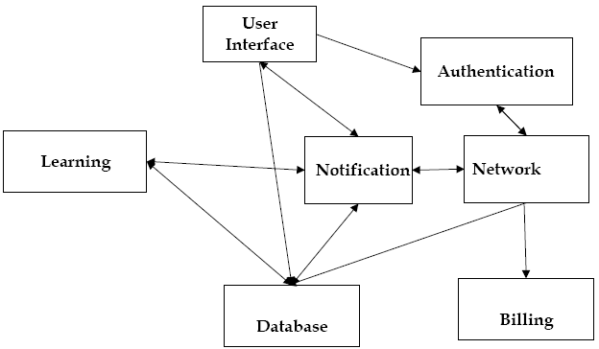
Example 1
Subsystem Decomposition

Slide 39
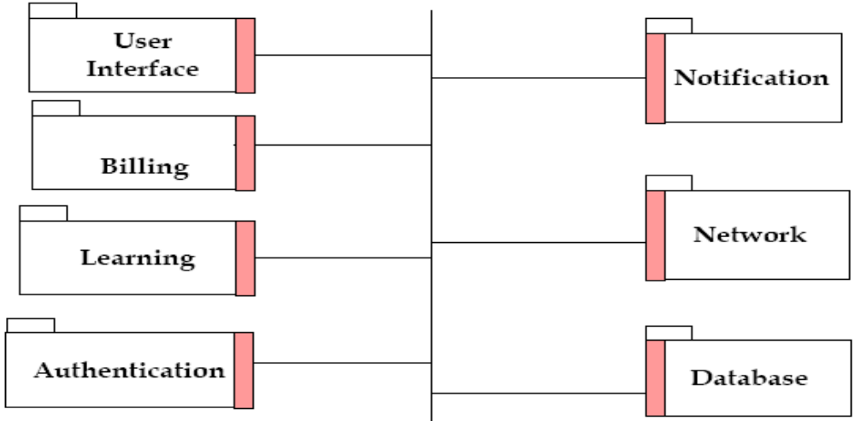
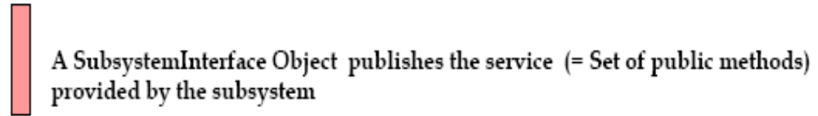
a set of subsystems communicating via a software bus

Slide 40
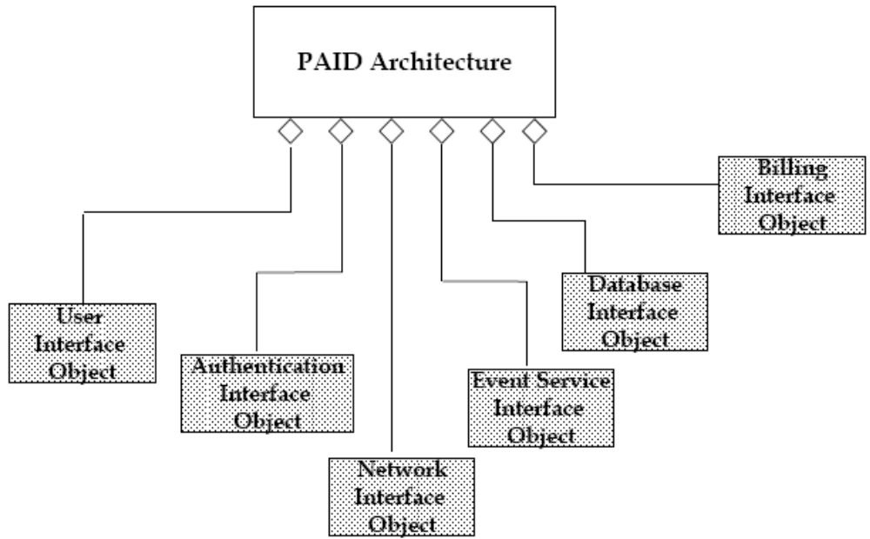
Software Architecture as a set of Facades

Slide 41
软件架构关注分割与交互
组成派认为：“软件系统的架构将系统描述为计算组件及组件之间的交互”,
计算组件是泛指，它可以是处理组件、数据组件、连接组件等。组件可以指子系统、框架、模块、类等不同粒度的软件单元，它们可以担负不同的计算职责。
这个定义从”软件组成”角度解析了软件架构的要素:组件及组件之间的交互.
交互
组件

Slide 42
MVC架构举例
MVC架构作为”组件+交互”的例子, 包含3种组件:Model、View、Controller
创建
View
Controller
读取
Model
通知
调用服务
为达到一定目的，这3种组件通过交互来协作。

Slide 43
3个组件的交互过程
1、View创建Controller后；
2、Controller根据用户交互调用 Model的相应服务；
3、而Model会将自身的改变通知View；
4、 View则会读取Model的信息以更新自己

Slide 44
决策派关于架构
决策派认为：软件架构是一系列重要决策的集合，这些决策与以下内容有关：
软件的组织；
构成系统的结构元素及其接口的选择；
这些元素在相互协作中明确表现出的行为；
这些结构元素和行为元素进一步组合构成的更大规模的子系统；
以及指导这些元素、接口、协作等的架构风格

Slide 45
组成派与决策的特点
关注架构实践中的客体-----软件，以软件本身为描述对象；
分析了软件的组成，即软件由承担不同计算任务的组件组成，这些组件通过相互交互完成更高层次的计算。
关注架构实践中的主体-----人，以人的决策为描述对象；
归纳了架构决策的类型，指出架构决策不仅包括关于软件系统的组织、元素、子系统和架构风格等几类决策，还包括非功能需求的决策。

Slide 46
软件架构是一系列有层次性的决策
软件架构属于设计范畴，但并不是所有设计都属于软件架构设计之列。
软件架构可以视为一系列重要决策的集合；
架构决策是分层次展开的：
随着对软件系统的依次分解，软件架构师要不断作出决策，比如：
需要划分成哪些模块、每个模块的职责为何、每个模块的接口如何定义、模块间采用何种交互机制，如何满足约束和质量属性的需求、如何适应可能发生的变化等。

Slide 47
关注点分离之道
好的架构设计必须把变化点错落有致地封装到软件系统的不同部分，为此，必须进行关注点分离。
好的架构必须使每个关注点分离，即，系统中的一部分发生了变化，不会影响其他部分。即使需要改变，也能清晰地识别出哪些部分需要改变。如果需要扩展架构，影响将会最小化。已经可以工作的每个部分都将继续工作。

Slide 48
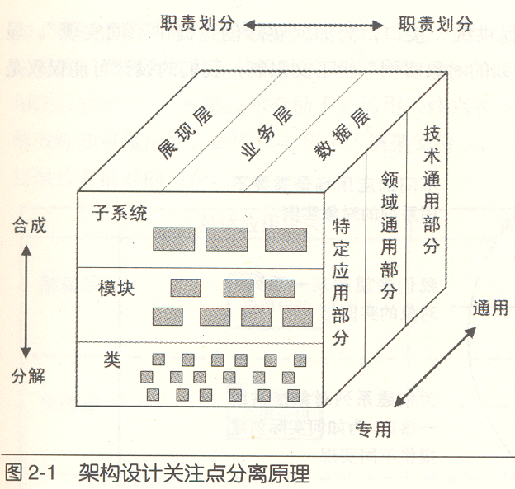

Slide 49
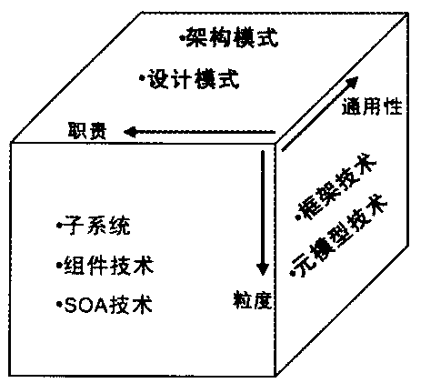

Slide 50
3. Concurrency
如果对象(或子系统)不是同时活动的，则不需要并发处理。这意味着对象(或子系统)可以在同一个处理器硬件上实现。
另一方面，如果对象(或子系统)必须同时或异步地作用于事件，则它们被视为并发的。
Goal: High Performance
Find as many threads of control as possible

Slide 51
A thread of control is a path through a set of state diagrams on which a single object is active at a time.
A thread remains within a state diagram until an object sends an event to another object and waits for another event.

Slide 52
Two objects are inherently concurrent if they can receive events at the same time without interacting
Inherently concurrent objects should be assigned to different threads of control
Objects with mutual exclusive activity should be folded into a single thread of control.

Slide 53
Implementing Concurrency
当子系统间是并发时，有以下两种分配方案：
1.将每个子系统分配到独立的处理器。
2.将子系统分配到相同的处理器并通过操作系统特性提供并发支持。
Concurrent systems can be implemented on any system that provides
  physical concurrency (hardware)
  logical concurrency (software)

Slide 54
4. Hardware Software Mapping
Major part of the design problem:
 How is the object model mapped on the existing hardware& software?
  Mapping Objects onto Reality: Processor, Memory, Input/Output
  Mapping Associations onto Reality: Connectivity
 How shall we realize the subsystems: In Hardware or Software?

Slide 55
Much of the difficulty of designing a system comes from meeting externally-imposed hardware and software constraints.
 Certain tasks have to be at specific locations
 Examples:
  Software for ATM machine (at ATM location?)
  Software for physical sensors (at sensor location?)

Slide 56
Mapping the Objects
Processor issues:
Is the computation rate too demanding for a single processor?
Can we get a speedup by distributing tasks across several processors?
How many processors are required to maintain steady state load?

Slide 57
Memory issues:
 Is there enough memory to buffer bursts of requests?
I/O issues:
 Do you need an extra piece of hardware to handle the data generation rate?
 Does the response time exceed the available communication bandwidth between subsystems or a task and a piece of hardware?

Slide 58
Hardware/Software Mapping Questions
What is the connectivity among physical units?
What is the appropriate communication protocol between the subsystems?
Is certain functionality already available in hardware?
Do certain tasks require specific locations to control the hardware or to permit concurrent operation?
General system performance question:
What is the desired response time?

Slide 59
Connectivity in Distributed Systems
If the architecture is distributed, we need to describe the network architecture (communication subsystem) as well.

Slide 60
Questions to ask：
What are the transmission media?
(Ethernet, Wireless)
 What is the Quality of Service (QOS)? What kind of communication protocols can be used?
 Is the interaction asynchronous, synchronous or blocking?
 What are the available bandwidth requirements between the subsystems?

Slide 61
Mapping the Associations: Connectivity
Describe the physical connectivity of the hardware
   Which associations in the object model are mapped to physical connections?
   Which of the client-supplier relationships in the analysis/design model correspond to physical connections?

Slide 62
Describe the logical connectivity (software connections)
  Identify associations that do not directly map into physical connections:
   How should these associations be implemented?

Slide 63
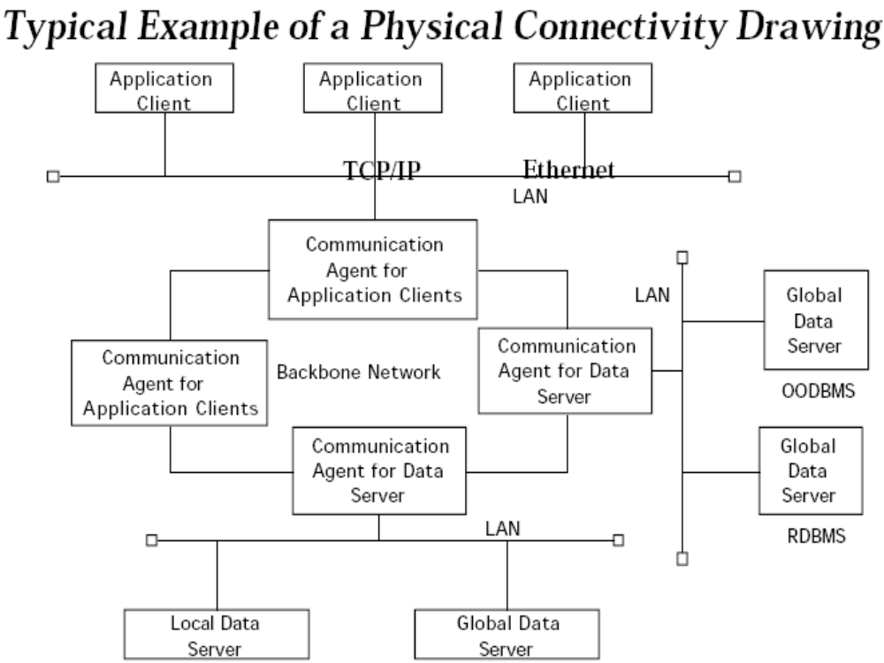

Slide 64
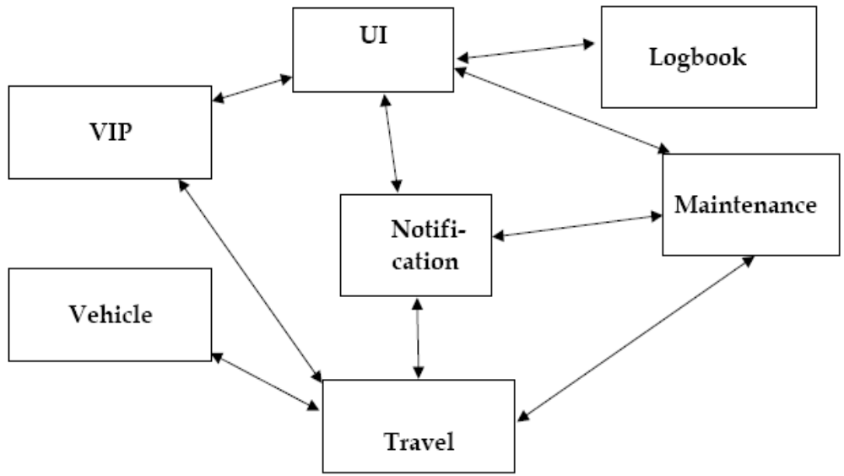
Typical Example of Logical Connectivity Drawing: Presentation of a System as Peer-to-Peer Architecture

Slide 65
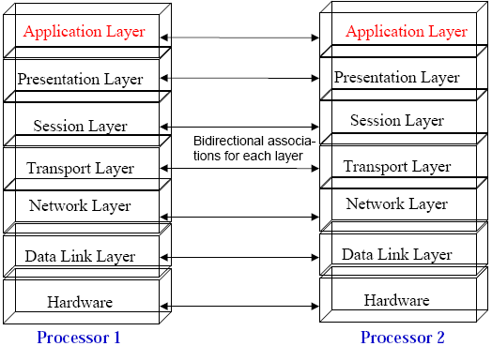
Logical vs Physical Connectivity and the relationship to Subsystem Layering

Slide 66
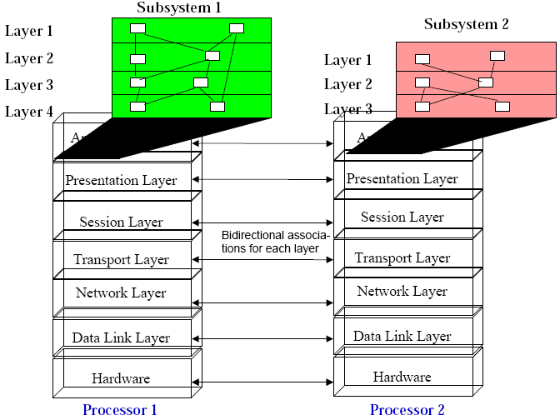

Slide 67
Drawing Subsystems in UML
System design must model static or dynamic (runtime) structures
  Component Diagram
   show the structure at design or compilation time
  Deployment Diagram
   show the structure of the run-time system

Slide 68
Component Diagram
Shows the dependencies among software components (source code, binary, executable components).
Some components exist at design time, compile time, some exist at link or runtime

Slide 69
Component Diagram
A graph of components connected by dependency relationships.
Compilation dependencies are shown as dashed arrows from the client component to the supplier component.
The kinds of dependencies are implementation language specific.
A component diagram may also be used to show interfaces (“facades”) using dashed arrows to interfaces.

Slide 70
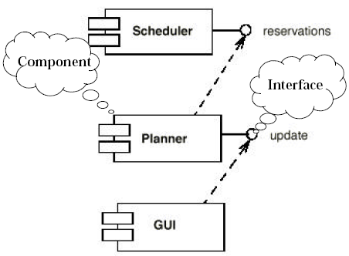
Component Diagram Example

Slide 71
Deployment Diagram
A deployment diagram is a graph of nodes connected by communication associations.
Nodes are shown as 3-D boxes.
Nodes may contain component instances.
Components may contain objects (indicating that the object is part of the component)

Slide 72
Deployment diagrams are very useful for showing a system design after the following decisions are made
Subsystem decomposition
Concurrency
Hardware/Software Mapping

Slide 73
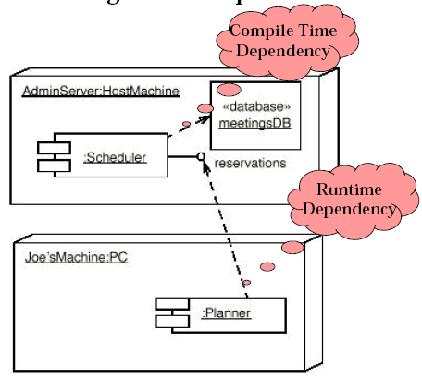
Deployment Diagram Example

Slide 74
5. Data Management
Some objects in the models need to be persistent
  Provide clean separation points between subsystems with welldefined interfaces.
A persistent object can be realized with one of the following
  Data structure
  Files
  Database   

Slide 75
File or Data base?
When should you choose a file?
  Are the data voluminous (bit maps)?
  Do you have lots of raw data (core dump, event trace)?
  Do you need to keep the data only for a short time?
  Is the information density low (archival files,history logs)?

Slide 76
When should you choose a database?
  Do the data require access at fine levels of details by multiple users?
  Must the data be ported across multiple platforms ( heterogenous systems异构系统)?
  Do multiple application programs access the data?
  Does the data management require a lot of infrastructure?

Slide 77
Database Management System
Contains mechanisms for describing data, managing persistent storage and for providing a backup mechanism
Provides concurrent access to the stored data
Contains information about the data (“meta-data”), also called data schema.

Slide 78
Issues to consider when choosing a Database
Storage space:
  Database require about triple the storage space of actual data
Response time:
  Mode databases are I/O or communication bound (distributed databases). Response time is also affected by CPU time, locking contention and delays from frequent screen displays

Slide 79
Locking modes:
  Pessimistic locking（悲观锁）: Lock before accessing object and release when object access is complete
  Optimistic locking （乐观锁） : Reads and writes may freely occur (high concurrency!) When activity has been completed, database checks if contention has occurred. If yes, all work has been lost.

Slide 80
Administration:
  Large databases require specially trained support staff to set up security policies, manage the disk space, prepare backups, monitor performance, adjust tuning.

Slide 81
Object-Oriented Databases
Support all fundamental object modeling concepts
  Classes, Attributes, Methods, Associations, Inheritance
Mapping an object model to an OO-database
  Determine which objects are persistent.
  Perform normal requirement analysis and object design
  Create single attribute indices to reduce performance bottlenecks

Slide 82
Relational Databases
Based on relational algebra
Data is presented as 2-dimensional tables. Tables have a specific number of columns and and arbitrary numbers of rows
  Primary key: Kombination of attributes that uniquely identify
a row in a table.Each table should have one primary key

Slide 83
Mapping an object model to a relational database
UML object models can be mapped to data schemas in relational databases:
  Some degradation occurs because all UML constructs must be mapped to a single relational database construct - the table.

Slide 84
Mapping:
  Each classes is mapped to a table
  Each class attribute is mapped onto a column in the table
  Methods are not mapped (!)
  An instance of a classe represents a row in the table
  One-to-many associations are implemented as a buried foreign key
  Each many-to-many association is mapped into its own table

Slide 85
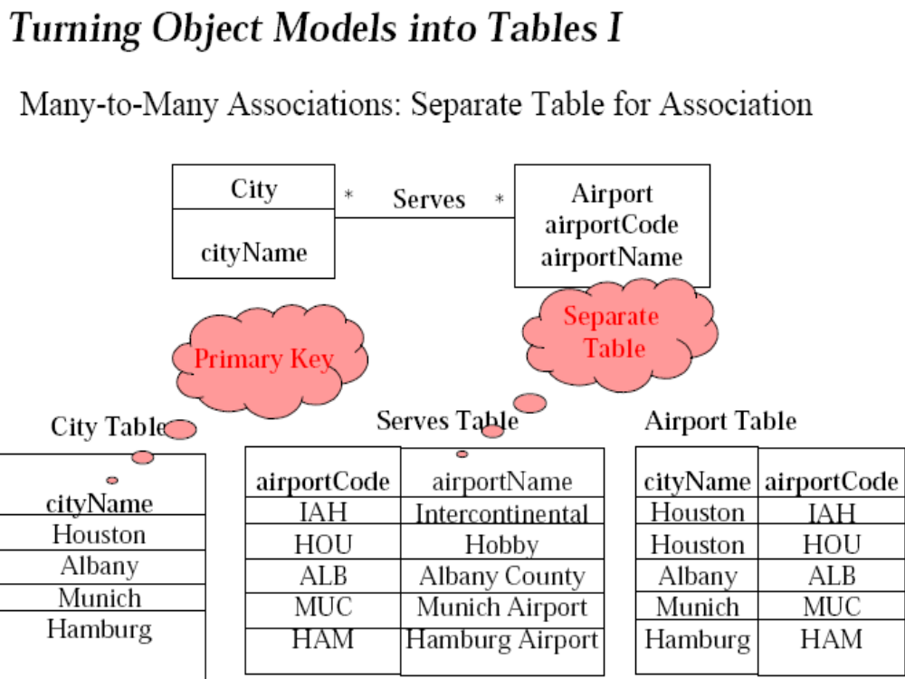
Airport table
Serves table

Slide 86
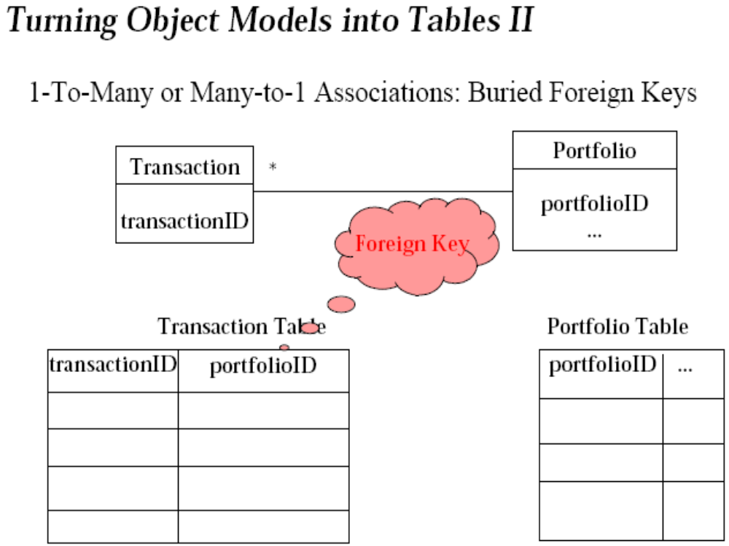

Slide 87
Data Management Questions
Should the data be distributed?
Should the database be extensible?
How often is the database accessed?
What is the expected request (query) rate? In the worst case?
What is the size of typical and worst case requests?

Slide 88
Do the data need to be archived?
Does the system design try to hide the location of the databases (location transparency)?
Is there a need for a single interface to access the data?
What is the query format?
Should the database be relational or object-oriented?

Slide 89
6. Global Resource Handling
Discusses access control
Describes access rights for different classes of actors
Describes how object guard against unauthorized access

Slide 90
Global Resource Questions
Does the system need authentication?
If yes, what is the authentication scheme?
  User name and password?
  Tickets?
What is the user interface for authentication?

Slide 91
Does the system need a network-wide name server?
How is a service known to the rest of the system?
  At runtime? At compile time?
  By Port?
  By Name?

Slide 92
7. Decide on Software Control
A. Choose implicit control
(non-procedural or declarative languages)
   Rule-based systems
   Logic programming
B. choose explicit control (procedural languages)

Slide 93
Centralized control
1. Procedure-driven control
–Control resides within program code.
Example: Main program calling procedures of subsystems.
– Simple, easy to build

Slide 94
2. Event-driven control
–Control resides within a dispatcher who calls subsystem functions via callbacks.
– Flexible, good for user interfaces

Slide 95

Decentralized control
Control resided in several independent objects
(supported by some languages).
Possible speedup by parallelization, increased communication overhead.
Example: Message based system.

Slide 96
Centralized vs Decentralized Designs
Should you use a centralized or decentralized design?
Centralized Design
  One control object or subsystem controls everything
  Change in the control structure is very easy
  Possible performance bottleneck

Slide 97
Decentralized Design
  Control is distributed
  Spreads out responsibility
  Fits nicely into object-oriented development

Slide 98
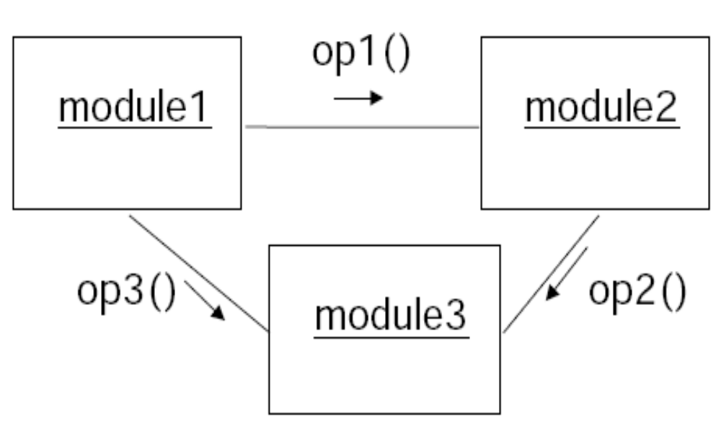
Example1
Procedure-Driven Control

Slide 99
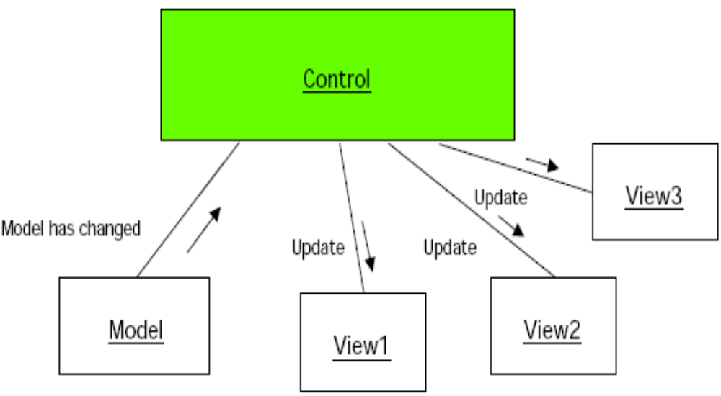
Event-Based System Example: MVC
Smalltalk-80 Model-View-Controller
Client/Server Architecture

Slide 100
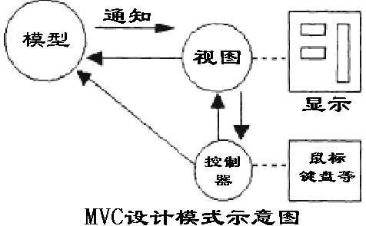
MVC是三个单词的缩写,分别为：
模型(Model), 视图(View)，
控制器( Controller)

Slide 101
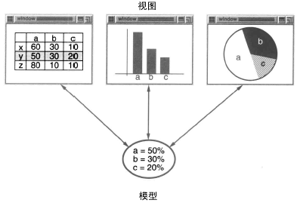

Slide 102

    MVC包括三类对象：
      模型(Model)：是应用对象，所有的操作都在这里实现，它若需要取得视图中的对象或更新视图，需通过控制器来进行处理。
      视图(View)：是模型在屏幕上的表示，模型在进行操作后，其结果是通过视图显示的。
      控制器(Controller)：用于管理用户与视图发生的交互，定义用户界面对用户输入的响应方式。一旦用户需要对模型进行处理，不能直接执行模型，而必须通过控制器间接实现的。

Slide 103
在MVC结构中，模型（Model）代表应用程序的数据（data）和用于控制访问和修改这些数据的业务规则（business rule）。通常模型被用来作为对现实世界中一个处理过程的软件近似，当定义一个模型时，可以采用一般的简单的建模技术。

Slide 104
当模型发生改变时，它会通知视图（View），并且为视图提供查询模型相关状态的能力。同时，它也为控制器（Controller）提供访问封装在模型内部的应用程序功能的能力。

Slide 105
一个视图（View）用来组织模型的内容。它从模型那里获得数据并指定这些数据如何表现。当模型变化时，视图负责维持数据表现的一致性。视图同时将用户要求告知控制器（Controller）.

Slide 106
控制器（Controller）定义了应用程序的行为；它负责对来自视图的用户要求进行解释，并把这些要求映射成相应的行为，这些行为由模型负责实现。在独立运行的GUI客户端，用户要求可能是一些鼠标单击或是菜单选择操作。
在一个Web应用程序中，它们的表现形式可能是一些来自客户端的GET或POST的 HTTP请求。
模型所实现的行为包括处理业务和修改模型的状态。根据用户要求和模型行为的结果，控制器选择一个视图作为对用户请求的应答。通常一组相关功能集对应一个控制器。

Slide 107
MVC 结构提供了一种按功能对各种对象进行分割的方法（这些对象是用来维护和表现数据的），其目的是为了将各对象间的耦合程度减至最小。
MVC结构本来是为了将传统的输入（input）、处理（processing）、输出（output）任务运用到图形化用户交互模型中而设计的。
但是，将这些概念运用于基于 Web的企业级多层应用领域也是很适合的。

Slide 108
MVC模式的好处
1. 各施其职，互不干涉
三个层各施其职，一旦哪一层的需求发生了变化，就只需要更改相应层中的代码而不会影响到其它层中的代码.
2. 有利于开发中的分工
按层把系统分开，能更好的实现开发中的分工。网页设计者开发视图层中的JSP，熟悉业务开发者开发业务层，其它开发人员开发控制层.
➢ 3. 有利于组件的重用
分层后更有利于组件的重用。如控制层可独立成一个通用的组件，视图层可做成通用的操作界面。

Slide 109
8. Boundary Conditions
Most of the system design effort is concerned with steady-state behavior.
However, the system design phase must also address the initiation and finalization of the system.
  Initialization
  Describes how the system is brought from an initialized state to steady-state ("startup scenario”).

Slide 110
 Termination
  Describes what resources are cleaned up and what tasks or other systems are notified upon termination ("termination scenarios").
 Failure
  Many possible causes: Bugs, errors, external problems (power supply).
Good system design foresees fatal failures. Example: Catch Unix signals or Java Exceptions.

Slide 111
      Boundary Condition Questions
Initialization
  How does the system start up?
   What data need to be accessed at startup time?
   What services have to registered?
  What does the user interface do at start up time?
   How does it present itself to the user?

Slide 112
Termination
  Are single subsystems allowed to terminate?
  Are other subsystems notified if a single subsystem terminates?
  How are local updates communicated to the database?

Slide 113
Failure
  How does the system behave when a node or communication link fails? Are there backup communication links?
  How does the system recover from failure? Is this different from initialization?

