Slide 1
第四部分 面向对象设计
对象设计
Object Design
厦门大学软件学院林坤辉

Slide 2
Object Design
1. Object design is the process of adding details to the requirements analysis and making implementation decisions
设计模型建立在分析模型的基础上，可以看成是分析模型的精化和细化。
设计模型添加了详细信息和特定技术的解决方案。
设计模型必须包括实现的详细信息。

Slide 3
2. The object designer must choose among different ways to implement the analysis model with the goal to minimize execution time, memory and other measures of cost.
3. Requirements Analysis:
Use cases, functional and dynamic model deliver operations for object model
4. Object Design:
We iterate on where to put these operations in the object model
5. Object Design serves as the basis of implementation

Slide 4
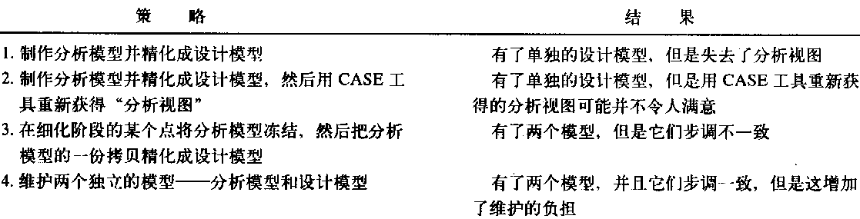
分析模型与设计模型

Slide 5
分析类来自于问题域，是系统中类的高级概念视图，其属性集和操作可能不完整。
分析类可以被分解成一个或多个接口或设计类。
设计类是已经完成了规格说明并且达到能够被实现的程度的类。
每个设计类是一些能真正做好一两件事情的小的、高内聚的单元。

Slide 6
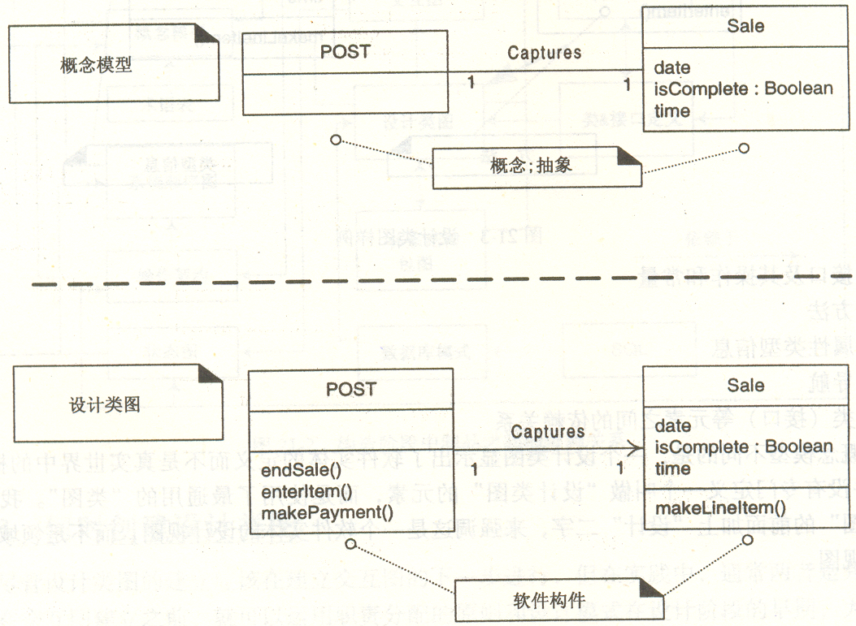

Slide 7
Object Design Issues
Full definition of associations
Full definition of classes
Choice of algorithms and data structures
Detection of new application-domain independent classes (example: Cache)
Optimization
Increase of inheritance
Decision on control
Packaging

Slide 8
Object Design Activities
1. Service specification
2. Component selection
3. Object model restructuring
4. Object model optimization

Slide 9
1. Service specification
Describes precisely each class interface
2. Component selection
Identify off-the-shelf(现货) components and additional solution objects
3. Object model restructuring
Transforms the object design model to improve its understandability and extensibility
4. Object model optimization
Transforms the object design model to address performance criteria such as response time or memory utilization.

Slide 10
1. Service Specification
Requirements analysis
Identifies attributes and operations without specifying their types or their parameters.
Object design
(1) Add visibility information
(2) Add type signature information
(3) Add contracts

Slide 11
1.1 Add Visibility
UML defines three levels of visibility:
1. Private(-):
(1) A private attribute can be accessed only by the class in which it is defined.
(2) A private operation can be invoked only by the class in which it is defined.
(3) Private attributes and operations cannot be accessed by subclasses or other classes.

Slide 12
Add Visibility ctd
2. Protected(#):
A protected attribute or operation can be accessed by the class in which it is defined and on any descendent(派生) of the class.
3. Public(+):
A public attribute or operation can be accessed by any class.

Slide 13
Information Hiding Heuristics
Build firewalls around classes
Carefully define public interfaces for classes as well as subsystems
Apply “Need to know” principle. The fewer an operation knows
--the less likely it will be affected by any changes
--the easier the class can be changed
Trade-off
Information hiding vs efficiency

Slide 14
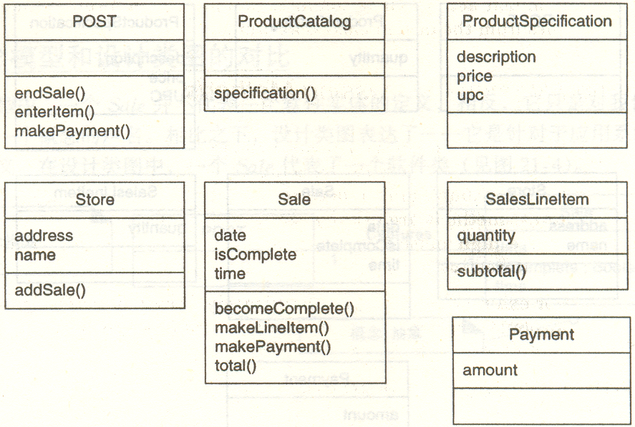

Slide 15
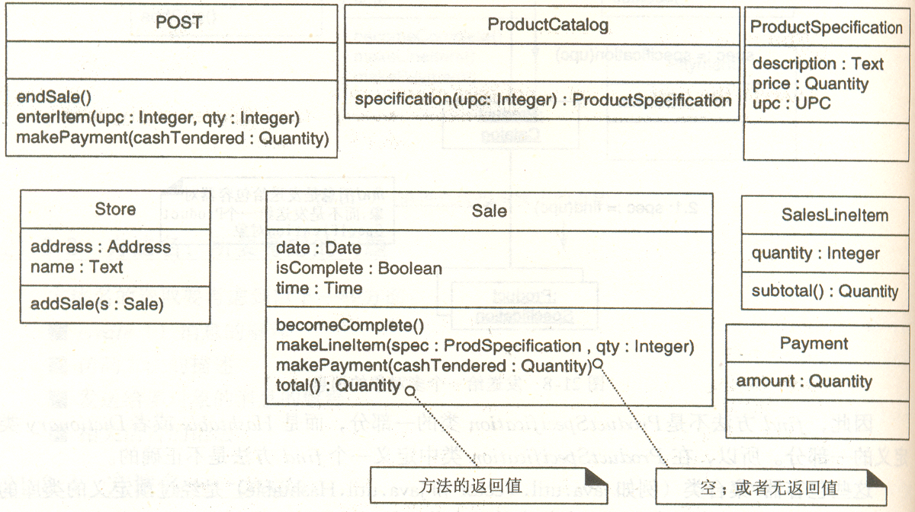

Slide 16
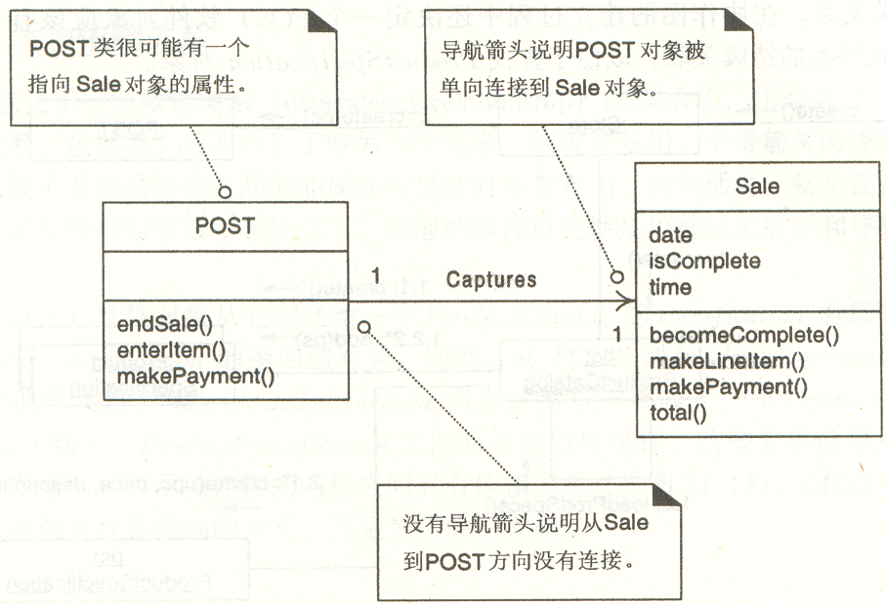

Slide 17
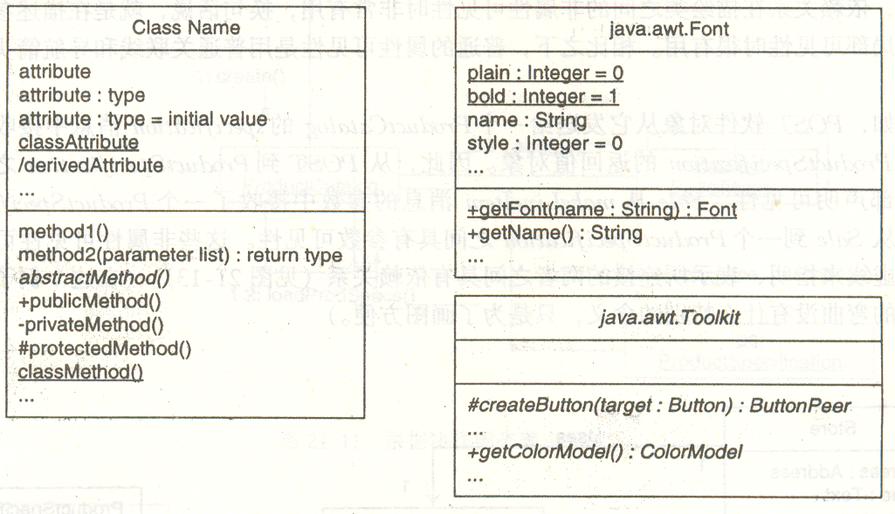

Slide 18
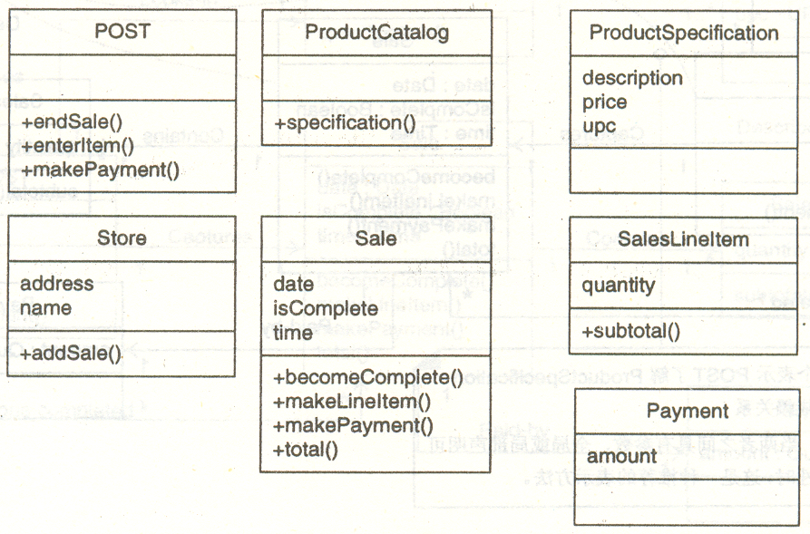

Slide 19
Information Hiding Design Principles
Only the operations of a class are allowed to manipulate its attributes
Access attributes only via operations.
Hide external objects at subsystem boundary
Define abstract class interfaces which mediate between system and external world as well as between subsystems
Do not apply an operation to the result of another operation.
Write a new operation that combines the two operations.

Slide 20
1.3 Contracts
Contracts on a class enable caller and callee to share the same assumptions about the class.
Contracts include three types of constraints:
(1) Invariant(不变式):
A predicate that is always true for all instances of a class.
Invariants are constraints associated with classes or interfaces.
Invariants are used to specify consistency constraints among class attributes.(比如三角形的边长关系)

Slide 21
(2) Precondition(前置条件):
A predicate that must be true before an operation is invoked.
Preconditions are associated with a specific operation.
如果该条件不正确,该操作可能拒绝执行,并可能产生一些异常情况.
Preconditions are used to specify constraints that a caller must meet before calling an operation.
例如:
后进先出堆栈的出栈操作的前置条件是非空

Slide 22
(3) Postcondition (后置条件):
A predicate that must be true after an operation is invoked.
Postconditions are associated with a specific operation.
如果该条件不正确，该操作的执行是不完全的，并一定是经过调整的。
Postconditions are used to specify constraints that the object must ensure after the invocation of the operation.
如果满足前置条件，同时必须满足后置条件.

Slide 23
类的不变式和操作运算的前置条件
操作运算执行
类的不变式和操作运算的后置条件
类的不变式是隐性的,
当设计一个操作运算或执行该运算的一个方法时,应该以此作为遵守的条件.

Slide 24
Expressing constraints in UML
OCL (Object Constraint Language)
(1) OCL allows constraints to be formally specified on single model elements or groups of model elements
(2) A constraint is expressed as an OCL expression returning the value true or false.
OCL is not a procedural language (cannot constrain control flow).

Slide 25
OCL expressions for Hashtable operation put():
Invariant:
context Hashtable inv: numElements >= 0
Precondition:
context Hashtable::put(key, entry) pre:!containsKey(key)
Post-condition:
context Hashtable::put(key, entry)
post: containsKey(key) and get(key) = entry
Context is a class operation
OCL expression

Slide 26
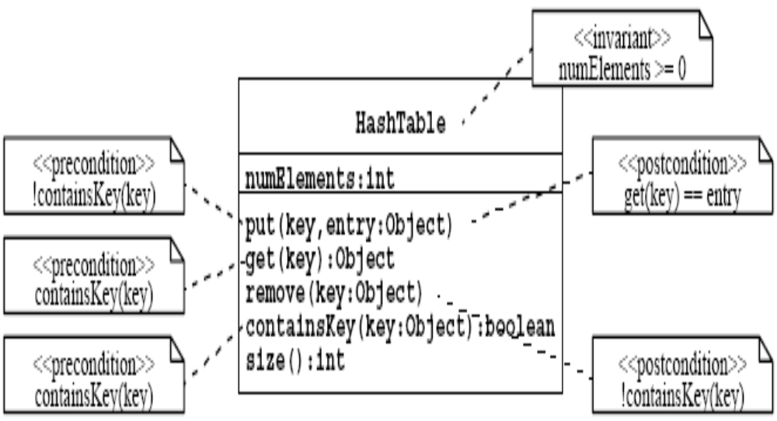
Expressing Constraints in UML
A constraint can also be depicted as a note attached to the constrained UML element by a dependency relationship.

Slide 27
2. Component Selection
Select existing off-the-shelf class libraries, frameworks or components
Adjust the class libraries, framework or components
(1) Change the API if you have the source code.
(2) Use the adapter or bridge pattern if you don’t have access

Slide 28
Reuse...
Look for existing classes in class libraries
JSAPI, JTAPI, ....
Select data structures appropriate to the algorithms
Container classes
Arrays, lists, queues, stacks, sets, trees, ...
Define new internal classes and operations only if necessary
Complex operations defined in terms of lower-level operations might need new classes and operations

Slide 29
3. Restructuring Activities
Realizing associations
Revisiting inheritance to increase reuse
Revising inheritance to remove implementation dependencies

Slide 30
3.1 Increase Inheritance
Rearrange and adjust classes and operations to prepare for inheritance
Abstract common behavior out of groups of classes
If a set of operations or attributes are repeated in 2 classes the classes might be special instances of a more general class.
Be prepared to change a subsystem (collection of classes) into a superclass in an inheritance hierarchy.

Slide 31
3.2 Building a super class from several classes
Prepare for inheritance. All operations must have the same signature but often the signatures do not match:
(1) Some operations have fewer arguments than others: Use overloading (重载) (Possible in Java)
重载: 是指在同一个类中定义的几个操作(或操作符)都具有同一类的名字或符号.

Slide 32
(2) Similar attributes in the classes have different names: Rename attribute and change all the operations.
(3) Operations defined in one class but no in the other: Use virtual functions and class function overriding(覆盖).
覆盖: 是指类C定义的方法在C的一个子类中被重定义.
对于重载而言,问题是如何在运行时将正确的程序绑定到操作名? 答案是使用消息参数(参数的类或数目)

Slide 33
Abstract out the common behavior (set of operations with same signature) and create a superclass out of it.
Superclasses are desirable. They
(1) increase modularity, extensibility and reusability
(2) improve configuration management

Slide 34
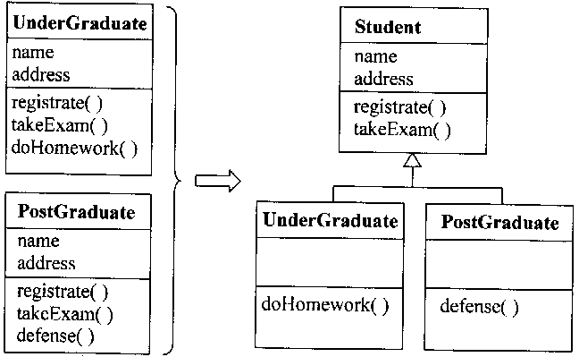
继承性是反映了特殊化的一个方向,反过来就是一般化(generalization).
一般化是把子类中的共性提升到父类中去，好处是去除了不同类中的重复逻辑和属性。例如：

Slide 35
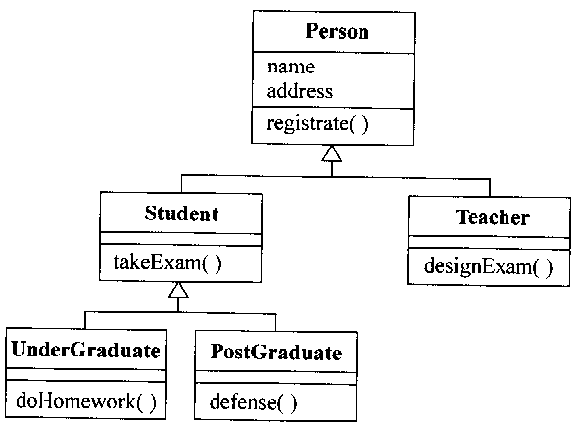

Slide 36
继承性的意义
在设计过程中，多数情况下不是先定义好父类，然后再继承到子类中，而是先有子类并发现共性，才归纳抽象出父类来。
在很多新项目中，通过这样的一般化抽象出父类.
抽象的基础是基于责任和行为的相似，而不一定是代码的相同。从理论上讲应该尽可能地把操作上拔。
所以继承性的意义应该反过来看，这样才能更好地体现它的威力。
继承是在已经有了父类后，再进一步地对原来的类进行的扩展，一般在项目的后期比较有用。
继承的理论基础是逻辑学上的三段论，所以子类是一种（类）父类。

Slide 37
多态性
多态性是指对同一个接口定义的操作，可以有不同的实现。
一般情况下，子类从父类中原封不动地继承原有的操作，但也可以有所不同。比如，本科生和研究生的“考试”实现可以不同。
多态性的最大意义是保证接口的一致性。
继承和多态经常被误用，从而产生危险性。
（1）继承是强的耦合形式，
（2）类的封装是脆弱的，基类的改变会直接波及子类。

Slide 38
3.3 Implement Associations
Strategy for implementing associations:
(1) Be as uniform as possible
(2) Individual decision for each association

Slide 39
Example of uniform implementation
(1) 1-to-1 association:
Role names are treated like attributes in the classes and translate to references
(2) 1-to-many association:
Translate to Vector
(3) Qualified(限定) association:
Translate to Hash table

Slide 40
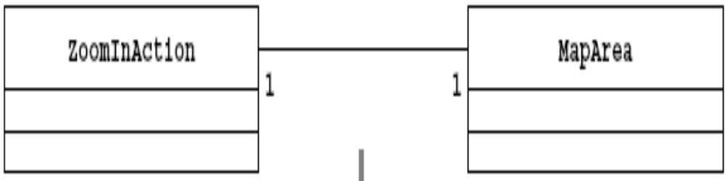
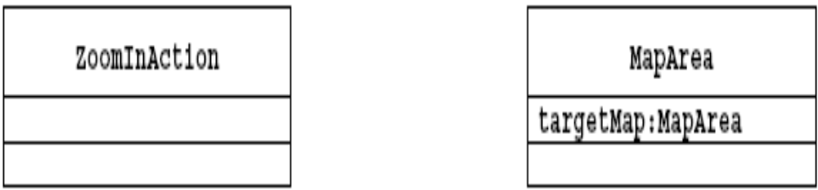
Unidirectional 1-to-1 Association
Object design model before transformation
Object design model after transformation

Slide 41
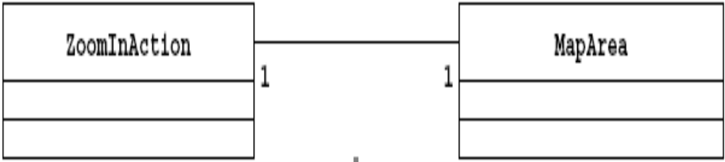
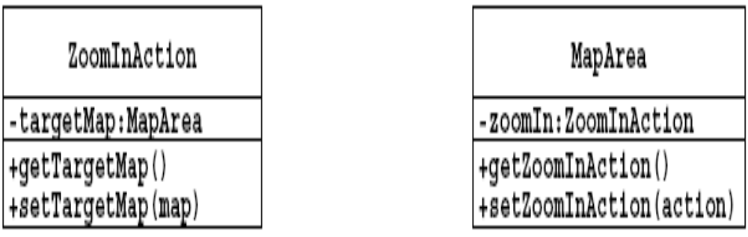
Bidirectional 1-to-1 Association
Object design model before transformation
Object design model after transformation

Slide 42
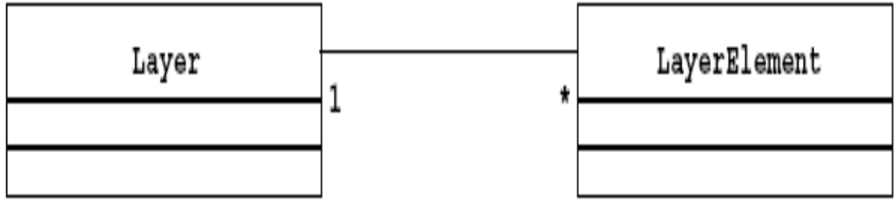
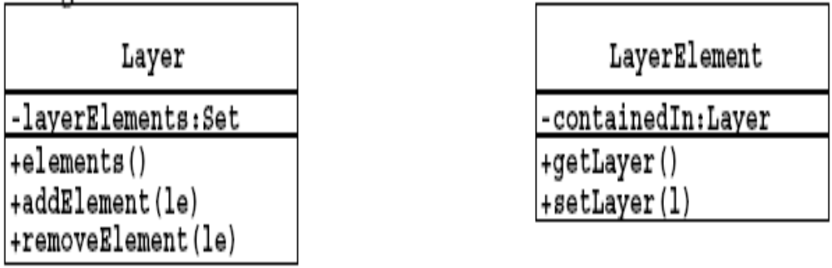
1-to-Many Association
Object design model before transformation
Object design model after transformation

Slide 43
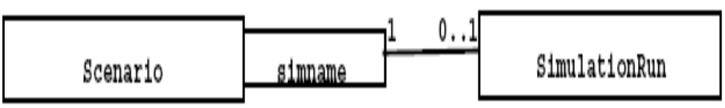
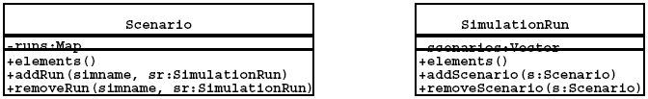
Qualification Association
Object design model before transformation
Object design model after transformation

Slide 44
4. Design Optimizations
Design optimizations are an important part of the object design phase:
The requirements analysis model is semantically correct but often too inefficient if directly implemented.

Slide 45
Optimization activities during object design:
(1) Add redundant associations to minimize access cost
(2) Rearrange computations for greater efficiency
(3) Store derived attributes to save recomputation time
As an object designer you must strike a balance between efficiency and clarity.
Optimizations will make your models more obscure

Slide 46
Design Optimization Activities
1. Add redundant associations
2. Rearrange execution order
3. Turn classes into attributes

Slide 47
1. Add redundant associations:
What are the most frequent operations? ( Sensor data lookup?)
How often is the operation called? (30 times a month, every 50 msec)
2. Rearrange execution order
(1) Eliminate dead paths as early as possible (Use knowledge of distributions, frequency of path traversals)
(2) Narrow search as soon as possible
(3) Check if execution order of loop should be reversed
3. Turn classes into attributes

Slide 48
Implement Application domain classes
To collapse or not collapse: Attribute or association?
Object design choices:
(1) Implement entity as embedded attribute
(2) Implement entity as separate class with associations to other classes
Associations are more flexible than attributes but often introduce unnecessary indirection.

Slide 49
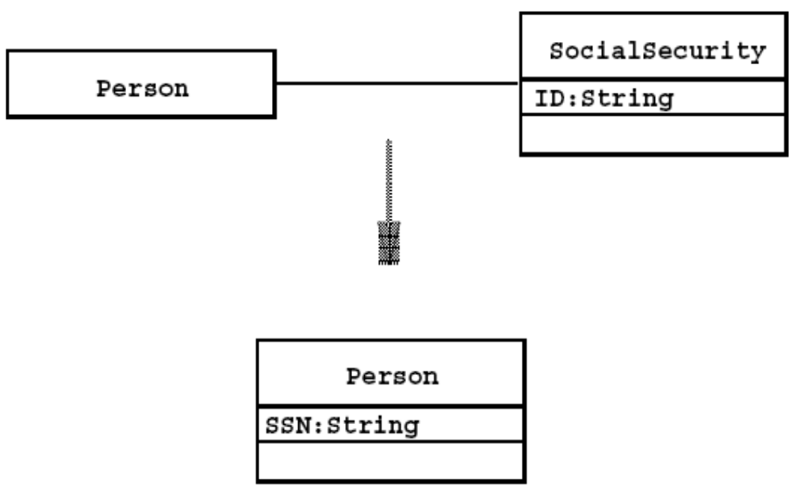
Optimization Activities:
Collapsing Objects

Slide 50
To Collapse or not to Collapse?
Collapse a class into an attribute if the only operations defined on the attributes are Set() and Get().

Slide 51
Design Optimizations ctd
Store derived attributes
Example: Define new classes to store information locally (database cache)
Problem with derived attributes:
(1) Derived attributes must be updated when base values change.

Slide 52
(2) There are 3 ways to deal with the update problem:
(a) Explicit code: Implementor determines affected derived attributes (push)
(b) Periodic computation: Recompute derived attribute occasionally (pull)
(c) Active value: An attribute can designate set of dependent values which are automatically updated when active value is changed (notification, data trigger)

Slide 53
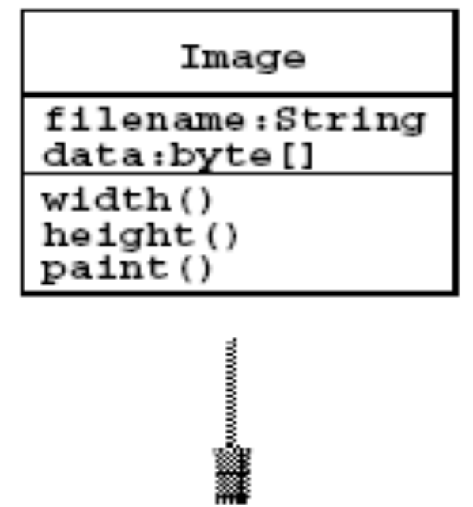
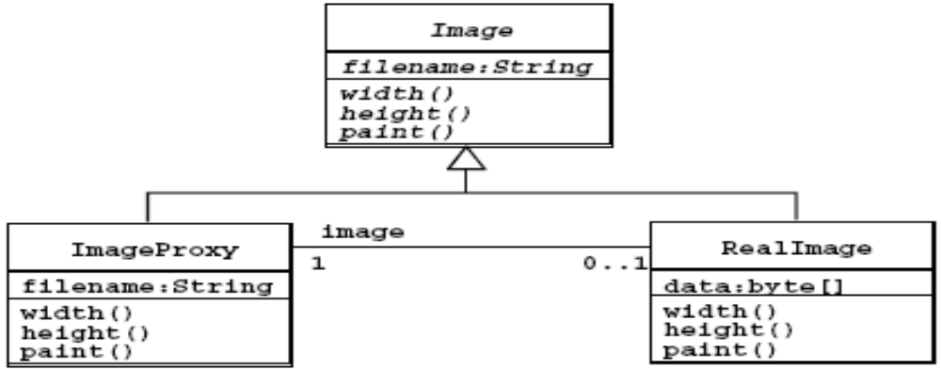
Optimization Activities: Delaying Complex
Computations

Slide 54
Package it all up
Pack up design into discrete physical units that can be edited, compiled, linked, reused
Construct physical modules
Ideally use one package for each subsystem
System decomposition might not be good for implementation.

Slide 55
Two design principles for packaging
(1) Minimize coupling(耦合):
(a) Classes in client-supplier relationships are usually loosely coupled
(b) Large number of parameters in some methods mean strong coupling (> 4-5)
(c) Avoid global data
(2) Maximize cohesiveness(内聚):
Classes closely connected by associations
same package

Slide 56
Packaging Heuristics
Each subsystem service is made available by one or more interface objects within the package
Start with one interface object for each subsystem service
Try to limit the number of interface operations (7+-2)
If the subsystem service has too many operations, reconsider the number of interface objects

Slide 57
If you have too many interface objects, reconsider the number of subsystems
Difference between interface objects and Java interfaces
(1) Interface object :
Used during requirements analysis, system design and object design. Denotes a service or API
(2) Java interface:
Used during implementation in Java (A Java interface may or may not implement an interface object)

