Slide 1
Making a (successful) Movie
Analysis of Movie Data
Henry Graham Costello | March 2022

Slide 2
Summary Findings
The Data
Doesn’t have to be good!
Sci-Fi, Animation, or Adventure (or all three!)
SUMMER!
Sources :
Two IMDB Data Sets
Box Office Mojo Gross Revenue Data Set
The MovieDB Data Set

Slide 3
Examining the Data
Cleaning the Data
IMDB Basics Data Set: 146,144 movies
IMDB Ratings Data Set: 73,856 movies
Box Office Mojo Data Set: 3,387 movies
The Movie Database Data Set: 26,517 movies
Rating and Genre graphs:
IMDB Data Sets + Box Office Mojo: 1,799 movies
Season graph:
The Movie Database + Box Office Mojo: 1,702 movies

Slide 4
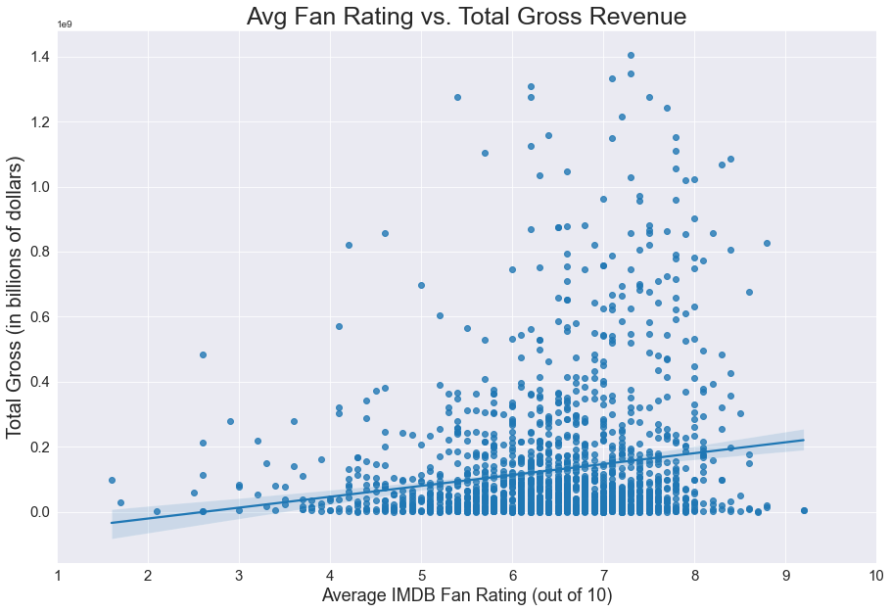
Correlation (r^2)
0.026
Key Takeaways
Don’t worry about quality
Cluster at low gross

Slide 5
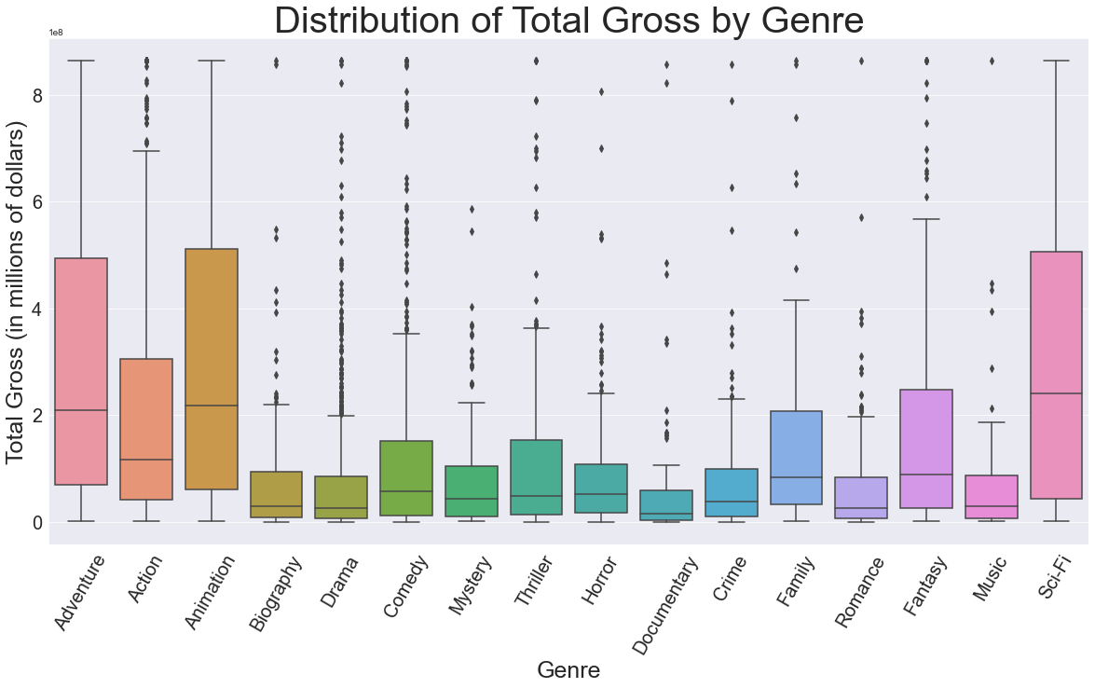
(cut top 2%)
Still very large range
Sci-Fi
Animation
Adventure
Action
Fantasy

Slide 6
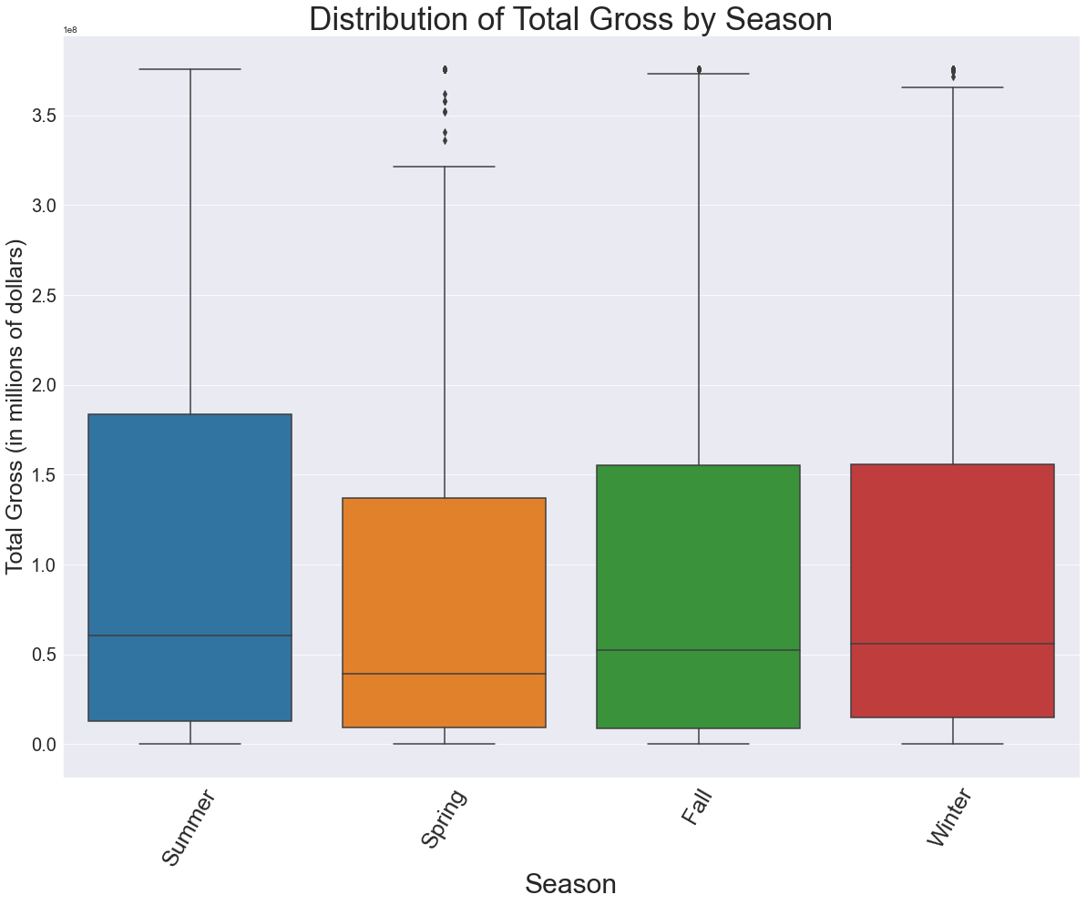
(cut top 10%)
Looks relatively similar, but remember outliers.
Summer Flic!

Slide 7
Conclusions
Doesn’t have to be good
Lights, Camera, Action !
😎
Further discussion:
-What are your parameters?

Slide 8
Thank You!
Email: hgcostello@gmail.com
GitHub: @hgcostello

