Slide 1
Introduction to Bitcoin & Blockchain
Haresh G

Slide 2
Agenda
Transacting - Traditional finance
Crash course in cryptography
Introducing Bitcoin
Public vs Private Blockchains
Investing
Caution

Slide 3


Transacting - Traditional finance
Lloyds Bank
Alice
Bob
User | Balance
Alice | 100$
Bob | 50$

Slide 4
Transacting - Traditional finance (contd)
Lloyds Bank
$50 (Bob)
Alice
Bob
(Before)
(After)
User | Balance
Alice | 100$
Bob | 50$
User | Balance
Alice | 50$
Bob | 100$

Slide 5
Transacting - Traditional finance
Users need to be KYC’d
Operated by private and state entities
Clearing and settlement process between banks
Additional fees for cross border payments
Users can have reduced access to account (Greece)
Users do not have financial transaction privacy

Slide 6
Crash course - Cryptography
Public-Key cryptography
Private Key (privKey) : 7dbcd5f856c4e7f01d1ba66f8da8c5538fd….
Public Key (pubKey) : 02e23033b91a7cc18381add40331923fde….
Private key is kept confidential
Public key is distributed to the public
Private key and public key are related

Slide 7
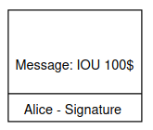
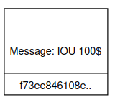
Crash course - Cryptography
Digital signatures
Sign any text with your private key, signature can be verified against the public key
Alice Public Key - Used to verify a message (Available to public)
Alice Private Key - Used to sign a message (confidential)
Signature - Generated for a message (Available to public)
Alice

Slide 8

Crash course - Cryptography
Hashing
Convert something with arbitrary length to fixed length deterministically.
War & Peace
ffbca180ea
War & Peace (one alphabet changed)
e3g5ff3ac

Slide 9
Introducing Bitcoin
Bitcoin is the first cryptocurrency which works due to a software break through called blockchain.
It was invented in 2008 and was operational in 2009.
The inventor(s) is Satoshi Nakamoto , a pseudonym
It allows any one in the world to send and receive value (bitcoins) using only a computer & internet connection
It is revolutionary , because there are no middlemen , corporations or states operating the network.
It is a public infrastructure for payments
Some notable characteristics are:
Open Network
Peer to peer network
Transparent
Immutable

Slide 10
Open Network
Any one can create a bitcoin address using number of ways.
A bitcoin account (wallet) is a combination of
Bitcoin Private Key
Bitcoin Address - Public Key
User | Balance
Alice | 100$
Address (public key) | Balance
1J2VRE3SWpfJakfTdA6dB1zM4gbCzrc7is | 1.46 BTC

Slide 11
Peer to Peer
User | Balance
Alice | 100$
Bob | 50$
User | Balance
Alice | 100$
Bob | 50$
User | Balance
Alice | 100$
Bob | 50$

Slide 12
Peer to Peer
Address (public key) | Balance
1J2VRE3SWpfJakfTdA6dB1zM4gbCzrc7is | 1.46 BTC
33PjTZu7Eh96Jihh1gyBin5ApXwcjSLXS6 | 0.5 BTC
Address (public key) | Balance
1J2VRE3SWpfJakfTdA6dB1zM4gbCzrc7is | 1.46 BTC
33PjTZu7Eh96Jihh1gyBin5ApXwcjSLXS6 | 0.5 BTC
Address (public key) | Balance
1J2VRE3SWpfJakfTdA6dB1zM4gbCzrc7is | 1.46 BTC
33PjTZu7Eh96Jihh1gyBin5ApXwcjSLXS6 | 0.5 BTC

Slide 13
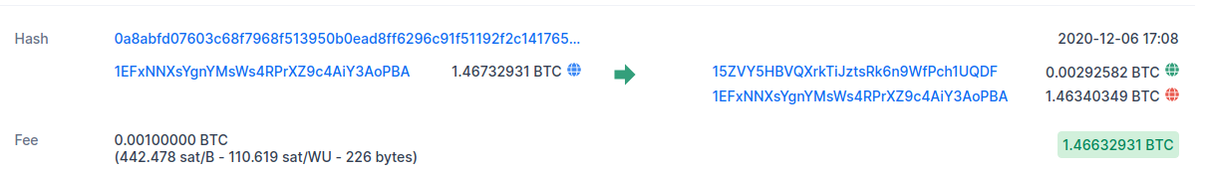
Transactions - Transparency
Bitcoin Network
Bob (0.46 BTC) + Alice Signature + Fees
Alice
Address (public key) | Balance
1J2VRE3SWpfJakfTdA6dB1zM4gbCzrc7is | 1.46 BTC

Slide 14
Bitcoin Network
Address (public key) | Balance
1J2VRE3SWpfJakfTdA6dB1zM4gbCzrc7is | 1.0 BTC
33PjTZu7Eh96Jihh1gyBin5ApXwcjSLXS6 | 0.96 BTC
Address (public key) | Balance
1J2VRE3SWpfJakfTdA6dB1zM4gbCzrc7is | 1.0 BTC
33PjTZu7Eh96Jihh1gyBin5ApXwcjSLXS6 | 0.96 BTC
Address (public key) | Balance
1J2VRE3SWpfJakfTdA6dB1zM4gbCzrc7is | 1.0 BTC
33PjTZu7Eh96Jihh1gyBin5ApXwcjSLXS6 | 0.96 BTC

Slide 15
Bitcoin Network Participants
User
Node Operator
Miner

Slide 16
Hang on..
Where do bitcoins come from?
Who adds the entry to the ledger?
Bitcoin Network
Bob (0.46 BTC) + Alice Signature + Fees
Alice
Address (pubKey) | Balance
1J2VRE3SWpfJakfTdA6dB1zM4gbCzrc7is | 1.46 BTC

Slide 17
Mining
TX01- From 1BFgc... To: 1Cd5491… Amount : 0.1BTC, Fees: 0.1
TX02 - From 1GCcc.. To: 15491… Amount : 0.2 BTC, Fees : 0.2
TX03 - From 1A0ac... To: 1e5491… Amount : 1.0 BTC, Fees: 0.3
Miner
Miner
Miner

Slide 18
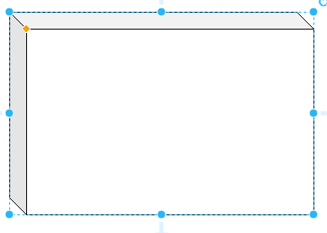
Block Creation
TX01- From 1BFgc... To: 1Cd5491…
TX02 - From 1GCcc.. To: 1C5491…
TX03 - From 1A0ac... To: 1e5491..
Miner
Puzzle:
3 + ? = 20
Ans : 17
Reward : 6.5 BTC

Slide 19
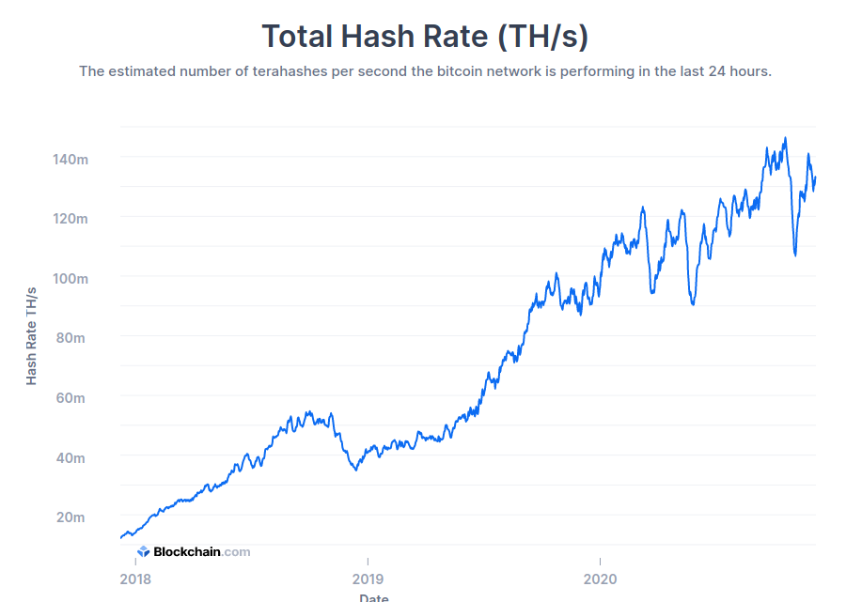
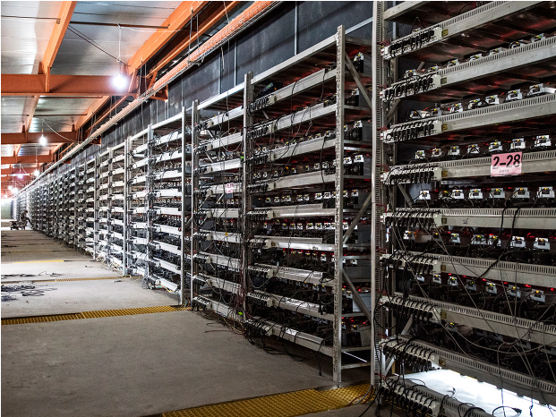
Block Creation
The puzzle is kinda - Hard
~77 TWH - Consumption of Chile
Customised hardware is designed and improved to mine bitcoins

Slide 20
Block Creation
TX01- From 1BFgc... To: 1Cd5491…
TX02 - From 1GCcc.. To: 1C5491…
TX03 - From 1A0ac... To: 1e5491..
Puzzle:
3 + ? = 20
Miner
Ans : 17
Reward : 6.5 BTC
Previous Block - ccde4813..

Slide 21
Immutable Blockchain
Current : 112233
Previous: c01ad
Height: 03
Current : 223344
Previous: 112233
Height: 04
Current : 334455
Previous: 223344
Height: 05
Current : 445566
Previous: 334455
Height: 06
Time (New block every 10 minutes)

Slide 22


Ledger Update

Slide 23
Ledger Update

Slide 24
Transacting - Bitcoin network
Existing Financial Infrastructure | Bitcoin Blockchain
Users need KYC | No KYC
No transaction Privacy | Transaction Privacy
Access can be reduced | Access guaranteed as long as you have your private keys and internet connection
Operated by private entities/state | Decentralised , no single point of failure

Slide 25
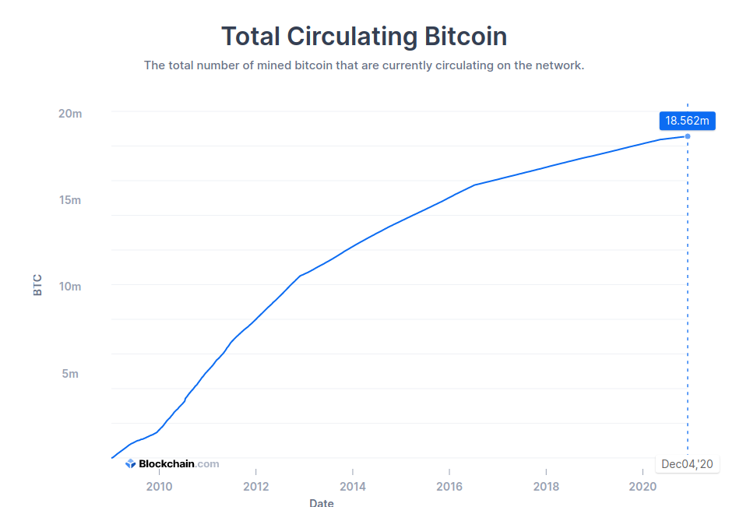
Bitcoin - Store of Value
Bitcoin is divisible. Smallest unit is Satoshis.
100 million Satoshis = 1 Bitcoin
There will only 21 million bitcoins in existence
Currently every new block 6.25 bitcoins are created. No QE possible
Bitcoin is fungible.

Slide 26
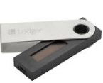
Investing
Custodial Solutions:
EU
Coinbase : https://www.coinbase.com/
Kraken : https://www.kraken.com/en-gb/
Binance : https://www.binance.com/en
Storage (Hardware Wallet)
Ledger Nano : https://www.ledger.com/
Trezor : https://trezor.io/

Slide 27




Current Interest
Winklevoss twins (Facebook) : Gemini Exchange (US)
Jack Dorsey (Ex-Twitter): Square 50 million USD
Microstrategy : 3 Billion USD
Grayscale : 500,000 BTC , 60 Billion USD AUM

Slide 28
Caution
Considered a social experiment
Regulation is being worked on
Very volatile market
Not your keys , not your coins
There is no helpline ...beware of clones, scams

Slide 29


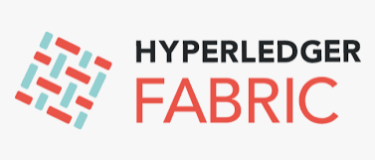


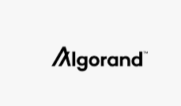

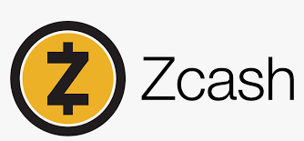

Public Blockchains vs Private Blockchains

Slide 30
Q&A

Slide 31
Resources
https://bitcoin.org/en/getting-started
https://www.whatbitcoindid.com/the-beginners-guide-to-bitcoin
https://twitter.com/aantonop
https://twitter.com/adam3us
Contact:
https://www.linkedin.com/in/haresh-gedia/
https://twitter.com/h_gedia
haresh.gedia@hotmail.co.uk

Slide 32
End

