Slide 1
Harit Gedia
License Plate Recognizer
Pre-Final Year, IIT Jodhpur
Email – gedia.1@iitj.ac.in
Ph. No. - 6377510853

Slide 2
Overall Approach
Character Recognition
OCR through Tesseract
New Frame
Input
Segmentation of individual characters
Training YOLOv4 Model on Google’s Open Image Dataset
Result
Running the model on the frame
Contour Formation
License Plate Localization
Bounded Box Prediction
Thresholding
Reducing Noise
Is Confidence Score > 0.5?
No
Cropping the box
Converting into B/W image
Image Processing
Yes

Slide 3
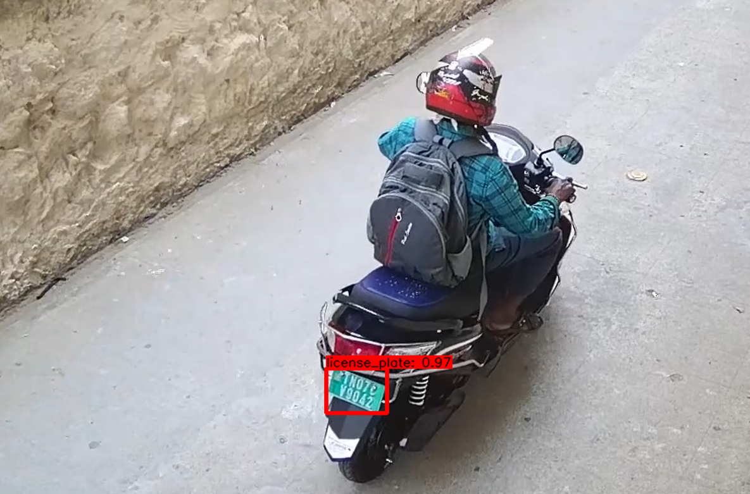
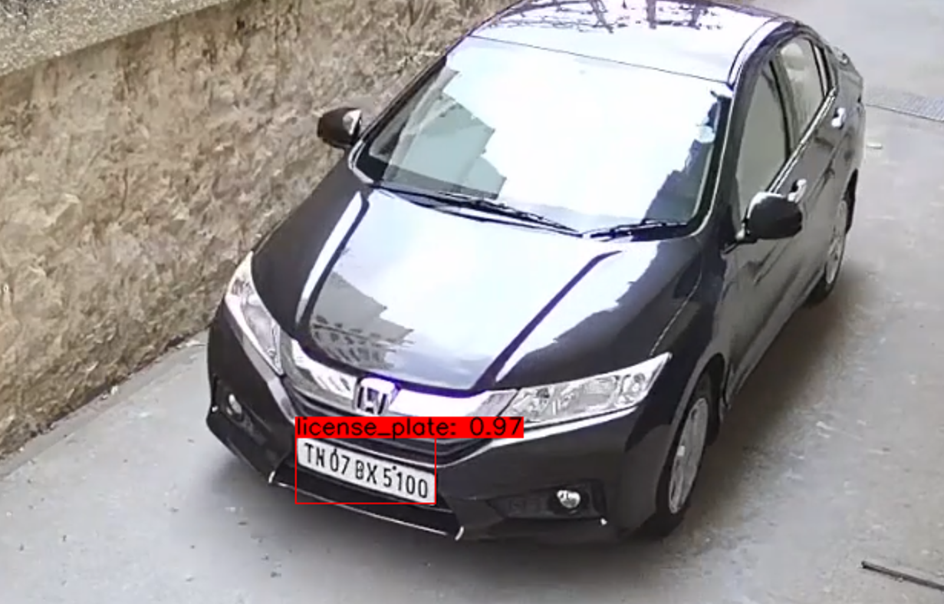
License Plate Localization
Here, I have trained YOLOv4 model using CSPDarkNet-53 on the Google’s Open Image Dataset. It is only able to detect one class (license_plate) and predict its location.
If the confidence score of the prediction > 0.5, it will go for further image processing. Output after number plate localization will look like this.

Slide 4
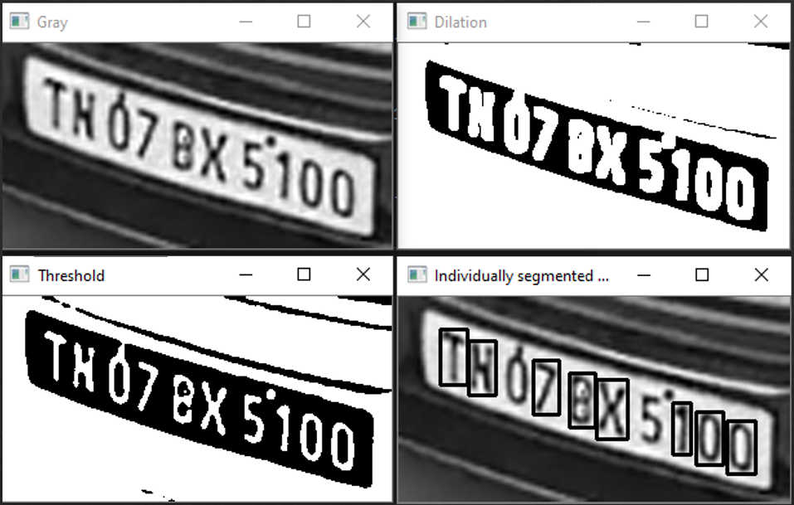
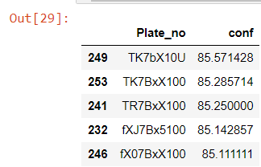
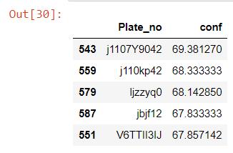
OCR - Results
After processing the image, I have extracted contours from the image and bounded them by rectangles.
I have performed character recognition using Tesseract - OCR on the bounded rectangles, directed from left to right to obtain the result.
Top 5 results(sorted by average confidence score with length>6)) for car and bike respectively along with their confidence scores and frame no. are shown below.
Thank You!

