Slide 1




Noisy Captcha Recognition
Hossein Ghaemi
Armin Yousefi

Slide 2

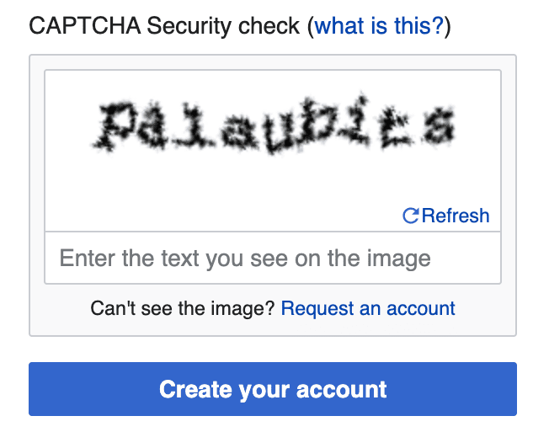
What is Captcha?
Definition
A CAPTCHA test is designed to determine if an online user is really a human and not a bot. CAPTCHA is an acronym that stands for "Completely Automated Public Turing test to tell Computers and Humans Apart”.

Slide 3







The CAPTCHAs used in this project are not standard or clean CAPTCHAs.
They contain heavy noise, distortions, overlapping characters, and various artifacts.
These challenges make recognition significantly harder and require a robust CNN-based model.
Limitations of the Initial Dataset & Our Solution
The CAPTCHA Dataset Used in This Project
The initial dataset contained only 25 samples, which is far too small for both training and testing a CNN model. In order to train a reliable model, a much larger dataset was required.
Since we needed thousands of samples and we are not graphic designers, we attempted to generate additional samples programmatic ally. However, the original CAPTCHA style was difficult to reproduce accurately using code.
Therefore, we designed and implemented our own CAPTCHA generation code, producing a large number of more complex and more noisy CAPTCHA samples.

Slide 4

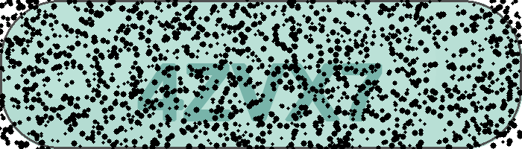

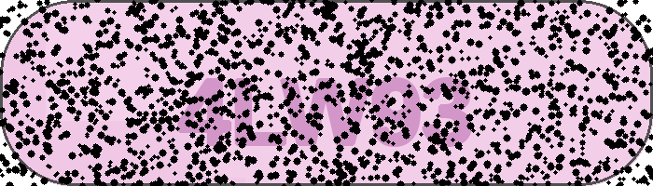

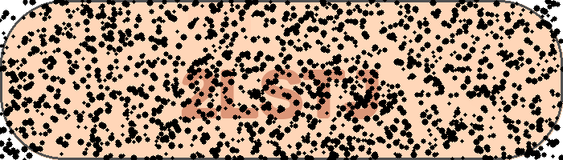

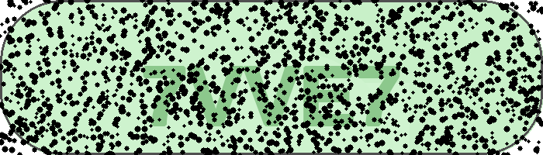
Comparison of CAPTCHA Types
Original
Generated

Slide 5






Image Preprocessing Steps
Before feeding images into the CNN model, we apply preprocessing to standardize the input format and improve training quality.
Images are loaded in grayscale to reduce complexity.
Each image is resized to 700×200 to match the model input.
Pixel values are normalized to range[0, 1].
The image tensor is expanded to (H, W, 1) for CNN compatibility.
Labels are extracted from filenames and encoded into character indices.

Slide 6
Model Selection
Built a CNN + BiLSTM model for sequence recognition.
Multiple convolution layers for feature extraction.
BiLSTM layers: capture sequence dependencies between characters.
Multi-output Dense layers: predict each character separately(5 softmax outputs for LENGTH=5)
Dataset Split
Images divided into training and testing sets
Ensure the model is evaluated on unseen samples
Data Generator
Uses CaptchaDataGenerator to load images in batches.
Encodes labels into character indices for multi-output model.

Slide 7
Training
Evaluation
Optimizer: Adam with learning rate 0.001
Mini-batch Gradient Descent: batch size = 16
Epochs:50 -> prevents overfitting
Loss: sparse categorical cross-entropy for each character
Callbacks: EarlyStopping, ReduceLROnPlateau, ModelCheckpoint
Full CAPTCHA accuracy & per-character accuracy measured.
Visualize predictions on test samples for qualitative analysis.

Slide 8


Libraries
Python 3 – main programming language
TensorFlow & Keras – model building & training
OpenCV – image processing
Pillow (PIL) – image generation & manipulation
NumPy – numerical operations
Matplotlib – visualization
Hardware
Google Colab – cloud environment
GPU: NVIDIA Tesla T4 (for faster training)

