Slide 1
Constrained Mixture Model of Coronary Autoregulation
Oct 5th, 2020

Slide 2
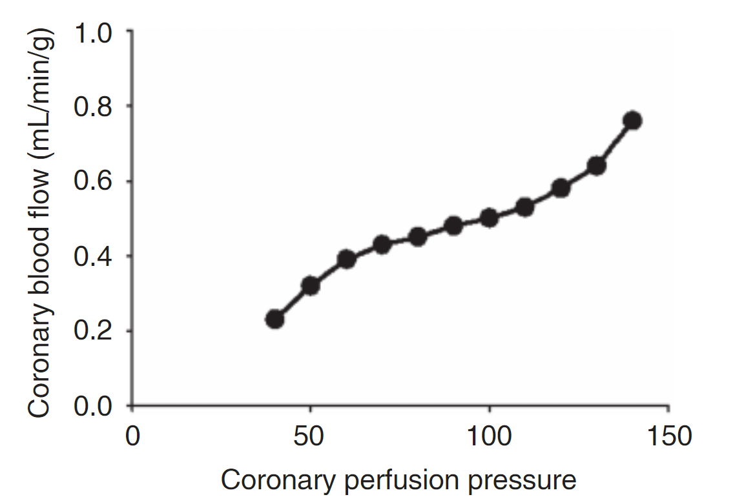
Coronary Autoregulation
Coronary autoregulation is defined as the capability of the coronary circulation to maintain the blood supply to the heart over a range of perfusion pressures.
Putative mechanisms:
Myogenic: The ability of vessels to constrict in response to an increase in transmural force.
Metabolic: A local feedback mechanism where a vasodilation signal is initiated in response to either an increase in local oxygen consumption or oxygen extraction from the myocardial blood supply.
Endothelial: Shear-dependent control mechanism mediated via shear-induced production of nitric oxide (NO) or endothelin by the endothelial cells.
Neural and hormonal control

Slide 3
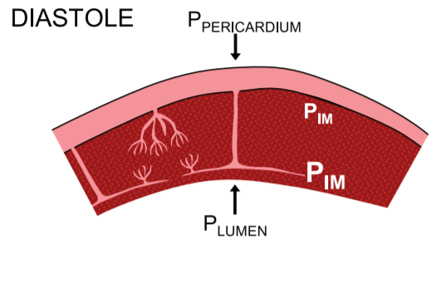
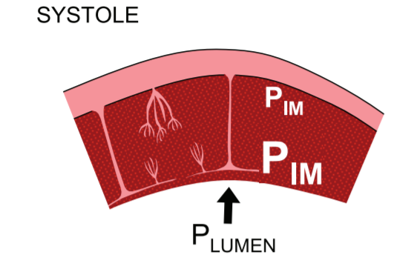
Coronary Circulation
Cyclic compression of the vasculature:
Subepicardial layer
Picture adapted from [Duncker and Bache 2008]
Subendocardial layer
Notes:
The features of coronary physiology dependent on the size of the arteries and their location across the myocardium.
Tight regulation of coronary vascular functions is necessary for maintaining the blood circulation in the heart and eventually the whole cardiovascular system which is manifested in coronary pressure-flow autoregulation
Modulated via active SMCs in the microvascular level.
Myocardial arteries are under significant compressive forces from the myocardium in a beating heart
Varies in vessels from subendocardial layer to subepicardial layer.
Flow is diastolically dominated.

Slide 4
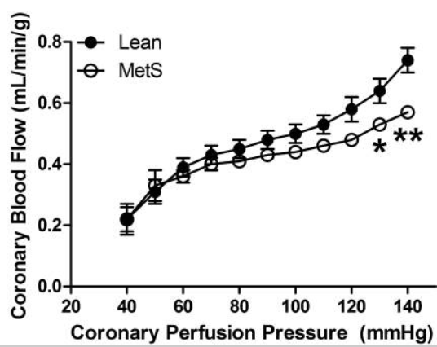
Coronary Autoregulation
Many questions in coronary autoregulation:
Previously, researchers hypothesized that coronary autoregulation is modulated via metabolic control. But recently, myogenic control has been proposed to be the main driver. So, which one is more important?
If both mechanisms are working in parallel, what would be their relative contributions?
For metabolic control, what is the main metabolite (ATP or peroxide) that mediates the metabolic control?
Are these response size and location dependent?
How does autoregulation change in the setting of disease (e.g., obesity)?
Computational methods can be combined with experimental measurements to answer some of these questions.

Slide 5
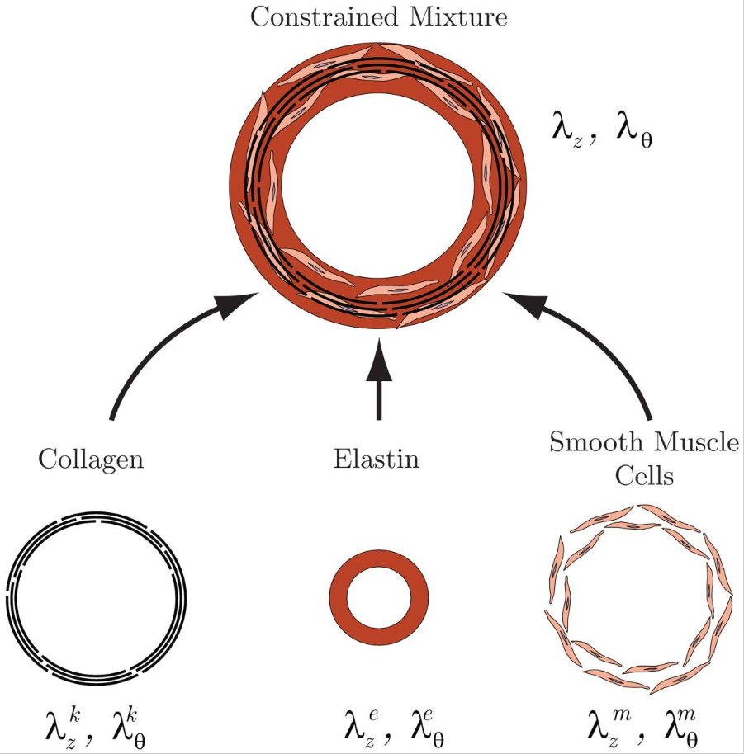
Constrained mixture model
To answer some of those questions, we develop a high-resolution model that can integrate data from various sources in a unified framework and can be extended to study long-term responses of vasculature.
Constrained mixture models of vascular mechanics:
The constituents of the arterial wall have individually-prescribed mechanical behavior.
Constituents can have different stresses but deform together (no-slip).
Constituents can have passive and active behavior:
Passive: Collagen, elastin, smooth muscle cells SMCs
Active: SMCs
The control mechanisms fundamentally rely on modulating the active tension of the SMCs.
How to develop a model”
We develop a constrained mixture model of coronary vessels.
We use a homeostatic optimization framework to propagate the parameters of the constrained mixture model to a coronary tree.
We equip our model with regulatory mechanisms
Picture adapted from [Figueroa et al. 2009]
5

Slide 6
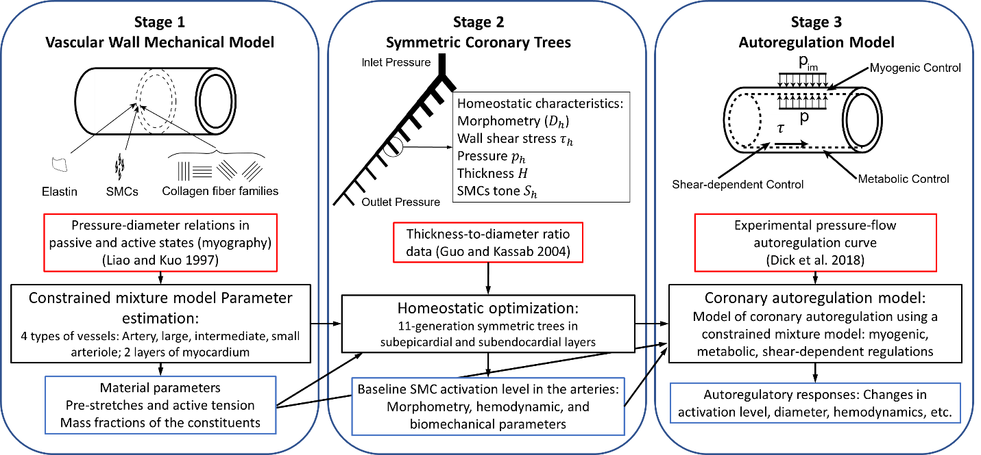
Methods: overall approach
We develop two coronary trees in subepicardial and subendocardial layers
6

Slide 7
Parameter estimation for the constrained mixture model of 8 representative coronary vessels
7

Slide 8
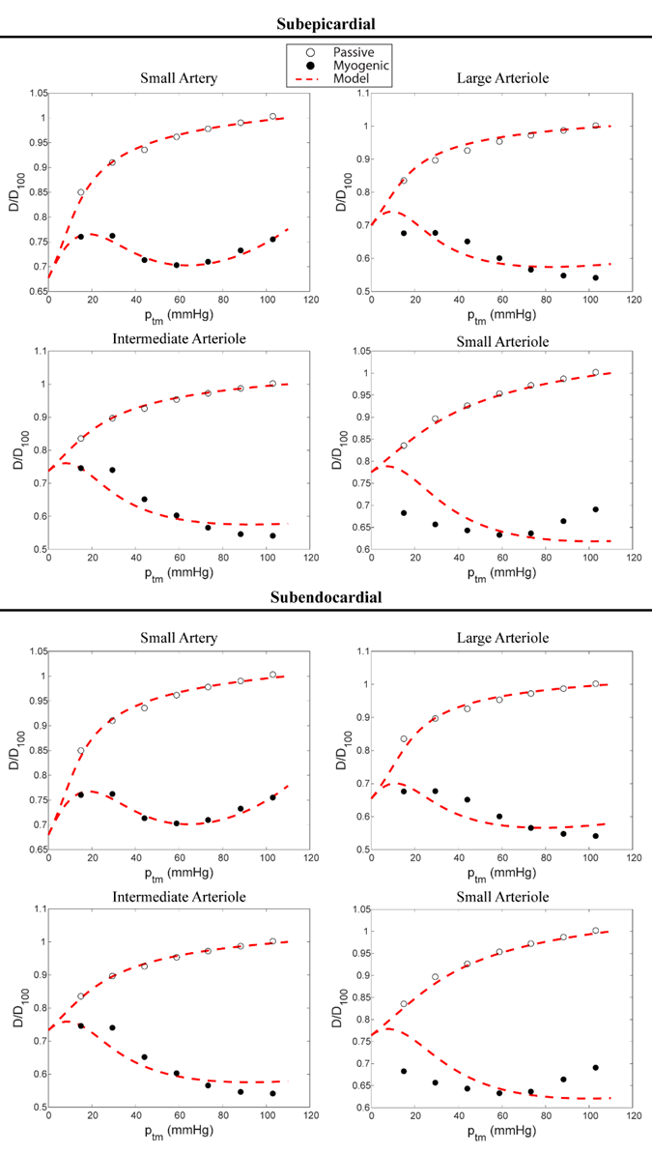
Parameter estimation for the constrained mixture model of 8 representative coronary vessels
Passive response
Myogenic response
8

Slide 9
Defining morphometry, structure, and hemodynamics of an entire coronary tree
To estimate the homeostatic morphometric (e.g, diameters), structural (e.g, thickness), and hemodynamics (e.g., wall shear stress) properties of a vascular tree by minimizing the global energy dissipation under the constraint of mechanical equilibrium.
$p_{tm}$ is higher for the subepicardial vessels than subendocardial vessels.
9

Slide 10
Defining morphometry, structure, and hemodynamics of an entire coronary tree
10

Slide 11
Defining morphometry, structure, and hemodynamics of an entire coronary tree
11

Slide 12
Defining morphometry, structure, and hemodynamics of an entire coronary tree
12

Slide 13
Coronary Autoregulation model
Active SMC tension:
Myogenic Response:
Metabolic control:
Shear-dependent control
13

Slide 14
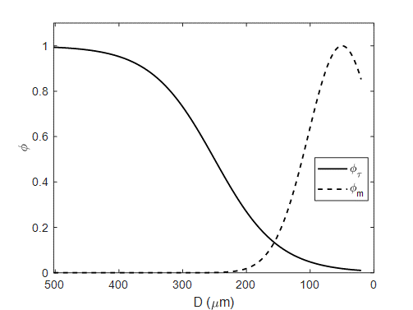
Coronary Autoregulation model
Metabolic and Shear-dependent controls
14

Slide 15
Coronary Autoregulation model Parameters
15

Slide 16
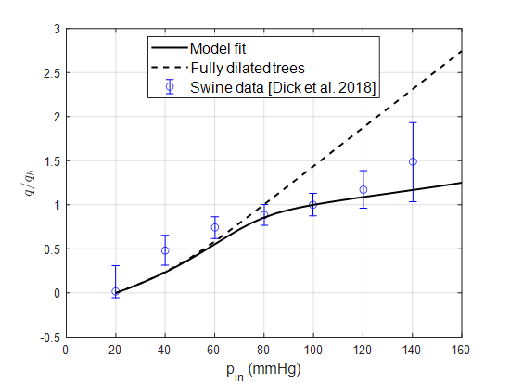
Coronary Autoregulation model
16

Slide 17
Coronary Autoregulation model
17

Slide 18
Coronary Autoregulation model
18

Slide 19
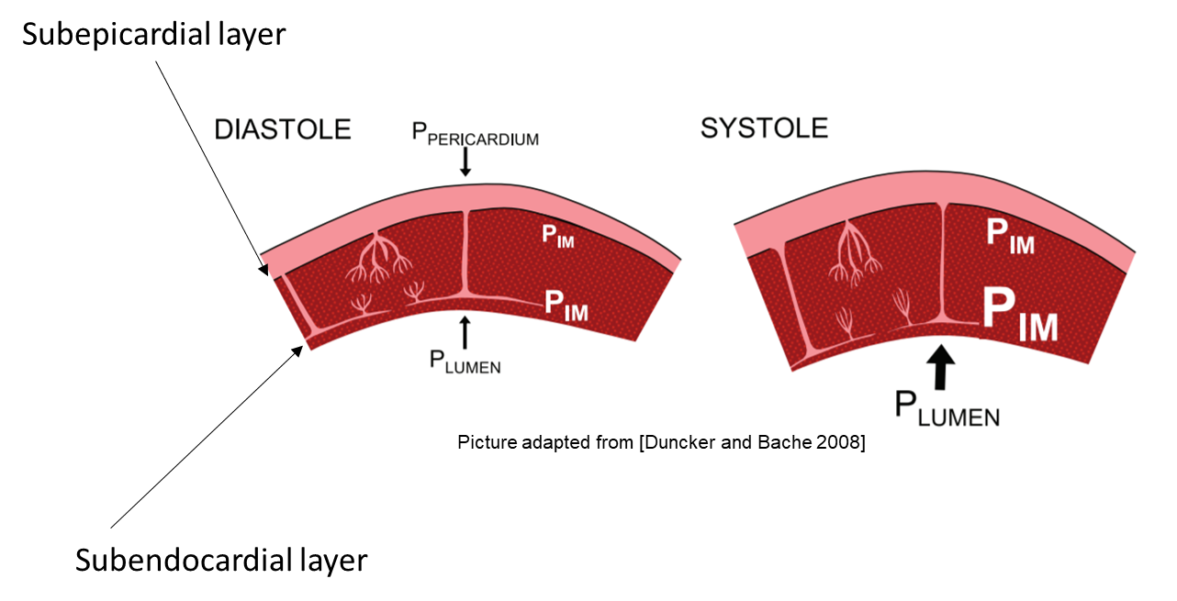
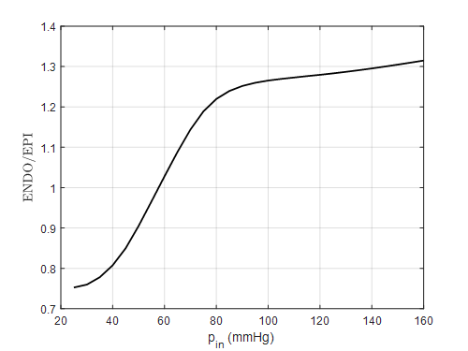
Coronary Autoregulation model
Average ENDO/EPI ratio:
19

Slide 20
Epicardial stenosis
20

Slide 21
Effects of drug administration
Adenosine: metabolic vasodilator
L-NAME: endothelial control inhibitor
21

Slide 22
Conclusion
Developed a model that combines data from literature
Our model captures the essential features of coronary autoregulation.
The parameter estimations highlight what is needed in future experimental studies.
We showed the utility of our model with two application examples.
22

