Slide 1


Demand Prediction Project Top4sport Company
HENRY GIORGI
Data Science Bootcamp

Slide 2
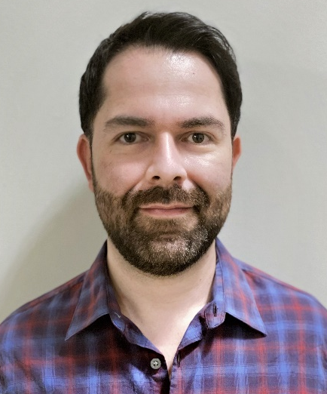



About me
Objective: To leverage the power of ML+AI to drive performance, competitiveness, and customer satisfaction for businesses.
Blend of technical and business academic background and expertise:
Electronics Engineering background
MSc in Energy Economics and Finance
Consulting and product and project management experience
Henry Giorgi
hgiorgib@gmail.com
linkedin.com/in/henry-giorgi
hgiorgib
Notes:
With the data science program of LHL I’ve achieved a better blend of skills objective

Slide 3


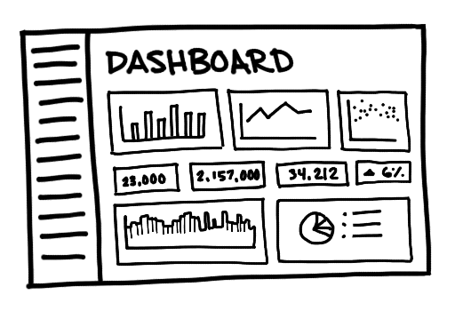

INSPIRATION
Demand Prediction
IA-ML | Data Science
2 csv files (Orders and items)
+2.5 M entries
30 columns
2.5 years of info (2019-2022)
Challenge: 1.5 weeks to
develop a deliverable
Top4sport Company
Notes:
(30-45 sec)
What inspired me?: this is a real case scenario of small companies that currently want to deploy AI+ML models aiming to improve their business
Additionally, it inspired me that the black box requires most of the knowledge learnt in this bootcamp.
I learned how to work with time series to generate predictions while at the same time producing historical analysis of data trends and time components. I struggled a little bit configuring the hyperparams tuning but in the end it worked well.

Slide 4
WorkFlow
EDA + Feature Engineering
Times Series Model
Visualization
*Data cleaning
*Data organization
*Orders and items tables merge
*Feature selection
*Feature engineering (Net sales and Gross Profit)
*Demand prediction
*Demand Analysis
*Metrics calculation
*Hyperparams tuning
*Top and lower countries in net sales
*Top products
*Gross profit
*Predictions
FB Prophet Model
Tableau Dashboard
Dataset (CSV)
Tech Stack: Python: Pandas, Numpy, Matplotlib, Seaborn, Sklearn, FB Prophet
Notes:
(120-150secs)

Slide 5
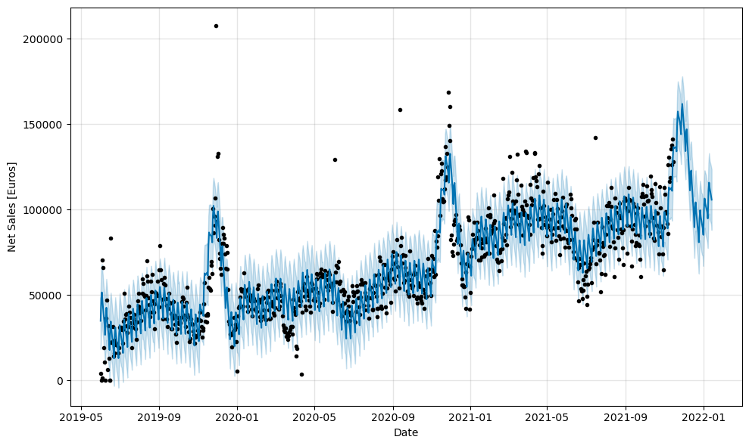
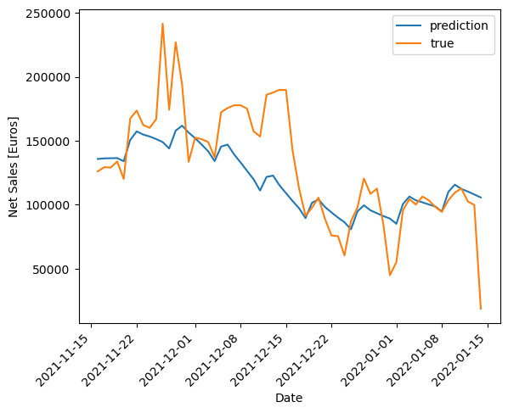
RESULTS
METRIC | VALUE
r2 | 0.464
MAE | 22,058
Std dev = 44,638.42
Hyper-params tuning:
METRIC | VALUE
r2 | 0.533
MAE | 23,159

Slide 6
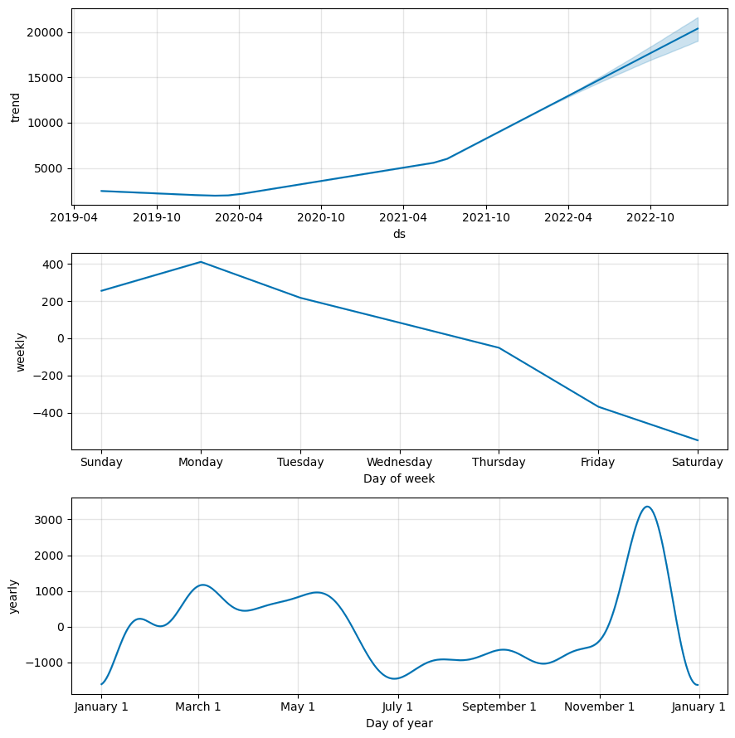
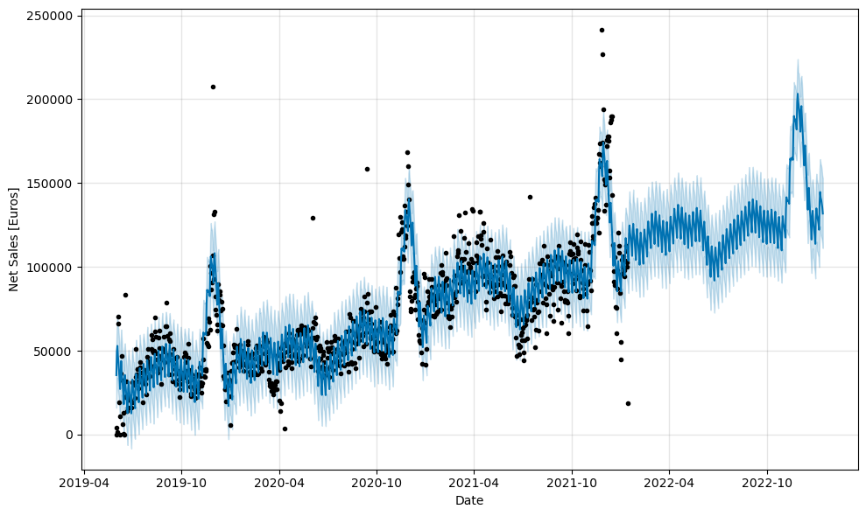
RESULTS
ALL COUNTRIES
Time Series Components

Slide 7
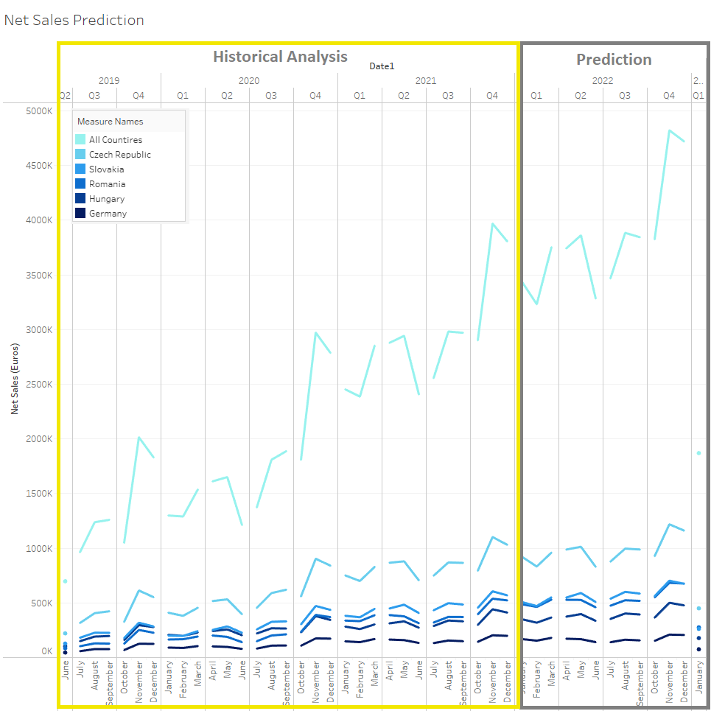

Slide 8
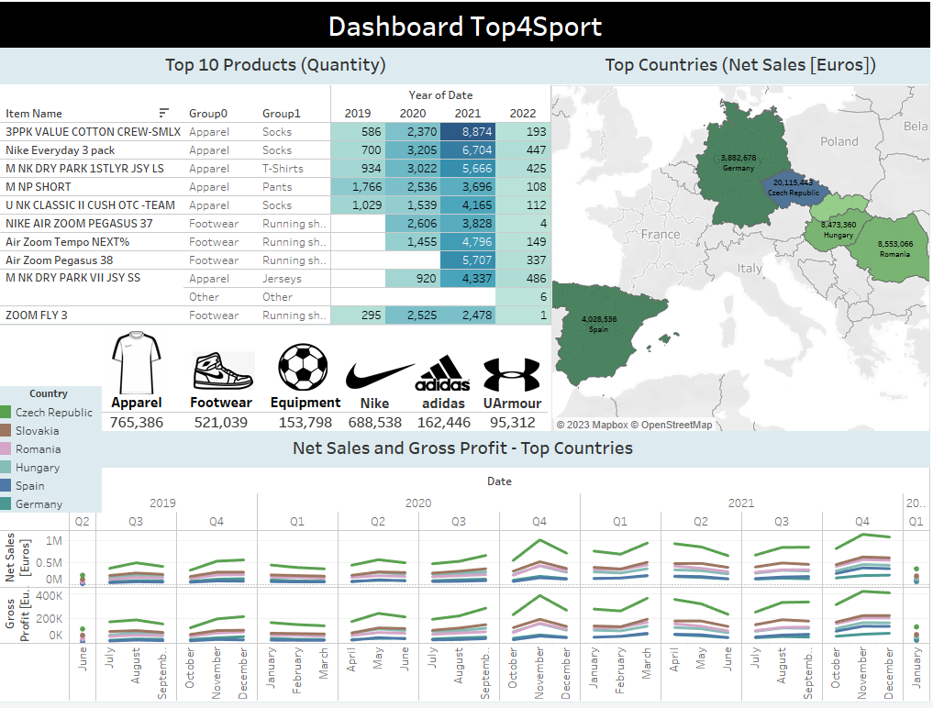
TABLEAU - DASHBOARD

Slide 9
Thank you

