Slide 1


Data Visualization Project
HENRY GIORGI
Data Science Bootcamp

Slide 2
Agenda
1. Project Flow Structure
2. Results
3. Biggest Challenges

Slide 3
1. PROJECT FLOW STRUCTURE
Project Topic: Option 2 - Airbnb
Main Features + KPIs
Visualizations
Data Source
Dashboard
*Connecting to data (Airbnb Excel file)
*Detecting data types
Features:
*Accommodation (Beds and Room Types)
*Price (Beds and Room Types)
*Hosts (Number and rating)
*Accommodation (2)
*Price (2)
*Hosts (2)
Analytics (3)
*Geolocation (1)
5 Graphs + 2 Global Params
Airbnb NYC Dashboard
10 Graphs

Slide 4
2. results
Questions
Price:
What is the average price per room type and per bed across the neighborhoods in New York?
Accommodation:
What is the availability in terms of number of beds and room types across the neighborhoods in New York?
Hosts:
What is the number of Airbnb hosts in the different neighborhoods of New York that joined the company from 2008 to 2015?
What is the top Airbnb most reliable hosts? (For reliability it was considered the better the higher amount of reviews in conjunction with the higher average review score rating).

Slide 5
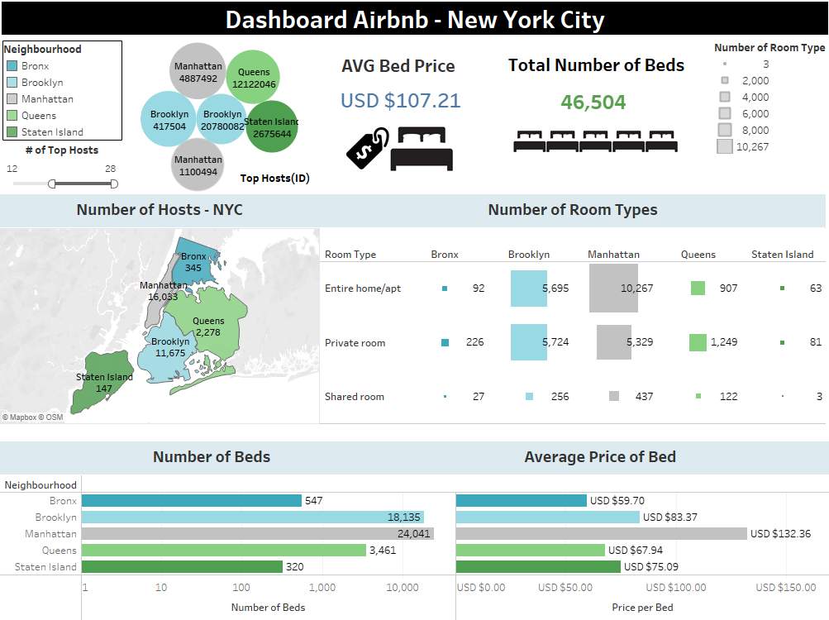
2. results

Slide 6
3. Challenges
The data available restricted the possibility of defining better KPIs for the Airbnb business case like: Occupancy rate, Average daily rate, Average length of stay, Revenue per available room, Net operation income, among others.
Restrictions of the Tableau public version to save files and use some tools.
Presence of nulls and data with the wrong format (Ex. Neighborhoods column).
Having additional time:
I would enrich the data source in order to be able to calculate the KPIs that are commonly used in the Airbnb business (Occupancy rate, Average daily rate, Average length of stay, Revenue per available room, Net operation income, among others).

Slide 7
Thank you

