Slide 1
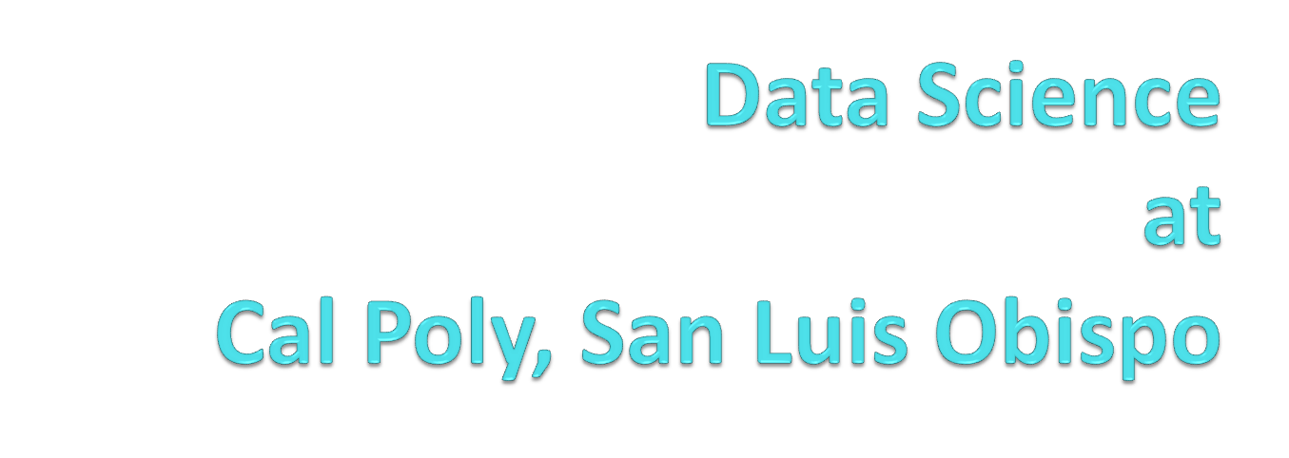

Computer Science
Statistics

Slide 2
Statistics for All at Cal Poly
Introductory Statistics required for vast majority of majors
  Different flavors (https://statistics.calpoly.edu/content/courses)
  All taught by the Statistics Department
  Usually applied in nature and involve software to some degree

Slide 3
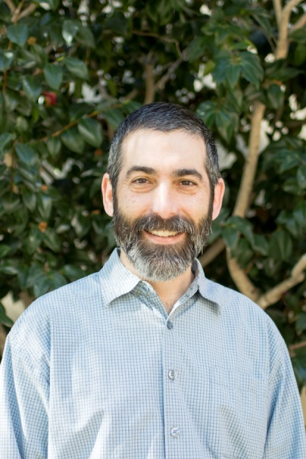
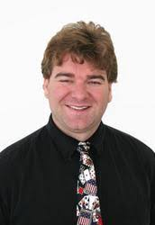
Starting Data Science at Cal Poly:
Cross-Disciplinary Minor (“Degree+”)
Started around 2013
Andrew Schaffner
(Statistics)
Alex Dekhtyar
(Computer Science)

Slide 4
Data Scientist Skills
Background
Computer Science
Linear Algebra
Linear/Numeric Analysis
Gradient Descent
Probability Theory
Databases
Algorithms
Distributed Computations
Data Mining
Specialized Knowledge
Statistics
Linear Regression
Max Likelihood
Expectation Maximization
Multivariate Analysis
Principal Component/
Factor Analysis
Data Acquisition
Data Modeling (Python, R, SAS)
Mathematical Models/Advanced
Analytical methods
IT Skills
Data Visualization
GIS awareness
…
Advanced Knowledge

Slide 5
STAT | CSC | Course | Units | STAT | CSC
required in the major | required in the major | CSC 101: Fundamentals of CS I | 4
Elective | required in the major | CSC 202: Fundamentals of CS II | 4
Elective | required in the major | CSC 203: Fundamentals of CS III | 4
required in the major | required in the major | MATH 206/244: Linear Algebra/ Analysis | 4
required in the major (*) | required in the major (*) | STAT 301/302: Intro to Statistics (STAT) Or STAT 312 : Statistics for Engineers (CS) | 4
required in the major (*) | Math elective | STAT 305 Probability Theory | 4
required in the major | required in the major | CSC 348: Discrete Structures | 4
Approved elective | technical elective | CSC 365: Databases | 4
approved elective | technical elective | CSC 369: Distributed Computations | 4
Elective | required in the major | CSC 349: Algorithms | 4
required in major | technical elective | STAT 331: R Programming | 4
required in major | Free elective | STAT 334: Applied Regression | 4
elective | Minor | STAT 419: Applied Multivariate analysis | 4 |  | 4
Free elective | technical elective | CSC 466: Knowledge Discovery from Data | 4
Minor | Minor | DATA 301: Introduction to Data Science | 4 | 4 | 4
Minor | Minor | DATA 401: Data Science | 4 | 4 | 4
Minor | Minor | DATA 451: Data Science Capstone I | 2 | 2 | 2
Minor | Minor | DATA 452: Data Science Capstone II | 2 | 2 | 2
Elective | technical elective | Technical electives (CS, STAT, DATA) | 8
TOTAL |  |  | 76 | 12 | 16

Slide 6
DATA 401: Data Science
Purpose: Synthesis of knowledge
Prerequisites: High (all other courses from minor)
Content:
“Big Data”
  Properties
  Computational approaches
Case Studies
  directed project-based learning
  full data science workflow/lifecycle
Full synthesis of knowledge from prior coursework
  Databases/data management (CSC 365)
  Data acquisition/preparation (DATA 301)
  Distributed computations (CSC 369)
  NoSQL (CS tech electives in Databases)
  Data Analysis (STAT 334, 419, CSC 466)
  R (DATA 301, STAT 331)

Slide 7
DATA 451/452: Capstone
Purpose: “Real World” Experience
Modeled after Computer Engineering capstone
  Two quarters
  Teams
  Outside customers (Cal Poly faculty; businesses)
Full-scale data science project
  “Big Data”
  Analytics
  Work with customer (collaboration and consulting)
  Visualization
  Explanation/Presentation
Synthesis and culminating experience

Slide 8
Data Science for All at Cal Poly
NSF HDR DSC: Collaborative Research: Central Coast Data Science Parntership
  Collaborative grant with UC Santa Barbara
  Foster inter-campus collaborations
  Primarily share ideas on
    Data Science for All curriculum and opportunities
    Data Science Capstone experiences

Slide 9
DATA 101
Basic approaches for answering questions using data
Tabular data, spreadsheets
Data manipulation and data visualization
Methods of acquiring data. Sampling bias and variability.
First course in two-course sequence
  Broad statistical and data skills

Slide 10
DATA 300
Computational skills relevant for data analysis
Introduction to programming for data analysis
Statistical inference and modeling
Machine learning topics such as classification and clustering
Data visualization and interpretation of results
Continuation of DATA 101

Slide 11
“Connecter” Course(s)
Collaboration with client departments to connect DATA 101/300 sequence to data science in any given discipline
Still being developed…

Slide 12
Thank You!
https://statistics.calpoly.edu/data-science-minor
http://catalog.calpoly.edu/collegesandprograms/collegeofsciencemathematics/statistics/crossdisciplinarystudiesminordatascience/

